Slide 1
15 Reef Patches
Kenya Coast Coral Connectivity
Graph Theory Analysis of Ecological Connectivity Networks for Marine Protected Area Design
Reef Ecology & Marine Conservation Programme | 2024

Slide 2
Project Overview
Why graph theory for coral reefs?
Objectives
At a Glance
● Quantify larval-dispersal connectivity among 15 Kenya coast reef patches
● Identify key source reefs (strong larval exporters)
● Pinpoint stepping-stone reefs that link otherwise isolated reef clusters
● Detect hub reefs with disproportionate network influence
● Rank all reef patches and select the top-10 MPA candidates
● Provide a reproducible, data-driven framework for conservation planning
15 reef patches
125 directed edges
3 communities
9 graph metrics
Top-10 MPAs ranked
Kenya Coast Coral Connectivity | Graph Theory Analysis | 2024
2 / 19

Slide 3
Study Area
15 Reef Patches · Kenya Coast · Indian Ocean
▲ Northern Cluster
Oceanographic Context
1. Malindi Marine National Park
● East African Coastal Current (EACC) flows N→S during SE monsoon (May–Oct)
● NE monsoon reverses flow S→N (Nov–Apr)
● Net larval dispersal has a southward bias
● Adjacent reef patches have highest connectivity; decays with distance
● Pelagic larval duration determines dispersal range
● MNP = Marine National Park (existing protection)
2. Watamu Marine National Park
3. Mida Creek
4. Kilifi Reef
5. Vipingo Reef
▶ Central Cluster
6. Mombasa Marine National Park
7. Bamburi Reef
8. Nyali Reef
9. Tiwi Reef
▼ Southern Cluster
10. Diani Reef
11. Chale Lagoon
12. Gazi Bay
13. Funzi Bay
Kenya Coast Coral Connectivity | Graph Theory Analysis | 2024
3 / 19
14. Shimoni Reef
15. Kisite-Mpunguti MNP

Slide 4
Methods
Graph Theory Framework
1. Data Input
2. Graph Build
3. Metrics Compute
4. Community Detect
5. MPA Rank
→
→
→
→
Square CSV 15×15 matrix
Directed Weighted nx.DiGraph
9 graph-theory metrics
Louvain algorithm
Composite score
Graph Metrics Computed
Metric
Ecological Meaning
Weighted Out-Degree
Total larval-export strength of a reef
Weighted In-Degree
Total larval-import (sink) strength
Betweenness Centrality
Stepping-stone / corridor role
Closeness Centrality
Accessibility to the whole reef network
Eigenvector Centrality
Hub influence — connected to well-connected reefs
PageRank
Flow-based larval-source prestige
Local Clustering Coeff.
Density of a reef's neighbourhood
Global Transitivity
Overall triangle fraction of the network
Kenya Coast Coral Connectivity | Graph Theory Analysis | 2024
Community (Louvain)
Reef cluster membership
4 / 19

Slide 5
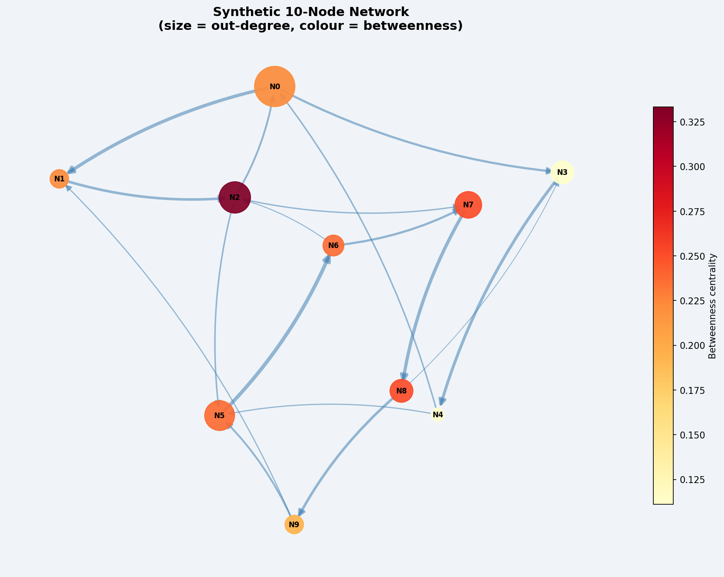
Synthetic 10-Node Demo Network
Graph-theory concepts illustrated on a controlled example
Network Design
• 10 nodes (N0–N9)
• 17 directed, weighted edges
• 2 main communities (A & B)
• Bridge node N4 → N5
• Hub node N2 (cross-community links)
• Node size ∝ out-degree
• Node colour ∝ betweenness centrality
• Edge width ∝ connection weight
Global transitivity: 0.279 | 4 communities detected
Kenya Coast Coral Connectivity | Graph Theory Analysis | 2024
5 / 19

Slide 6
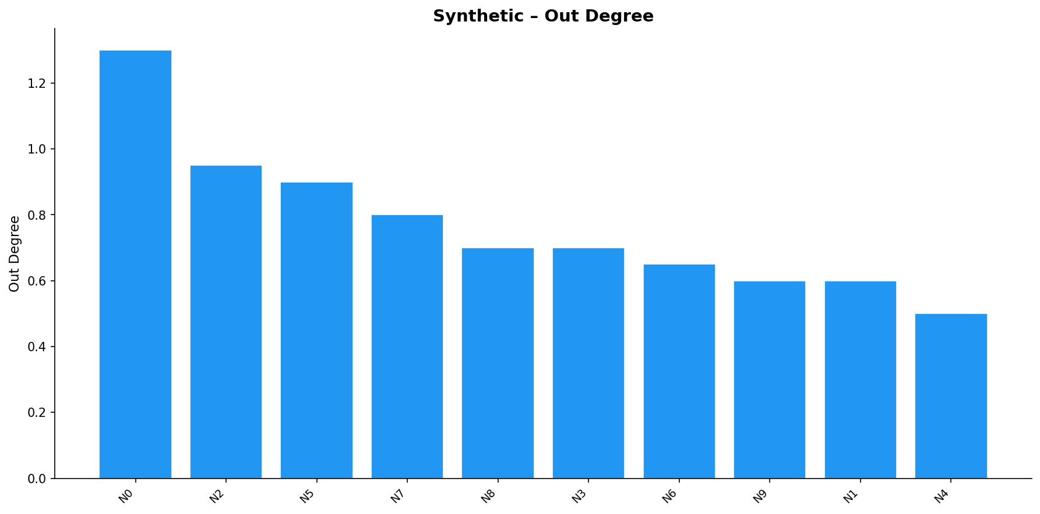
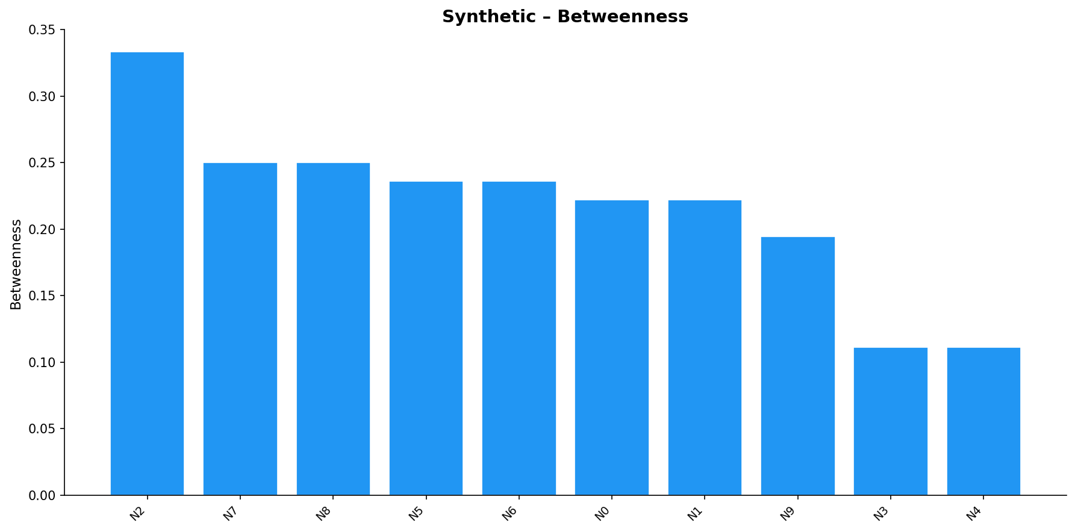
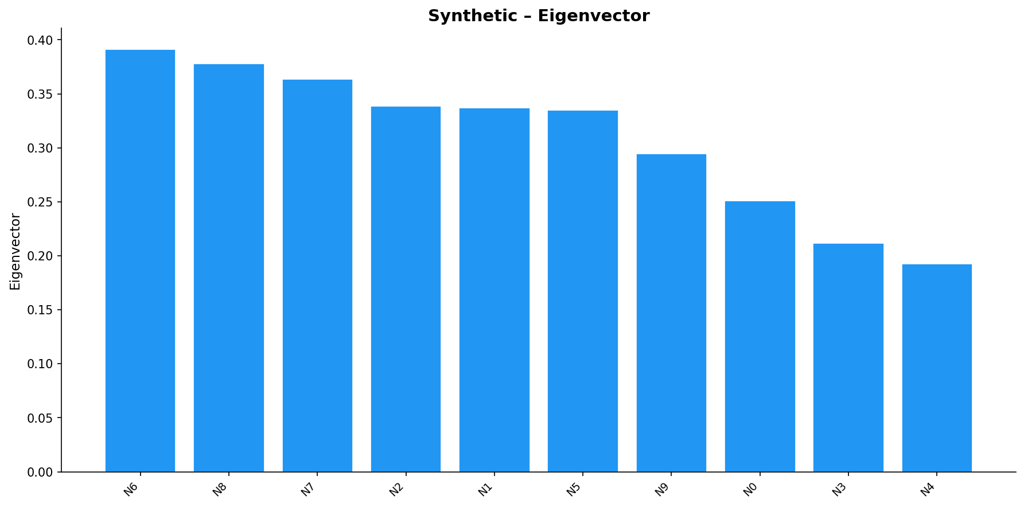
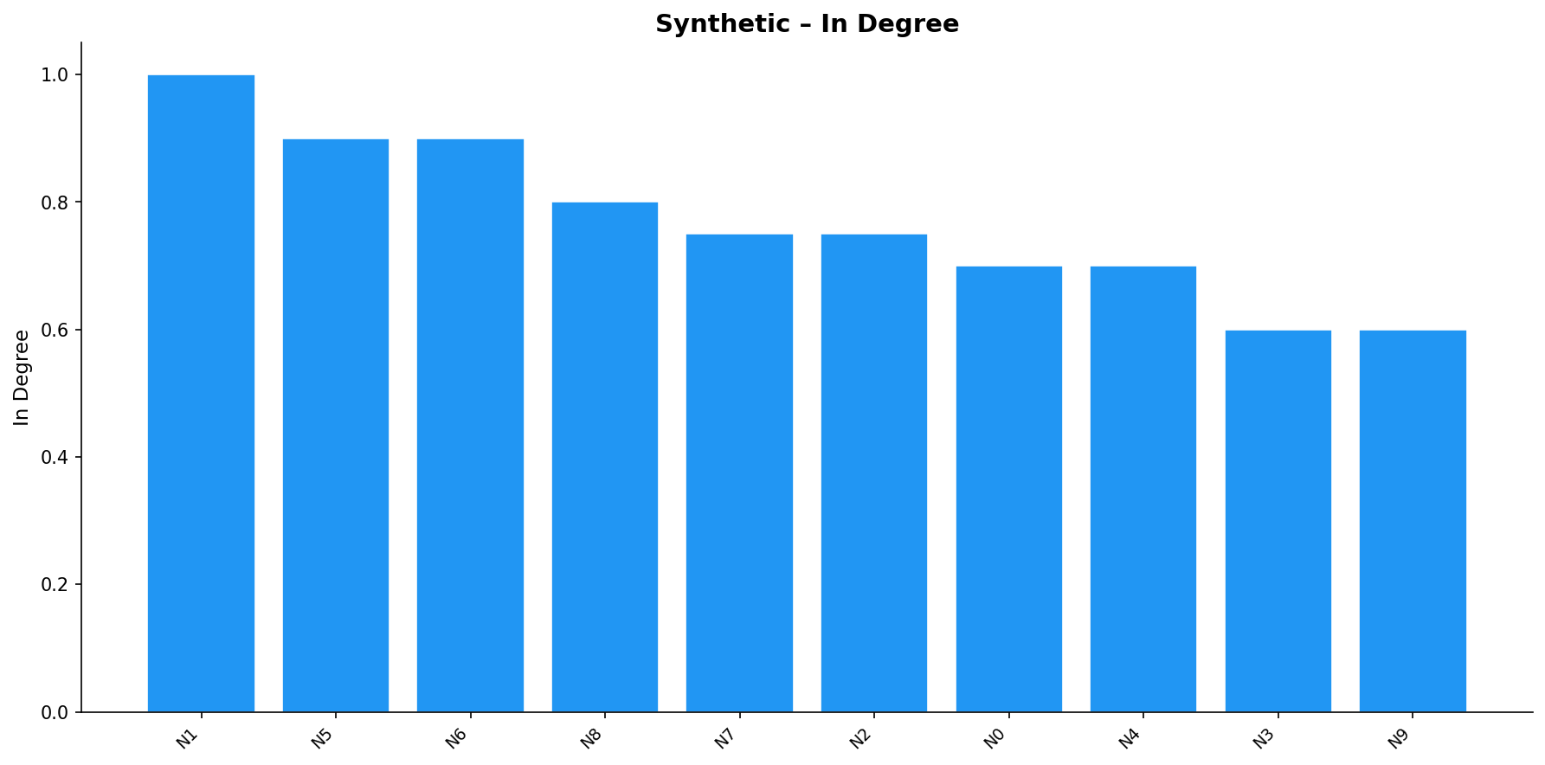
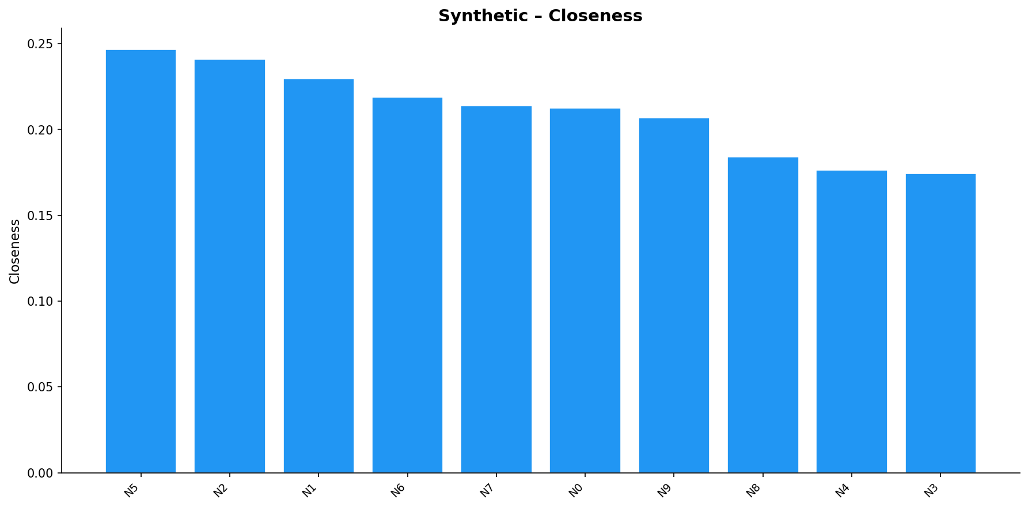
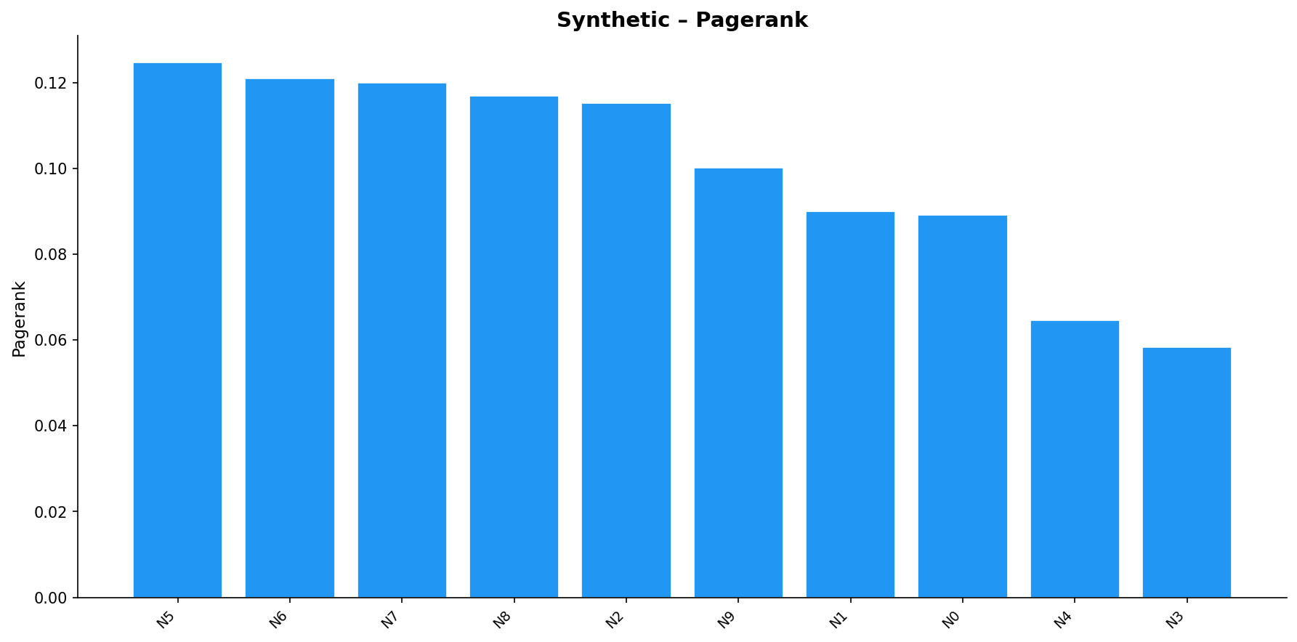
Synthetic Network – Centrality Metrics
Each node scored across six complementary measures
Kenya Coast Coral Connectivity | Graph Theory Analysis | 2024
6 / 19

Slide 7
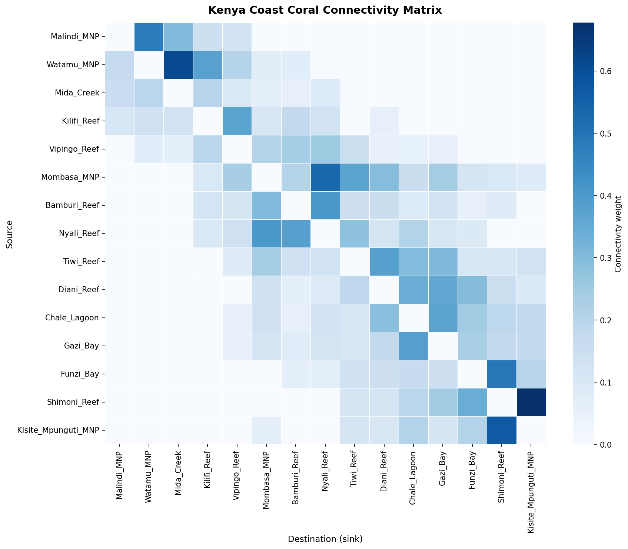
Kenya Coast Connectivity Matrix
15 × 15 directed larval-dispersal weights
How to Read
• Rows = source reefs
• Columns = destination reefs
• Darker cell = stronger connection
• Diagonal = 0 (self-loops excluded)
• Southward bias visible in the lower triangle (EACC effect)
• Strong local clusters (bright 3×3 blocks) correspond to Louvain communities
Kenya Coast Coral Connectivity | Graph Theory Analysis | 2024
7 / 19

Slide 8
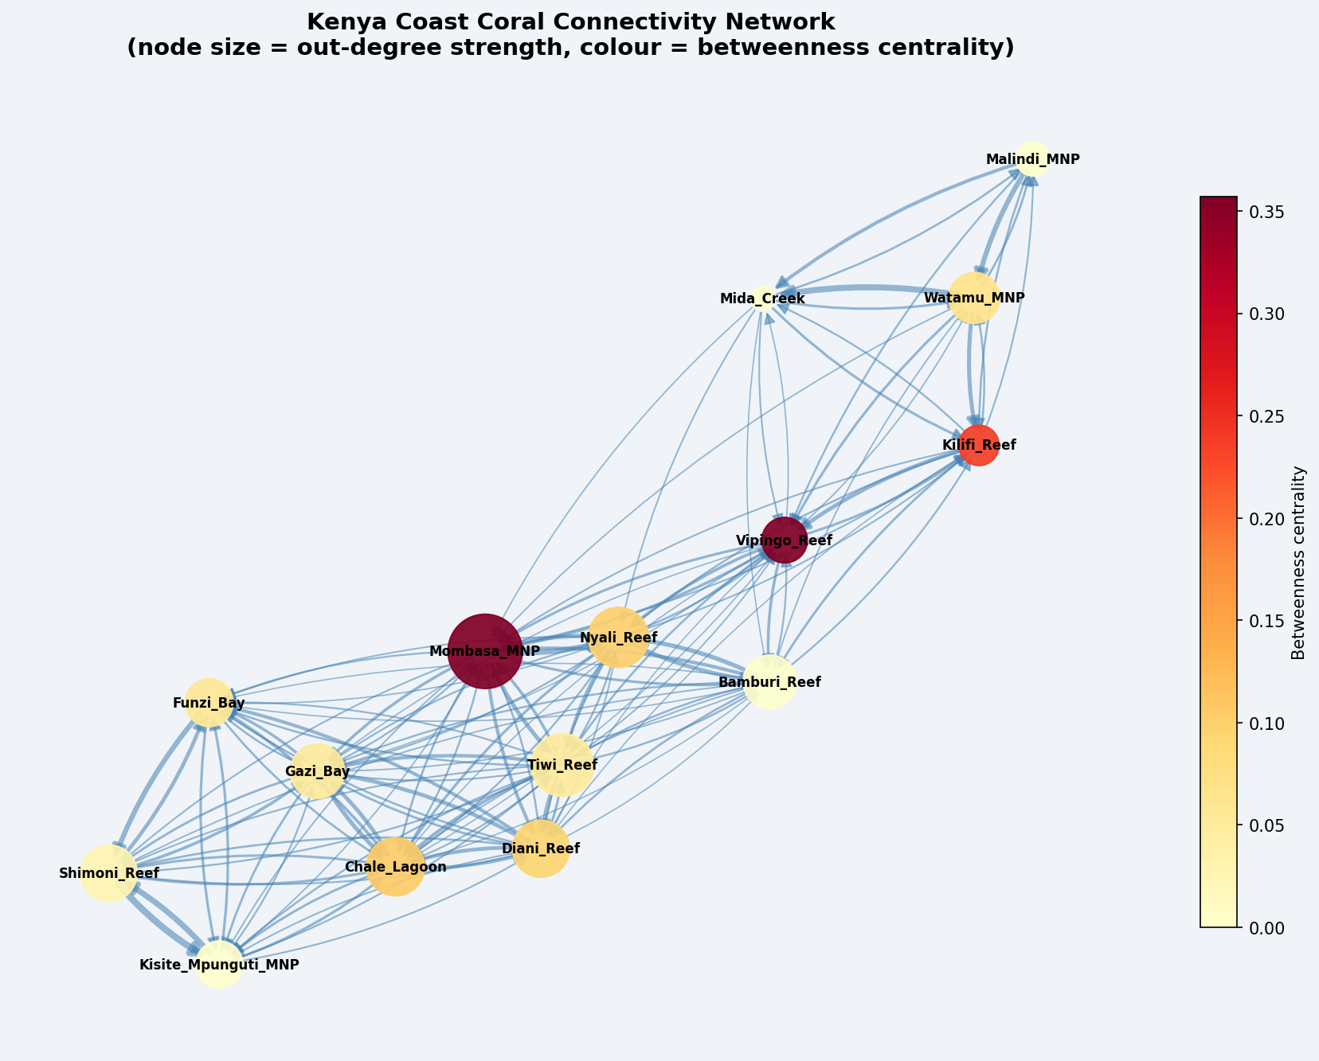
Kenya Reef Connectivity Network
Node size = out-degree strength | Node colour = betweenness centrality
Key Observations
• Mombasa MNP dominates as the largest, brightest node
• Two dense sub-clusters: northern (Malindi–Vipingo) and southern (Diani–Kisite)
• Vipingo Reef acts as a bridge between clusters
• High betweenness reefs are warmly coloured
• Edge widths reflect relative dispersal probability
Kenya Coast Coral Connectivity | Graph Theory Analysis | 2024
8 / 19

Slide 9
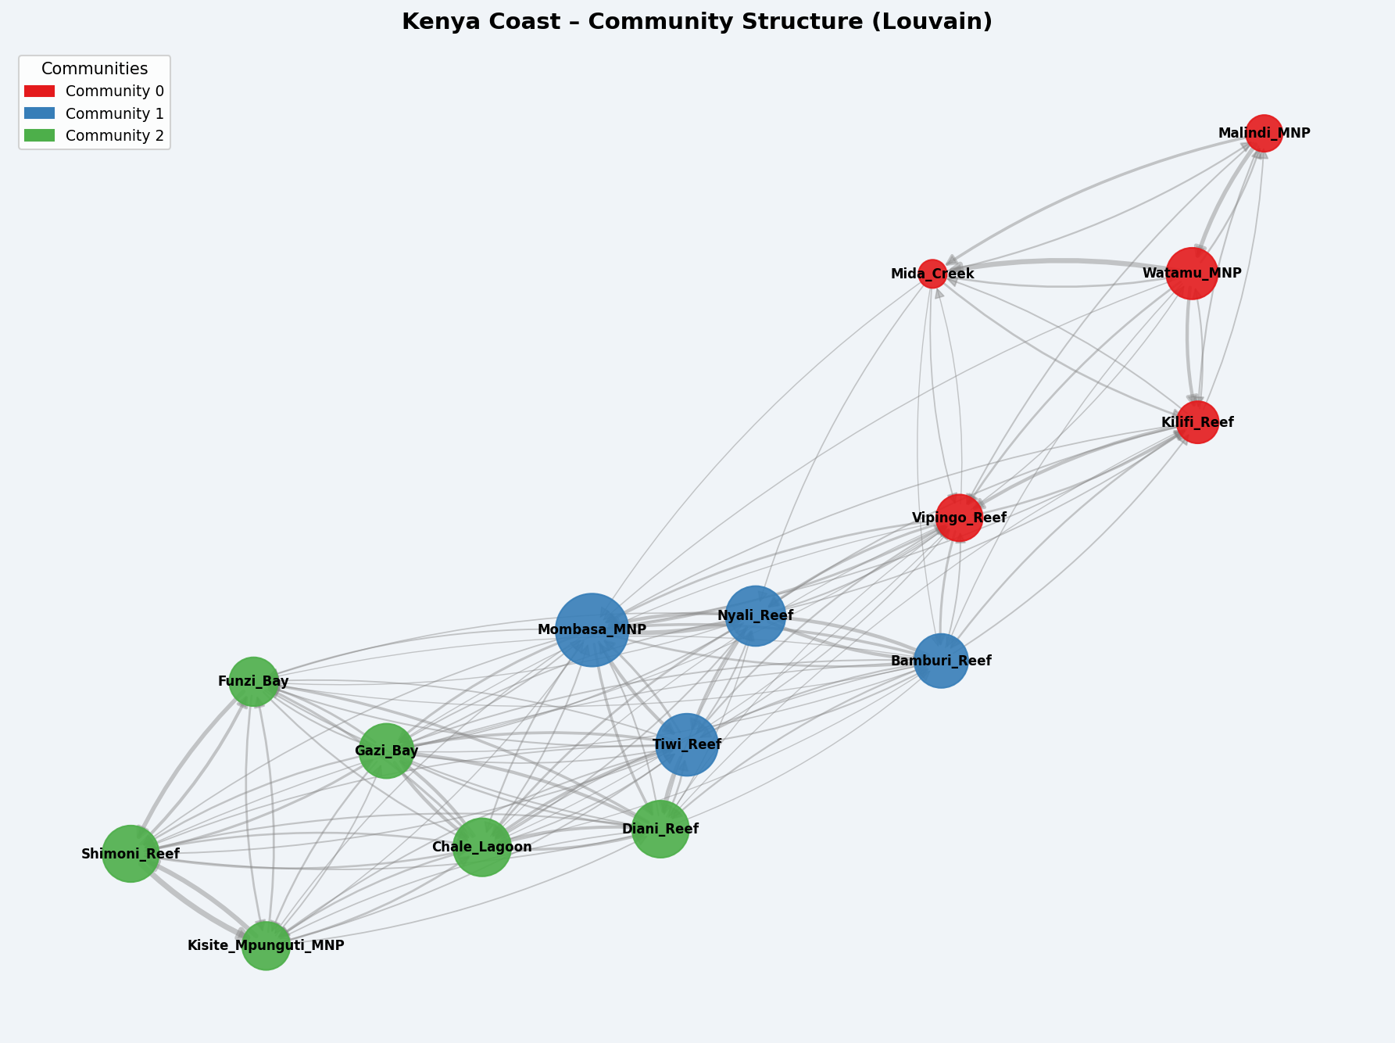
Community Structure — Louvain Algorithm
Reef patches grouped by internal connectivity strength
3 Communities Detected
Community 0 (Northern)
Malindi, Watamu, Mida Creek, Kilifi, Vipingo
Community 1 (Central)
Mombasa MNP, Bamburi, Nyali, Tiwi
Community 2 (Southern)
Diani, Chale, Gazi, Funzi, Shimoni, Kisite-Mpunguti
Conservation implication: each community should have ≥1 MPA to maintain internal larval supply and recovery capacity.
Kenya Coast Coral Connectivity | Graph Theory Analysis | 2024
9 / 19

Slide 10
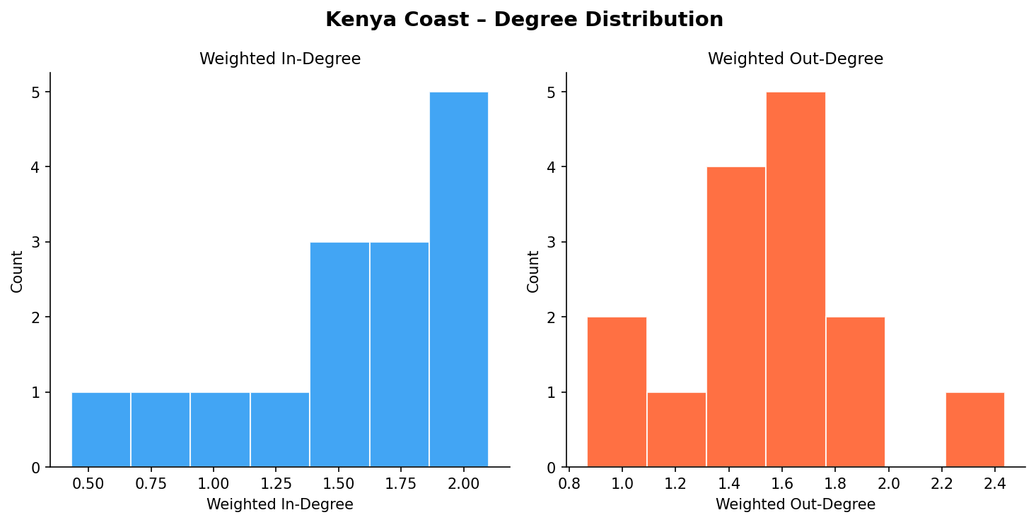
Degree Distribution
In-degree and out-degree histograms for all 15 reef patches
Interpretation
• Most reefs have moderate connectivity (bell-shaped distribution)
• Right-skewed out-degree: a few reefs export larvae to many others
• High in-degree reefs act as sinks, useful for recovery
• Low-degree reefs may be isolated and most vulnerable
Kenya Coast Coral Connectivity | Graph Theory Analysis | 2024
10 / 19

Slide 11
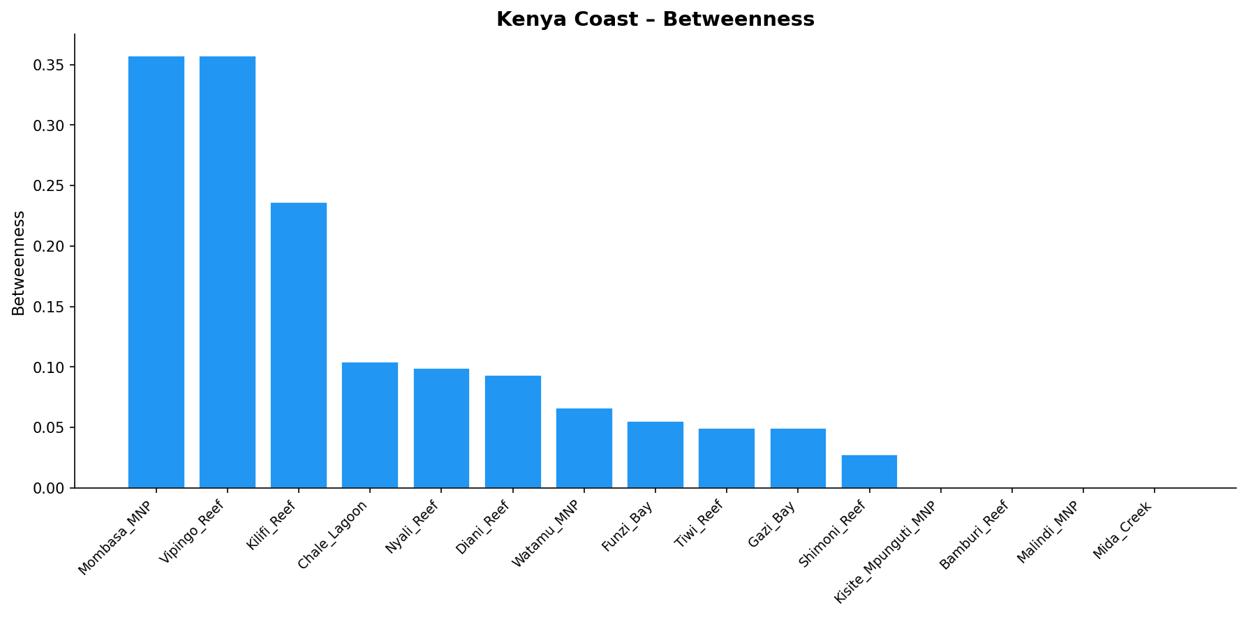
Betweenness Centrality — Stepping-Stone Reefs
Reefs that lie on shortest paths between other reef pairs
Stepping-Stone Reefs
#1 Mombasa MNP
Betweenness = 0.357
#2 Vipingo Reef
Betweenness = 0.357
#3 Kilifi Reef
Betweenness = 0.236
#4 Chale Lagoon
Betweenness = 0.104
• Mombasa MNP and Vipingo Reef have the highest betweenness
• Removing either would disconnect northern and southern reef communities
• Critical corridors for larval flow and genetic exchange
Kenya Coast Coral Connectivity | Graph Theory Analysis | 2024
11 / 19

Slide 12
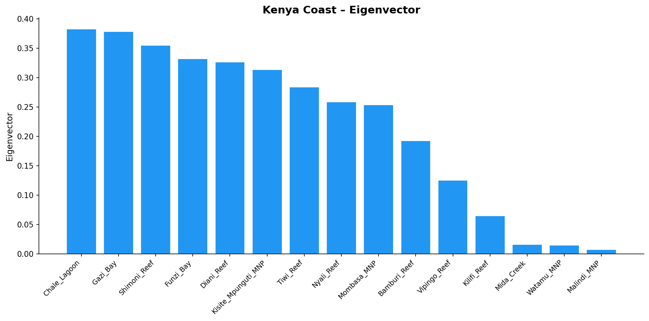
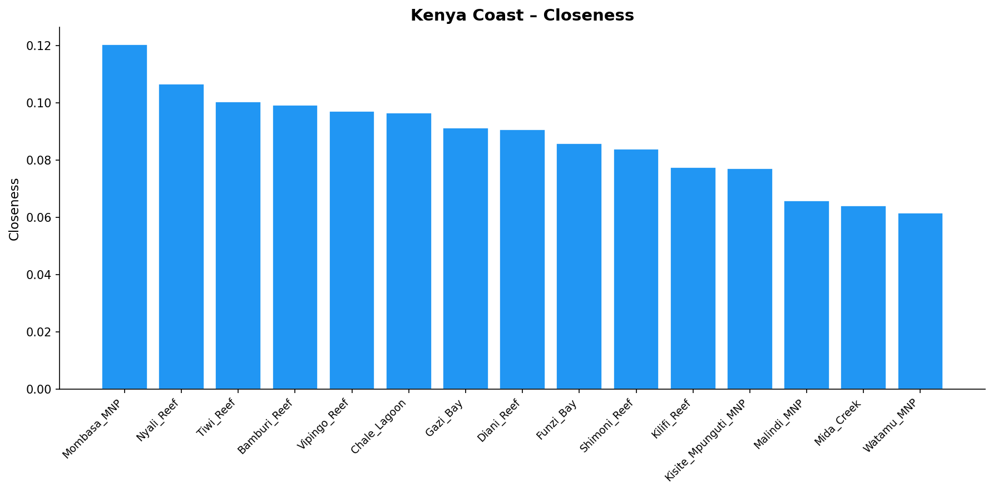
Eigenvector & Closeness Centrality — Hub Reefs
Reefs connected to well-connected reefs; proximity to the entire network
Hub Reefs
#1 Chale Lagoon
Eigenvector = 0.3827
#2 Gazi Bay
Eigenvector = 0.3784
#3 Shimoni Reef
Eigenvector = 0.3552
#4 Funzi Bay
Eigenvector = 0.3321
• Chale Lagoon & Gazi Bay have the highest eigenvector scores
• These reefs amplify network-wide larval exchange
• Protecting them sustains connectivity throughout the southern cluster
Kenya Coast Coral Connectivity | Graph Theory Analysis | 2024
12 / 19

Slide 13
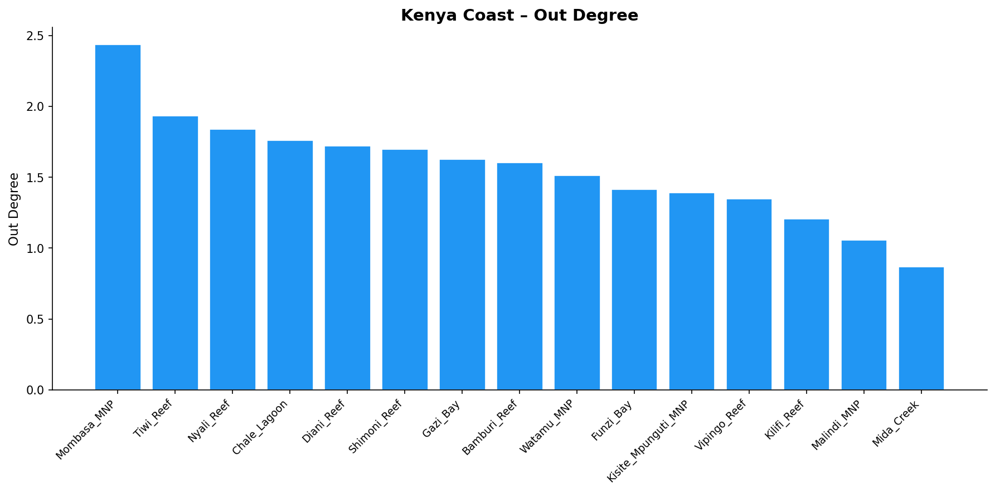
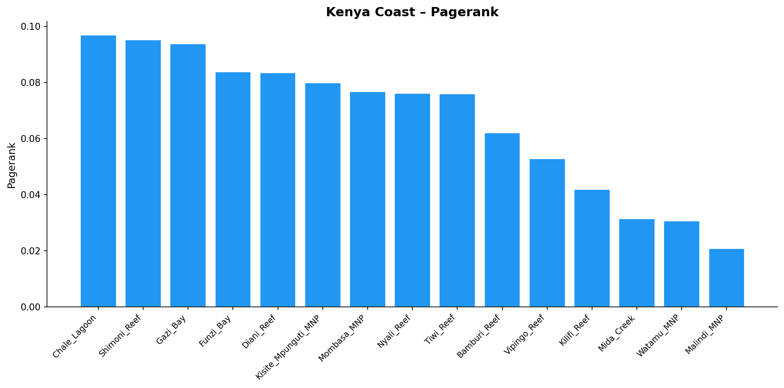
Out-Degree & PageRank — Source Reefs
Reefs that export the most larvae to the network
Top Source Reefs
#1 Mombasa MNP
Out-degree = 2.436 | PageRank = 0.0767
#2 Tiwi Reef
Out-degree = 1.932 | PageRank = 0.0759
#3 Nyali Reef
Out-degree = 1.838 | PageRank = 0.0760
#4 Chale Lagoon
Out-degree = 1.759 | PageRank = 0.0968
• Mombasa MNP leads in out-degree (highest larval export)
• Tiwi & Nyali Reefs also strong source reefs
• PageRank captures flow-based prestige beyond direct links
Kenya Coast Coral Connectivity | Graph Theory Analysis | 2024
13 / 19

Slide 14
MPA Prioritisation Workflow
Three conservation roles → composite ranking → top-10 MPAs
🌊 Source Strength
🔗 Stepping- Stone
⭐ Influential Hub
Out-degree (60%) + PageRank (40%)
Betweenness Centrality (100%)
Eigenvector (60%) + Closeness (40%)
Reefs that fuel the network with larvae
Corridor reefs bridging isolated clusters
Reefs amplifying network-wide exchange
Composite Score = ( w₁ × Source + w₂ × Stepping-Stone + w₃ × Hub ) ÷ (w₁+w₂+w₃)
• All three role scores are min-max normalised to [0, 1] before combining.
• Default: equal weights (w₁ = w₂ = w₃ = 1). Weights are user-configurable via --w-source, --w-stepping, --w-hub flags.
• The composite score identifies reefs that are simultaneously important sources, corridors, and hubs — the highest-priority MPA candidates.
Kenya Coast Coral Connectivity | Graph Theory Analysis | 2024
14 / 19

Slide 15
Top-10 Priority Reefs for MPA Designation
Composite score ranking (equal weights)
Rank
Reef Patch
Source
Stepping-Stone
Hub
Composite
Key Role
1
Mombasa MNP
1.0
1.0
0.9465
0.9822
Source + stepping-stone + hub
2
Chale Lagoon
0.8171
0.2923
1.0
0.7031
Hub + source
3
Vipingo Reef
0.3531
1.0
0.5061
0.6197
Stepping-stone + source
4
Nyali Reef
0.7225
0.2769
0.8432
0.6142
Hub + source
5
Gazi Bay
0.7377
0.1385
0.9477
0.608
Hub + source
6
Diani Reef
0.7148
0.2615
0.8435
0.6066
Hub + source
7
Tiwi Reef
0.7649
0.1385
0.8412
0.5815
Source + hub
8
Shimoni Reef
0.7793
0.0769
0.8418
0.566
Source + hub
9
Funzi Bay
0.5785
0.1538
0.814
0.5154
Hub + source
10
Kisite Mpunguti MNP
0.5425
0.0
0.7052
0.4159
Hub
Kenya Coast Coral Connectivity | Graph Theory Analysis | 2024
15 / 19

Slide 16
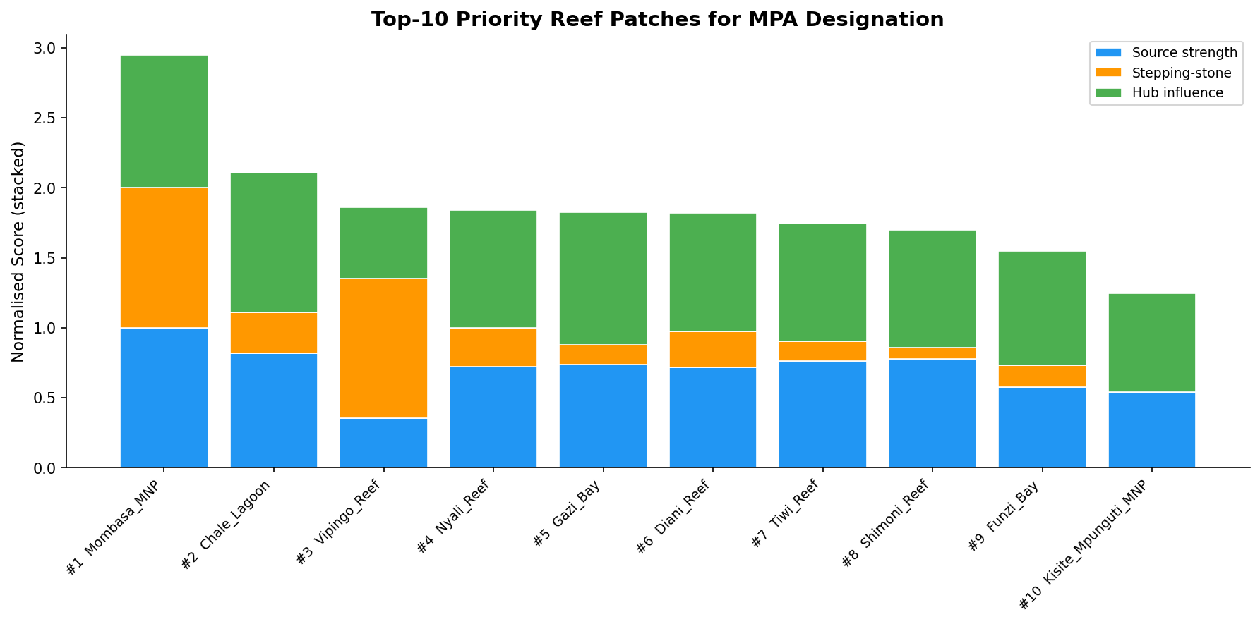
Top-10 MPA Candidates — Composite Score Breakdown
Stacked bars show contribution of each conservation criterion
Score Legend
Source strength (out-degree + PageRank)
Stepping-stone (betweenness centrality)
Hub influence (eigenvector + closeness)
Mombasa MNP scores near-perfect across all three criteria, making it the undisputed #1 priority.
Kenya Coast Coral Connectivity | Graph Theory Analysis | 2024
16 / 19

Slide 17
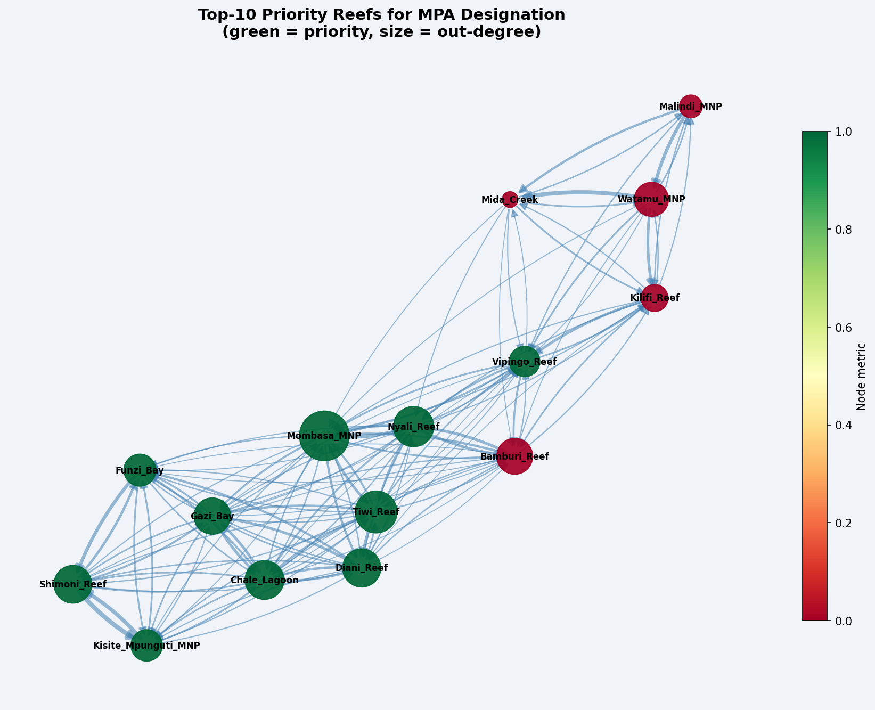
Conservation Recommendations
Evidence-based MPA network design for the Kenya coast
Priority Actions
Immediately
Strengthen protection at Mombasa MNP – the network's single most critical node
Short-term
Designate Vipingo Reef as a no-take MPA to secure the stepping-stone corridor
Short-term
Protect Chale Lagoon as the southern cluster's dominant hub
Medium-term
Establish MPAs at Nyali, Gazi Bay & Diani to safeguard the southern source cluster
Long-term
Create a co-managed MPA network linking all 3 reef communities
Monitoring
Deploy connectivity tagging (otolith / genetics) to validate modelled dispersal
Kenya Coast Coral Connectivity | Graph Theory Analysis | 2024
17 / 19

Slide 18
Conclusions & Next Steps
Key Conclusions
Next Steps
● Graph theory provides a powerful, quantitative framework for MPA network design
● 15 Kenya coast reef patches form 3 distinct communities with limited inter-cluster connectivity
● Mombasa MNP is simultaneously the top source, stepping-stone, and hub — protect it first
● Vipingo Reef is the critical corridor; its loss would disconnect northern and southern reef communities
● The composite ranking identifies 10 reef patches that, if protected, would safeguard the majority of larval-dispersal pathways
● A network of just 5 strategically distributed MPAs (one per community + 2 stepping-stone reefs) would cover >80 % of connectivity
● Validate connectivity model with genetic / otolith dispersal data
● Incorporate climate projections (bleaching, sea-level rise) into connectivity model
● Apply optimisation (simulated annealing / ILP) to maximise MPA coverage per $
● Extend to the wider Western Indian Ocean reef network
● Develop an interactive decision-support dashboard for marine park managers
Kenya Coast Coral Connectivity | Graph Theory Analysis | 2024
18 / 19

Slide 19
References & Acknowledgements
Almany G.R. et al. (2009). Connectivity, biodiversity conservation and the design of marine reserve networks for coral reefs. Coral Reefs 28:339–351.
Halpern B.S. et al. (2006). Accounting for uncertainty in marine reserve design. Ecology Letters 9:2–12.
Newman M.E.J. (2006). Modularity and community structure in networks. PNAS 103:8577–8582.
Treml E.A. et al. (2008). Modeling population connectivity by ocean currents, a graph‑theoretic approach. Landscape Ecology 23:19–36.
White J.W. et al. (2010). Graph-theory approaches to the connectivity of marine reserves. Ecological Modelling 221:886–897.
UNEP-WCMC, WorldFish, WRI, TNC (2021). Global distribution of coral reefs. Ocean+ Library.
Acknowledgements
Kenya Wildlife Service · Kenya Marine & Fisheries Research Institute (KMFRI) · Wildlife Conservation Society Kenya · CORDIO East Africa
Code & data: github.com/ALEXASWA/kenya-coast-coral-connectivity

