Slide 1
Motion Signal Extraction Framework for the Microsoft Kinect Camera: Point Cloud Registration and its Application as a Motion Correction Metric in PET/CT
Dr Nikolaos Efthymiou Alexander Whitehead

Slide 2

OpenGL Visualisation Output (Depth)

Slide 3
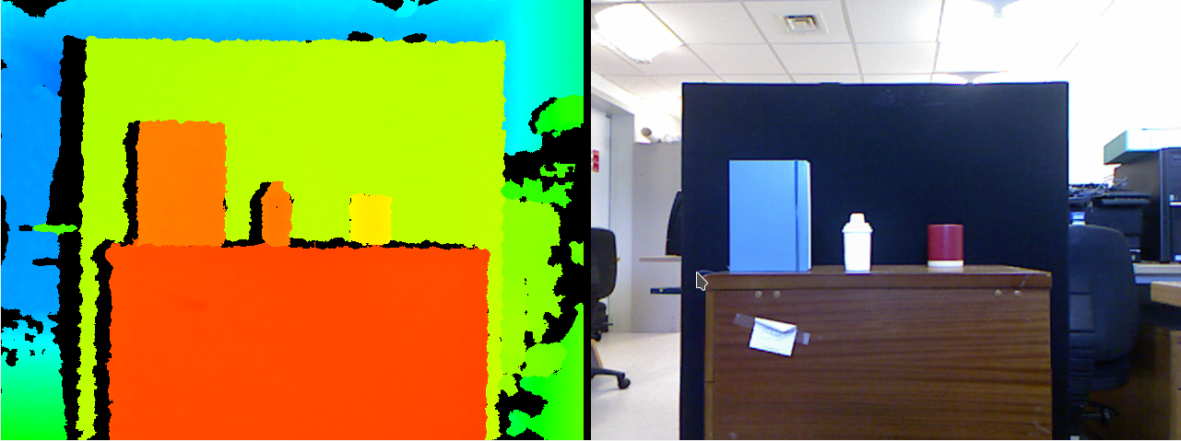
OpenGL Visualisation Output

Slide 4
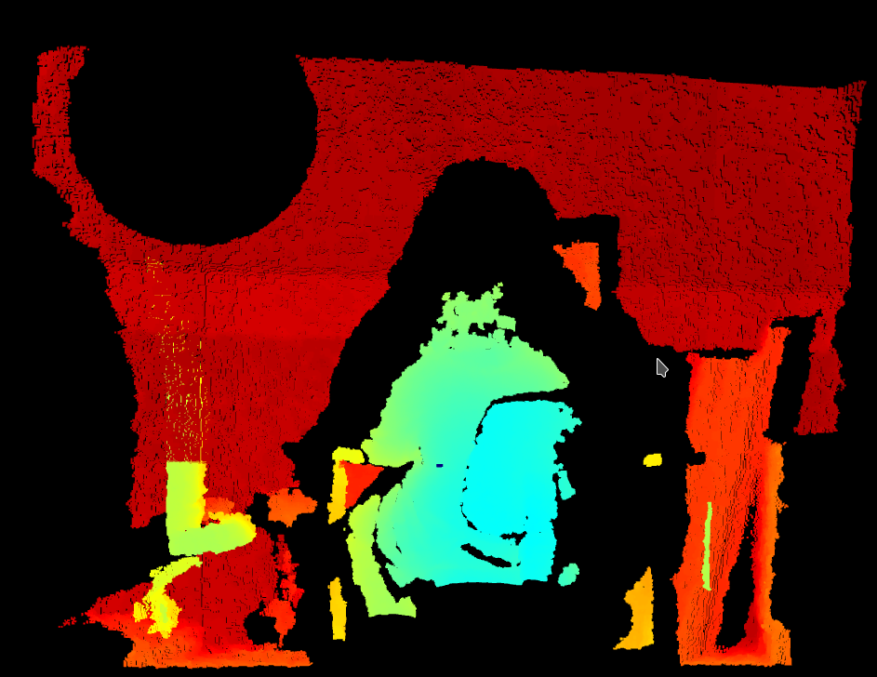
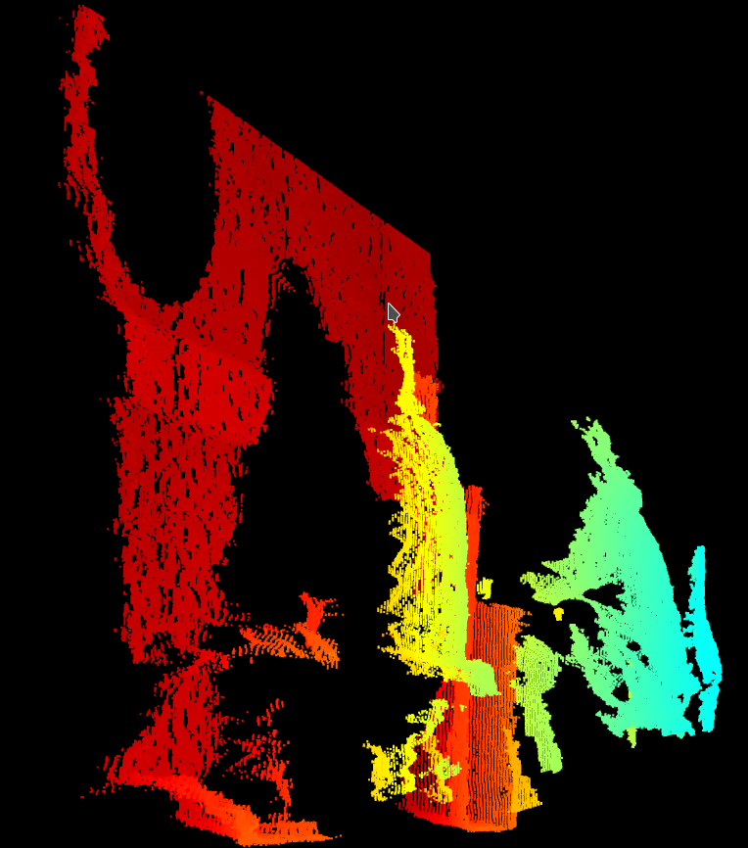
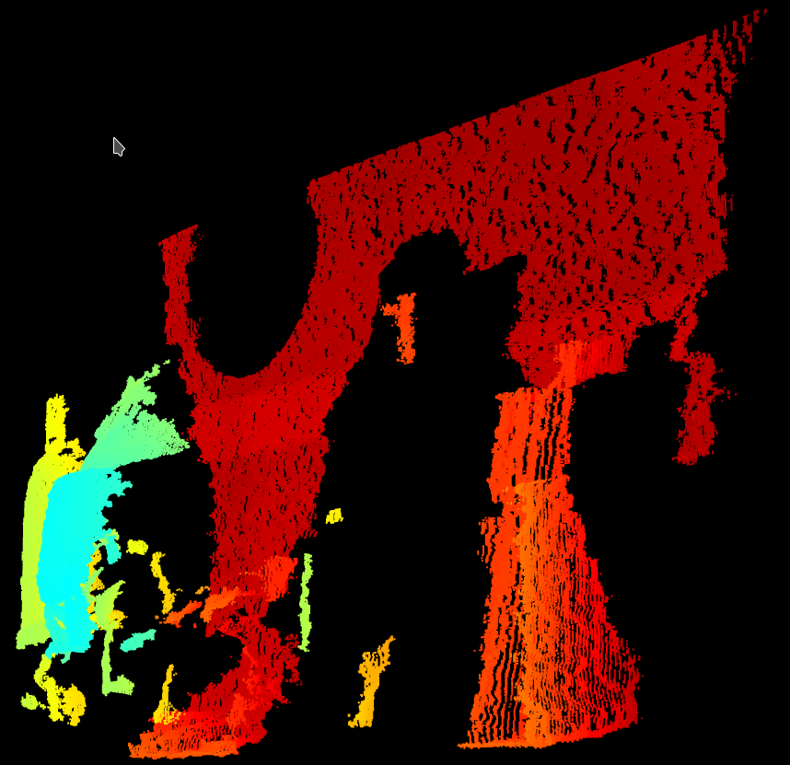
Point Cloud Online Visualisation

