Slide 1
Motion Signal Extraction Framework for the Microsoft Kinect Camera: Point Cloud Registration and its Application as a Motion Correction Metric in PET/CT
Dr Nikolaos Efthymiou Alexander Whitehead

Slide 2
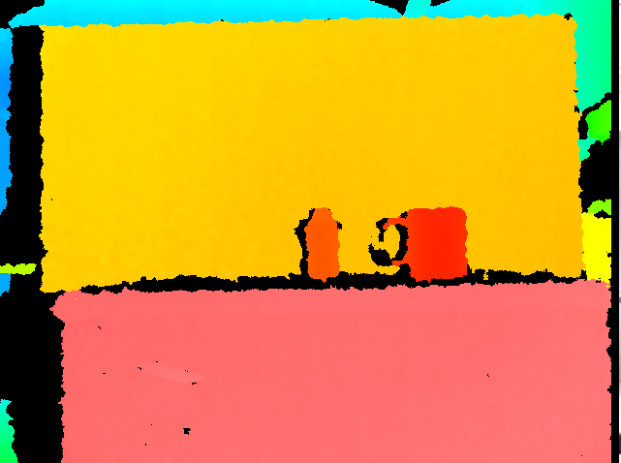
OpenGL Visualisation Output (Depth)
The image above shows the output from an OpenGL viewer which is receiving a data stream from a Kinect V1 camera. The image contains, at the bottom in red a desk upon which two cylindrical objects are sat, a board is positioned behind these objects.
The colours in this visualisation represent the distance at which the objects are located, red is closer and blue is further away.
The black bars along the left hand side of each object is caused by the parallax of the camera's sensor.

Slide 3
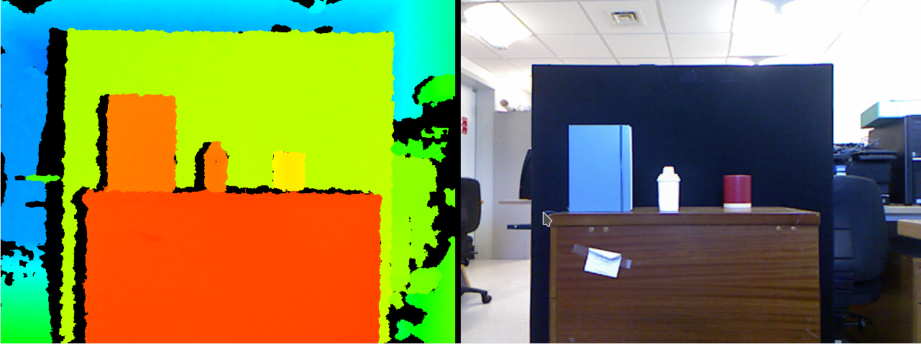
OpenGL Visualisation Output
The image above shows the output from an OpenGL viewer which is receiving a data stream from a Kinect V1 camera. The image contains, the same objects as before but now a rectangular book has been placed to the left of the previous objects.
The image to the right shows the RGB data stream from the camera.

Slide 4
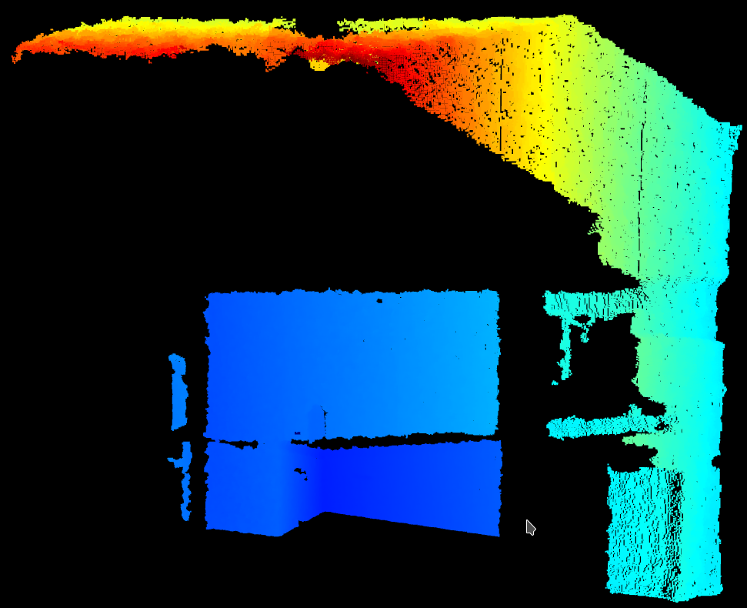
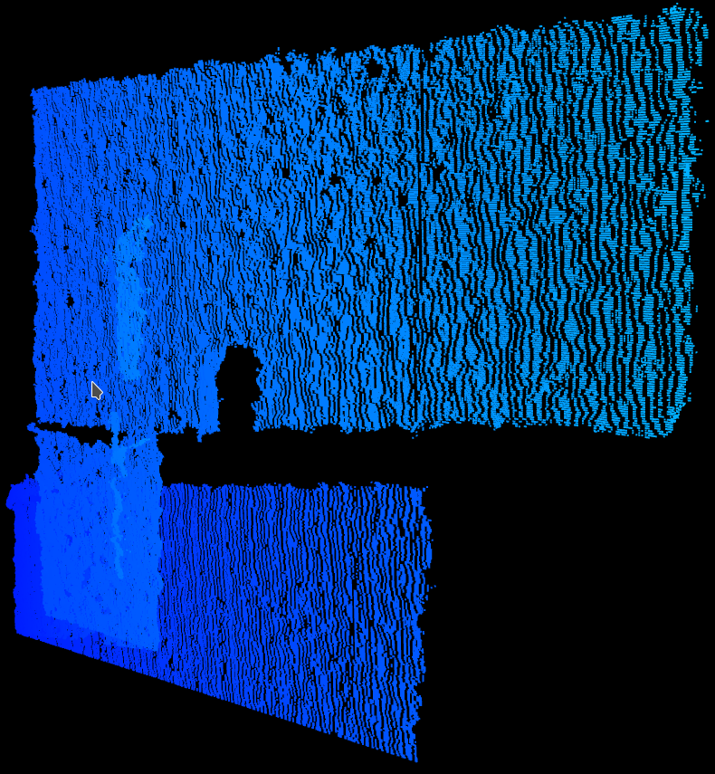
Point Cloud
The image above shows a point cloud visualisation of data which was similar to what was visualised in the previous slides previously.
A point cloud is a collection of points which represent the position of objects in 3D space. Each point here represents one piece of depth information which was gathered from the Kinect camera.
A point cloud can be manipulated, eg. rotating and scaling.

Slide 5
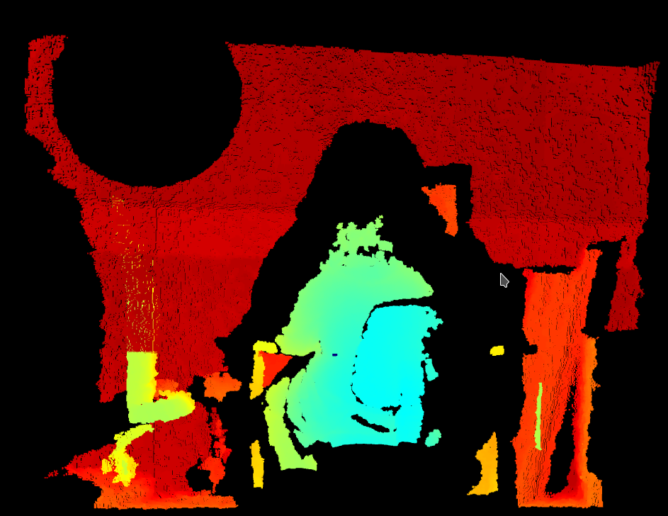
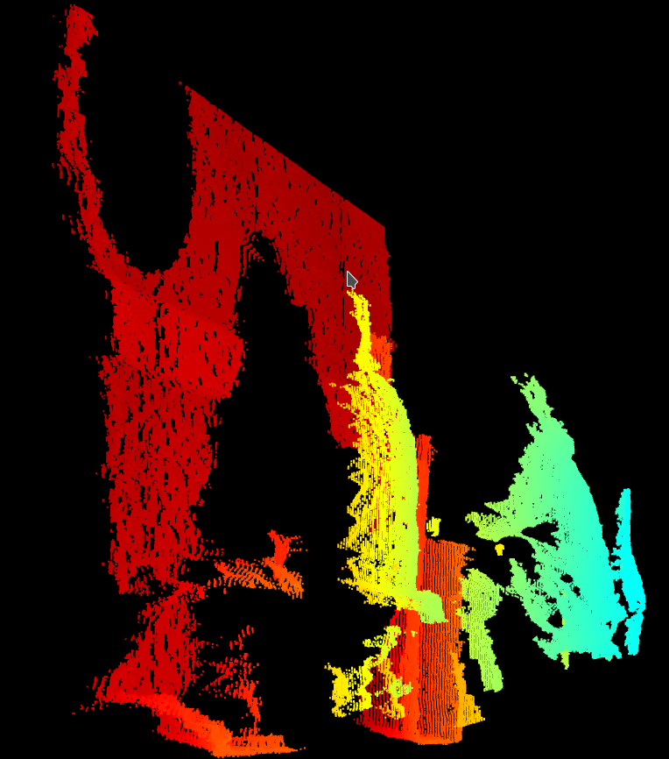
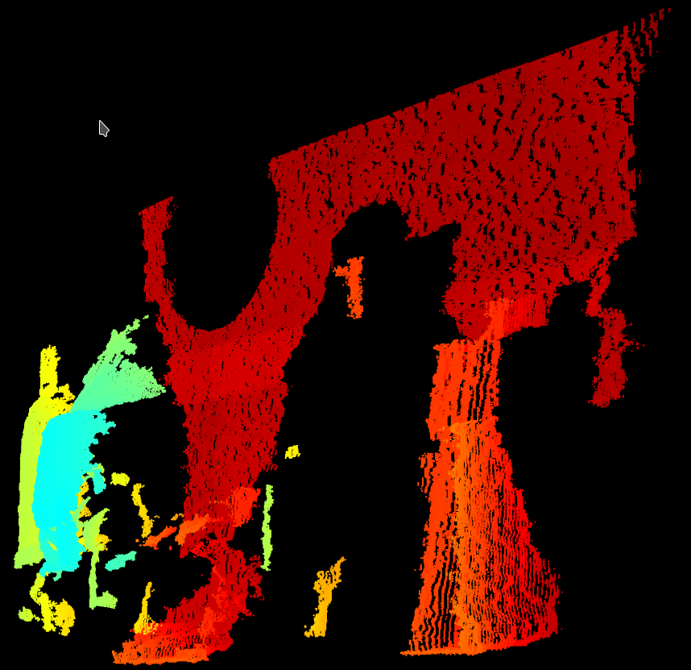
Point Cloud Online Visualisation
Point Cloud visualisation of two people with a wall and window.
Person 1 is blue, person 2 is orange, wall is red, window is black circle.

Slide 6
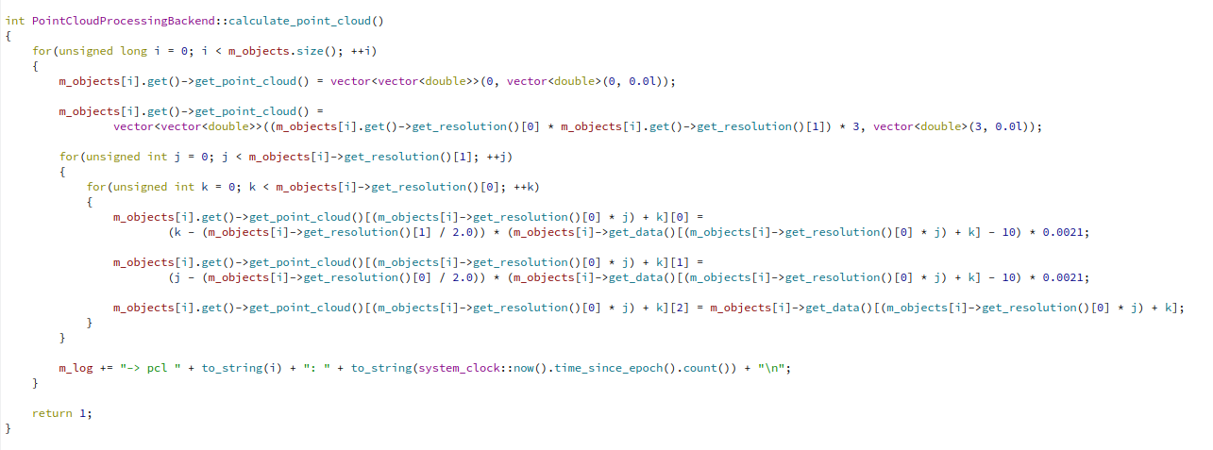
Depth image to Point Cloud Code
This image shows the code which is used to convert from a depth image to a point cloud.
In this instance a number of depth images are being passed into the method as part of the m_objects list, a depth image is stored as a list of numbers.
The point cloud is passed out as a list of lists of numbers, in this case the second list is being used to hold the individual X Y Z components, this is to mirror the format of the PCL PCD file format.
The values of 10 and 0.0021 have been sourced from the OpenKinect documentation.

Slide 7
Depth image to Point Cloud Code
Px = (xi - Cx) * (Dx / BA) Py = (yi - Cy) * (Dy / BA)
Pz = zi;

Slide 8
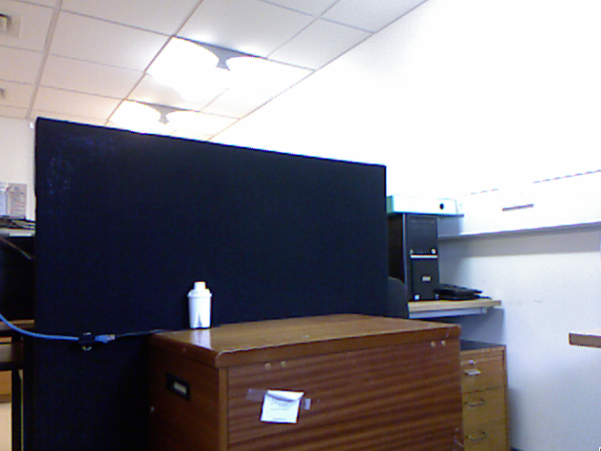
Application Output (video)

Slide 9
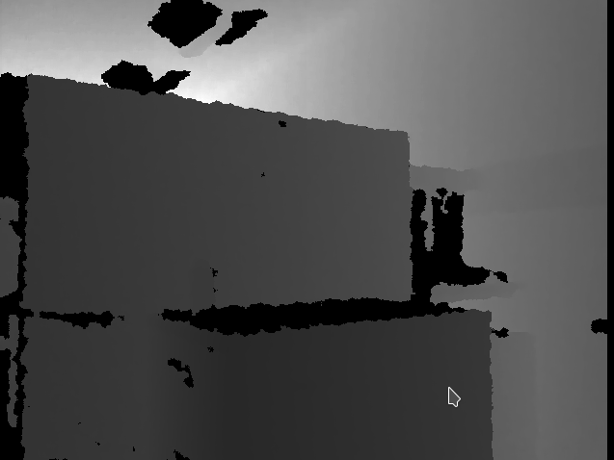
Application Output (depth)

Slide 10
Application Output (point cloud)

Slide 11
Next Steps
The next steps for this project are to convert the existing code to use the PCL PCD file format.
This is necessary as the goal of this project is to eventually try to find the changes between each point cloud in the m_objects list.
To do this registration algorithms from the PCL will be used.

