Slide 1

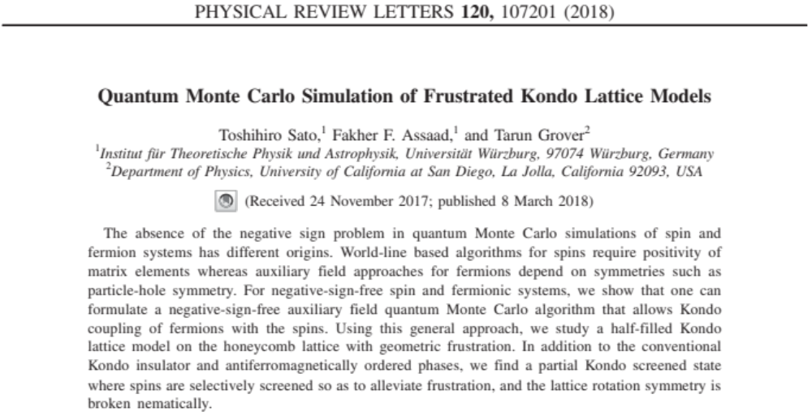
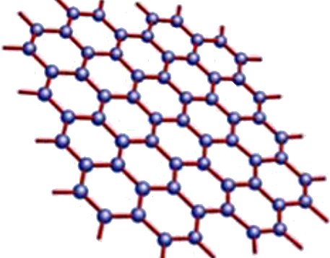
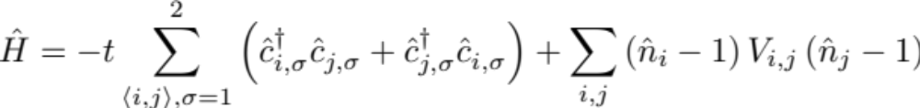
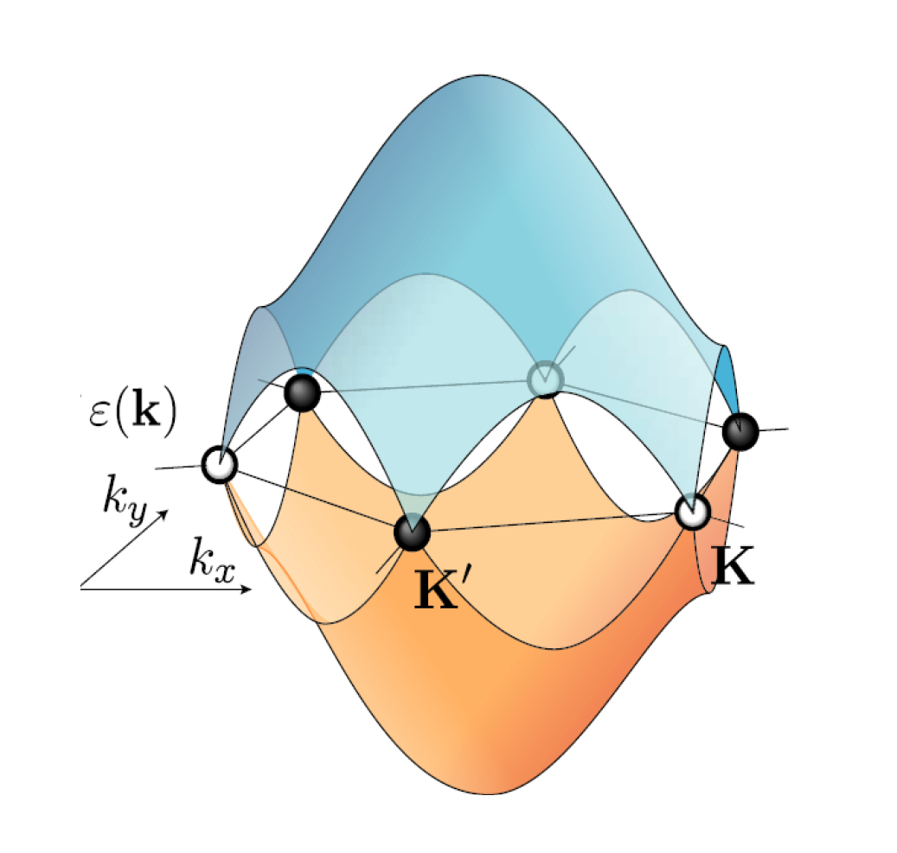
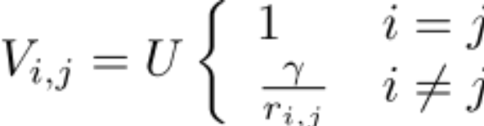
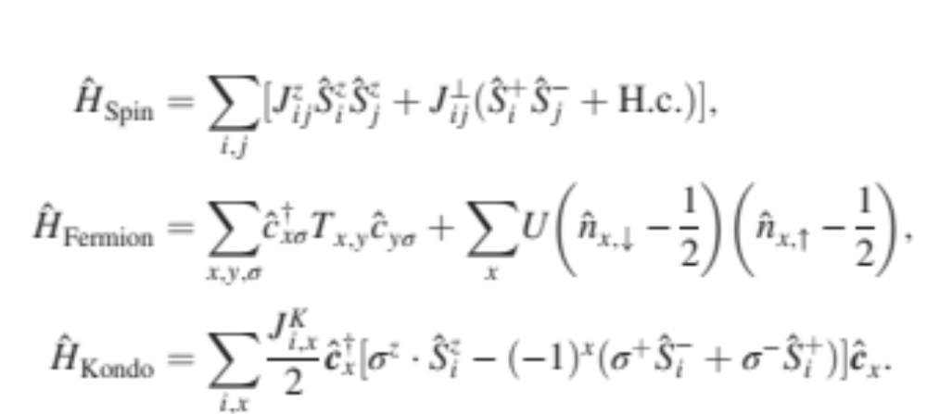
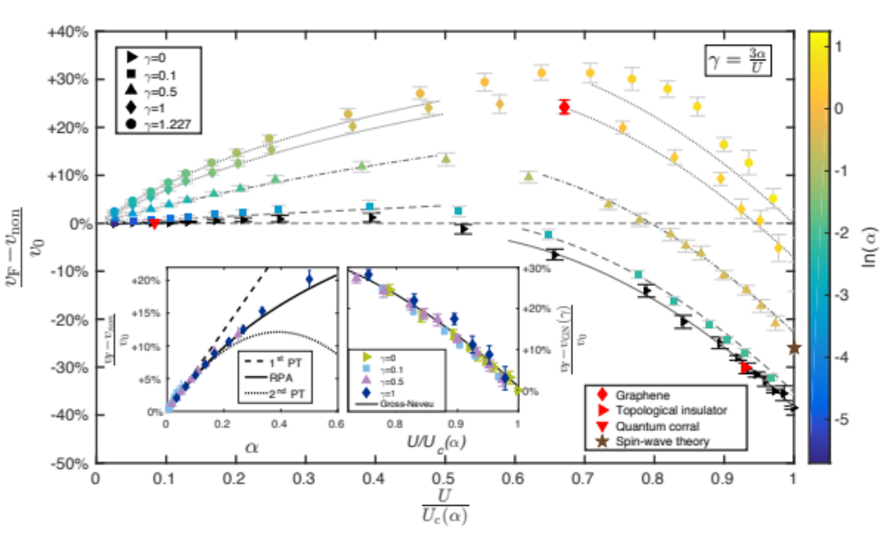

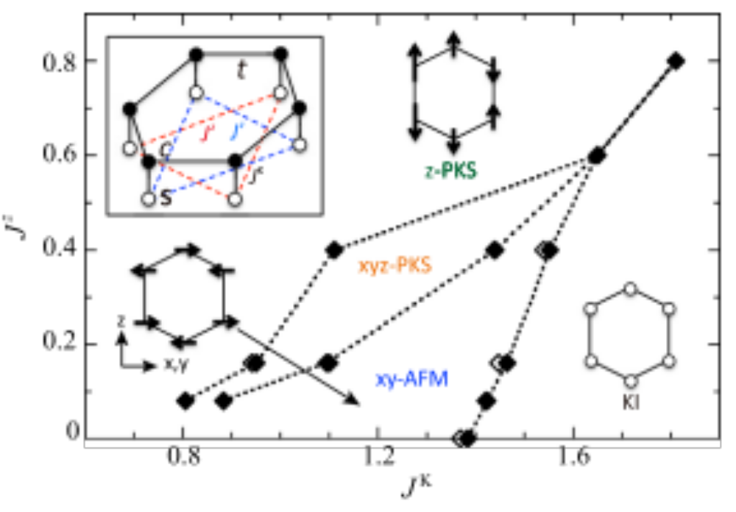
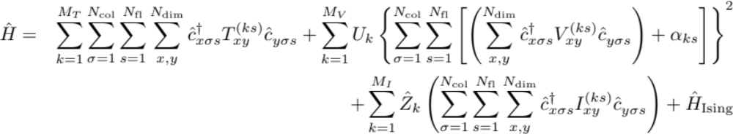



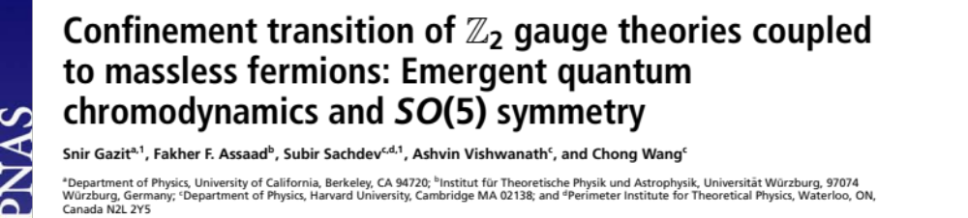
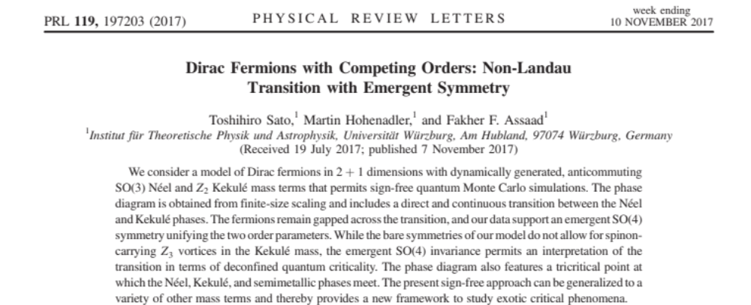
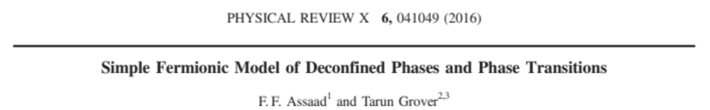
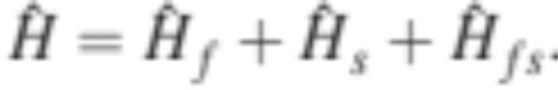
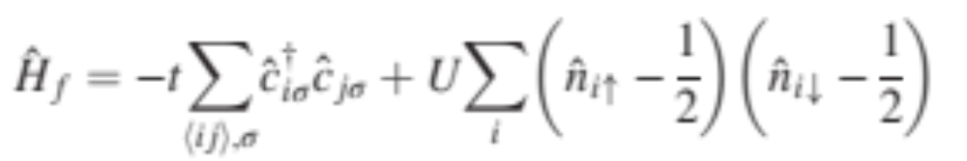
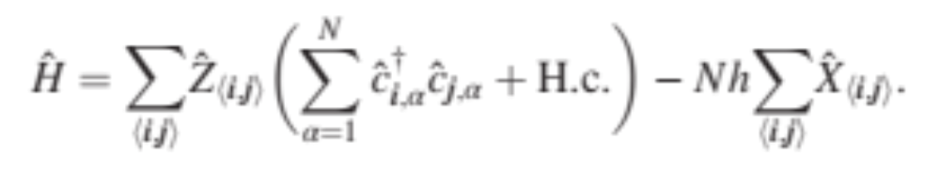
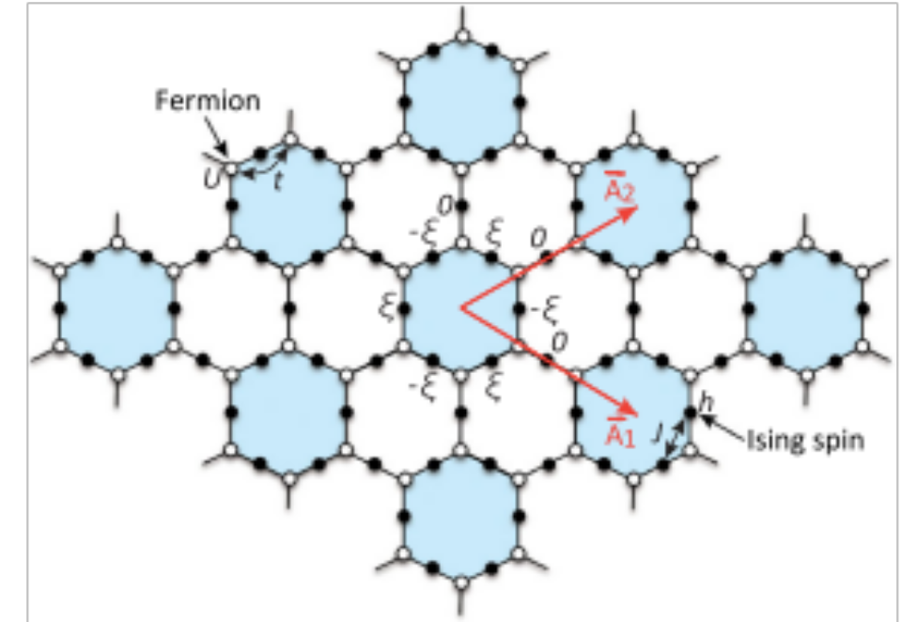
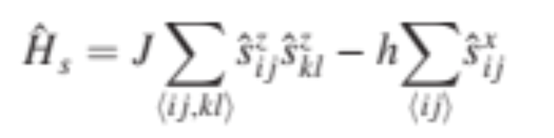
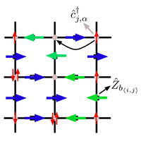
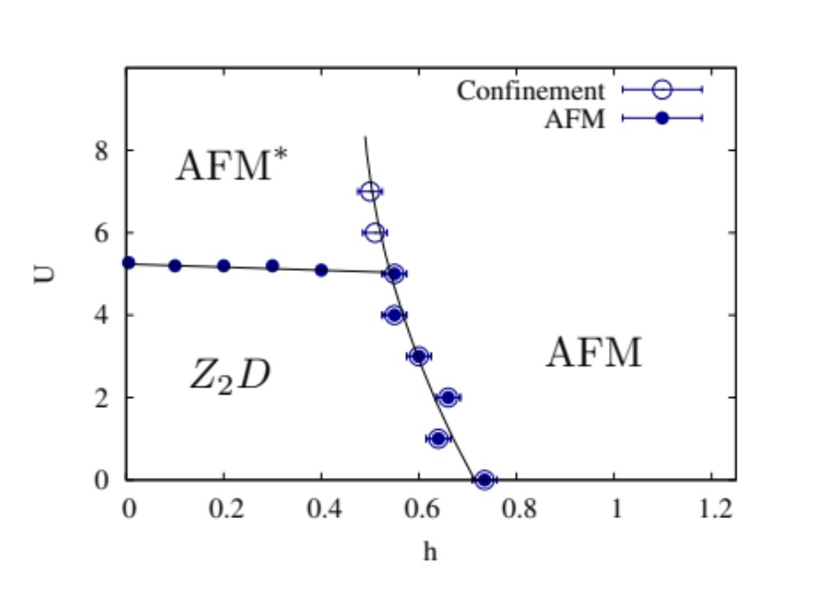
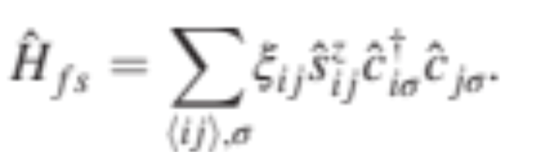

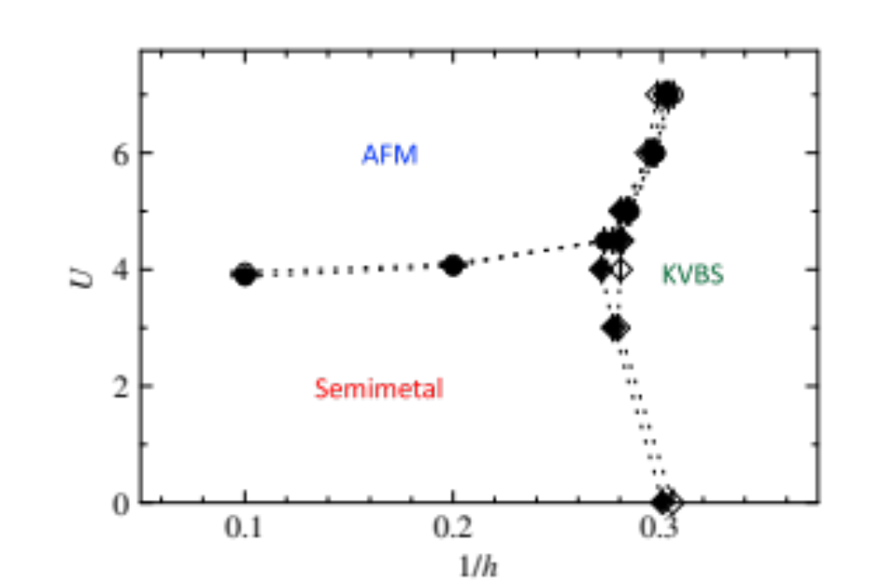
Algorithms for lattice fermions (ALF):
a flexible package for the efficient simulation of lattice Hamiltonians
The ALF collaboration ( F. F. Assaad, M. Bercx, F. Goth, J. S. Hofmann and J. Schwab)
SFB1170
ToCoTronics
Goals:
Generic package for Monte Carlo simulations of fermion-boson lattice models
Efficient implementation on modern HPC systems
Benchmarking and golden standards
The role of electron-electron interactions in two
dimensional Dirac fermions
Interplay of Kondo, RKKY and geometric frustration
Ho-Kin Tang, J. N. Leaw, J. N. B. Rodrigues, I. F. Herbut, P. Sengupta, F. F. Assaad, and S. Adam,
Science, to appear
The ALF package
Kinetic
Potential (sum of perfect squares)
Coupling of fermions to Ising field
Model can be specified at minimal programming cost
MPI/OpenMP implementation
Fortran 2003 standard
SU(N_{col}) symmetric in colors N_{col}
Arbitrary Bravais lattice for d=1, 2
Block diagonal in flavors, N_{fl}
Parallel tempering, projective and finite T approaches
Future developments
Continuous fields
Hybrid molecular dynamics
Langevin dynamics
Wissenschaftliche
Literaturversorgungs
und Informationssysteme (LIS)
M. Bercx, F. Goth, J. S. Hofmann and F. F. Assaad, SciPost Phys. 3 (2017), 013.
Direct and
continuous
transition with
emergent O(4)
symmetry
Project Z03
 | Gauge Field | Particle-hole
Z₂D | De-confined | No binding
AFM | Confined | Condensed
AFM* | De-confined | Condensed
The c-electrons carry global U(1)
charge and local Z₂ charge

