Slide 1
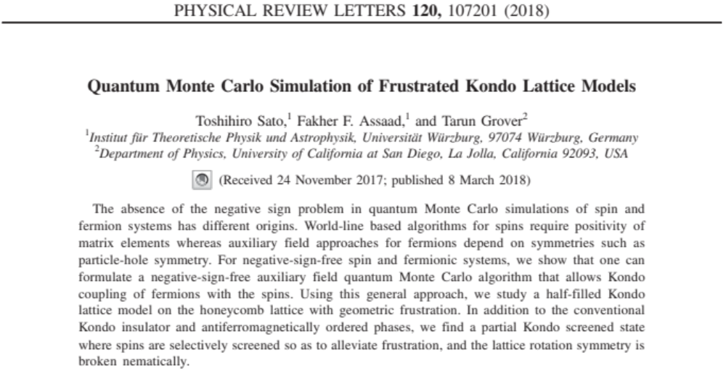
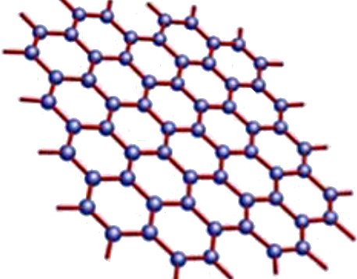
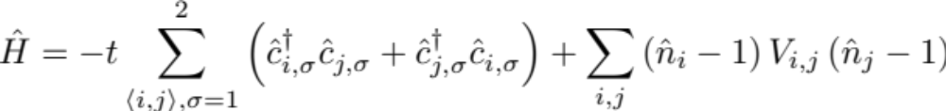
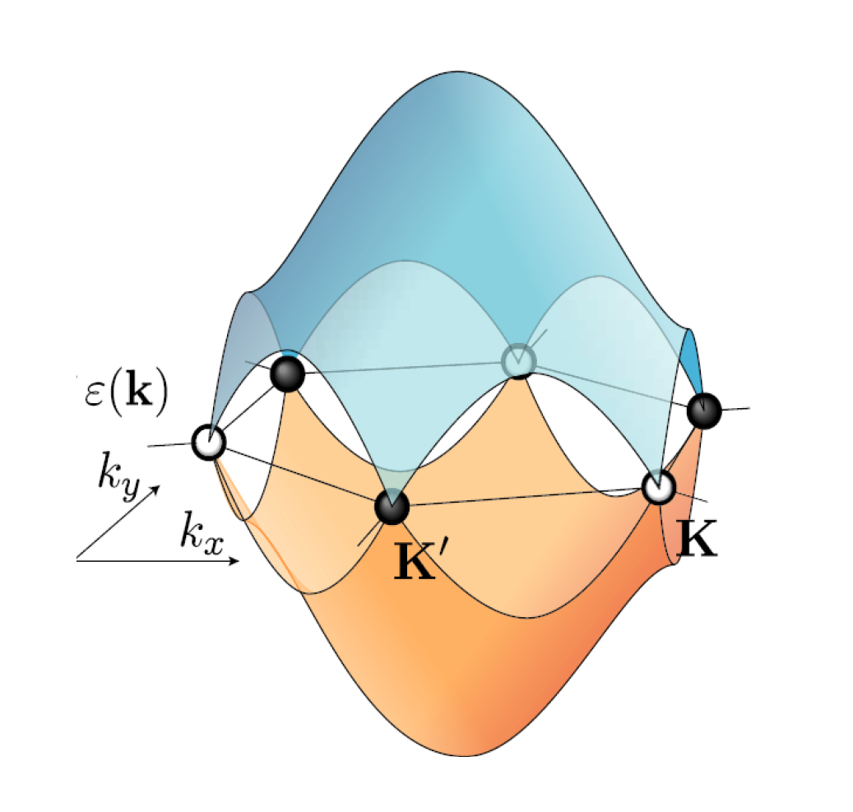
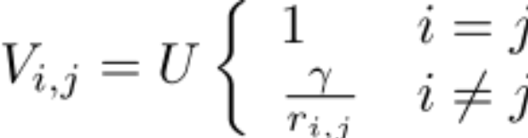
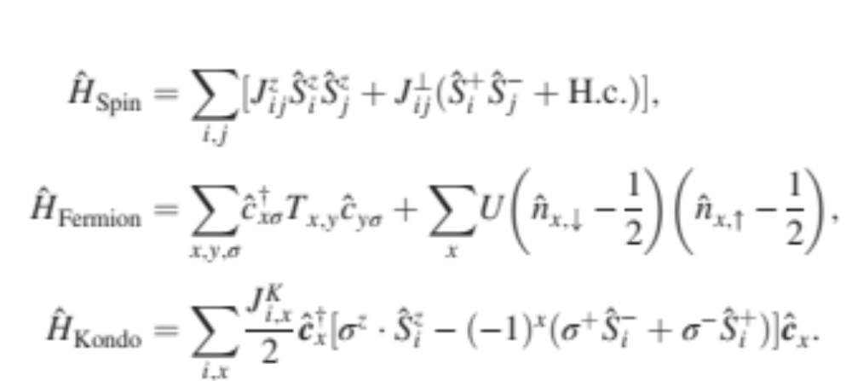
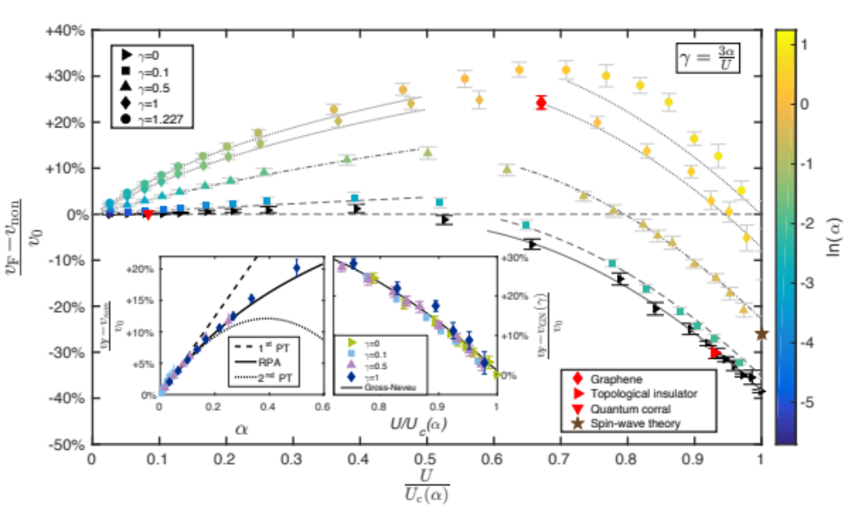
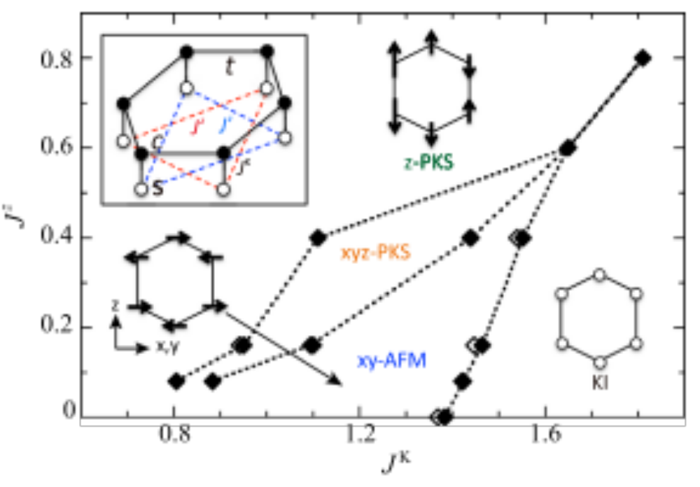

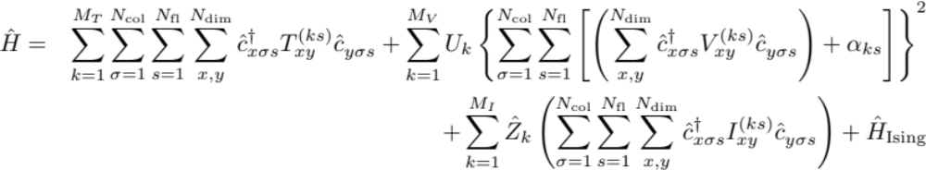



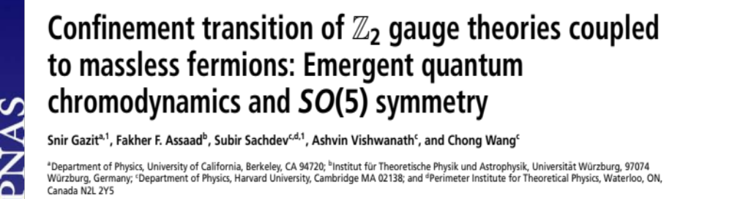
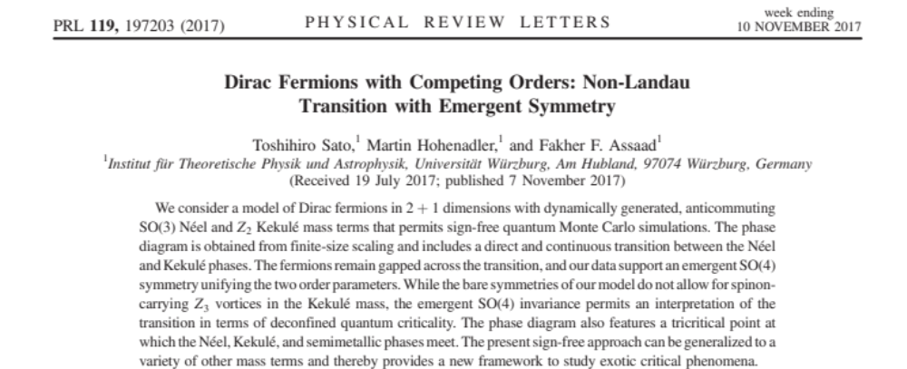
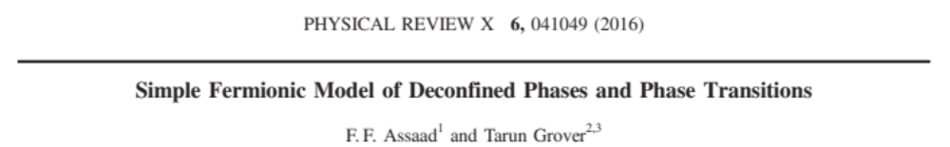
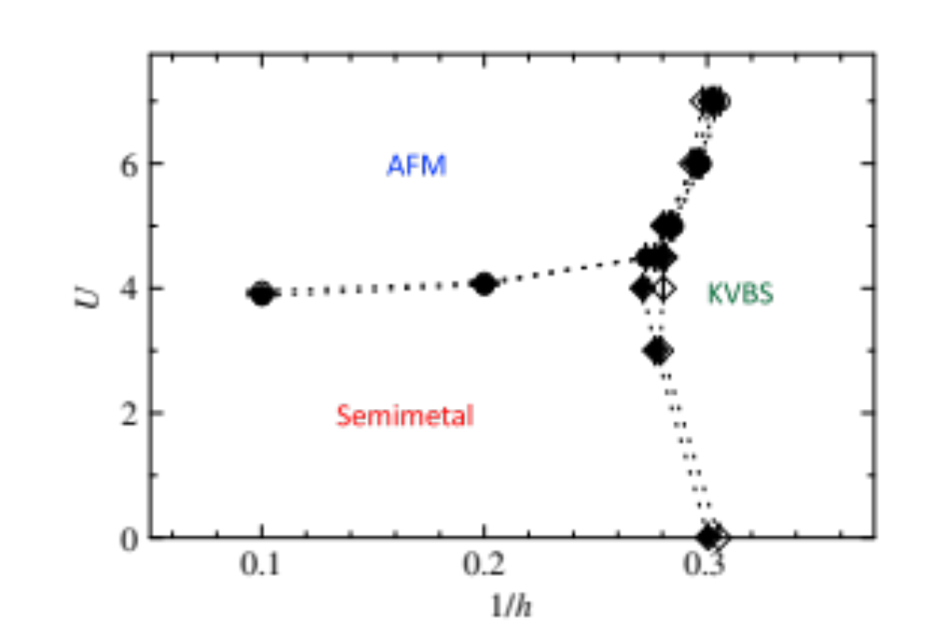
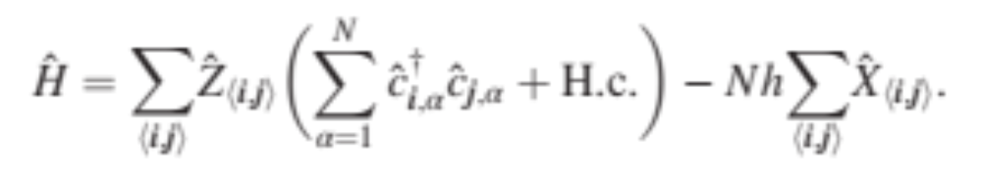
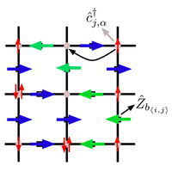
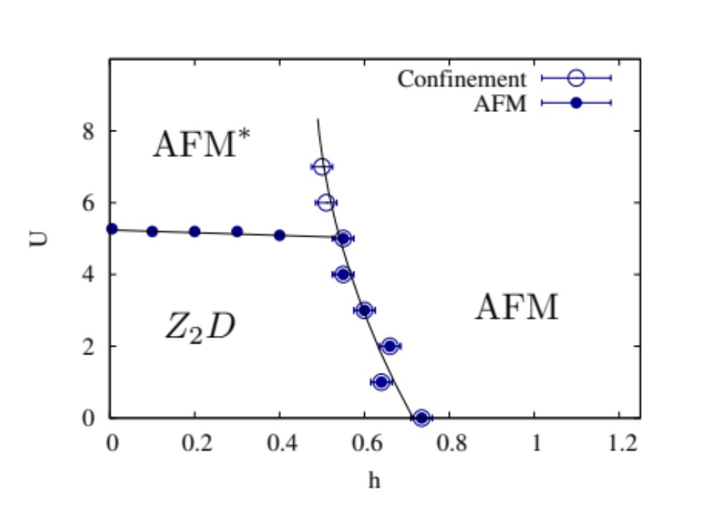

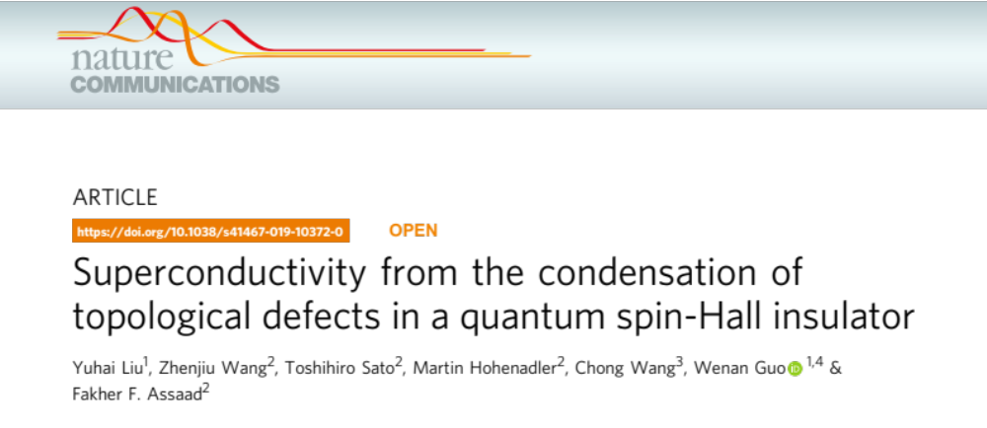
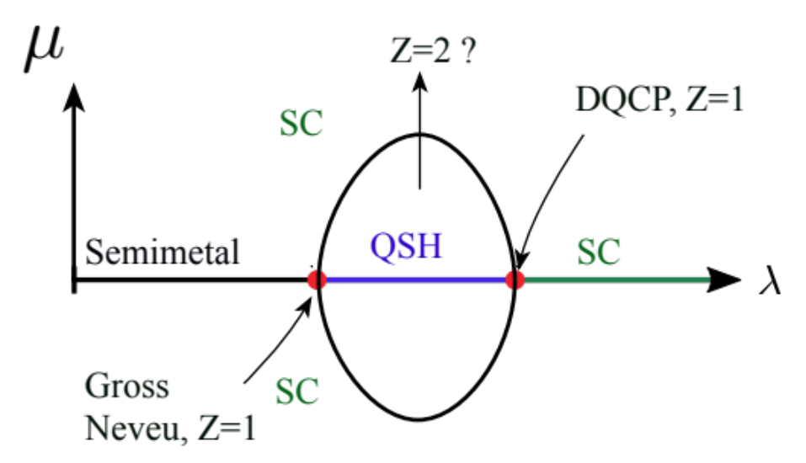
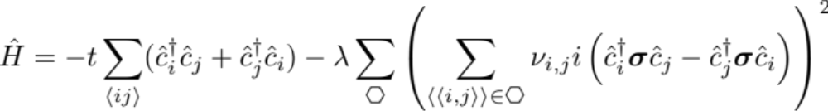
Algorithms for lattice fermions (ALF):
a flexible package for the efficient simulation of lattice Hamiltonians
The ALF collaboration ( F. F. Assaad, M. Bercx, F. Goth, J. S. Hofmann, J. Portela, and J. Schwab)
Goals:
Generic package for auxiliary field Monte Carlo simulations of fermion-boson lattice models
Efficient implementation on modern HPC systems
Benchmarking and golden standards
The role of electron-electron interactions in two
dimensional Dirac fermions
Interplay of Kondo, RKKY
and geometric frustration
Ho-Kin Tang, J. N. Leaw, J. N. B. Rodrigues, I. F. Herbut, P. Sengupta, F. F. Assaad, and S. Adam,
Science 361 (2018), no. 6402, 570–574.
See also.
J. S. Hofmann, FFA, and T. Grover, PRB 2019, FL* phase in Kondo lattice model. BFG model Kondo
coupled to electrons.
M. Raczkowski and FFA, PRL 2019, B. Danu, FFA. and F. Mila, arXiv:1903.08622 Nano-Kondo systems.
https://git.physik.uni-wuerzburg.de/ALF
The ALF package
Kinetic
Potential (sum of perfect squares)
Coupling of fermions to Ising field
Model can be specified at minimal programming cost
MPI/OpenMP implementation
Fortran 2003 standard
SU(N_{col}) symmetric in colors N_{col}
Arbitrary Bravais lattice for d=1, 2
Block diagonal in flavors, N_{fl}
Parallel tempering, projective and finite T approaches
Future/ongoing developments
Continuous fields
Hybrid molecular dynamics
Langevin dynamics
Imaginary time dependent Hamiltonians
Wissenschaftliche
Literaturversorgungs
und Informationssysteme (LIS)
SFB1170
ToCoTronics
M. Bercx, F. Goth, J. S. Hofmann and F. F. Assaad, SciPost Phys. 3 (2017), 013.
Lattice gauge theories
Intertwined orders in Dirac fermions
AFM (QSH) and VBS (SSC) from
quintuplet of anticommuting
Mass terms.
OSM
Doping
The c-orthogonal fermion carries
global U(1) charge and local Z₂ charge
 | Gauge Field | Particle-hole
OSM | De-confined | No binding
AFM | Confined | Condensed
AFM* | De-confined | Condensed
See also.
M. Hohenadler and FFA (arXiv:1906.11937, PRL 18), Orthogonal metal in Falicov-Kimball model.
S. Gazit, FFA, and S. Sachdev (arXiv:1906.11250), OSM → FL* transitions

