Slide 1

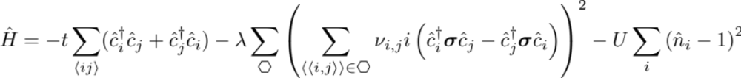
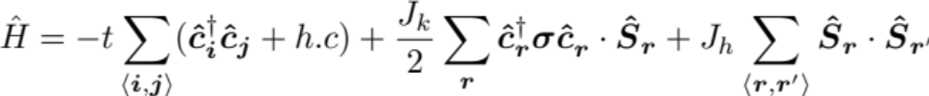
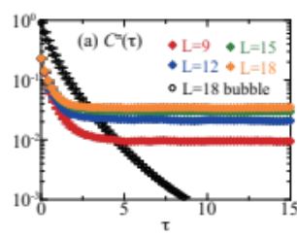
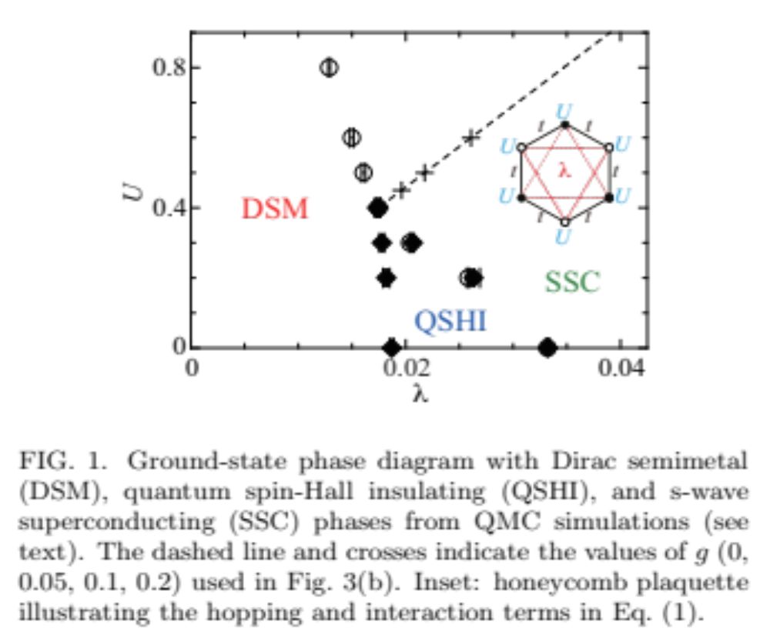
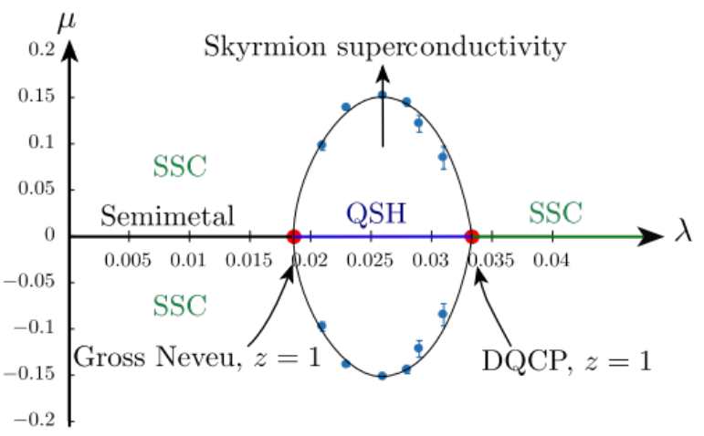
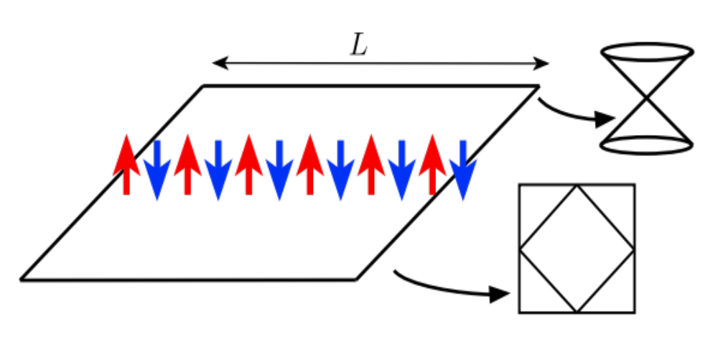

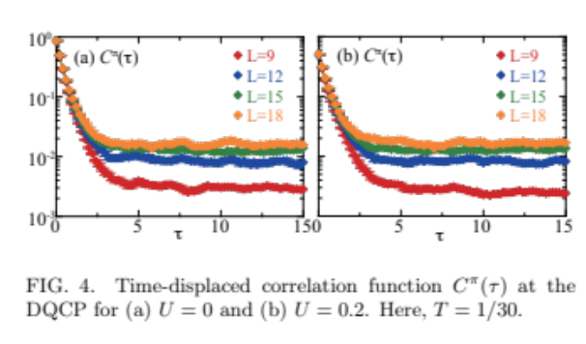

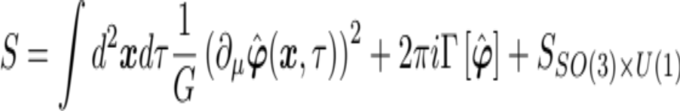
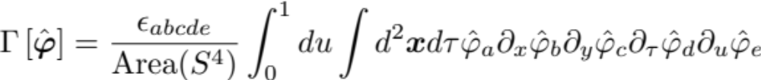
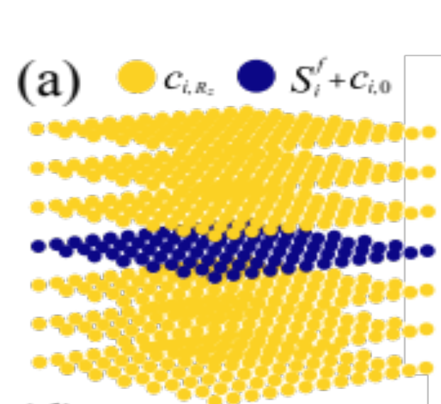
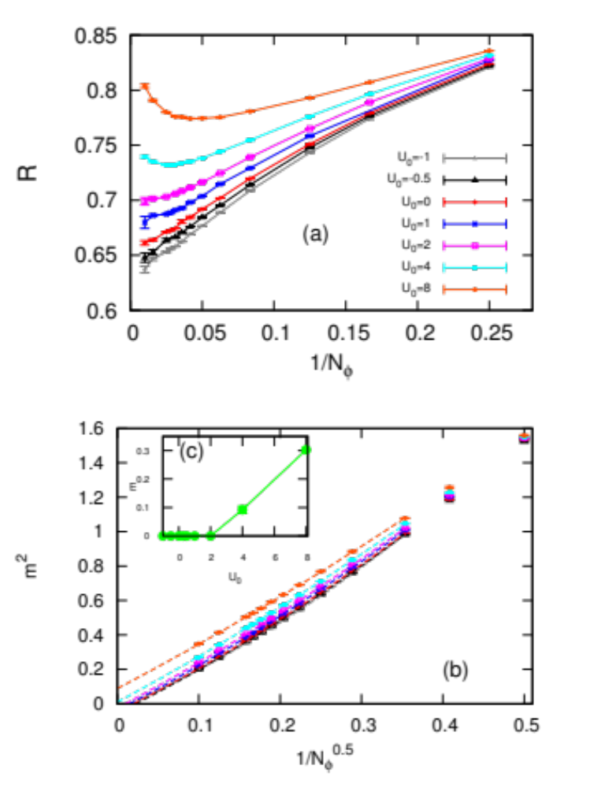
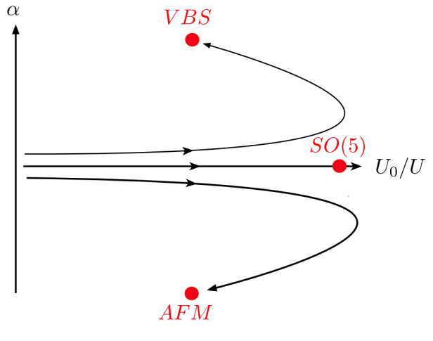
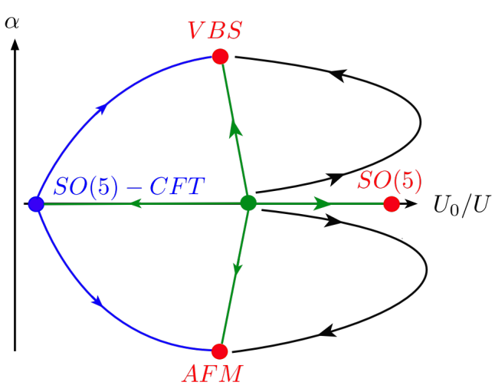
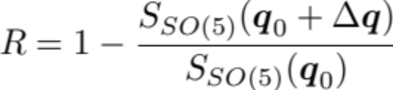
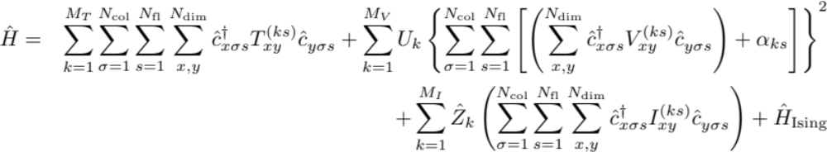




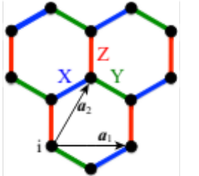
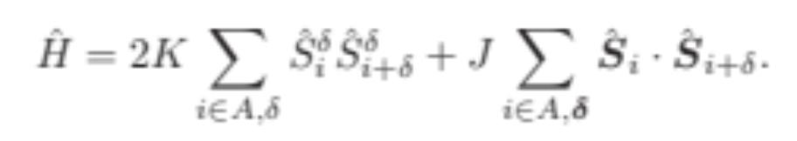
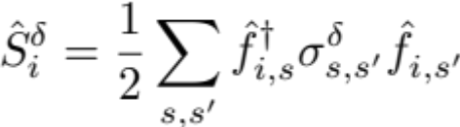
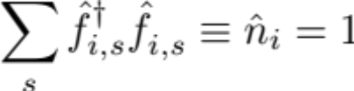
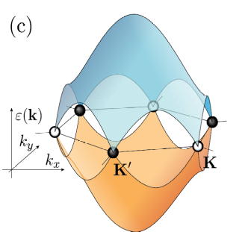
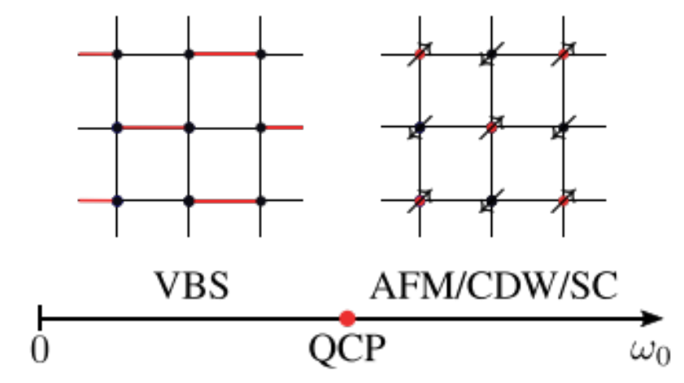
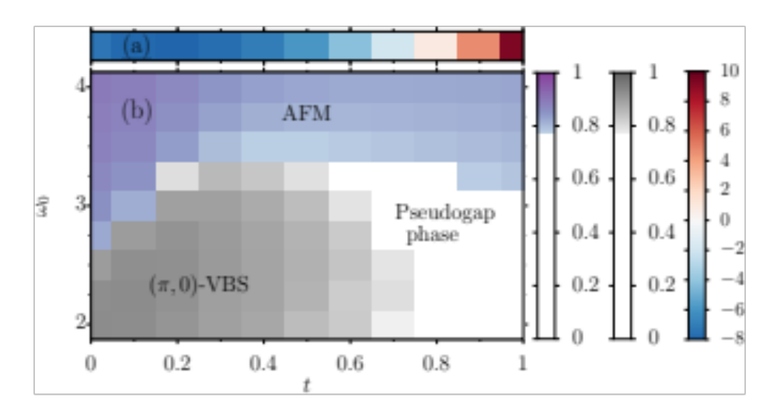
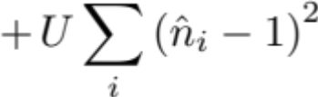
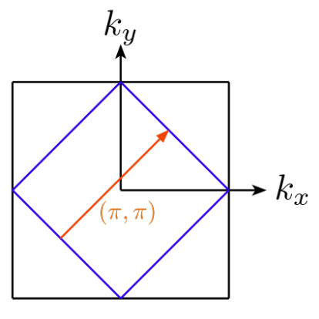
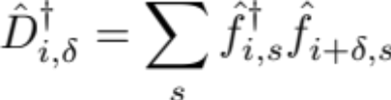

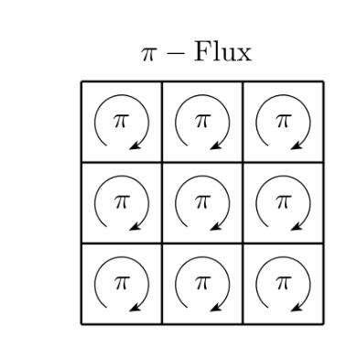
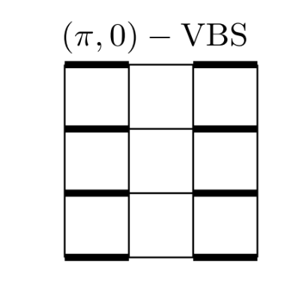
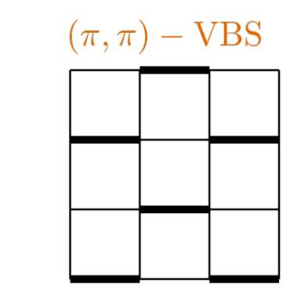
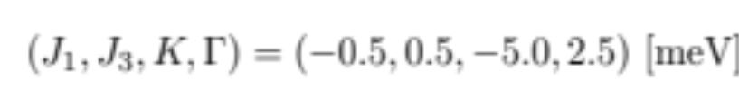

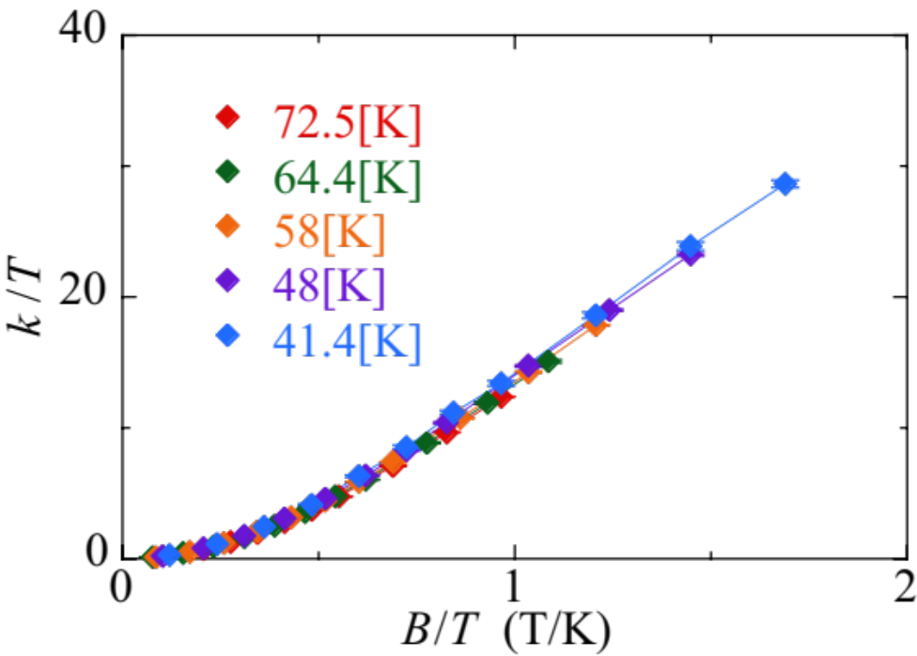
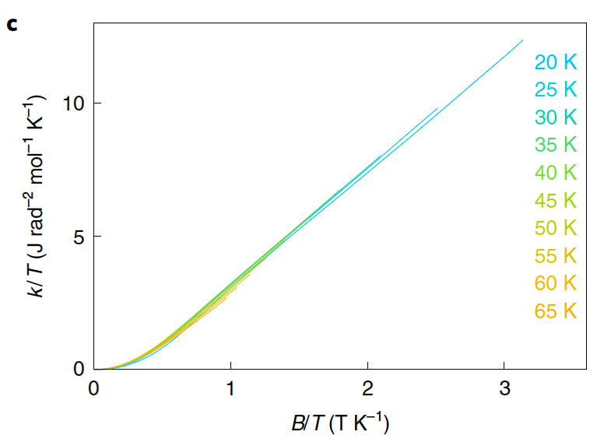
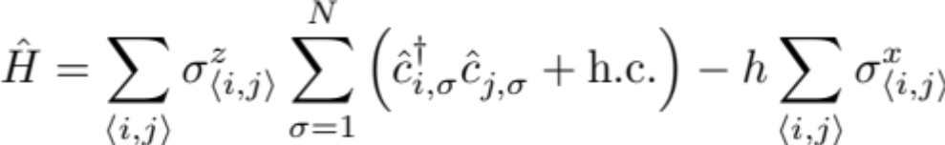
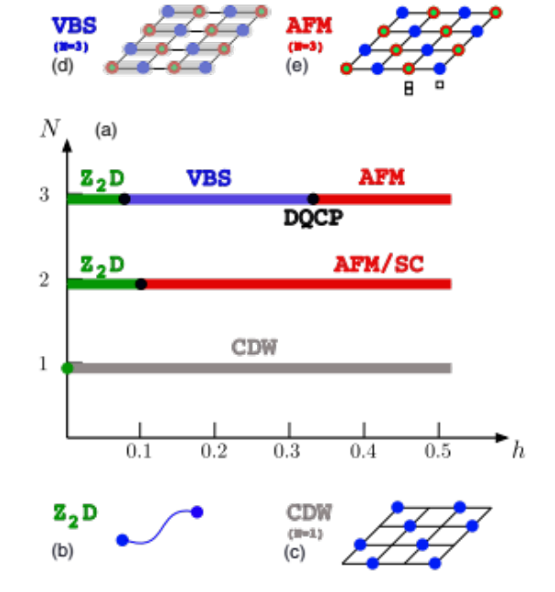
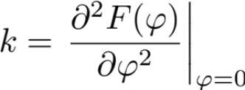
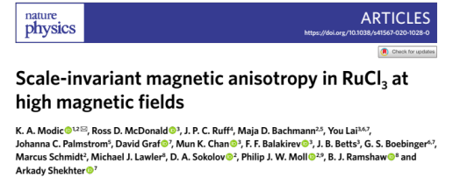
Algorithms for lattice fermions (ALF) 2.0:
The ALF collaboration: F. F. Assaad, M. Bercx, F. Goth, A. Götz, J. S. Hofmann,
E. Huffman, Z. Liu, F. Parisen Toldin, J. S. E. Portela, J. Schwab
ALF 1.0: SciPost Phys. 3 (2017), 013 ALF 2.0 SciPost Phys. Codebases 1 (2022)
Goals:
Generic and flexible package for auxiliary field Monte Carlo simulations of fermion-boson lattice models
Efficient implementation on modern HPC systems
Benchmarking and golden standards
Dirac systems
SU(N) Kondo-Heisenberg
Y. Liu, Z. Wang, T. Sato, M. Hohenadler, C. Wang, Wenan Guo, and F. F. Assaad,
Nature Communications 10 (2019), no. 1, 2658, PRL 126 (2021), 205701, arXiv:2212.11395
Doping induced transitions
Bandwidth-controlled transitions
Kondo breakdown transition
B. Danu, M. Vojta, F. F. Assaad, and T. Grover, PRL. 125 (2020), 206602
:Rotation QSH to SSC
Dissipation induced long range order QCP between antiferromagnetic heavy fermion metal and heavy fermion metal
Candidate theory for DQCP
Z. Wang, M. P. Zaletel, R. S. K. Mong, and F. F. Assaad, PRL 126 (2021), 045701.
B. Danu, M. Vojta, T. Grover, and F. F. Assaad, PRB 106 (2022), L161103.
Correlation ratio
Realization of marginal Fermi liquid at QCP between antiferromagnetic heavy fermion metal and heavy fermion metal
SO(5) symmetry breaking field
Z.H Liu, B. Frank, L. Janssen, M. Vojta, and F. F. Assaad,
PRB 107 (2023), 165104, arXiv:2212.11283
See also:
B. Danu, Z. Liu, F. F. Assaad, and M. Raczkowski, PRB 104 (2021), 155128.
M. Raczkowski and F. F. Assaad, PRR. 2 (2020), 013276.
See also: J. S. Hofmann, E. Khalaf, A. Vishwanath, E. Berg, and J. Y. Lee, PRX 12 (2022), 011061, for TBG.
https://git.physik.uni-wuerzburg.de/ALF
The ALF package
Kinetic
Potential (sum of perfect squares)
Coupling of fermions to Ising field
Model can be specified at minimal programming cost
MPI/OpenMP implementation
Fortran 2008 standard
SU(N_{col}) symmetric in colors -index
Arbitrary Bravais lattice for d=1, 2
Block diagonal in flavors, N_{fl} s-index
Projective and finite T approaches
Parallel tempering, Continuous fields,
Langevin dynamics, hybrid Monte Carlo
Imaginary time dependent Hamiltonians
PyALF: Python interface
SFB1170
ToCoTronics
Wissenschaftliche
Literaturversorgungs
und Informationssysteme (LIS)
Center of excellence –
complexity and topology in quantum matter
Electron-phonon/Lattice gauge
Frustrated spin systems
Exotic phases and phase transitions in an SSH model on a square lattice
A. Götz, S. Beyl, M. Hohenadler, and F. F. Assaad, PRB 105 (2022), 085151, arXiv:2307.07613
Kitaev-Heisenberg
Simulating spins with fermions.
T. Sato and F. F. Assaad, PRB 104 (2021), L081106
Emergent Dirac fermions
Flux/plaquette
Instabilities of nested FS
Constraint commutes with Hamiltonian dynamics
Phase of fermion determinant is pinned to
RuCl₃
Winter et al. Nat. Comm. 8 (2017), PRL. 120 (2018)
At t=0 model has same symmetries as Z₂ lattice gauge theory
QMC
F. F. Assaad and Tarun Grover, PRX 6 (2016), 041049
S. Gazit, M. Randeria, and A. Vishwanath, Nat Phys 13 (2017), 484
S. Gazit, F. F. Assaad, S. Sachdev, A. Vishwanath, and C. Wang, PNAS (2018)
(Work in progress)
Notes:
Götz, S. Beyl, M. Hohenadler, and F. F. Assaad, PRB 105 (2022), 085151, arXiv:2307.07613
T.Sato and F. F. Assaad, PRB 104 (2021), L081106 F. F. Assaad and Tarun Grover, PRX 6 (2016), 041049.

