Slide 1

Page 01
Network Intrusion Detection & Prevention
Snort
-

Slide 2

Page 03
Understanding IDS and IPS
Intrusion Detection System (IDS)
Intrusion Prevention System (IPS)
An IDS acts as a security watchdog, passively monitoring network traffic and system logs for suspicious activities. It analyzes patterns and identifies potential security breaches, alerting administrators when anomalies are detected. Key characteristics include passive monitoring, a focus on alerting rather than prevention, and the ability to analyze network packets or host-based activities.
An IPS takes a proactive approach, actively monitoring network traffic and taking immediate action to prevent threats. It acts as a gatekeeper, blocking malicious traffic in real-time. It features proactive and inline monitoring, the ability to block traffic, quarantine threats, or shut down connections, ensuring that threats are neutralized before they can impact the network.

Slide 3

Page 02
Snort: A Deep Dive into Network Intrusion Detection and Prevention
Snort is an open-source Network Intrusion Detection and Prevention System (NIDPS) that detects and optionally blocks malicious traffic using a rule-based engine. Developed by Sourcefire, it is now maintained by Cisco.

Slide 4
Page 04
Snort main roles
1
Packet Sniffing
2
Network Intrusion Detection (NIDS)
Snort captures network traffic in real-time, capturing packets as they flow through the network. This allows for comprehensive monitoring and analysis of all network activity.
Utilizing its rule-based engine, Snort can detect known attack patterns based on predefined signatures. This allows for proactive identification of threats based on previously known malicious activity.
3
Network Intrusion Prevention (NIPS)
4
Traffic Logging
When operating in inline mode, Snort can actively block malicious traffic. This proactive approach prevents threats from reaching their intended targets, ensuring network security and data integrity.
Snort logs network activities, providing a detailed record of all network events. These logs are invaluable for security audits, forensic analysis, and identifying attack trends.

Slide 5
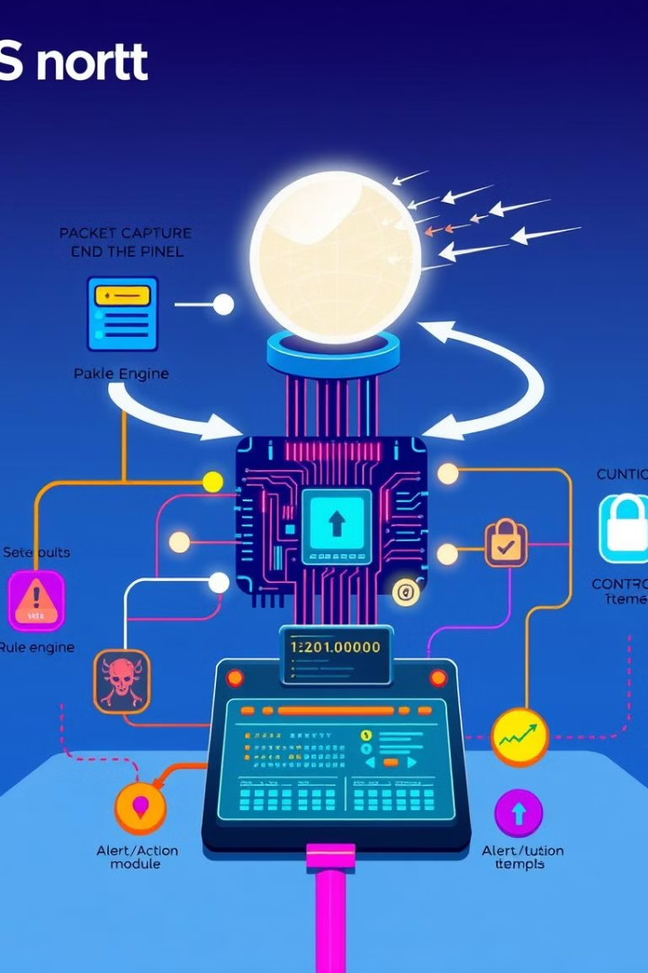
Page 05
How Snort Works?
When active Snort capture network packets, analyzing their contents, and matching them against a set of predefined rules. These rules define criteria for identifying suspicious traffic, such as specific patterns, port numbers, or protocol vulnerabilities. If a packet matches a rule, Snort make decision as to whether to send an alert or drop the traffic (in the case of IPS).

Slide 6
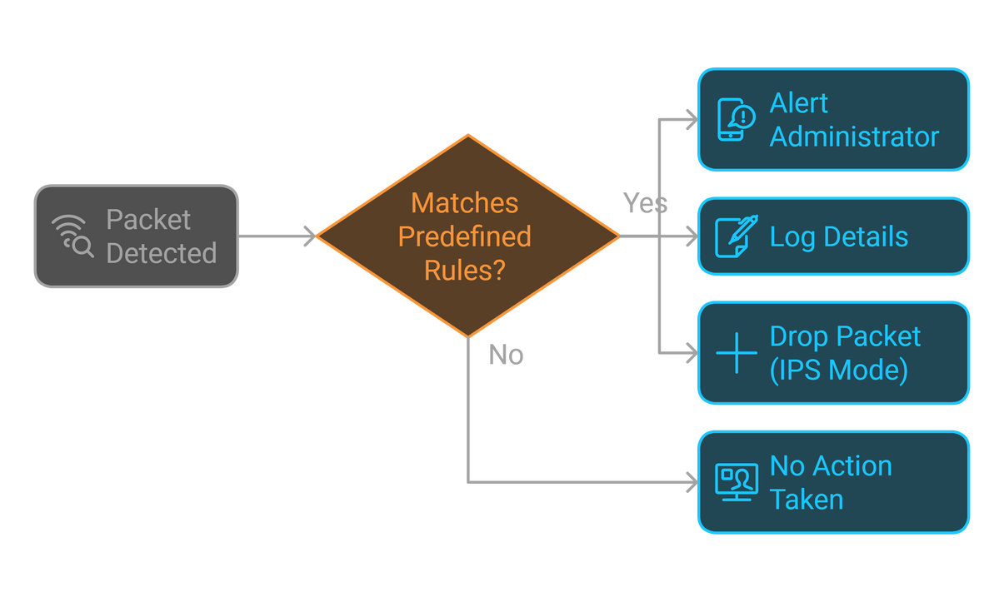
Action Based on Rule Match
If Snort finds a packet that matches one of its predefined rules (i.e., the traffic fits the suspicious pattern defined by the rule), it takes action.
The action might be:
Alert: Notify the administrator about suspicious activity.
Log: Record details about the packet and the suspicious event.
Drop (if in IPS mode): Block the packet from passing through the network, preventing potential harm.

Slide 7
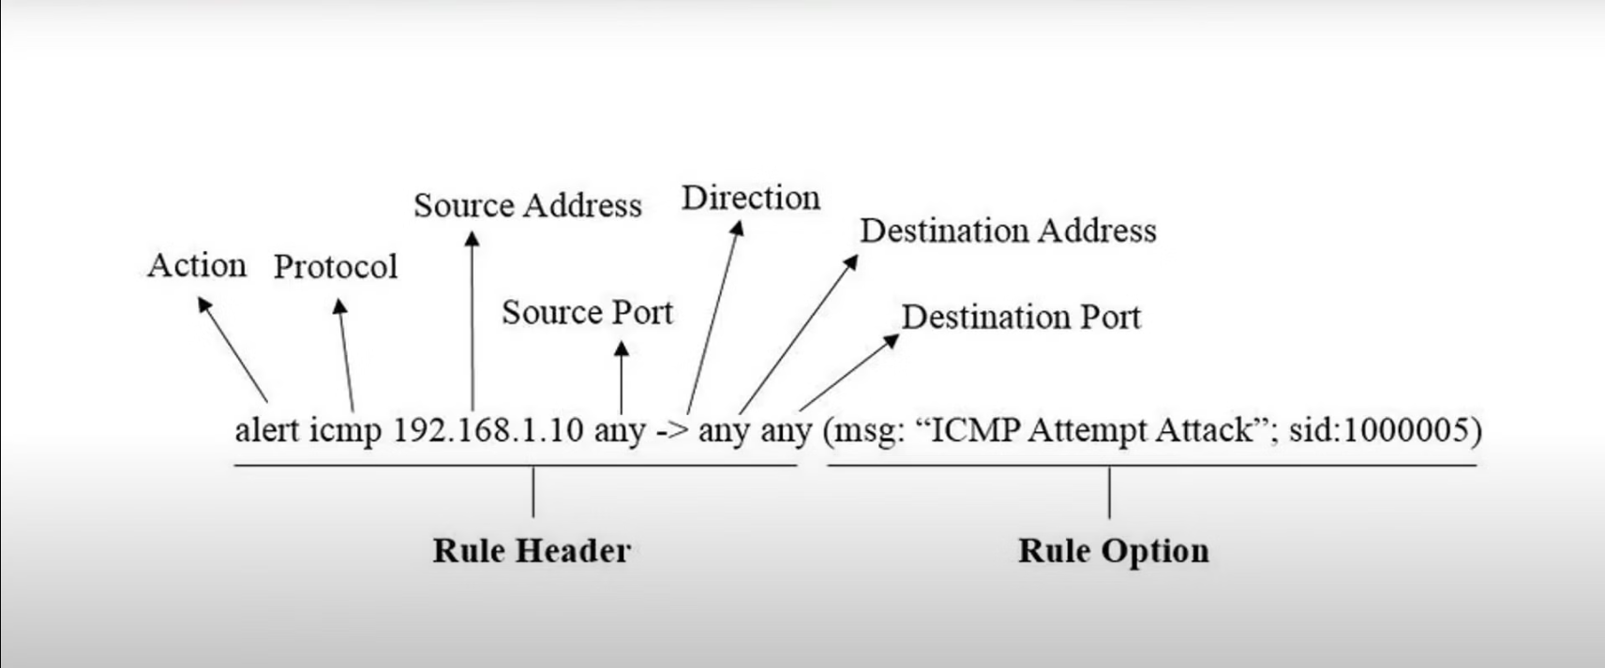
Page 07
Snort rule syntax:

Slide 8
Snort Rule-Based Engine
Page 06
Rule Types:
Snort rules are categorized into three main types:
community rules: Free rule-sets created by the snort community.
Snort has a large a mount of rules set created by snort community, the community generate the rules for the
latest attack or exploits.
registered rules: Paid rule-sets created talos.
subscription-only rules: these rule-sets require an active subcription in order to be accessed and used
Customizing Snort Rules for Specific Needs
Beyond the provided rule sets, you can create custom rules tailored to your specific security requirements. This allows you to detect attacks that might not be covered by standard rules or to enforce unique security policies.

Slide 9


Page 08
Simulation

