Slide 1
BIZIONARY ERP SYSTEM
A Secure, Agentic AI-Enabled Enterprise Resource Planning Platform for SMEs
Corporate Ledgers
AI-Driven Insights
Dynamic Ingest
• Consolidated relational DB schemas.
• Strict double-entry journal auditing.
• Automatic database stock signals.
• Groq Llama 3.3 chatbot helper.
• NLP pricing margin alerts.
• Demand velocity forecasting models.
• Drag & Drop sales PDF uploader.
• Robust monthly Excel parser.
• Zero-downtime key administration.

Slide 2
BIZIONARY ERP SYSTEM
The Problem vs. The Bizionary Solution
SME Operational Bottlenecks
The Integrated Solution
• Fragmented Tools: rely on offline sheets and paper slips, causing stock data mismatches.
• No Transaction Auditing: updates occur without logs, masking errors or theft.
• Delayed Business Intelligence: compiling cash flow sheets manually takes weeks.
• Costly Restock Checks: physical inventory checks cause stockouts or overstocks.
• Centralized ERP Layout: relational DB linking Sales, Purchases, Ledgers, and stock.
• Automated Ledger Signals: hooks post transactions to double-entry journals instantly.
• Agentic Conversational BI: chatbot runs local queries to fetch real-time reports.
• Automated Ingestion Pipeline: parsers ingest Excel sheets and PDFs to update database.

Slide 3
BIZIONARY ERP SYSTEM
Enterprise Technology Stack
React Client
Django Server
Cognitive AI
Data & Ingestion
Infrastructure
FRONTEND SPA • React 19.2 (Vite) • Tailwind CSS v4 • Lucide Icons • Recharts graphs • jsPDF downloads • HTML Canvas
APPLICATION CORE • Django 4.2.7 Core • REST Framework • JWT Stateless Auth • post_save Signals • CORS Middleware
INTELLIGENT LAYER • Groq SDK • Llama 3.3 Engine • Function Calling • OpenAI API GPT • Sentiment Analysis • Predictive Insights
ANALYSIS & STORAGE • SQLite 3 (Local) • PostgreSQL (Cloud) • Pandas parser • openpyxl Engine • DB Cache manager
DEPLOYMENT • Vercel Edge CDN • Railway API host • Docker runtimes • PyInstaller build • Windows standalone

Slide 4
BIZIONARY ERP SYSTEM
Project Components & Data Flow Diagram
3. Relational DB
1. Frontend (React SPA)
2. Django REST API
• SQLite 3 local storage • PostgreSQL deployment schema • Double-entry general ledger logs
Visual Screens: • Executive Dashboard • POS Scan Form & Ingestion • Stock Modals & Calculations Mechanism: • Asynchronous Axios clients • JWT Bearer Auth tokens
Endpoints Viewsets: • `/api/dashboard/summary/` • `/api/sales/transactions/` • `/api/chatbot/query/` Event Triggers: • Django DB Signals (COGS, cash flows, inventory items mapping)
4. AI Layer (Groq & OpenAI)
• Groq Llama 3.3 Function calling • Local database query router • OpenAI sentiment and OCR text parsing

Slide 5
BIZIONARY ERP SYSTEM
Master Data & 6-Month Sales Seeding
Step 1: Master Catalog Data
Step 2: Seeding Engine
Step 3: Outcome & Analytics
Initial Data Setup: • Exposes real catalogs of items, standard purchase costs, supplier profiles, and categories. • Registers items like Beverages, Grocery, Pharmaceuticals, and Stationery. • Pre-defines minimum stock thresholds for alert triggers.
Seeding Logic: • Executes script `seed_historical_sales.py` to generate sample logs. • Seeds data across multiple calendar months (e.g. January to April 2026). • Simulates random order sizes (1-8 pcs) and standard payment methods.
Outcome Results: • Generates 6 months of sales history representing over 100+ transactions. • Populates dashboard insights with real trending sales velocity curves. • Enables AI analytics to test demand forecasts, profit summaries, and reorder levels.

Slide 6
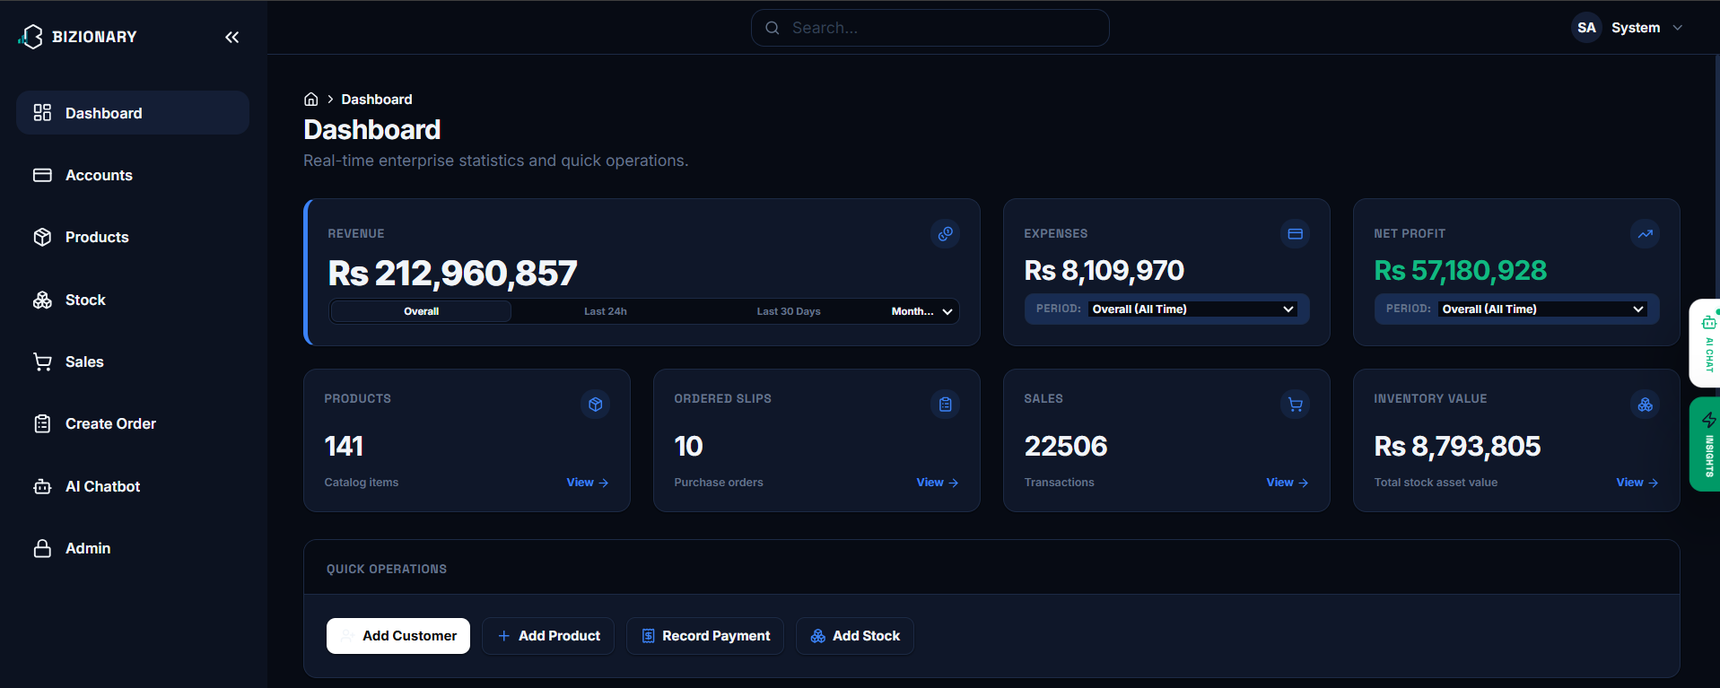
BIZIONARY ERP SYSTEM
Executive Dashboard Overview
Metrics & Workflows
• Interface: Displays revenue (Rs. 212M), expenses (Rs. 8M), net profits (Rs. 57M), active items, pending ordered slips, and asset valuation.
• Link: React fetches `/api/dashboard/summary/`. Django ORM aggregates records and caches the outputs.
• Outcome: Immediate overview of company liquidity and shortcuts to core operations.

Slide 7
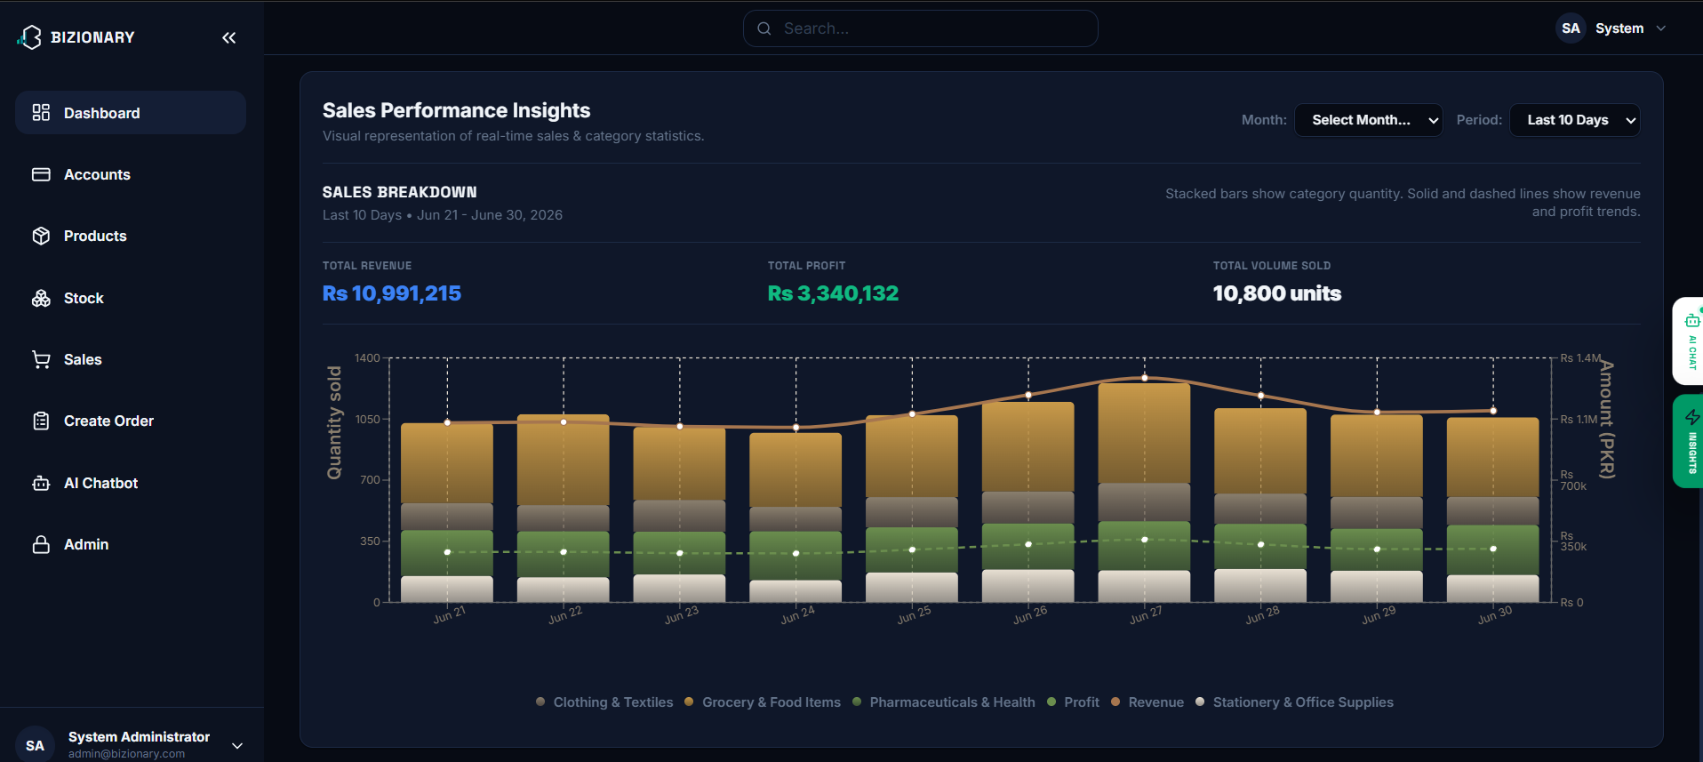
BIZIONARY ERP SYSTEM
Sales Performance Insights Dashboard
Interactive Sales Charts
• Interface: Stacked vertical category bars (Clothing, Grocery, Stationery) and profit lines over 10-day period.
• Link: Recharts SPA queries `/api/dashboard/insights/?period=10`. Backend returns transaction grouped JSON data.
• Outcome: Renders immediate sales dynamics, tracking margins and categories sold.

Slide 8
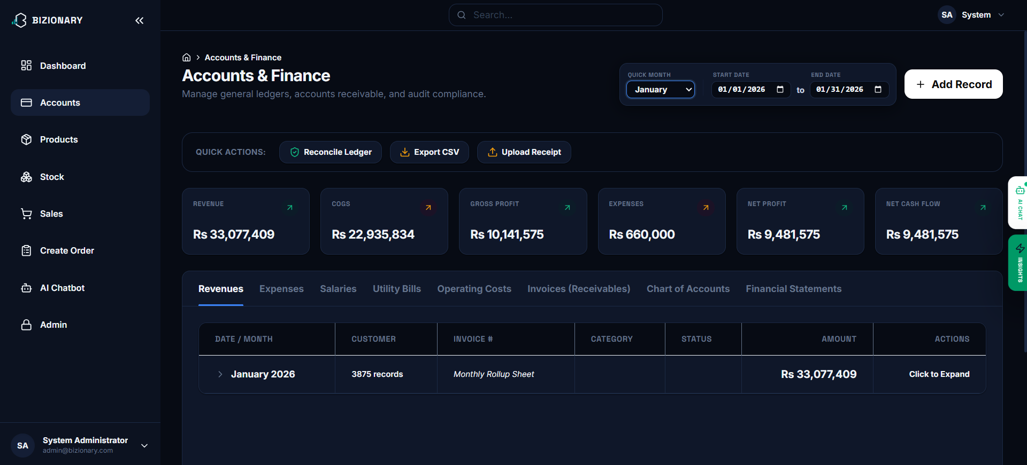
BIZIONARY ERP SYSTEM
Accounts & Financial Ledger Module
Ledger Rollup & Reconciliation
• Interface: Monthly financial aggregates (Profit, Cost, Cash) with general journal transaction entries.
• Link: Queries `/api/accounts/ledger-summary/`. Reconcile button calls backend `/api/accounts/reconcile/` checking debits/credits balance.
• Outcome: Auto-balancing transaction ledger checks and click-to-verify audits.

Slide 9
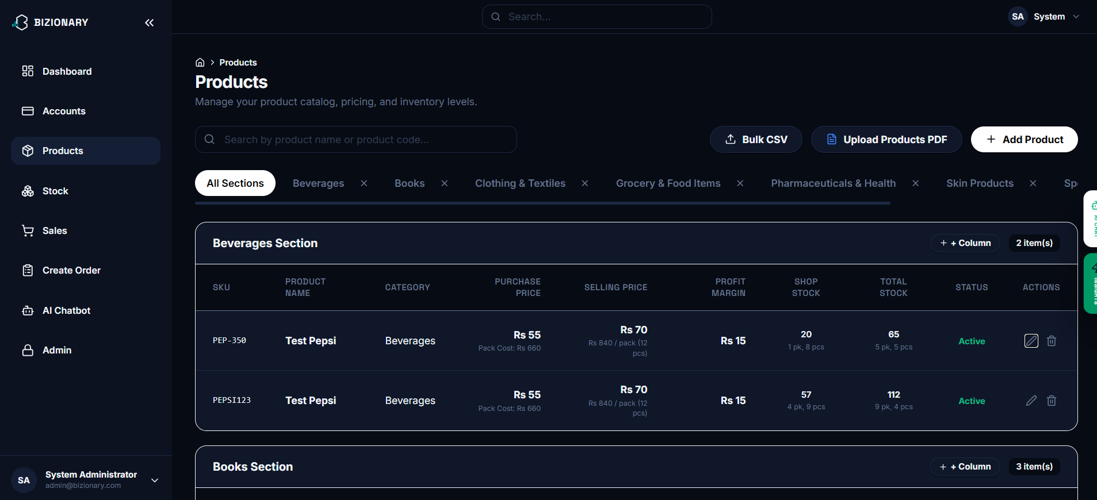
BIZIONARY ERP SYSTEM
Product Catalog & Custom Sections
Metadata Columns & Inventory Sync
• Interface: Product catalog grid showing SKU, purchase/selling price, margins, shop/warehouse stock, and edit tools.
• Link: React tables render records. Dynamic columns calls `/api/products/custom-columns/` schema modification.
• Outcome: Complete items cataloging and automatic price adjustments across POS terminals.

Slide 10
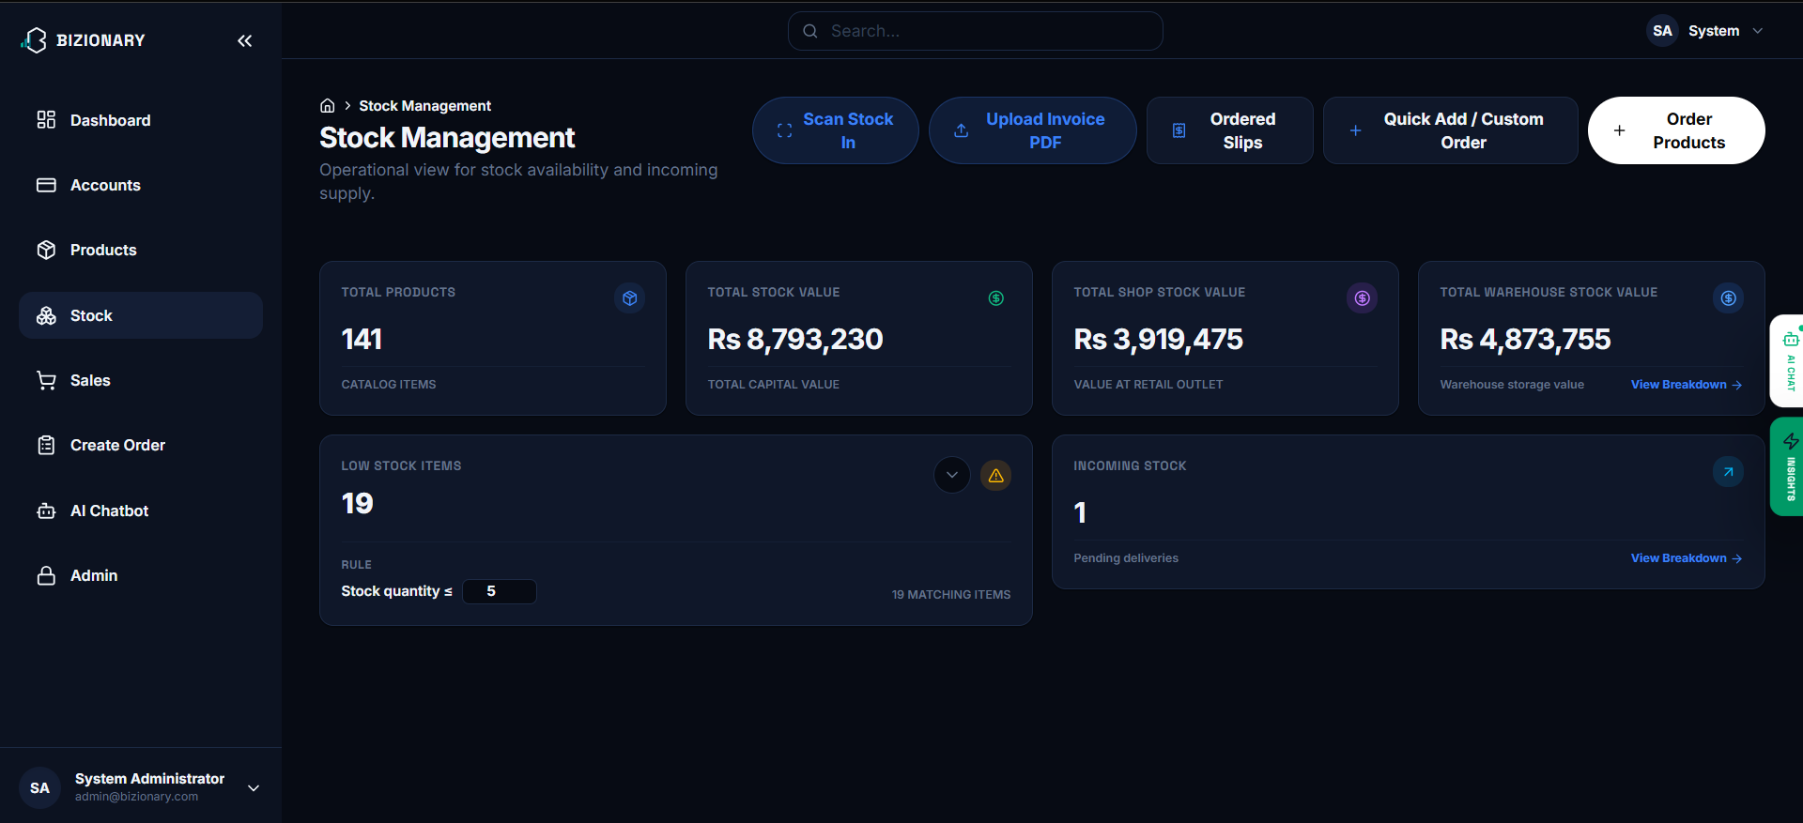
BIZIONARY ERP SYSTEM
Stock Management Control Center
Reorder Threshold Alerts
• Interface: Inventory valuation cards, low stock alerts, incoming items cards.
• Link: Client fetches `/api/stock/status/`. Modifying the warning parameters updates `/api/stock/settings/` immediately.
• Outcome: Eliminates stockouts by raising flags on low stock thresholds.

Slide 11
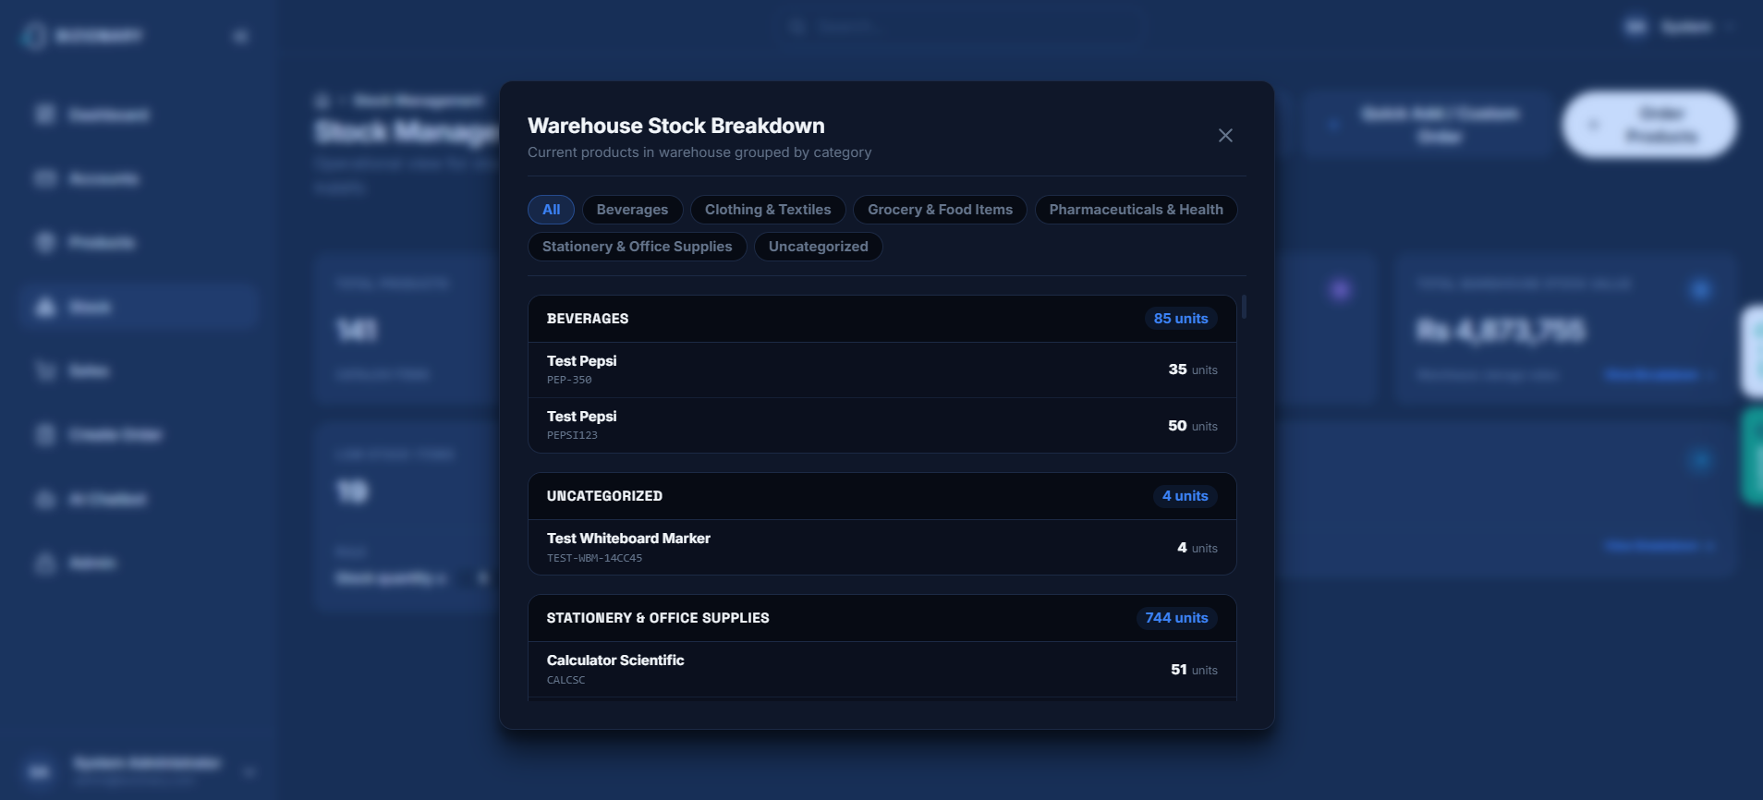
BIZIONARY ERP SYSTEM
Warehouse Stock & Procurement Modals
Granular Location Tracking
• Interface: Modal lists breakdown of items inside the warehouse vs. pending supplier shipments.
• Link: React hooks query `/api/stock/warehouse-breakdown/` and `/api/procurement/pending-breakdown/` endpoints.
• Outcome: Total tracking of item location balances and incoming supplier arrivals.

Slide 12
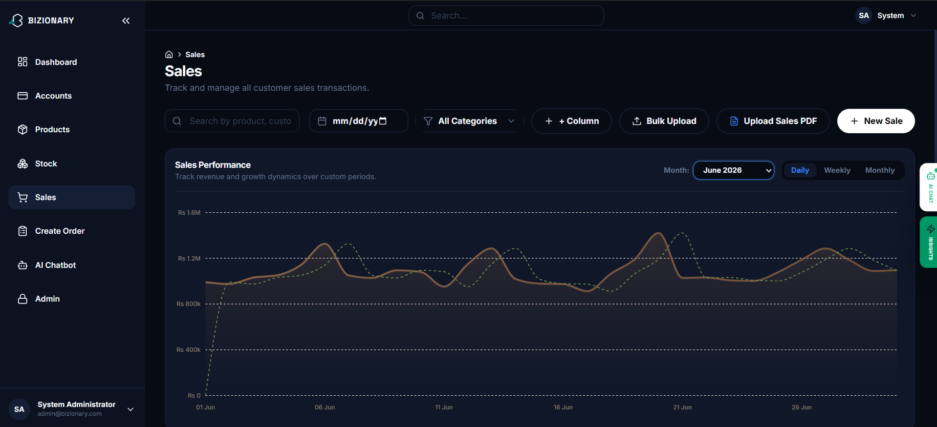
BIZIONARY ERP SYSTEM
Sales Transactions & Ingestion Suite
Transaction Logging & PDF Upload
• Interface: Sales goal analytics gauge, sales table displaying references, dates, costs, customer details.
• Link: Renders paginated listings from `/api/sales/transactions/`. Excel/PDF uploads call bulk import services.
• Outcome: Immutable audit trails and immediate ledger synchronization upon upload.

Slide 13
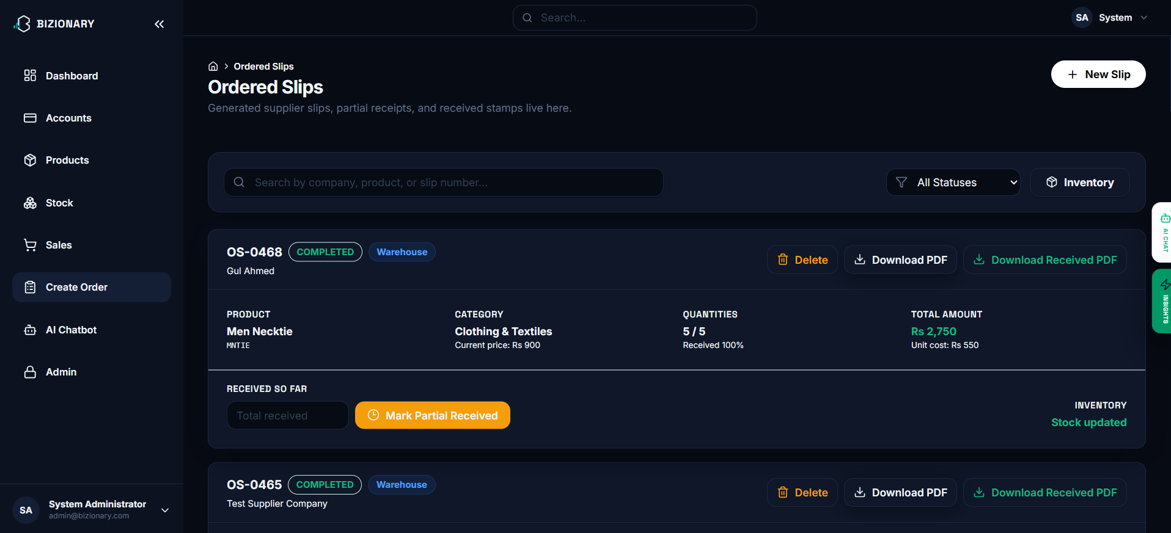
BIZIONARY ERP SYSTEM
Supplier Ordered Slips Management
Procurement Order Cycles
• Interface: Supplier slips table tracking ordered/received ratios, costs, totals, and pending status.
• Link: Exposes `/api/procurement/slips/`. 'Mark Partial' endpoint registers incoming units to inventory.
• Outcome: Seamless tracking of vendor shipments and click-to-print procurement slips.

Slide 14
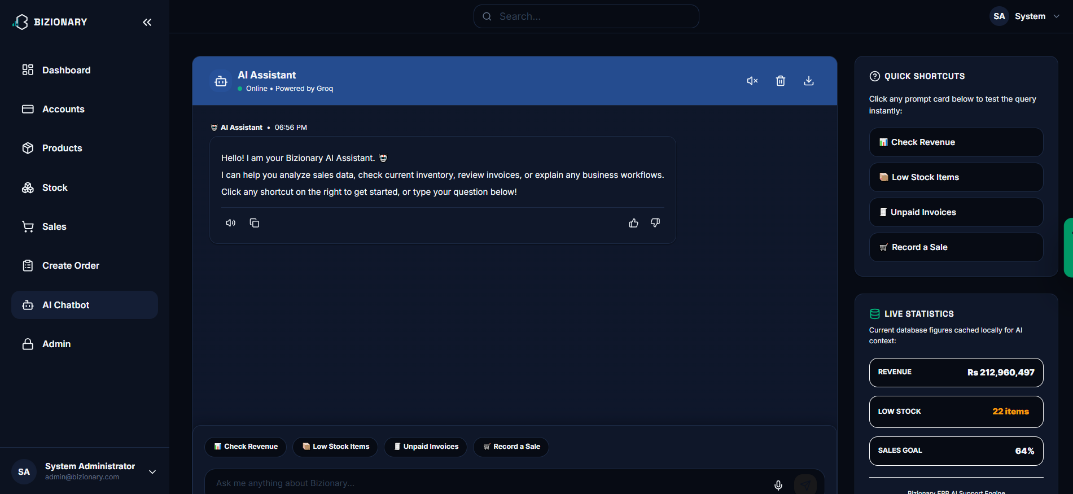
BIZIONARY ERP SYSTEM
AI Chatbot Assistant Interface
Agentic Chatbot
• Interface: Conversational panel answering database queries (e.g. low stock, sales totals) and outputting graphs.
• Link: Groq API `/api/chatbot/query/` using RAG. Chatbot maps queries to local python tool calling functions.
• Outcome: Rapid analytics reporting and quick stats lookup without manual search.

Slide 15
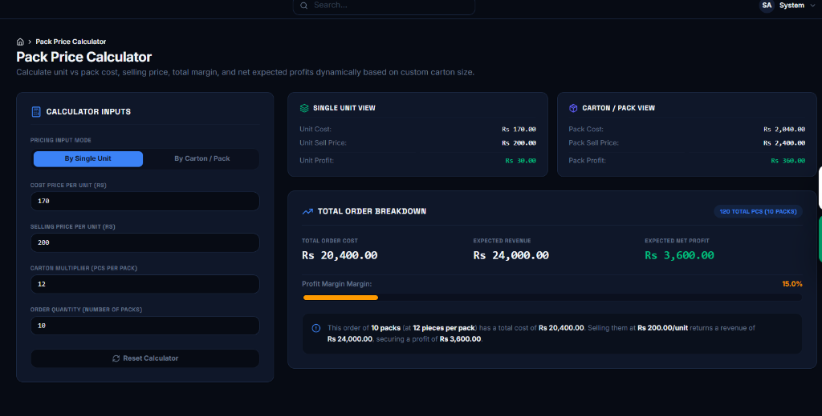
BIZIONARY ERP SYSTEM
Pack & Carton Price Calculator
Pack Dynamics Calculator
• Interface: Interactive calculations panel with input selectors (Single Unit vs Carton Mode) and dynamically updated profit margin indicators.
• Link: Real-time React calculation inputs updating unit margin ratios based on custom carton size parameters.
• Outcome: Minimizes arithmetic estimation errors, helping shopkeepers evaluate expected profits immediately.

Slide 16
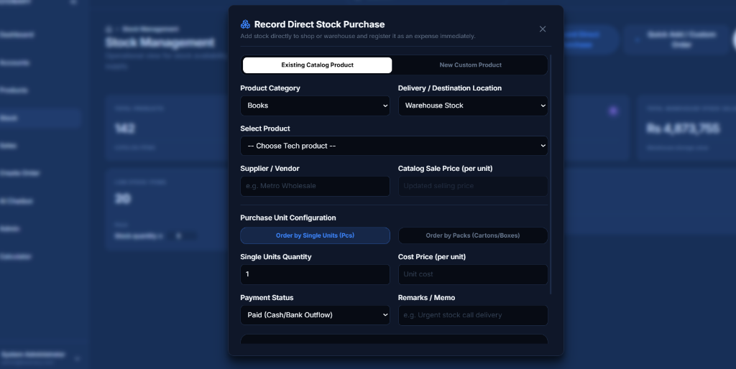
BIZIONARY ERP SYSTEM
Direct Stock Purchase (Latest Modification)
Direct Inflow Ledger Entries
• Interface: Overlay modal panel for recording direct purchases, selecting product catalogues, and configuring pack sizes.
• Link: Submits records to Purchases API and triggers database signals routing stock quantities to Shop or Warehouse.
• Outcome: Instant ledger records and COGS updates for products purchased directly from suppliers.

Slide 17
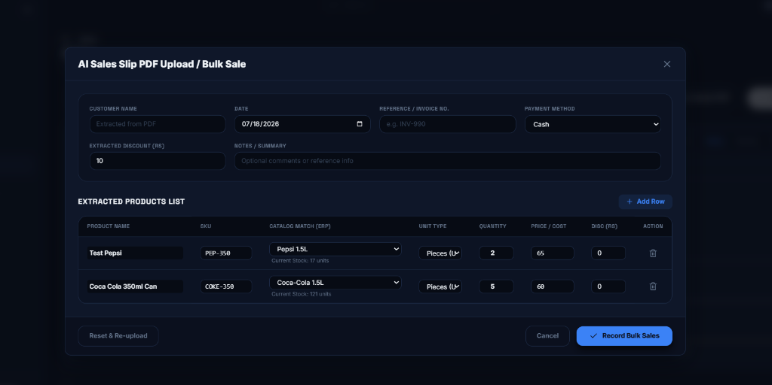
BIZIONARY ERP SYSTEM
AI Sales Slip PDF Upload / Bulk Sale
AI-Driven Parser Modal
• Interface: Drag-and-drop file upload dialog and dynamic extracted products table (matching parsed names with existing items).
• Link: React extracts PDF texts and posts metadata to `/api/sales/bulk-upload/` resolving matches using OpenAI GPT models.
• Outcome: Automatically processes bulk invoice items, logs general journals, and increments catalog stock.

Slide 18
BIZIONARY ERP SYSTEM
Standalone Desktop Executable (.exe)
Vite React Compilation
Django Ledger Migration
PyInstaller Executable
Step 1: Frontend Build: • Cleans former build outputs. • Bundles static HTML, CSS, and JS components using Vite compiler. • Optimizes asset trees to generate single-page static distribution directories.
Step 2: Database Preparation: • Runs Django model checkups and applies migrations to build a blank SQLite database schema. • Collects static bundles using python command-line scripts.
Step 3: Packaged Binary: • Invokes PyInstaller compiler wrapping `run_server.py` and embedding Python DLLs and sqlite schemas. • Generates a standalone double-clickable `BizionaryERP_Windows.zip` archive containing the local runner.

Slide 19
BIZIONARY ERP SYSTEM
Data Portability & Porting
Self-Contained SQLite Backups
Procedure for Updating System
• Database Portability: All records (products, transactions, cash flows, user credentials) are saved in a single, robust file named `db.sqlite3`.
• Physical Isolation: The database resides inside the `_internal` subdirectory of the compiled standalone package.
• Simple Copy-Paste Backup: Users can back up their entire store database by making a duplicate copy of `db.sqlite3`.
• 1. Copy Old DB: Go to the old folder and copy `BizionaryERP/_internal/db.sqlite3`.
• 2. Extract New Version: Extract the updated compiled zip package.
• 3. Replace Template: Paste the copied `db.sqlite3` file into the new `_internal` directory, replacing the blank database.
• 4. Run Launcher: Double-click the launch script; all historical records will load immediately.

Slide 20
BIZIONARY ERP SYSTEM
Future Enhancements
Scalability & Product Roadmap
• Multi-Tenant SaaS Support: Transition the current single-enterprise design to support multi-tenant user bases, permitting multiple businesses to register and manage their operations independently.
• Hardware Integration: Build direct interfaces for POS peripheral devices, including barcode scanners, receipt thermal printers, and electronic cash drawers.
• Automated Notifications Pipeline: Connect SMS (Twilio) and Email (SendGrid) triggers to dynamically alert suppliers on low stock, send invoice reminders to customers, and email managers financial summaries.
• Extended AI Capabilities: Build deep learning models for advanced predictive demand forecasting based on external seasonal events, market trends, and historic data.

Slide 21
THANK YOU!
Questions & Answers Session

