Slide 1
BIZIONARY ERP SYSTEM
A Secure, Agentic AI-Enabled Enterprise Resource Planning Platform for SMEs
Corporate Ledgers
AI-Driven Insights
Dynamic Ingest
• Consolidated relational schema
• Strict double-entry journal logs
• Signal-driven inventory ledgers
• Groq Llama 3.3 chatbot RAG
• NLP pricing recommendations
• Stock velocity demand forecasts
• Drag & Drop sales PDF uploader
• Robust monthly Excel parser
• Zero-downtime key administration

Slide 2
BIZIONARY ERP SYSTEM
The Problem vs. The Bizionary Solution
SME Operational Bottlenecks
The Integrated Solution
• Fragmented Tools: Relying on paper billing, disconnected PDFs, and offline spreadsheets leads to massive inventory and ledger errors.
• No Transactional Audits: Manual database overrides occur without log checks, causing trace errors or unauthorized stock edits.
• Delayed Business Intelligence: Managers must compile logs manually at month-end to understand cash flows or revenue margins.
• Manual Restock Checks: Physical inventory checks lead to unexpected stockouts or expensive cash-blocking overstocks.
• Centralized ERP Architecture: Relational database linking Sales, Purchases, Ledgers, Invoices, and Inventory in one schema.
• Automated Signals Ledger: Post-save hooks run debits/credits and update inventory counts automatically upon saving transactions.
• Sub-Second Conversational BI: Manager-level chatbot translating natural language queries to fetch real-time reports.
• Automated Ingestion Pipeline: Parse dynamic monthly sales worksheets and drag-and-drop PDF invoices to update system counts.

Slide 3
BIZIONARY ERP SYSTEM
Enterprise Technology Stack
React Client
Django Server
Cognitive AI
Data & Ingestion
Infrastructure
FRONTEND SPA • React 19.2 (Vite) • Tailwind CSS v4 • Lucide Icons • Recharts graphs • jsPDF generator
APPLICATION CORE • Django 4.2.7 Core • REST Framework • JWT Stateless Auth • post_save Signals • CORS Middleware
INTELLIGENT LAYER • Groq SDK • Llama 3.3 Engine • Function Calling • OpenAI API GPT • Sentiment Analysis • Predictive Insights
ANALYSIS & STORAGE • SQLite 3 (Dev) • PostgreSQL (Prod) • Pandas parser • openpyxl Engine • DB In-memory cache
DEPLOYMENT • Vercel Edge CDN • Railway API host • Docker runtimes • Git CI/CD flows • local Windows build

Slide 4
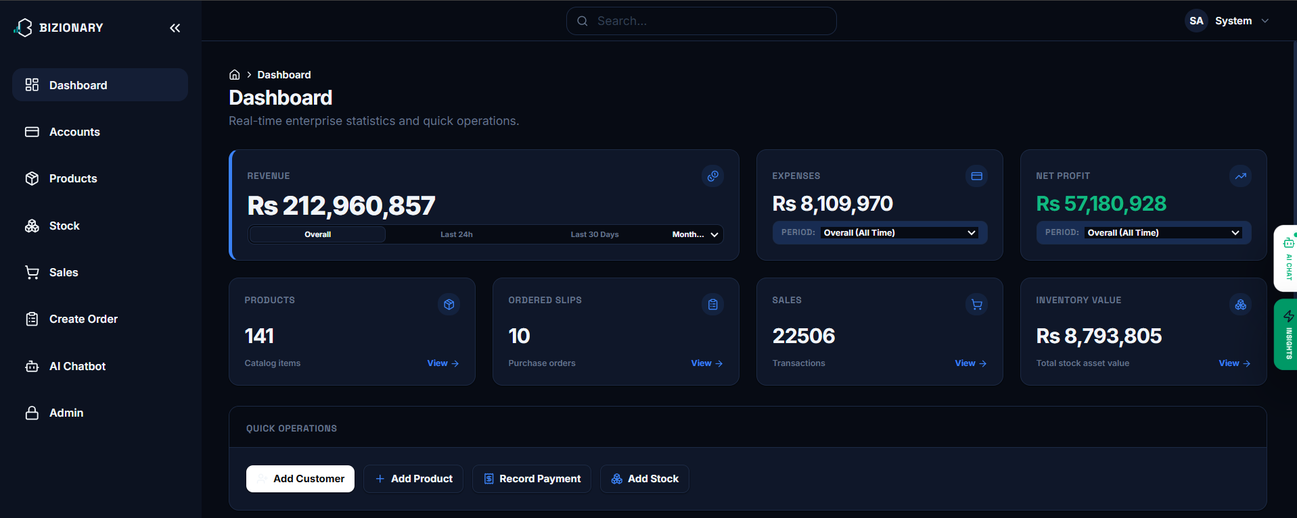
BIZIONARY ERP SYSTEM
Executive Dashboard Overview
Metrics & Workflows
• How it works: Displays real-time executive indicators (revenue, expense, profit), active items count, pending procurement count, sales volume, and inventory valuations.
• Backend/Frontend Attachment: React triggers Axios queries to `/api/dashboard/summary/`. Django aggregates records using ORM (`Sum`, `Count`) and caches variables in memory.
• Outcomes: Immediate overview of company solvency, financial position, and quick navigation routes (add sales, adjust stocks, create products).

Slide 5
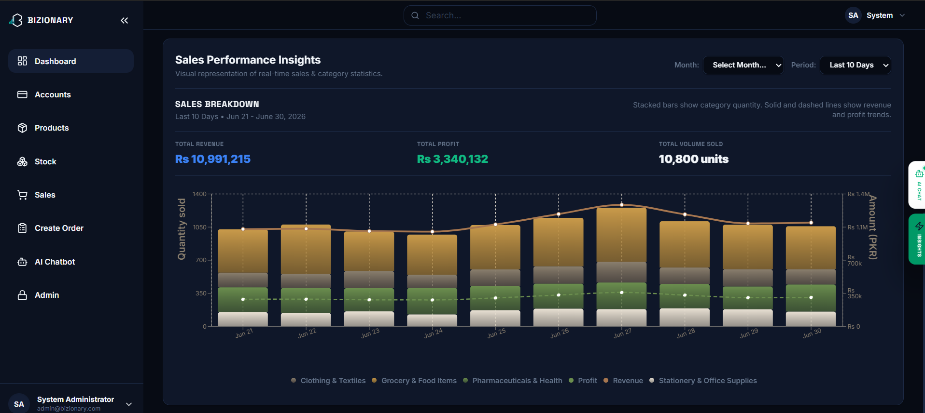
BIZIONARY ERP SYSTEM
Sales Performance Insights Dashboard
Interactive Sales Charts
• How it works: Features a dual-axis analytical layout displaying quantities sold by stacked category bars and revenue trends by solid lines.
• Backend/Frontend Attachment: Powered by Recharts on the client which queries `/api/dashboard/insights/?period=10`. Backend executes database aggregates grouping transactions by category and date.
• Outcomes: Helps managers visual sales demand trends, monitor category velocities, and track profit projections over custom periods.

Slide 6
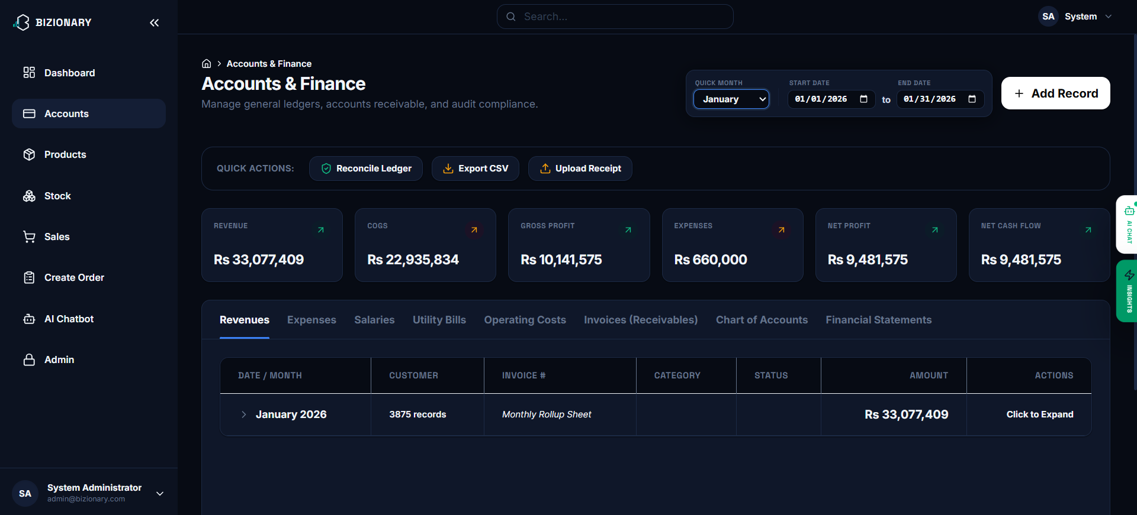
BIZIONARY ERP SYSTEM
Accounts & Financial Ledger Module
Double-Entry Financial Auditing
• How it works: Organizes financial accounts (Revenues, Expenses, Receivables, Utility Bills) in tabbed lists, displaying gross balances and expandable general journal transactions.
• Backend/Frontend Attachment: Queries `/api/accounts/ledger-summary/`. The 'Reconcile Ledger' button triggers backend `/api/accounts/reconcile/` which verifies that the sum of debits equals the sum of credits.
• Outcomes: Mathematically balanced company registers, automated transaction ledger trail, and click-to-verify double-entry compliance.

Slide 7
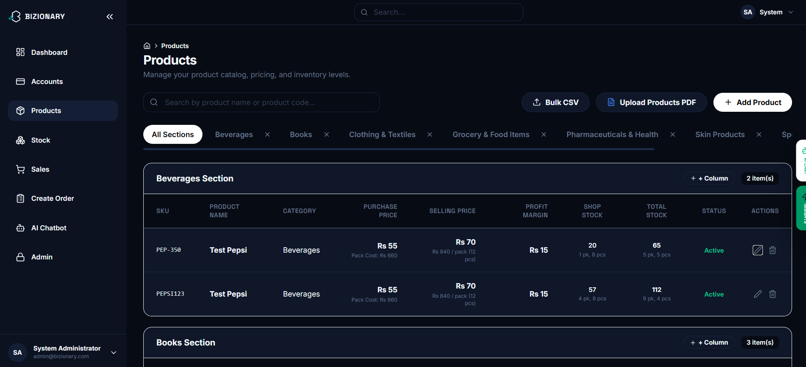
BIZIONARY ERP SYSTEM
Product Catalog & Custom Sections
Metadata Columns & Inventory Sync
• How it works: Renders dynamic product tables grouped by category sections (Beverages, Stationery, Books). Displays SKU, cost, selling price, margin, and stock levels.
• Backend/Frontend Attachment: React constructs category filters locally. The `+ Column` tool calls `/api/products/custom-columns/` to alter metadata schemas dynamically without database downtime.
• Outcomes: Complete catalog management, automatic updates of cost/sale margins, and instant price syncing across POS checkouts and invoice registers.

Slide 8
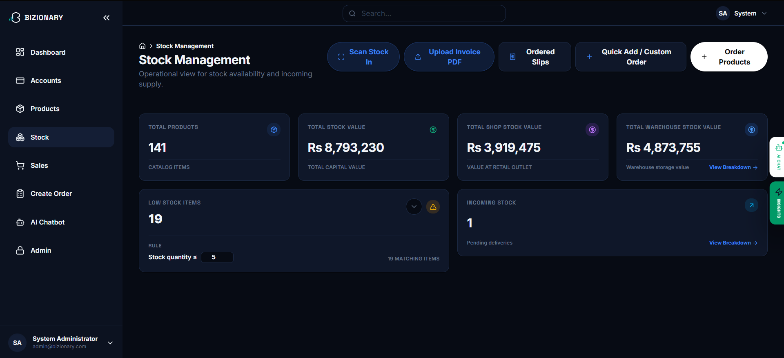
BIZIONARY ERP SYSTEM
Stock Management Control Center
Reorder Threshold Alerts
• How it works: Displays total stock values, shop inventory valuations, warehouse counts, low stock lists, and active incoming orders.
• Backend/Frontend Attachment: Fetches data from `/api/stock/status/`. Editing the low stock threshold updates the backend rule `/api/stock/settings/` immediately.
• Outcomes: Prevents stockouts by flagging low stock items dynamically, updates inventory value, and tracks incoming warehouse logs.

Slide 9
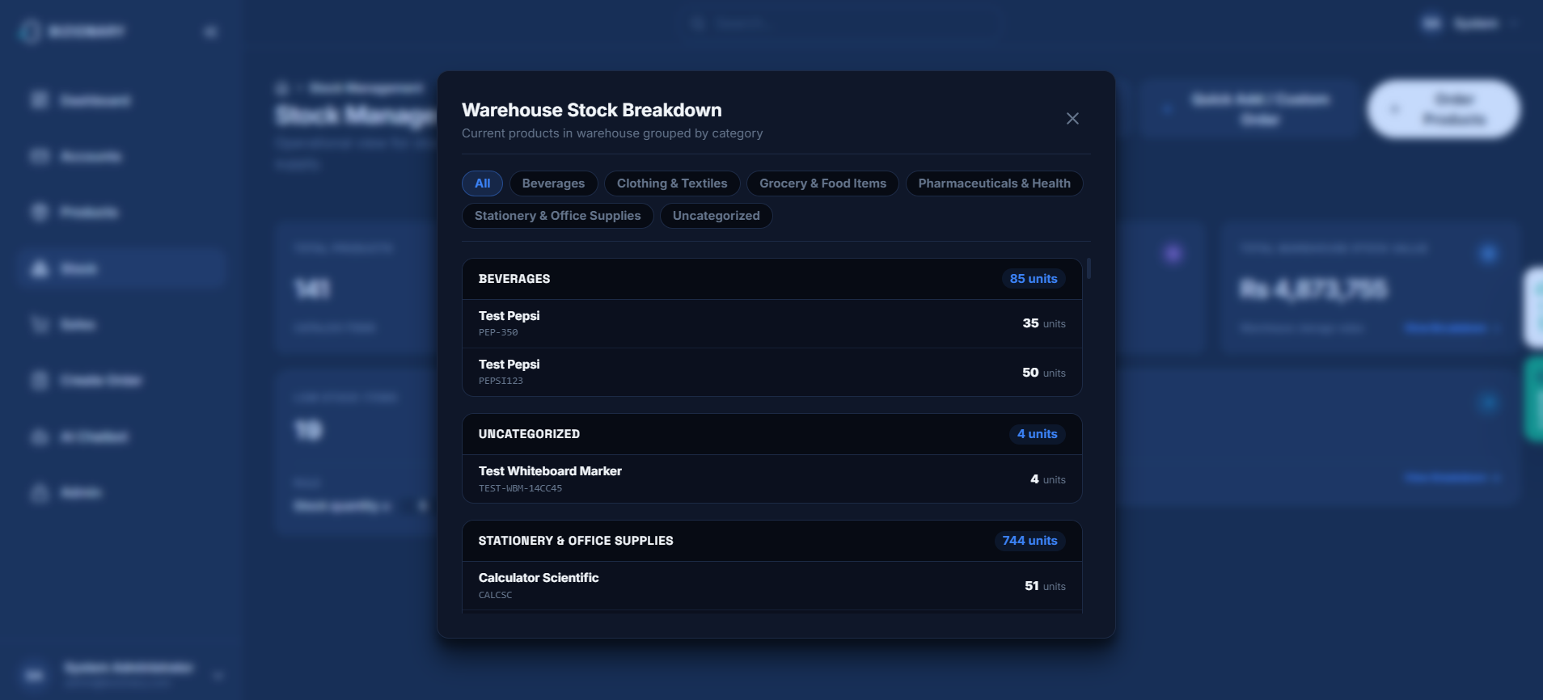
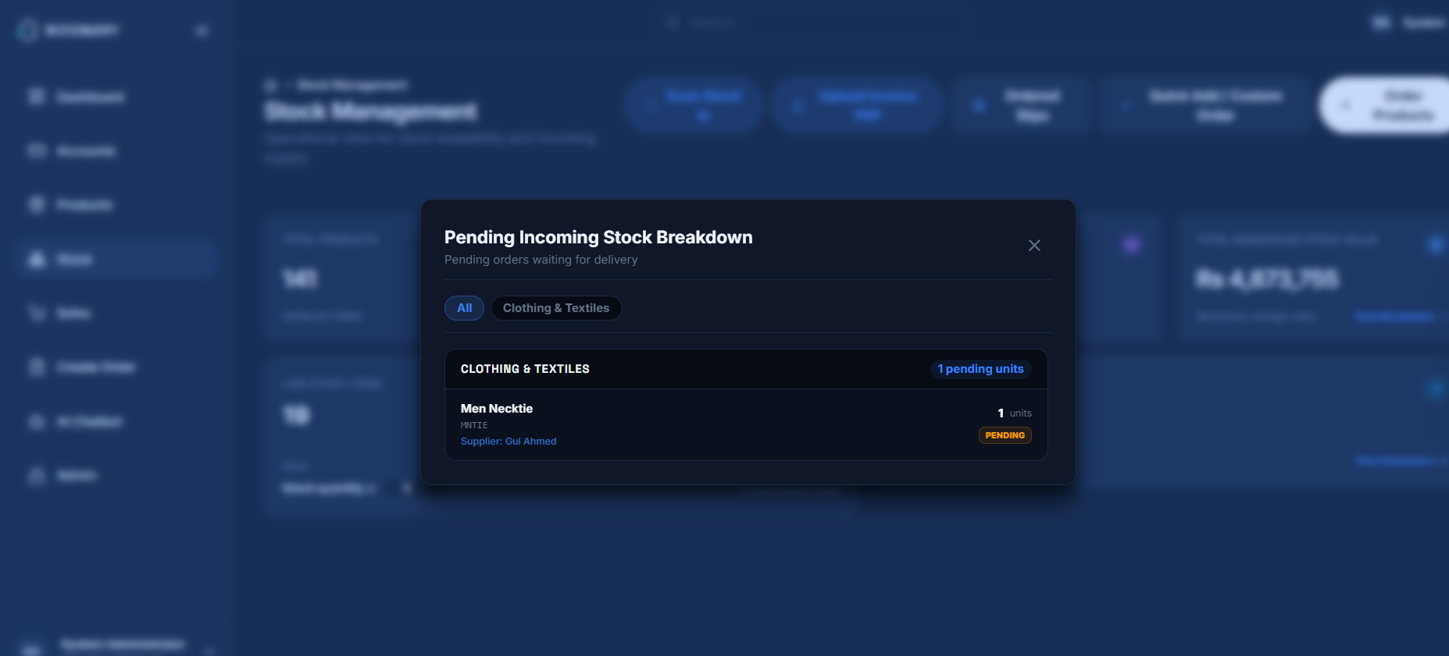
BIZIONARY ERP SYSTEM
Warehouse Stock & Procurement Modals
Granular Stock Tracking
• How it works: Details modal windows overlaying the stock dashboard to show product lists filtered by category (Warehouse breakdown) and pending supplier shipments (Incoming breakdown).
• Backend/Frontend Attachment: React hooks query `/api/stock/warehouse-breakdown/` and `/api/procurement/pending-breakdown/` views.
• Outcomes: Complete routing traceability of product locations, precise pending delivery schedules, and zero-error stock counts.

Slide 10
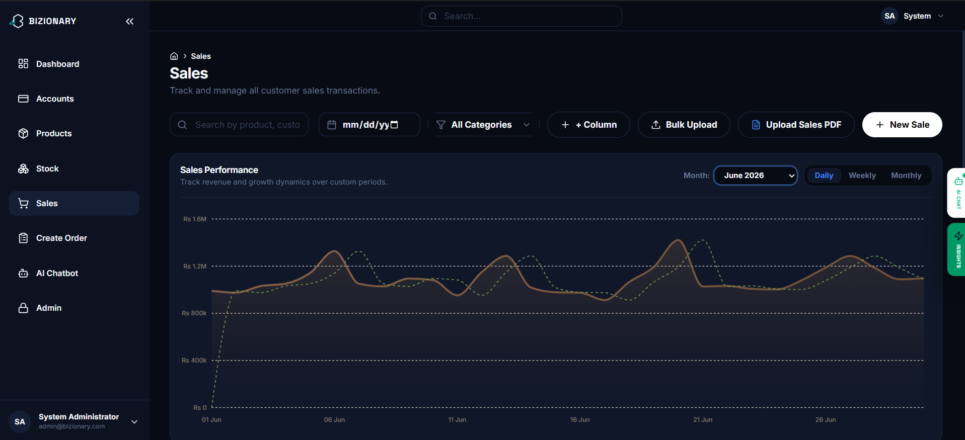
BIZIONARY ERP SYSTEM
Sales Transactions & Ingestion Suite
Transaction Logging & PDF Upload
• How it works: Visualizes daily sales volumes against target benchmarks and lists detailed searchable logs of customer invoice references, product codes, margins, and payment methods.
• Backend/Frontend Attachment: Renders paginated listings from `/api/sales/transactions/`. Dragging/uploading sales billing records calls the parser REST API backend.
• Outcomes: Searchable logs, historical audit trails, and dynamic data ingestion to update charts and general ledgers automatically.

Slide 11
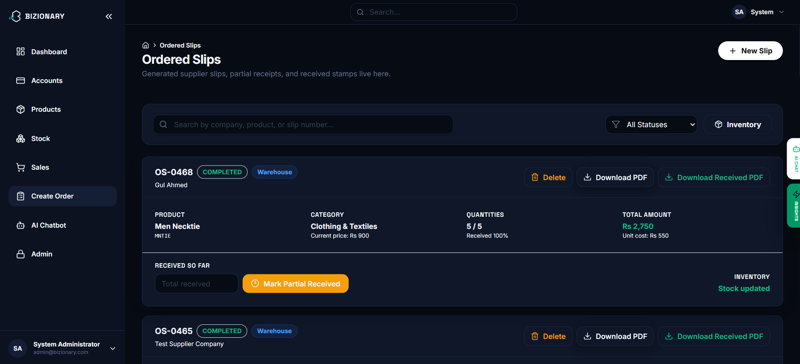
BIZIONARY ERP SYSTEM
Supplier Ordered Slips Management
Procurement Order Cycles
• How it works: Manages supplier order slips, displaying items, ordered/received ratios, costs, and statuses (Pending, Completed, or Partial).
• Backend/Frontend Attachment: Frontend calls `/api/procurement/slips/` viewset. Clicking 'Mark Partial' sends a update request to adjust pending quantity balances.
• Outcomes: Enables managers to audit procurement deliveries, download generated slip PDFs, and verify received stock before adding it to active inventory.

Slide 12
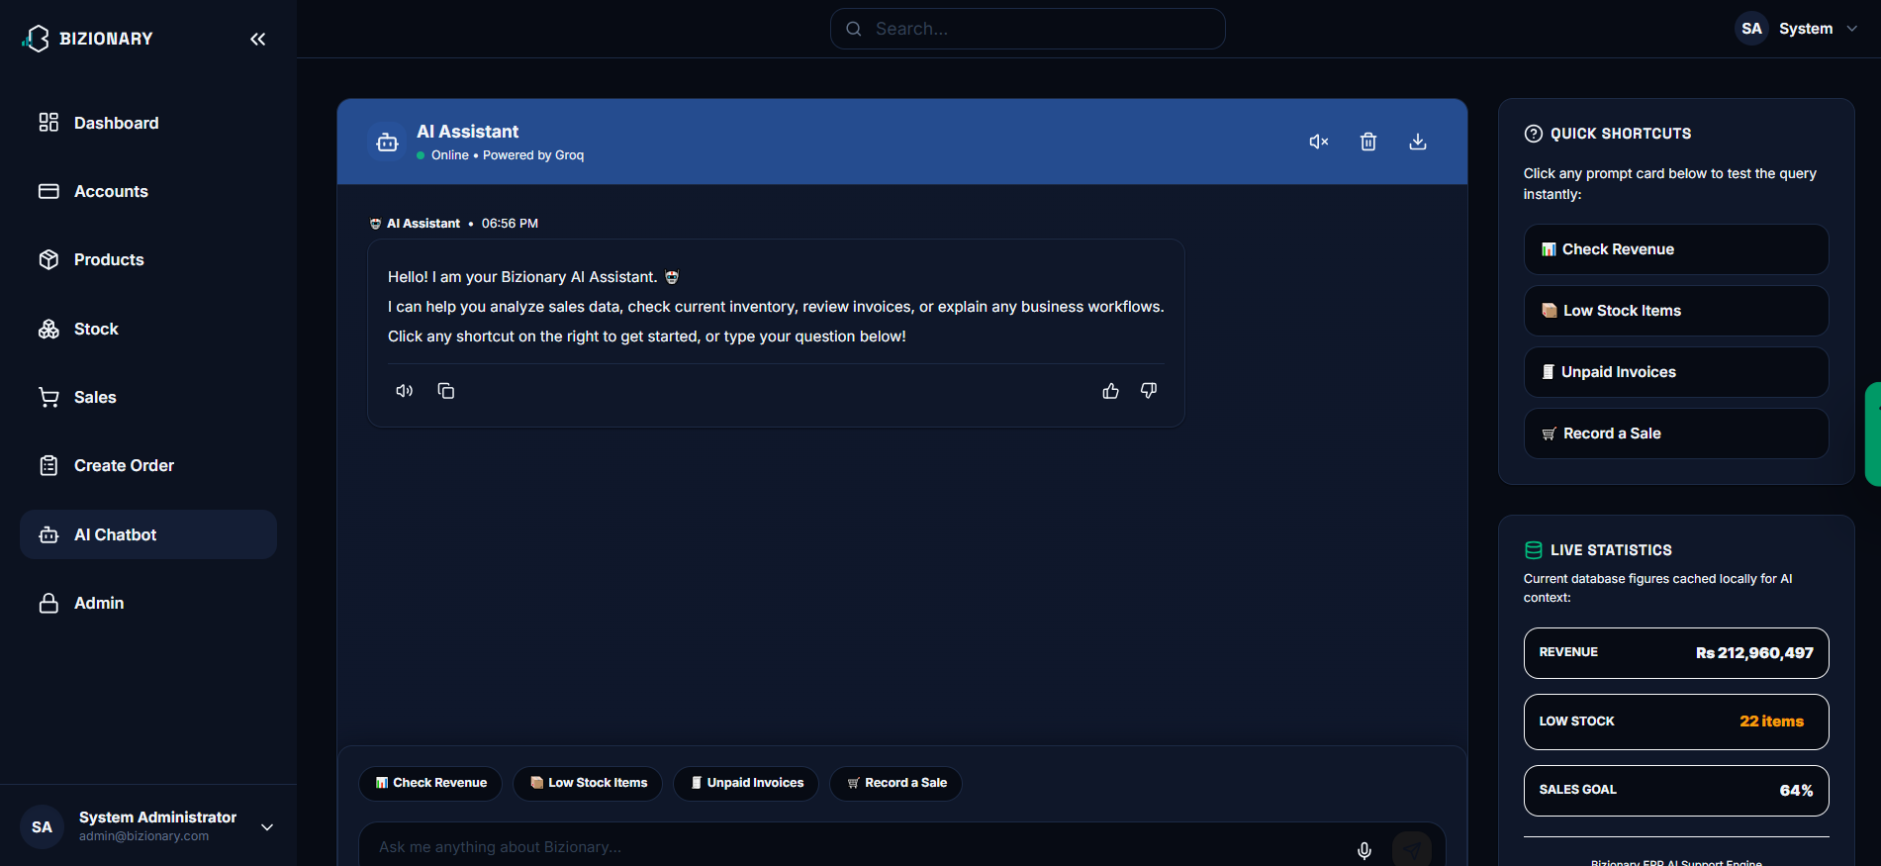
BIZIONARY ERP SYSTEM
AI Chatbot Assistant Interface
Agentic Function Calling Chatbot
• How it works: A natural language assistant that answers questions about database records (e.g. sales trends, unpaid invoices, low stock items) and builds visual graphs directly in chat.
• Backend/Frontend Attachment: Integrates the Groq API via `/api/chatbot/query/` using RAG. The system exposes tool specifications allowing Llama 3.3 to execute functions locally to query real data.
• Outcomes: Instant operational reporting, conversational graphs, and accessible KPI indicators without manually navigating panels.

Slide 13
BIZIONARY ERP SYSTEM
Latest Modification: Direct Stock Purchase
Operational Direct Stock Input Modal
Dynamic Backend Integration & Outcomes
• Record Stock Instantly: Allows immediate receipt logging when shopkeepers buy stock directly (e.g., calling suppliers rather than ordering through slips).
• Two Operational Modes: Supports select from 'Existing Catalog Product' or register 'New Custom Product' directly.
• Pack and Cartons Sizing: Dynamically configures 'Pieces Per Pack' to calculate cost per single unit and update inventory counts.
• Dynamic Catalog Synchronization: If cost, selling price, or pack sizing are altered on saving, the product catalog entry is automatically updated.
• Double-Entry LEDGER Postings: Atomically credits cash/payable accounts and debits COGS (5010) or Inventory assets upon purchase creation.
• Location-Based Routing Signals: Django post-save signals check `delivery_location` to route incoming stock directly to Warehouse or Shop Outlet.
• Multi-Choice Search Fallback: If shopkeepers type partial SKU or ID terms (like searching '123' matching 'PEP-BUG-123'), a modal displays matching choices to prevent duplicate entries.

Slide 14
BIZIONARY ERP SYSTEM
Latest Modification: AI PDF Invoice Upload
AI-Driven Document Extraction
Database Automation & Outcomes
• Optical Character Recognition (OCR): Parses uploaded PDF invoice documents directly on the client side.
• AI Semantic Mapper: Django REST API receives raw text extraction and prompts OpenAI GPT models to map fields (Item Name, SKU, quantities, cost).
• Error Tolerant Parsing: Case-insensitive fuzzy matching reconciles scanned names with existing catalog items.
• Automatic Stock Entry: Confirms and pushes scanned items directly to inventory (warehouse/shop) using bulk-created ledger signals.
• Journal Expense Recognition: Automatically posts the PDF invoice totals as expenses in the Chart of Accounts.
• Operational Value: Reduces manual data entry time from 15 minutes per invoice to a single click, eliminating typist errors.

Slide 15
BIZIONARY ERP SYSTEM
Data Portability & Porting
Self-Contained SQLite Backups
Procedure for Updating System
• Database Portability: All records (products, transactions, cash flows, user credentials) are saved in a single, robust file named `db.sqlite3`.
• Physical Isolation: The database resides inside the `_internal` subdirectory of the compiled standalone package.
• Simple Copy-Paste Backup: Users can back up their entire store database by making a duplicate copy of `db.sqlite3`.
• 1. Copy Old DB: Go to the old folder and copy `BizionaryERP/_internal/db.sqlite3`.
• 2. Extract New Version: Extract the updated compiled zip package.
• 3. Replace Template: Paste the copied `db.sqlite3` file into the new `_internal` directory, replacing the blank database.
• 4. Run Launcher: Double-click the launch script; all historical records will load immediately.

Slide 16
BIZIONARY ERP SYSTEM
Future Enhancements
Scalability & Product Roadmap
• Multi-Tenant SaaS Support: Transition the current single-enterprise design to support multi-tenant user bases, permitting multiple businesses to register and manage their operations independently.
• Hardware Integration: Build direct interfaces for POS peripheral devices, including barcode scanners, receipt thermal printers, and electronic cash drawers.
• Automated Notifications Pipeline: Connect SMS (Twilio) and Email (SendGrid) triggers to dynamically alert suppliers on low stock, send invoice reminders to customers, and email managers financial summaries.
• Extended AI Capabilities: Build deep learning models for advanced predictive demand forecasting based on external seasonal events, market trends, and historic data.

Slide 17
THANK YOU!
Questions & Answers Session

