Slide 1
BIZIONARY ERP SYSTEM
A Secure, Agentic AI-Enabled Enterprise Resource Planning Platform for SMEs
Corporate Ledgers
AI-Driven Insights
Dynamic Ingest
• Relational database schemas.
• Double-entry ledger logs.
• Automatic stock signals.
• Groq Llama 3.3 chatbot.
• NLP pricing recommendations.
• Stock velocity demand forecast.
• Drag & Drop sales PDF upload.
• Monthly Excel parser.
• Zero-downtime key rotation.

Slide 2
BIZIONARY ERP SYSTEM
The Problem vs. The Bizionary Solution
SME Operational Bottlenecks
The Integrated Solution
• Data Silos: Using paper bills and offline sheets causes inventory mismatch.
• No Auditing: Database changes are done without logs, leading to errors.
• No Real-time Profit View: Creating financial statements takes weeks.
• Bad Restock Habits: Checking stock by hand leads to out-of-stock items.
• One Database: Connects Sales, Purchases, Ledgers, and stock in one place.
• Auto Journals: Database signals save debit/credit journals automatically.
• Sub-Second AI Help: Chatbot queries the live DB to show reports.
• Auto-Ingest: Drag-and-drop Excel or PDFs to update inventory quickly.

Slide 3
BIZIONARY ERP SYSTEM
Enterprise Technology Stack
React Client
Django Server
Cognitive AI
Data & Ingestion
Infrastructure
FRONTEND SPA • React 19.2 (Vite) • Tailwind CSS v4 • Lucide Icons • Recharts graphs • jsPDF downloads • HTML Canvas
APPLICATION CORE • Django 4.2.7 Core • REST Framework • JWT Stateless Auth • post_save Signals • CORS Middleware
INTELLIGENT LAYER • Groq SDK • Llama 3.3 Engine • Function Calling • OpenAI API GPT • Sentiment Analysis • Predictive Insights
ANALYSIS & STORAGE • SQLite 3 (Local) • PostgreSQL (Cloud) • Pandas parser • openpyxl Engine • DB Cache manager
DEPLOYMENT • Vercel Edge CDN • Railway API host • Docker runtimes • PyInstaller build • Windows standalone

Slide 4
BIZIONARY ERP SYSTEM
Project Components & Data Flow Diagram
3. Relational DB
1. Frontend (React SPA)
2. Django REST API
• SQLite 3 local storage • PostgreSQL database structure • Double-entry journal tables
Visual Screens: • Executive Dashboard • POS Scan Form & Ingestion • Stock Modals & Calculations Mechanism: • Asynchronous Axios clients • JWT Bearer Auth tokens
Endpoints Viewsets: • `/api/dashboard/summary/` • `/api/sales/transactions/` • `/api/chatbot/query/` Event Triggers: • Django DB Signals (COGS, cash flows, inventory items mapping)
4. AI Layer (Groq & OpenAI)
• Groq Llama 3.3 chatbot agent • Local function calling mapping • OpenAI sentiment and OCR matching

Slide 5
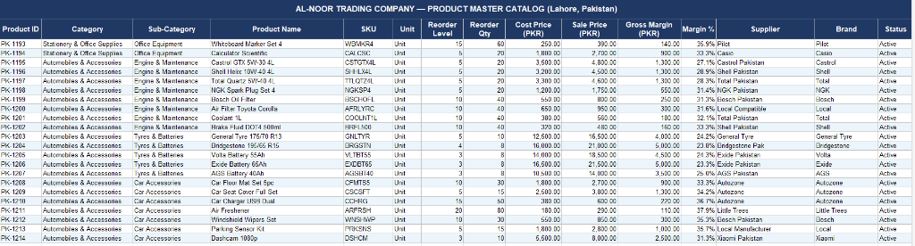
BIZIONARY ERP SYSTEM
Raw Product Master Catalog Data
Product Catalog Excel Sheet
• Store Master Data: Defines Lahore office product keys, categorizations, and brands.
• Key Fields: Includes SKUs, reorder limits, cost values, selling margins, and supplier listings.
• System Mapping: The raw Excel contains structural attributes that are parsed into SQL product objects.
1. Open Excel
2. Map Schema
3. Seed DB

Slide 6
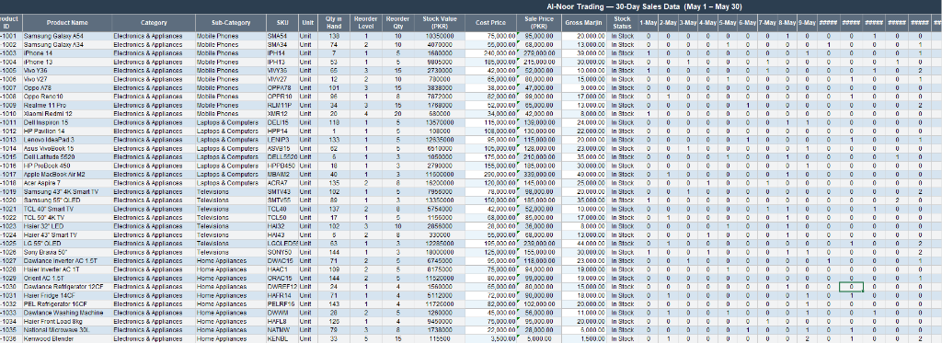
BIZIONARY ERP SYSTEM
Raw 30-Day Monthly Sales Data Sheet
Sales Sheet Columns
• Monthly Logs: Stores transaction rows containing margins, reorder units, and stock statuses.
• Daily Columns: Tracks unit sales quantities sold day-by-day (from 1-May to 30-May).
• Parser Connection: Scans date headers dynamically to index quantities without hardcoded months.
1. Read Columns
2. Parse Quantities
3. Record Sales

Slide 7
BIZIONARY ERP SYSTEM
Master Data & 6-Month Sales Seeding
Step 1: Master Catalog Data
Step 2: Seeding Engine
Step 3: Outcome & Analytics
Initial Data Setup: • Exposes real catalogs of items, standard purchase costs, supplier profiles, and categories. • Registers items like Beverages, Grocery, Pharmaceuticals, and Stationery. • Pre-defines minimum stock thresholds for alert triggers.
Seeding Logic: • Executes script `seed_historical_sales.py` to generate sample logs. • Seeds data across multiple calendar months (e.g. January to April 2026). • Simulates random order sizes (1-8 pcs) and standard payment methods.
Outcome Results: • Generates 6 months of sales history representing over 100+ transactions. • Populates dashboard insights with real trending sales velocity curves. • Enables AI analytics to test demand forecasts, profit summaries, and reorder levels.

Slide 8
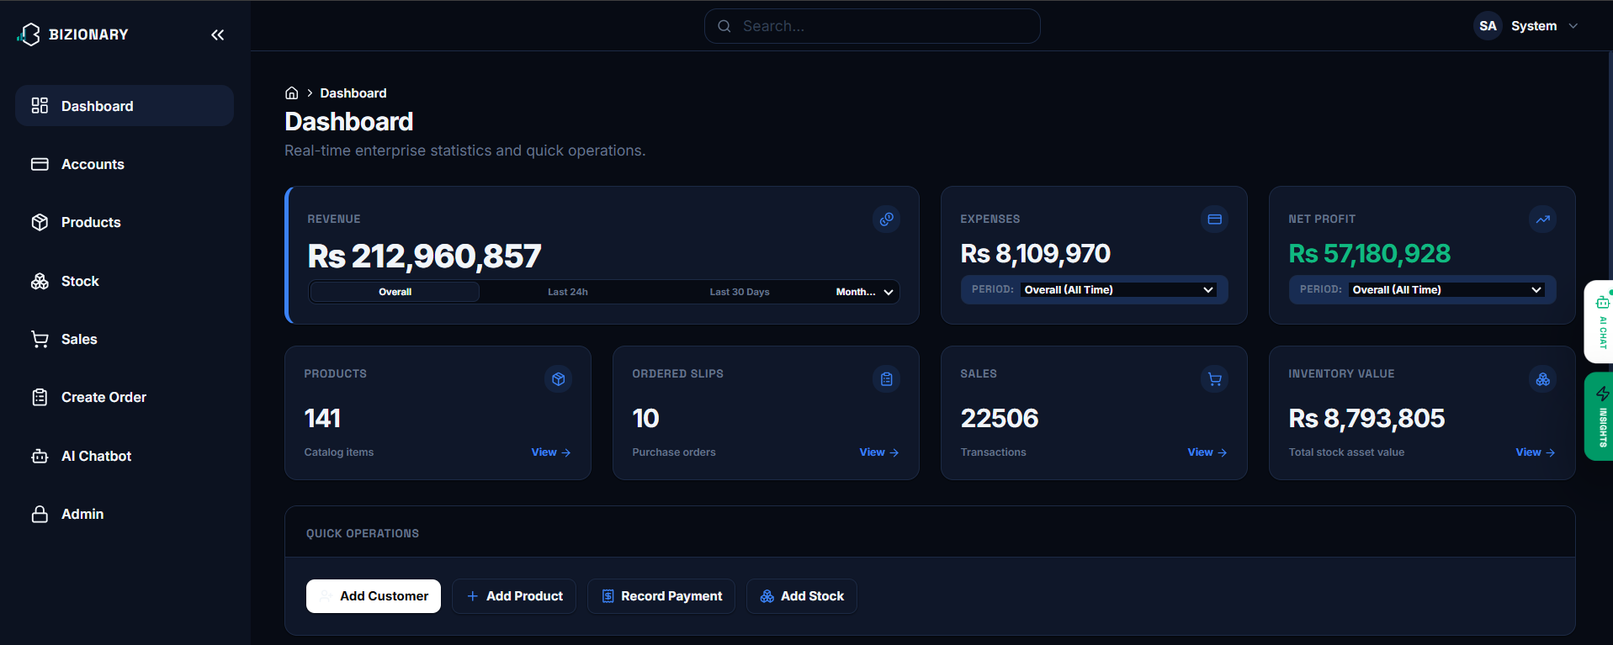
BIZIONARY ERP SYSTEM
Executive Dashboard Overview
Executive Summary stats
• Overview: Displays total sales, expenses, net profits, and inventory value.
• Quick Buttons: Easily add products, register suppliers, or log adjustments.
1. Open Screen
2. Fetch Stats
3. Show Dashboard

Slide 9
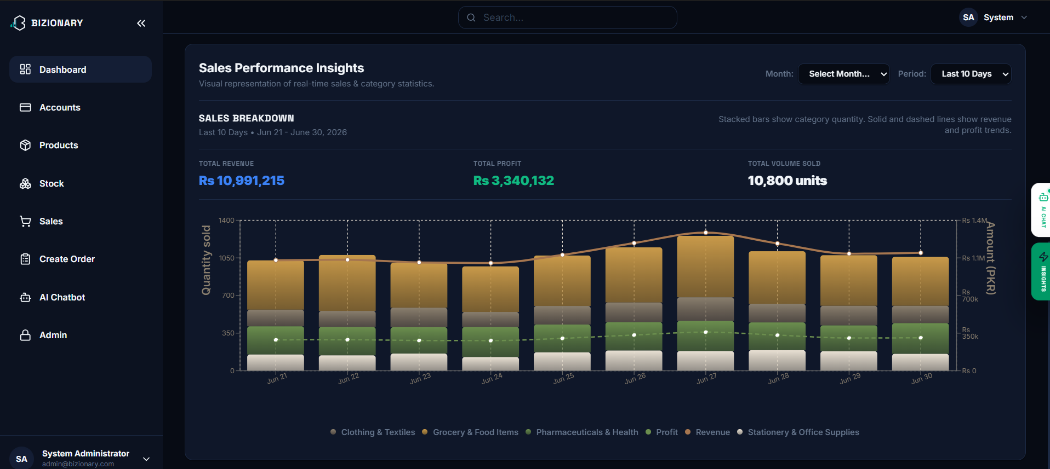
BIZIONARY ERP SYSTEM
Sales Performance Insights Dashboard
Interactive Sales Charts
• Charts: Shows categories sold (stacked bars) and revenue trends (lines).
• Filtering: Toggle days to filter trends instantly.
1. Pick Period
2. Group Dates
3. Recharts Graph

Slide 10
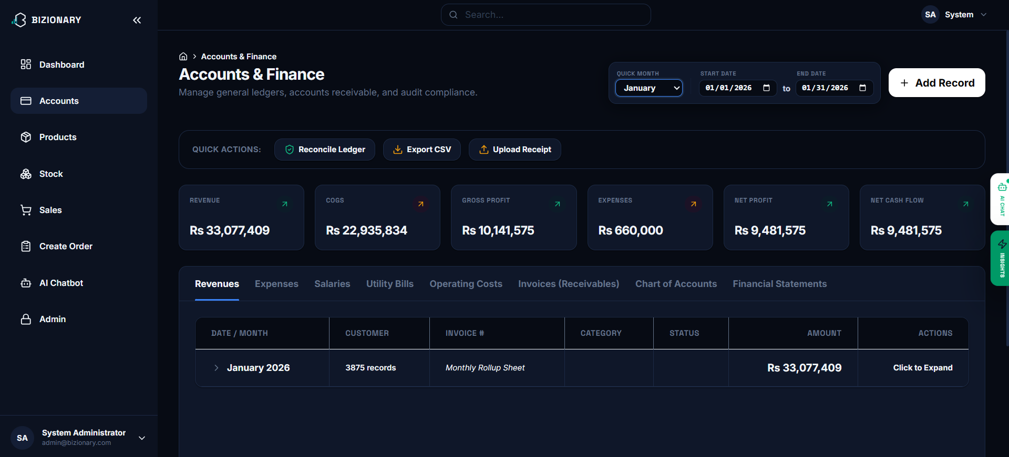
BIZIONARY ERP SYSTEM
Accounts & Financial Ledger Module
Double-Entry Audits
• Financial Tabs: View Revenues, Expenses, Utility Bills, and statement logs.
• Reconciliation: Simple button to verify debits equal credits instantly.
1. Log Action
2. Signals Trigger
3. Ledger Entry

Slide 11
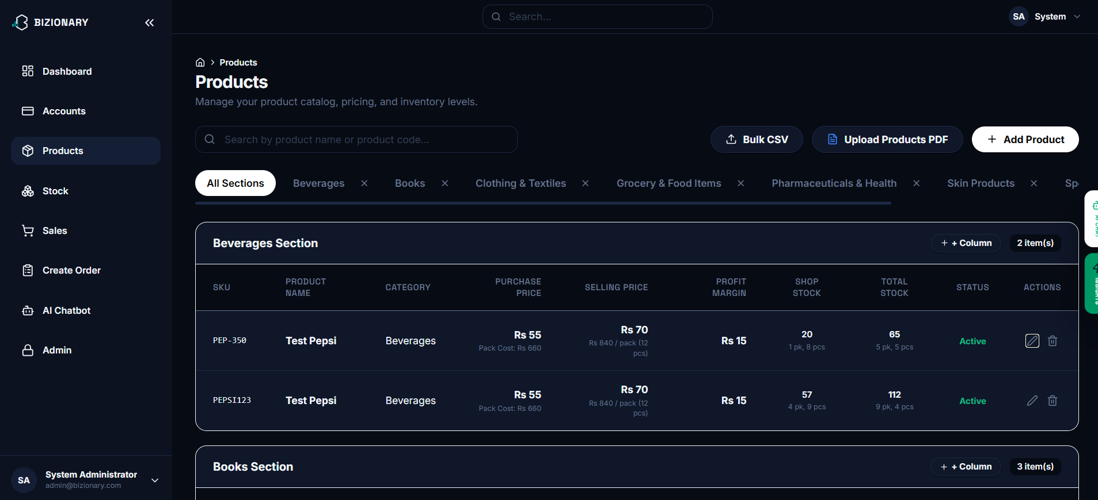
BIZIONARY ERP SYSTEM
Product Catalog & Custom Sections
Inventory Catalog System
• Grid List: Shows catalog product SKUs, prices, margins, and active status.
• Custom Columns: Create extra fields for specific categories dynamically.
1. Add Columns
2. Alter Schema
3. Update Tables

Slide 12
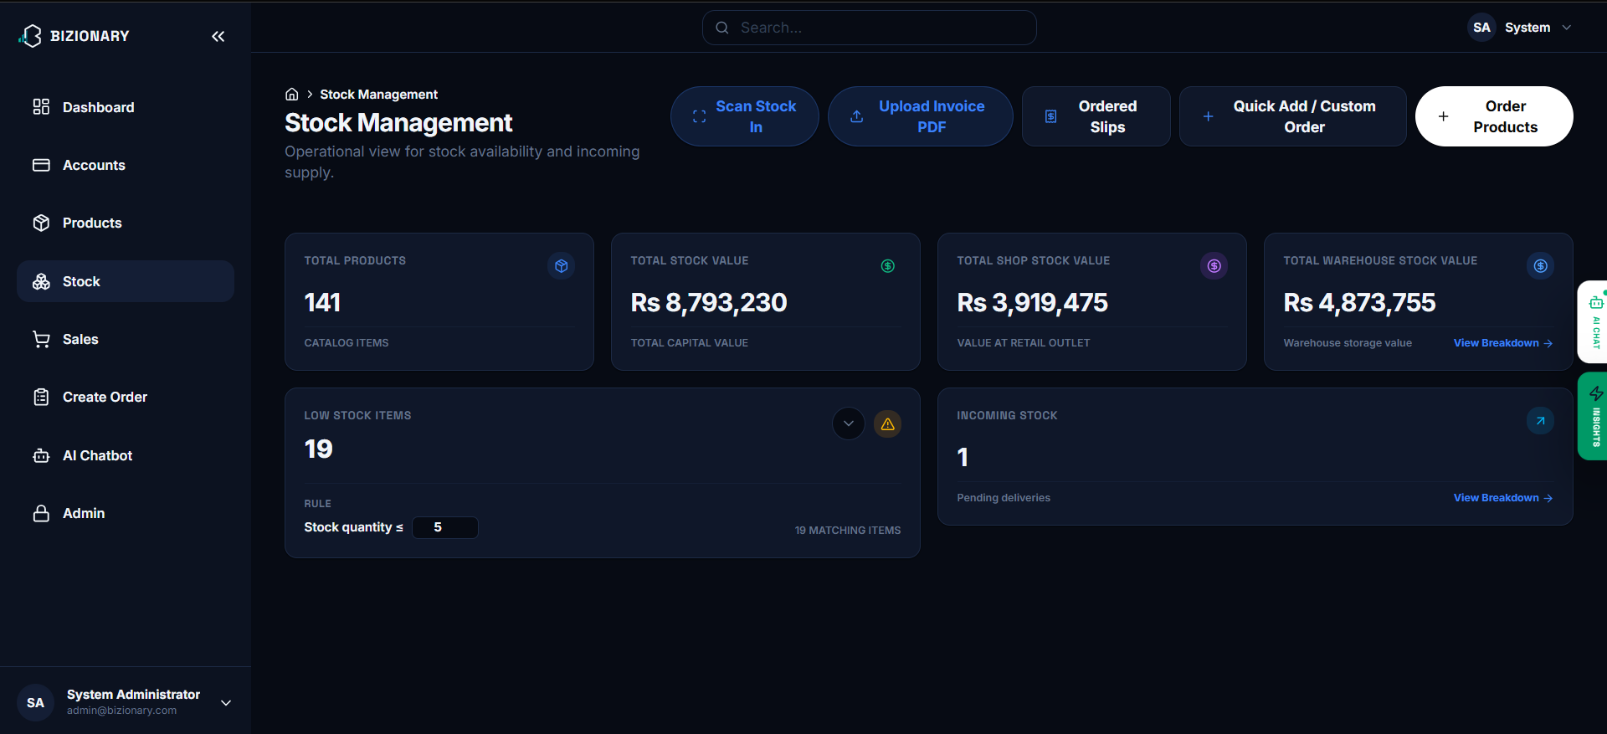
BIZIONARY ERP SYSTEM
Stock Management Control Center
Reorder Alerts System
• Valuations: Tracks shop retail value vs. warehouse stock valuations.
• Alerts: Highlights items where stock quantity is below safety limits.
1. Check Stock
2. Compare Limit
3. Trigger Alert

Slide 13
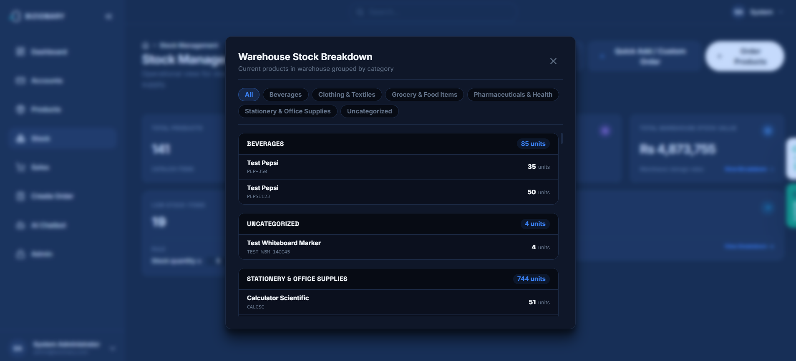
BIZIONARY ERP SYSTEM
Warehouse Stock & Incoming Modals
Stock Locations Reports
• Location Splitting: Traces items inside the warehouse vs. items in shop.
• Incoming Orders: List of pending items ordered from supplier shipments.
1. Select Item
2. Query Location
3. Display Modal

Slide 14
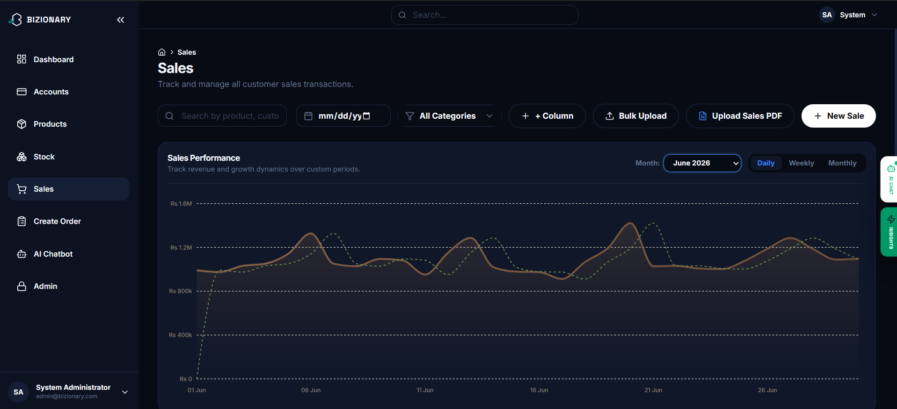
BIZIONARY ERP SYSTEM
Sales Transactions & Ingestion Suite
Transactions Logging
• Logs: Search and filter complete logs of customer sales and margins.
• Auto-Ingest: Drag-and-drop Excel sheets to parse transactions quickly.
1. Import Sheet
2. Pandas Parser
3. Log Sale DB

Slide 15
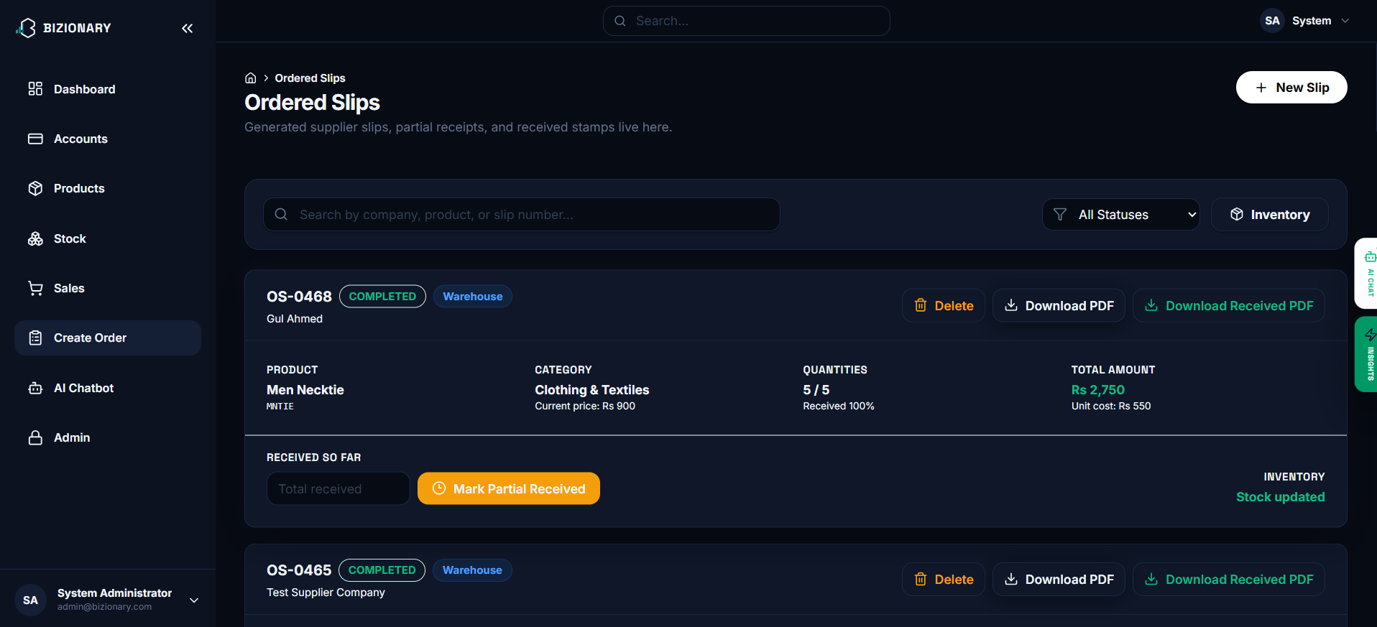
BIZIONARY ERP SYSTEM
Supplier Ordered Slips Management
Procurement Cycles
• Tracking: Monitor supplier slips, quantities, total sums, and pending statuses.
• Stock-in: Easily mark items as received to update inventories immediately.
1. Mark Received
2. Update Slip Ratio
3. Inflow Stock

Slide 16
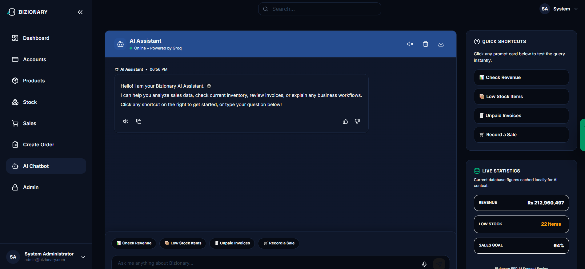
BIZIONARY ERP SYSTEM
AI Chatbot Assistant Interface
Agentic AI Chatbot
• RAG Agent: Answers questions on invoices, stock alerts, and revenues.
• Quick Shortcuts: One-click buttons to check margins or display charts.
1. User Prompt
2. Groq Tool Use
3. Local Python DB

Slide 17
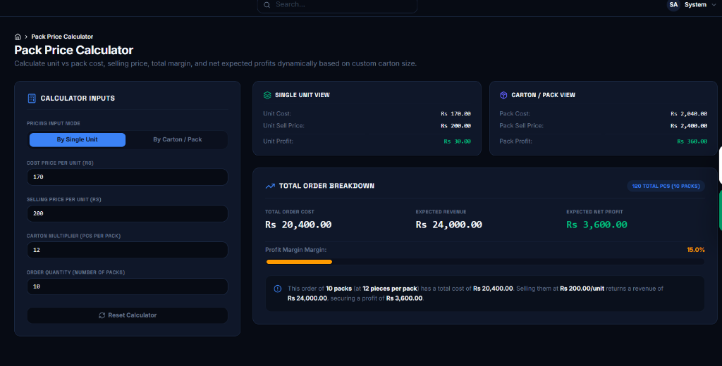
BIZIONARY ERP SYSTEM
Pack & Carton Price Calculator
Pack Dynamics Calculator
• Inputs: Configure product single unit selling prices and carton multipliers.
• Profit Projections: Displays expected net revenue and margins instantly.
1. Enter Quantity
2. React State
3. Compute Profit

Slide 18
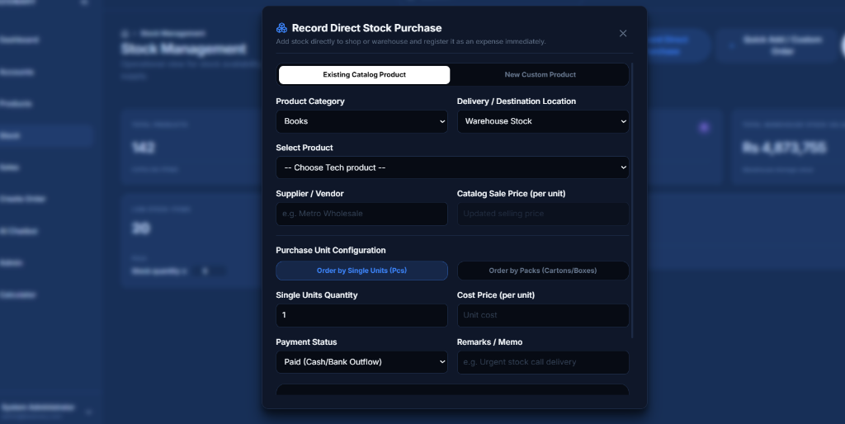
BIZIONARY ERP SYSTEM
Direct Stock Purchase (Latest Modification)
Direct Inflow Ledger Entries
• Stock Intake: Log supplier purchases directly to shop or warehouse stock.
• Custom Pack Sizes: Input unit cost and packs to update catalogs.
1. Select Product
2. Route Location
3. Signal Stock In

Slide 19
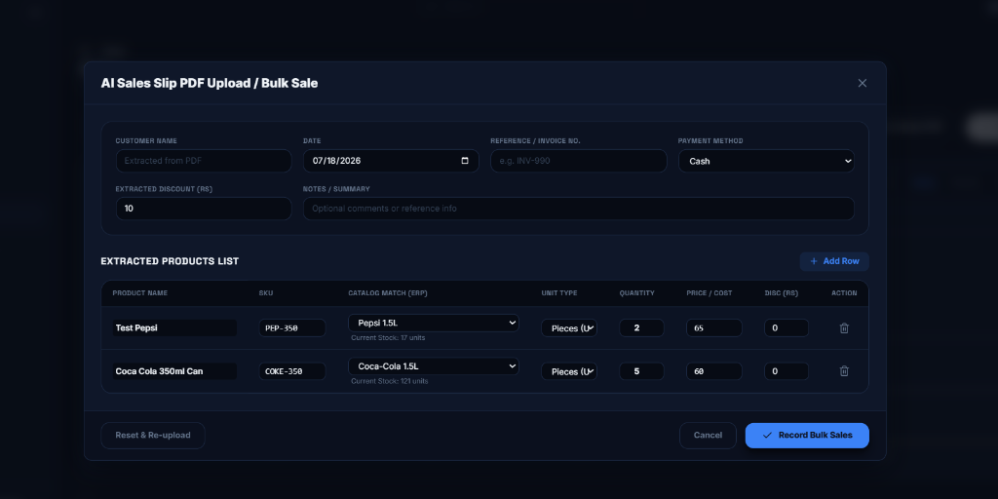
BIZIONARY ERP SYSTEM
AI Sales Slip PDF Upload / Bulk Sale
AI-Driven Parser Modal
• Upload PDF: Extracts item name, quantities, and cost automatically.
• Fuzzy Matcher: AI maps scanned invoice details to existing catalog SKUs.
1. Upload File
2. OpenAI Extract
3. Record Sales DB

Slide 20
BIZIONARY ERP SYSTEM
Standalone Desktop Executable (.exe)
Vite React Compilation
Django Ledger Migration
PyInstaller Executable
Step 1: Frontend Build: • Cleans former build outputs. • Bundles static HTML, CSS, and JS components using Vite compiler. • Optimizes asset trees to generate single-page static distribution directories.
Step 2: Database Preparation: • Runs Django model checkups and applies migrations to build a blank SQLite database schema. • Collects static bundles using python command-line scripts.
Step 3: Packaged Binary: • Invokes PyInstaller compiler wrapping `run_server.py` and embedding Python DLLs and sqlite schemas. • Generates a standalone double-clickable `BizionaryERP_Windows.zip` archive containing the local runner.

Slide 21
BIZIONARY ERP SYSTEM
Data Portability & Porting
Self-Contained SQLite Backups
Procedure for Updating System
• Database Portability: All records (products, transactions, cash flows, user credentials) are saved in a single, robust file named `db.sqlite3`.
• Physical Isolation: The database resides inside the `_internal` subdirectory of the compiled standalone package.
• Simple Copy-Paste Backup: Users can back up their entire store database by making a duplicate copy of `db.sqlite3`.
• 1. Copy Old DB: Go to the old folder and copy `BizionaryERP/_internal/db.sqlite3`.
• 2. Extract New Version: Extract the updated compiled zip package.
• 3. Replace Template: Paste the copied `db.sqlite3` file into the new `_internal` directory, replacing the blank database.
• 4. Run Launcher: Double-click the launch script; all historical records will load immediately.

Slide 22
BIZIONARY ERP SYSTEM
Future Enhancements
Scalability & Product Roadmap
• Multi-Tenant SaaS Support: Transition the current single-enterprise design to support multi-tenant user bases, permitting multiple businesses to register and manage their operations independently.
• Hardware Integration: Build direct interfaces for POS peripheral devices, including barcode scanners, receipt thermal printers, and electronic cash drawers.
• Automated Notifications Pipeline: Connect SMS (Twilio) and Email (SendGrid) triggers to dynamically alert suppliers on low stock, send invoice reminders to customers, and email managers financial summaries.
• Extended AI Capabilities: Build deep learning models for advanced predictive demand forecasting based on external seasonal events, market trends, and historic data.

Slide 23
THANK YOU!
Questions & Answers Session

