Slide 1
PPO RL Project
CarRacing-v3 PPO Agent Demo

Slide 2
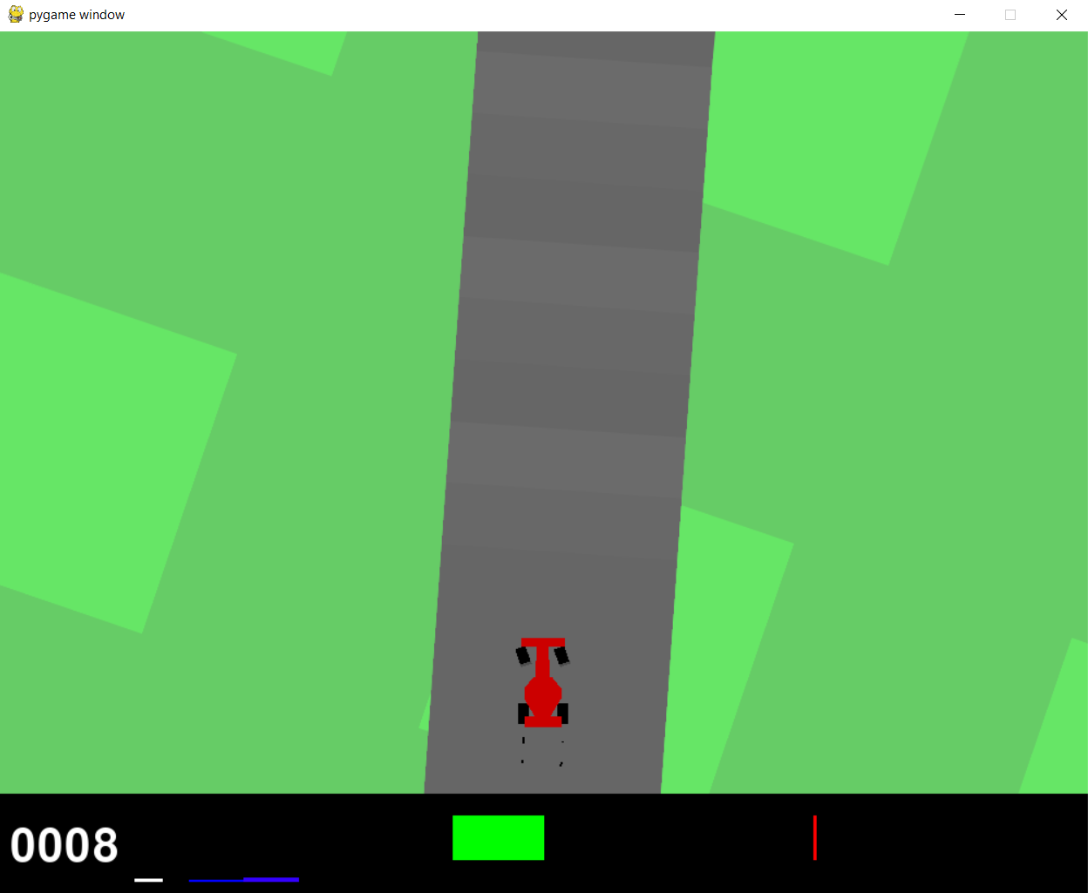
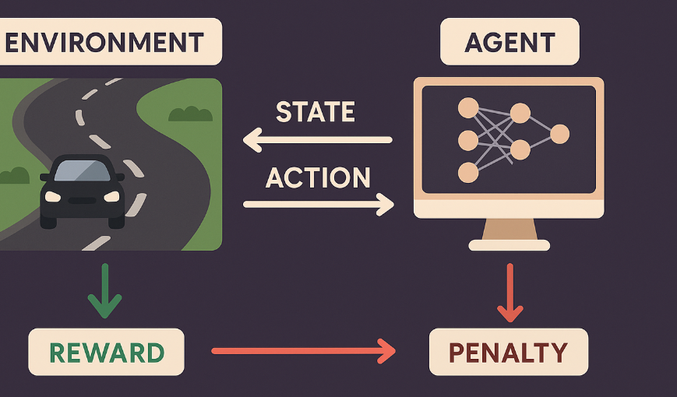
Brief Description of Idea
Concept: Train an AI agent to autonomously navigate the CarRacing-v3 track using reinforcement learning, emphasizing reward shaping and live rendering for real-time feedback.
Objective: Develop a skilled agent that optimizes driving based on visual inputs, with a live window to monitor training progress.
Image Reference: A screenshot of the CarRacing-v3 environment displaying a car racing on a dynamic track.

Slide 3
Core Components
Environment: CarRacing-v3 (Gymnasium), a 2D continuous control environment with a top-down view of a car on a track.
Type: Visual, pixel-based, with 96x96 RGB image observations.
Action: Continuous action space:
Steering: [-1, 1].
Acceleration: [0, 1].
Brake: [0, 1].
State: 96x96 RGB pixel frames (Box(0, 255, (96, 96, 3), uint8)), processed by a CNN.
Reward: Shaped to promote track progress:
+0.5 * distance for correct direction.
+0.001 * distance for staying on track.
Penalty: -0.5 for wrong direction to discourage errors.
Agent: PPO-based RL agent with a CNN policy to interpret visual inputs and select actions.

Slide 4
Predicted Output Without Implementation
Expected Behavior: The agent starts with random actions but learns to follow the track, improving lap completion over time.
Performance: After 20,000 timesteps, episode rewards are expected to range from 100–400, reflecting consistent track navigation.
Challenges: Risk of local optima (e.g., getting stuck in corners), addressed through enhanced reward shaping and extended training.

Slide 5
Updated Work in Game Projects
Enhancements:
Reward Shaping: Refined with distance-based rewards (+0.5 * distance, +0.001 * distance) and penalties (-0.5) for better learning.
Frame Skip: Set to 1 to ensure precise frame-by-frame observation.
Training Duration: Extended to 20,000 timesteps with a 5-minute timeout for robust training.
Hyperparameters: Optimized PPO settings (learning_rate=1e-4, n_steps=2048, batch_size=128, gamma=0.999, gae_lambda=0.98) for stability and accuracy.
Live Rendering: Enhanced with real-time visualization for immediate training insights.
New Addition: Environment type clarified as a continuous control, pixel-based environment to highlight its complexity.

Slide 6
Algorithm Used and Preference
Algorithm: Proximal Policy Optimization (PPO)
Why PPO?
Stability: Clipped objectives ensure safe policy updates, ideal for continuous control tasks.
Efficiency: Handles high-dimensional visual inputs (RGB frames) via CNN policy.
Simplicity: Stable-Baselines3 implementation simplifies tuning and deployment.
Preference: Preferred over Deep Deterministic Policy Gradient (DDPG) and Twin Delayed DDPG (TD3) for its superior handling of continuous action spaces, more stable learning, and simpler hyperparameter tuning.
DDPG and TD3 are designed for continuous control, but they tend to suffer from instability and require complex hyperparameter tuning.
PPO, on the other hand, provides a more reliable and robust solution for environments like CarRacing-v3, offering a balance of performance and stability without the need for extensive fine-tuning.

Slide 7

Thank you

