Slide 1
PDK Abstraction for ALIGN

Slide 2
PDK Abstraction
We abstract BEOL/MEOL and FEOL layers design rules for a PDK
Each BEOL/MEOL and FEOL layer has a set of abstracted design rules
We store these rules in a JSON format file
This file is used across different modules in ALIGN tool
Advantages of PDK abstraction
Portable across processes
Abstracted PDK links to other tools
Simplifies design rules, enables improved code quality
This presentation summarizes steps to create JSON file (abstracted rules) for a given PDK

Slide 3
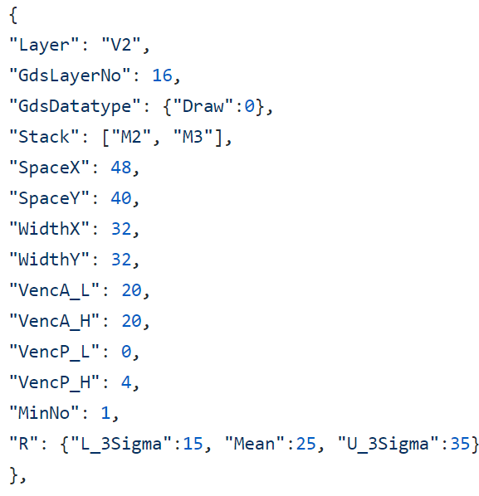
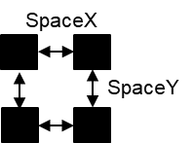
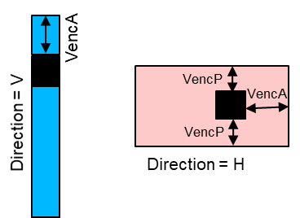
PDK Abstraction: ‘layers.json’
Defines abstracted design rules for BEOL/MEOL/FEOL in a pdk
We store these rules in a JSON format file
This file is used across different modules in ALIGN tool

Slide 4
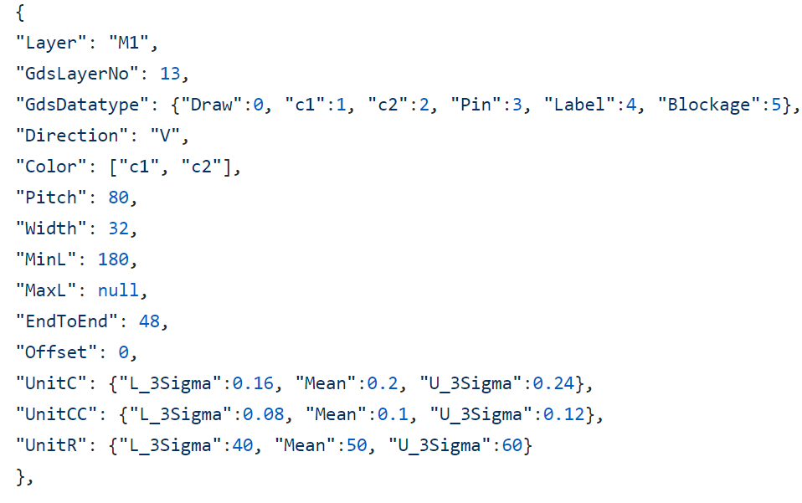
PDK Abstraction: ‘layers.json’
Defines abstracted design rules for BEOL/MEOL/FEOL in a pdk
We store these rules in a JSON format file
This file is used across different modules in ALIGN tool
Pitch
End-to-End

Slide 5
PDK Abstraction: ‘models.sp’
Define models for devices available in a pdk
The model names are used in ‘annotation phase’
To recognize devices in a netlist
.modelsky130_fd_pr__pfet_01v8 pmos w=1 l=1
.model sky130_fd_pr__nfet_01v8 nmos w=1 l=1

Slide 6
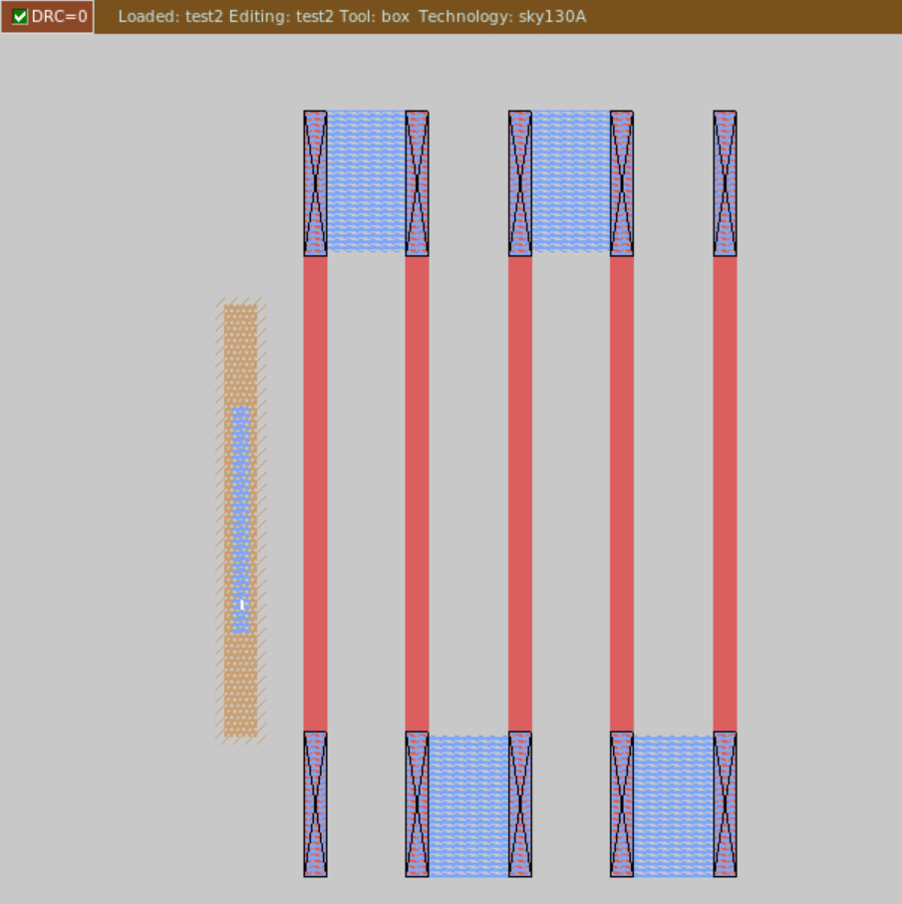
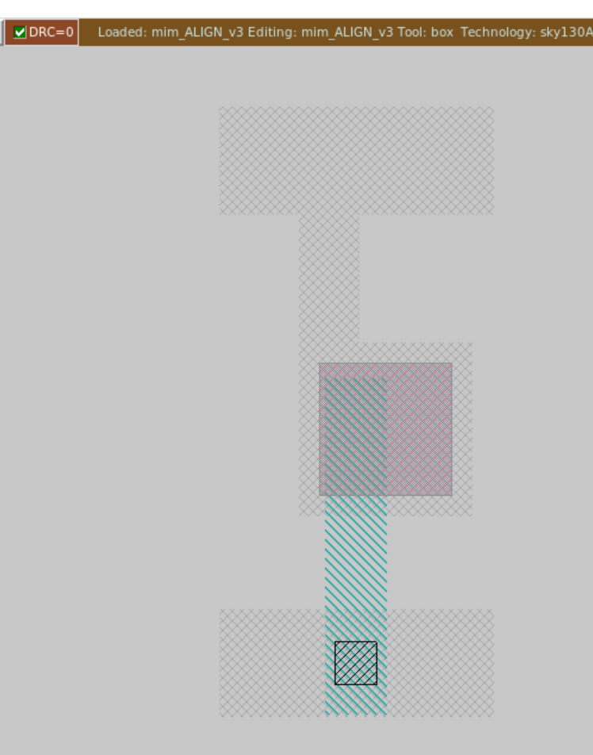
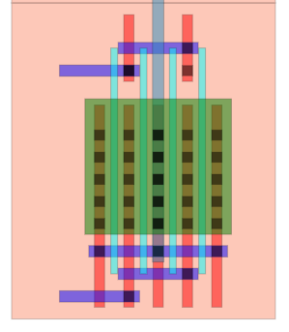
PDK Abstraction: ‘mos/cap/res.py’
Generators for MOS/CAP/RES devices
Minor modification may be required based on a pdk
MOS
Poly RES
MIM Cap

Slide 7
PDK Abstraction: Assumptions
We will explain the abstraction considering a pdk
With N metal layers (including MEOL)
With N-1 vias
Metal names in the ‘layers.json’ must start with ‘M’
For example, M1, M2, …., MN
Via names in the ‘layers.json’ must start with ‘V’
For example, V1, V2, ….., VN-1
Do not use FEOL layer names starting with ‘M’ or ‘V’
All dimensions are in nanometer

Slide 8
Design Rule Abstraction: Vias
Step1: Decide the number of vias V1, V2, … VN-1 (except V0)
Maximum V0 are placed automatically based on active width
We use two type of vias in ALIGN
Single via (Fig. 1) and Via array (Fig. 2)
NumX and NumY define the number of vias in X- and Y- direction, respectively
Via
NumY:2
NumY:2
Metal
NumX:2
NumX:3
Fig. 1
Fig. 2

Slide 9
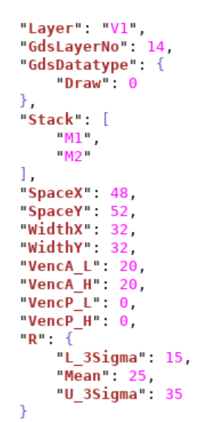
Design Rule Abstraction: Single Via
Definition of parameters:
“Layer”: Defines a layer name
“GdsLayerNo”: Used for layer mapping in GDSII generation
“GdsDatatype”: Layer data type used in GDSII generation
“Stack”: Metal layers which are connected using the Via
“SpaceX”/”SpaceY”: Minimum spacing between two vias in X/Y direction (Fig. 1)
“WidthX/WidthY”: Via widths in X/Y direction
“VencA_L/VencA_H(VencP_L/VencP_H)”: Minimum enclosure of a Via by a lower/higher metal layer along its ‘Direction’ (Perpendicular to its ‘Direction’) as shown in Fig. 2
“R”: Resistance per via (not required to run the tool, you can leave it as)
Via
SpaceX
Fig. 2
SpaceY
Fig. 1
Metal

Slide 10
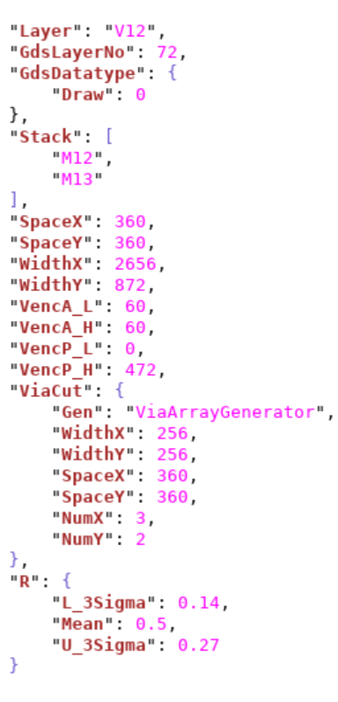
Design Rule Abstraction: Via array
Definition of parameters:
“Layer”, “GdsLayerNo”, “GdsDatatype”, “Stack”, definition is same as for a single via
“SpaceX”/”SpaceY”: Minimum spacing between two vias in X/Y direction
“VencA_L/VencA_H(VencP_L/VencP_H)”: Minimum enclosure of a Via by a lower/higher metal
layer along its ‘Direction’ (Perpendicular to its ‘Direction’; same as for a single via)
“ViaCut” parameters:
“Gen”: This define the name of via array generator. Use “ViaArrayGenerator” for it.
“WidthX/WidthY”: This defines single Via widths in X/Y direction
***“SpaceX”/”SpaceY”: Minimum spacing between two vias in X/Y direction
“NumX”/”NumY”: Number of vias in X/Y direction (Fig. 1)
“WidthX” = NumX*(WidthX of ViaCut) + (NumX-1)*(SpaceX of ViaCut)
“WidthY” = NumY*(WidthY of ViaCut) + (NumY-1)*(SpaceY of ViaCut)
NumY:2
NumY:2
NumX:2
NumX:3
***“SpaceX”/”SpaceY” are same in “ViaCut” and outside of it
Fig. 1

Slide 11
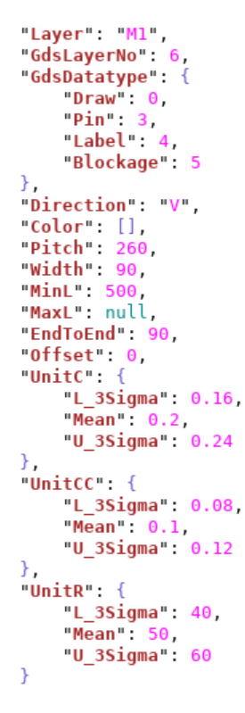
Design Rule Abstraction: Metal/Poly
Definition of parameters:
“Layer”: Defines a layer name
“GdsLayerNo”: Used for layer mapping in GDSII generation
“GdsDatatype”: Layer data type used in GDSII generation
“Direction”: Defines the allowed direction for the layer e.g., V (Vertical) or H (Horizontal)
“Color”: Define available coloring patterns for the layer e.g., [C1, C2] or [] (Leave it blank if only single color allowed)
“Pitch”: Center-to-Center distance for a layer (Shown in next slide Fig. 1)
“Width”: Define width of the layer
“MinL”: Minimum length of a layer; Please note that the length is along a layer ‘Direction’
“MaxL”: Maximum allowed length for a layer (null means infinite; If there is no max limit in the PDK keep it null)
“EndToEnd”: Minimum end-to-end spacing for a layer (Shown on next slide Fig. 2)
“Offset”: Defines a layer offset from X or Y- axis; It is shown for a layer in V direction (Shown on next slide Fig. 3)
“UnitC”: Per micrometer length capacitance for a layer
“UnitCC”: Per micrometer length coupling capacitance for a layer
“R”: Per micrometer length resistance for a layer

Slide 12
Design Rule Abstraction: Metal/Poly
Y-axis, X = 0
Offset
Offset
End-to-End
Pitch
End-to-End
Fig. 1
Fig. 2
Fig. 3
Fig. 2
These are some checks and might help in PDK abstraction:
Exact values of “UnitC”, “UnitCC”, and “R” are not required to run the tool, you can leave them as it is
“MinL” rule can be found out in the PDK using Min Area rule: Min Area = “MinL” * “Width”
Keep “Offset” = 0 for all metal layers; for “Poly” layer “Offset” = “Pitch”/2
“M1” and “Poly” “Pitch” must be same to generate a correct layout
“M3” “Pitch” must be multiple of “M1” “Pitch” for the correct functionality of the tool
If you have a FinFET PDK “M2” “Pitch” is constrained by “Fin” “Pitch” (see the next slide)
To find out poly pitch draw a two-finger transistor using pcells in your pdk and calculate center to center distance

Slide 13
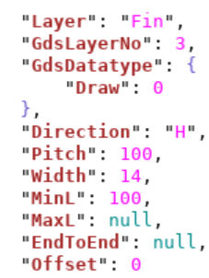
Design Rule Abstraction: Fin
Parameters definition is same as for Metal/Poly layers
“Direction” is always “H” for “Fin” layer
“Offset” is 0 for “Fin” layer
For a bulk PDK:
Use “Pitch” = half of M2 “Pitch” and leave other parameters as it is
We will remove the “Fin” layer for bulk PDKs In future releases
For FinFET PDKs:
Make sure that M2 “Pitch” = 2* Fin “Pitch” (Contact us if you want to use a different value)

Slide 14
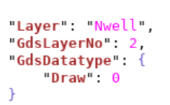
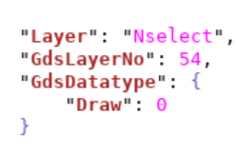
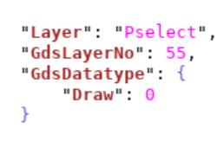
Design Rule Abstraction: FEOL -> Nwell/Nselect/Pselect
Definition of parameters:
“Layer”: Defines a layer name
“GdsLayerNo”: Used for layer mapping in GDSII generation
“GdsDatatype”: Layer data type used in GDSII generation
In your PDK Nselect/Pselect can be with names like N+/P+ or NN/PP

Slide 15
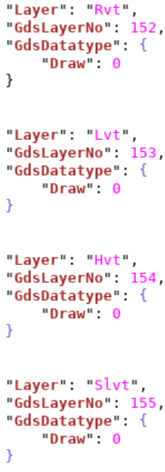
Design Rule Abstraction: FEOL -> RVT/LVT/HVT/SLVT
These layers define VT (threshold voltage) type for a device
Definition of parameters:
“Layer”: Defines a layer name
“GdsLayerNo”: Used for layer mapping in GDSII generation
“GdsDatatype”: Layer data type used in GDSII generation
In your PDK you may have SVT (standard VT) or ELVT (extreme low VT), etc.

Slide 16
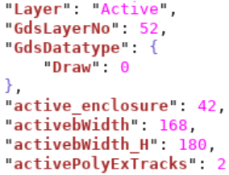
Design Rule Abstraction: FEOL -> Active
Definition of parameters:
“Layer”: Defines a layer name
“GdsLayerNo”: Used for layer mapping in GDSII generation
“GdsDatatype”: Layer data type used in GDSII generation
“active_enclosure”: Defines enclosure of “Active” layer by VT layer (RVT, LVT, etc.) as shown in Fig. 1
“activebWidth”: “Active” width for body contact
“activebWidth_H”: “Active” width in horizontal direction
“activePolyExTracks”: It defines the distance between “Active” and poly contact
in terms of number of M2 tracks (Shown in Fig. 2) e.g., 2 will result in 2*M2.”Picth”
distance between active and poly contact
= 2*V0.”Width”
Poly contact
“activePolyExTracks”
active_enclosure
VT layer
Active
Active
active_enclosure
Fig. 2
Fig. 1

Slide 17
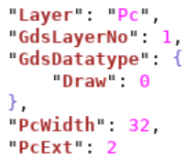
Design Rule Abstraction: FEOL -> Pc
“Pc” is poly connect layer
Definition of parameters:
“Layer”: Defines a layer name
“GdsLayerNo”: Used for layer mapping in GDSII generation
“GdsDatatype”: Layer data type used in GDSII generation
“PcWidth”: Defines the width (Shown in Fig. 1)
“PcExt”: “Pc” extension over poly layer
For Bulk PDKs:
Poly is used as a contact layer
Use poly layer “GdsLayerNo” for “Pc” layer (do not delete it)
“PcWidth” = 2*(”Width” of V0 layer)
“PcExt” = 0
Poly contact
PcWidth
PcExt
Active
Fig. 1

Slide 18
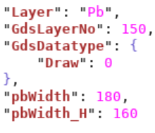
Design Rule Abstraction: FEOL -> Pb
Definition of parameters:
“Layer”: Defines a layer name
“GdsLayerNo”: Used for layer mapping in GDSII generation
“GdsDatatype”: Layer data type used in GDSII generation
“pbWidth”: “Pb” width for body contact
“pbWidth_H”: “Pb” width in horizontal direction
“Pb” is used in body contact only
In some pdks an extra layer other than
active/Nselecet/Pselect/Nwell is used
If in your pdk this layer is not used leave “Pb”
layer as it is in layers.json (do not delete)
Active
Pb layer
pb_Width
pb_Width_H
Fig. 1

Slide 19
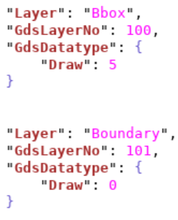
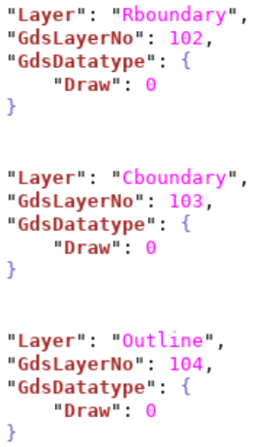
Design Rule Abstraction: Boundary Layers -> Bbox/Boundary/Outline/R/C-boundary
These layers defines boundary/outline around the layout
If not required in your pdk leave them as it is.
Definition of parameters:
“Layer”: Defines a layer name
“GdsLayerNo”: Used for layer mapping in GDSII generation
“GdsDatatype”: Layer data type used in GDSII generation

Slide 20
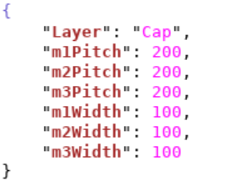
Design Rule Abstraction: MOM Cap
ALIGN has in built MOM cap cells
It uses M1, M2 and M3 metal layers
Caps layouts are very specific to a PDK, therefore, we do not have a generalized template
Definition of parameters:
“Layer”: Defines a layer name
“GdsLayerNo”: Used for layer mapping in GDSII generation
“GdsDatatype”: Layer data type used in GDSII generation

Slide 21
How to Generate a Primitive
Run the following commands in your installed ALIGN pdk directory
The following commands will generate a differential pair GDSII
- b : defines block name, you can use any name for it. In this example ‘test’ is used
Import the generated GDS in Cadence virtuoso and run DRC checks for your PDK
If there are any DRCs please contact us.

