Slide 1
MockPDK & Analog Router: Getting Started
Nikolay Ryzhenko
Created: October 29, 2018
Last updated: July 3, 2019
DARPA IDEA technical meeting
Training material

Slide 2
Updates
7/3/2019: (rev 16195): Added a new optional parameter: Tie

Slide 3
Outline
Origin on the mock process design kit
The layer stack
Basic design numbers and metal templates
PDK files
Format of the files

Slide 4
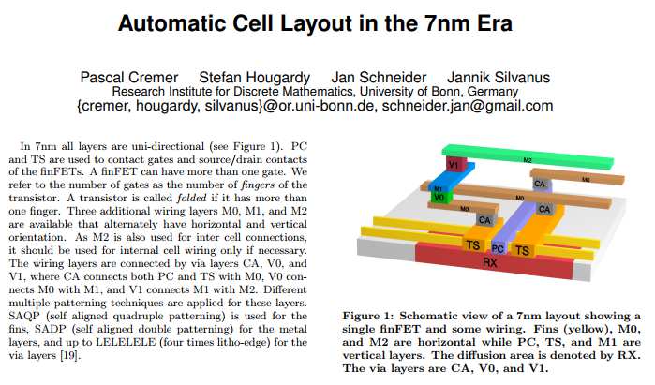
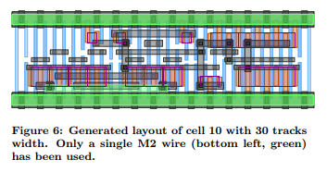
MockPDK: Mock Process Design Kit
A process design kit (PDK) is a set of files used to model a fabrication process for the tools used to design integrated circuits.
Disclaimer: A public paper (ISPD 2017) highlights some details of a possible 7nm process. We use a layer stack presented in Figure 1 in our subsequent examples. The original paper has no actual numbers and design rules. In this presentation, mock numbers were selected to keep similar relative shapes of layout objects.
Source: Automatic Cell Layout in the 7nm Era
Pascal Cremer, Stefan Hougardy, Jan Schneider, Jannik Silvanus
Proceedings of the ACM on International Symposium on Physical Design, 2017

Slide 5
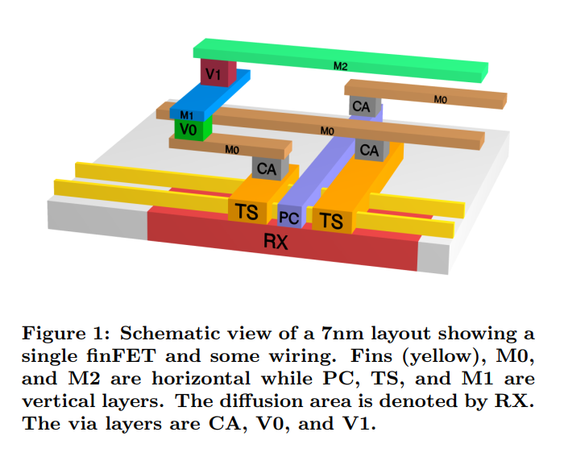
Layer Stack
Substrate
RX, n-well
PC, gate contact
TS, source/drain contact
SF, silicon fin (added acronym)
CA, a via between PC/TS and M0
M0
V0
SF
M1
V1
M2
V2
M3
V3
M4
V4
M5
Source: Automatic Cell Layout in the 7nm Era
Pascal Cremer, Stefan Hougardy, Jan Schneider, Jannik Silvanus
Proceedings of the ACM on International Symposium on Physical Design, 2017
V5
M6

Slide 6
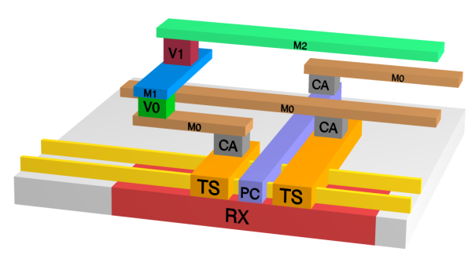
Basic Numbers: PC, TX, SF, M0, M1, M2
RX
M2
All wires are unidirectional; the orientation is either vertical or horizontal.
Poly (PC) pitch is set to 1000 mock units. Having this, other numbers mimic layouts of the paper such as depicted in Fig.6. The remaining values are set as follows:
TS/M1 fixed pitch = PC fixed pitch: 1000 units
Fin (SF) fixed pitch: 400 units
PC fixed width: 300
TS fixed width: 400
M1 fixed width: 700
PC fixed side-to-side (STS) spacing: 700
TS fixed STS: 600
M1 fixed STS: 300
M0 fixed STS: 300
M0 regular template of widths: {1100, 500, 500, 300, 300, 300, 500, 500, 1100}
M2 fixed STS: 300
M2 regular template of widths: {1000, 900, 600, 600, 600, 900, 1000}
Vias are placed at the intersections of corresponding center-wire grid lines.
PC
V2
TS
M3
SF
V3
CA
M4
M0
V4
V0
M5
M1
V5
V1
M6
Source: Automatic Cell Layout in the 7nm Era
Pascal Cremer, Stefan Hougardy, Jan Schneider, Jannik Silvanus
Proceedings of the ACM on International Symposium on Physical Design, 2017

Slide 7
Basic Grids: PC, TX, SF
RX
M2
PC
V2
TS
M3
SF
V3
CA
M4
6400
16 fins per row height
M0
V4
V0
M5
Fin
M1
V5
V1
M6
FET boundary

Slide 8
M0, M1, and M2 templates
M0 template:
Fixed side-to-side spacing (STS): 300
{1100, 500, 500, 300, 300, 300, 500, 500, 1100}
Period: 6400 (16 fins)
M1 template:
Fixed pitch: 1000
Fixed width: 700
Fixed STS: 300
M2 template:
Fixed STS: 300
{1000, 900, 600, 600, 600, 900, 1000}
Period: 6400 (16 fins)

Slide 9
MockPDK: All available metal templates
M0:
{1100, 500, 500, 300, 300, 300, 500, 500, 1100}, STS=300
M1:
{700}, STS=300
M2 templates (two options):
{1000, 900, 600, 600, 600, 900, 1000}, STS=300
{500}, STS=300
M3:
{800, 600, 400, 400, 400, 600, 800}, STS=300
M4:
{800, 600, 400, 600, 800}, STS=400
M5:
{1000, 800, 600, 600, 600, 800, 1000}, STS=400
M6:
{1600, 1200, 1000, 1200, 1600}, STS=400
Black values have been chosen to mimic layouts from a paper:
Automatic Cell Layout in the 7nm Era
Pascal Cremer, Stefan Hougardy, Jan Schneider, Jannik Silvanus
Proceedings of the ACM on International Symposium on Physical Design, 2017
Green values are arbitrary mock numbers.

Slide 10
Detailed Router Collateral
Process collateral:
layers.txt - technology layers
design_rules.txt - numeric values for primary design rules
via_generators.txt - geometries and names of available vias + metal enclosures
patterns.txt - forbidden layout patterns for vias
metal_templates.txt - available metal templates
Circuit-specific collateral:
mtis.txt - a list of active metal template instances
netlist.txt - cell name, bounding box, and input wires
globalrouting.txt - connected entities and global routes
Flow and execution:
arch.txt - a list of synthesis options
file.txt - run file

Slide 11
Layer file: layers.txt
The file describes all layers. Almost all fields are optional. However, correct layer specification for any PDK must have a strict number of consistent parameters.
The only mandatory field
Optional
Layer name=<STRING> pgd=hor|ver level=<INT> {
Type value=well|diffusion|wire|poly|via|metal
Technology pitch=<INT>
ElectricallyConnected layer=<STRING>
Color type=<STRING> name=<STRING>
}
All entries are optional

Slide 12
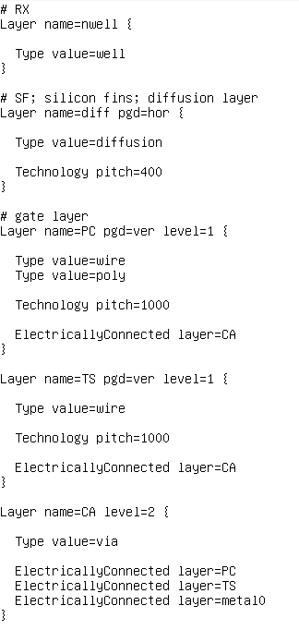
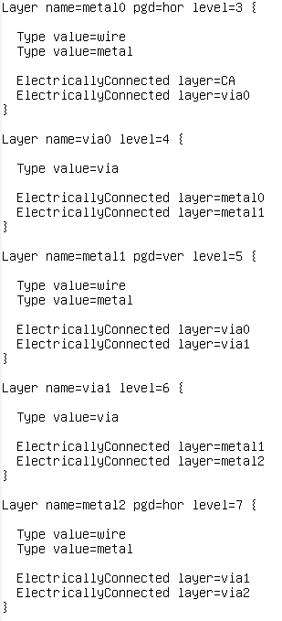
Tips for the layer file
Layers which are not used for routing don’t need a level. For example, well and diffusion.
Carefully set levels for vias and wires.
Levels, orientation, types, and electrically connected layers are used to guide the router.
The router doesn’t have any hardcoded information about layers. The router doesn’t interpret names of layers anyhow.
Need to specify both the diffusion pitch and the poly pitch because they define the global routing grid.

Slide 13
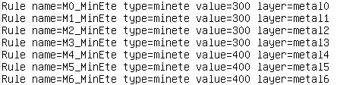
Design rules: design_rules.txt
The file defines a few primary design rules. Examples:
minete is a minimal spacing between wire line-ends (“minimal end-to-end“)
minlength is a minimal wire length
Rule name=<STRING> type=minete value=<INT> layer=<STRING>
Rule name=<STRING> type=minlength value=<INT> layer=<STRING>
minete
line-end, edge
Horizontal metal wire
Horizontal metal wire
side
minlength
Example:
OGD
orthogonal grid direction for a horizontal layer
PGD
primary grid direction for a horizontal layer

Slide 14
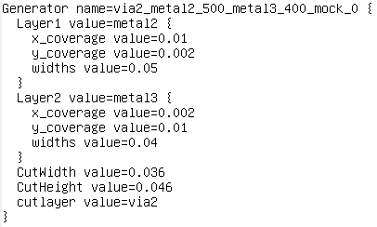
Via generators: via_generators.txt
A via generator is a set of several wires: a via cut, a metal landing (layer below), and a metal enclosure (layer upper). Format is a bit awkward. Some fields are upper-case, other fields are lower-case. It was made to keep a backward compatibility with another old and user-unfriendly format. x_coverage and y_coverage can be zero or even negative. Widths is a list of wire widths where this via type is allowed to be landed. All numbers are FLOAT (are to be multiplied by 10,000 to get actual integer units).
20: Layer1 y_coverage
Generator name=<STRING> {
Layer1 value=<STRING>
x_coverage value=<FLOAT>
y_coverage value=<FLOAT>
widths value=<FLOATs>
}
Layer2 value=<STRING>
x_coverage value=<FLOAT>
y_coverage value=<FLOAT>
widths value=<FLOATs>
}
CutWidth value=<FLOAT>
CutHeight value=<FLOAT>
cutlayer value=<STRING>
}
Example:
100: Layer2: y_coverage
M2
V2
500
460
M3

Slide 15
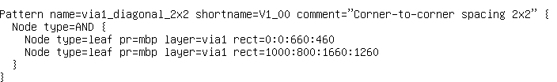
Layout pattern: patterns.txt
Layout patterns are used to model forbidden layout cases. Right now, vias are supported best of all. Any arbitrary function can be expressed: any width, any depth. “mbp” stands for “must be present”. “mba” stands for “must be absent”. While you have a finite list of metal templates, you need to enumerate all possible forbidden via layouts. If you have very few regular and uniform templates, the number of patterns is really small.
Pattern name=<STRING> shortname=<STRING> comment=“any arbitrary comment”
Node type=AND|OR|NAND|NOR {
Node type=leaf pr=mbp|mba layer=<STRING> rect=<xl>:<yl>:<xh>:<yh>
}
}
Example
Design rule: Corner-to-corner spacing between vias
Pattern: Forbidden “diagonal” placement of two vias.
1260
via1
800
via1
460
0
0
660
1000
1660

Slide 16
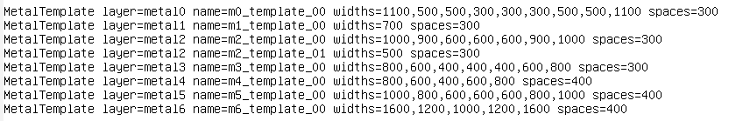
Metal templates: metal_templates.txt
Metal template is a repeating fixed set of wire widths and side-to-side spaces.
MetalTemplate layer=<STRING> name=<STRING> widths=<INTs> spaces=<INTs> colors=<STRINGs> stops=<INTs>
Metal2 in this MockPDK has two available templates. All other metals have one available template.
A list of available metal templates is technology information. Circuit may use 1+ of available metal templates.
You may specify a custom list of side-to-side spaces separated by commas.
Stops define fixed stopping points for wire line-ends.
Mandatory fields:
layer
name
widths
spaces (side to side spacing)
Optional fields:
colors (default: “”)
stops (default: “”)

Slide 17
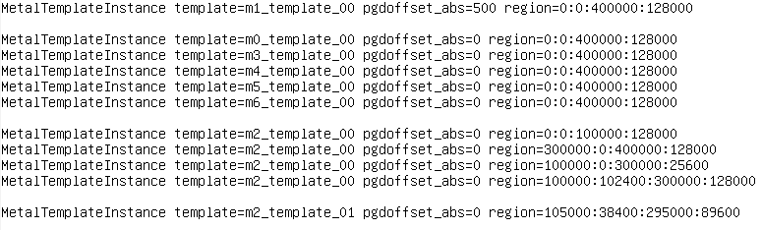

Metal templates instances: mtis.txt
A list of metal template instances (MTIs) is usually custom for a given circuit.
MetalTemplateInstance template=<STRING> pgdoffset_abs=<INT> region=<xl>:<yl>:<xh>:<yh> inverted=1|0
pgdoffset_abs defines the offset of the first wire track with respect to the PGD grid line at point (0,0).
An example is shown for M1.
500
(0,0)
Mandatory fields:
template
Optional fields:
pgdoffset_abs (default: 0)
pgdoffset_rel (default: 0)
region (default: bbox)
inverted (default: 0)
m1_template_00
4 MTIs define a m2 routing region m2_template_00 {1000, 900, 600, 600, 600, 900, 1000} with a rectangular hole in the middle.
The last M2 MTI defines a rectangular routing region m2_template_01 {500, 500} in the middle of the block.
128000
m2_template_00, pgdoffset_abs=0
89600
m2_template_01, pgdoffset_abs=0
38400
0

Slide 18
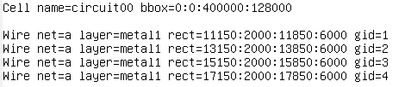
Input file: netlist.txt
The file defines a rectangular bounding box of the cell and a list of input wires. Hierarchy is not supported yet; layout is flat. A special format specifies what wires should be connected and how. See the next foil.
Cell name=<STRING> bbox=<xl>:<yl>:<xh>:<yh>
Wire net=<STRING> layer=<STRING> rect=<xl>:<yl>:<xh>:<yh> gid=<INT>
An unique Global ID, an optional integer
See the next foil for more details
Example:

Slide 19
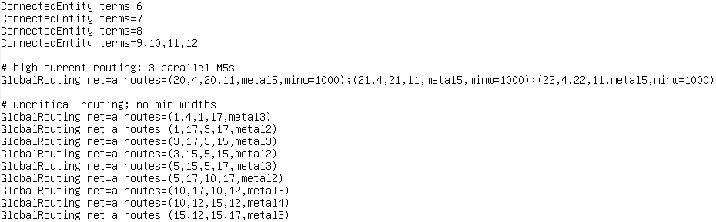
Connected entities and GR: globalrouting.txt
Connected entity is a list wires which are supposed already connected even these wires may look unconnected. The detailed router connects connected entities rather than input wires. Global routes define global routing. Global route (GR) must be either vertical of horizontal; net, coordinates, and layer are mandatory. Minimal width of GR is optional.
Minimal width for this route
Unique GR id
“same width as” another GR gid
ConnectedEntity terms=<list of GIDs>
GlobalRouting net=<STRING> routes=(<xl>,<yl>,<xh>,<yh>,<layer>,minw=<INT>,gid=<INT>,samewas=<INT>); . . .
Integers are GIDs (wire’s global IDs).
Target minimal width
Uncritical routing: no target minimal width

Slide 20
Tie: globalrouting.txt
Tie is an optional parameter that assigns a terminal wire to a global routing segment. Both the terminal and the GR segment must have an unique integer gid. Ties improve correlation between GR and DR. Ties reduce the solution space and significantly reduces the runt time. By default (without ties), DR creates all possible routes between terminals and all GR segments around.
A tie can bind only a terminal wire and a GR segment. A tie cannot bind two terminal wires. A tie cannot bind two GR segments.
Tie term0=<terminal gid> gr0=<GR gid>
For example:
ConnectedEntity terms=7587
GlobalRouting net=n0 routes=(2,4,23,4,metal2,gid=849)
Tie term0=7587 gr0=849

Slide 21
Options: arch.txt
Some synthesis options are stored in a separate file. Following two options define global routing grid.

Slide 22
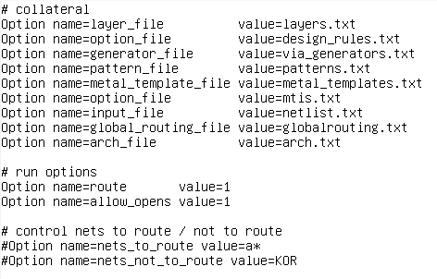
Run file: file.txt
A minimal list of options:

Slide 23
How to run
amsr.exe -file file.txt

