Slide 1
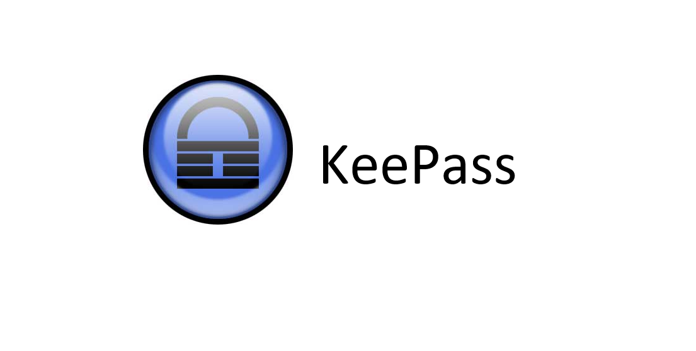

KeePass Safe
ALIJON FATOEV

Slide 2

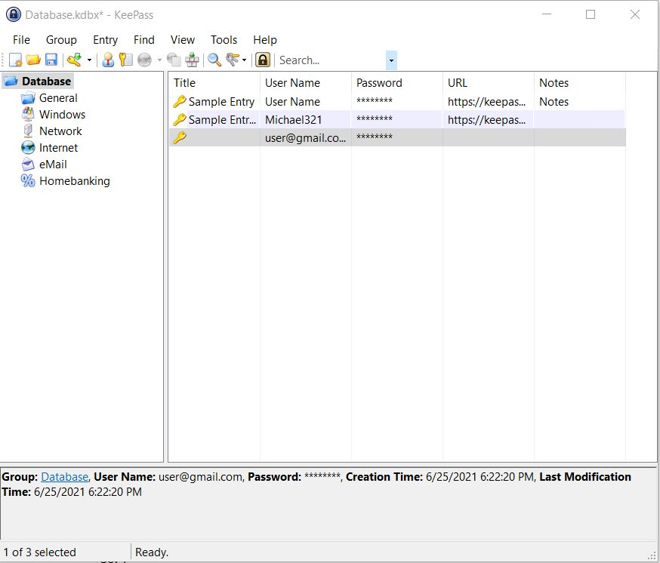
WHAT IS KeePass
KeePass Safe is a free and open-source password manager primarily for Windows. It officially supports macOS and Linux operating systems through the use of Mono. KeePass stores usernames, passwords, and other fields, including free-form notes and file attachments, in an encrypted This file can be protected by any combination of a master password, a key file, and the current Windows account details

Slide 3
KEY FEATURES
Strong Security
Multiple User Key
Portable and No Installation Required, Accessibility
Support of Password group
Strong Random Password Generator
Open Source

Slide 4
SAFETY
The next section of this KeePass review will look at how safe this password manager is. The KeePass vault is heavily encrypted.
The service is not cloud-based, which helps keep the service secure because you have control over where you store your data. You can store your data on a hard drive, USB key, or even on a third-party cloud service if you want.
It also has two-factor authentication. Overall, KeePass is safe as long as you have a strong master password. The heavily encrypted vault is useless if someone gains access to your master password. Thus, you want a strong password

Slide 5
TECHNICAL SPECIFICATION
KeePass works with Windows
Mac
Linux
This app requires Windows Vista/Windows 7 or higher
macOS Sierra or higher
Linux
For mobile devices you need a port

Slide 6
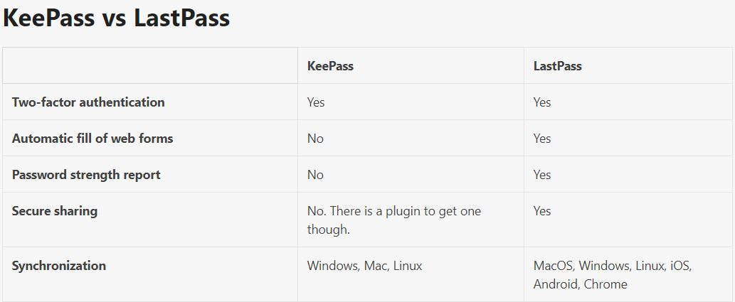
KeePass COMPARISON
KeePass works a lot differently than LastPass. KeePass doesn’t have all the bells and whistles that LastPass has. You won’t get web form filling, password sharing, password strength reports, or easy synchronization. What KeePass has going for it is that it’s completely off the cloud. Many people are wary about storing sensitive information over the cloud, even if it’s encrypted. KeePass and KeePassX are quite similar though.

Slide 7
PRICING
KeePass is a free open-source program. Unlike most other password managers, there is no paid version or way to upgrade the service.

Slide 8
PROS AND CONS
The best part of KeePass is that it’s free. It also has standard password management features like two-factor authentication.
Another thing we like about KeePass is that you can import saved passwords from a bunch of different sources. The interface is very outdated. One of the biggest disadvantages is that there are a lot of features that require special plugins, which makes using the service a little challenging
On the downside, there’s no automatic password capture function. You can sync across multiple devices, but it isn’t the easiest process. There’s also no mobile support.

Slide 9
THE END
THANKS FOR YOUR ATTATION!!

