Slide 1
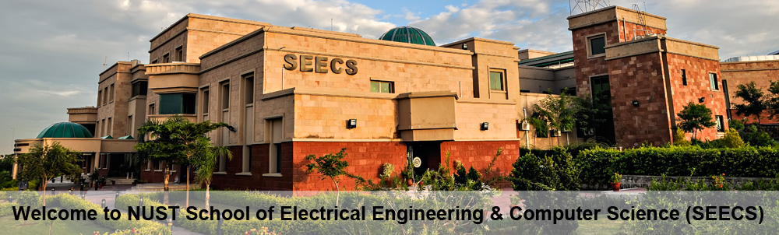
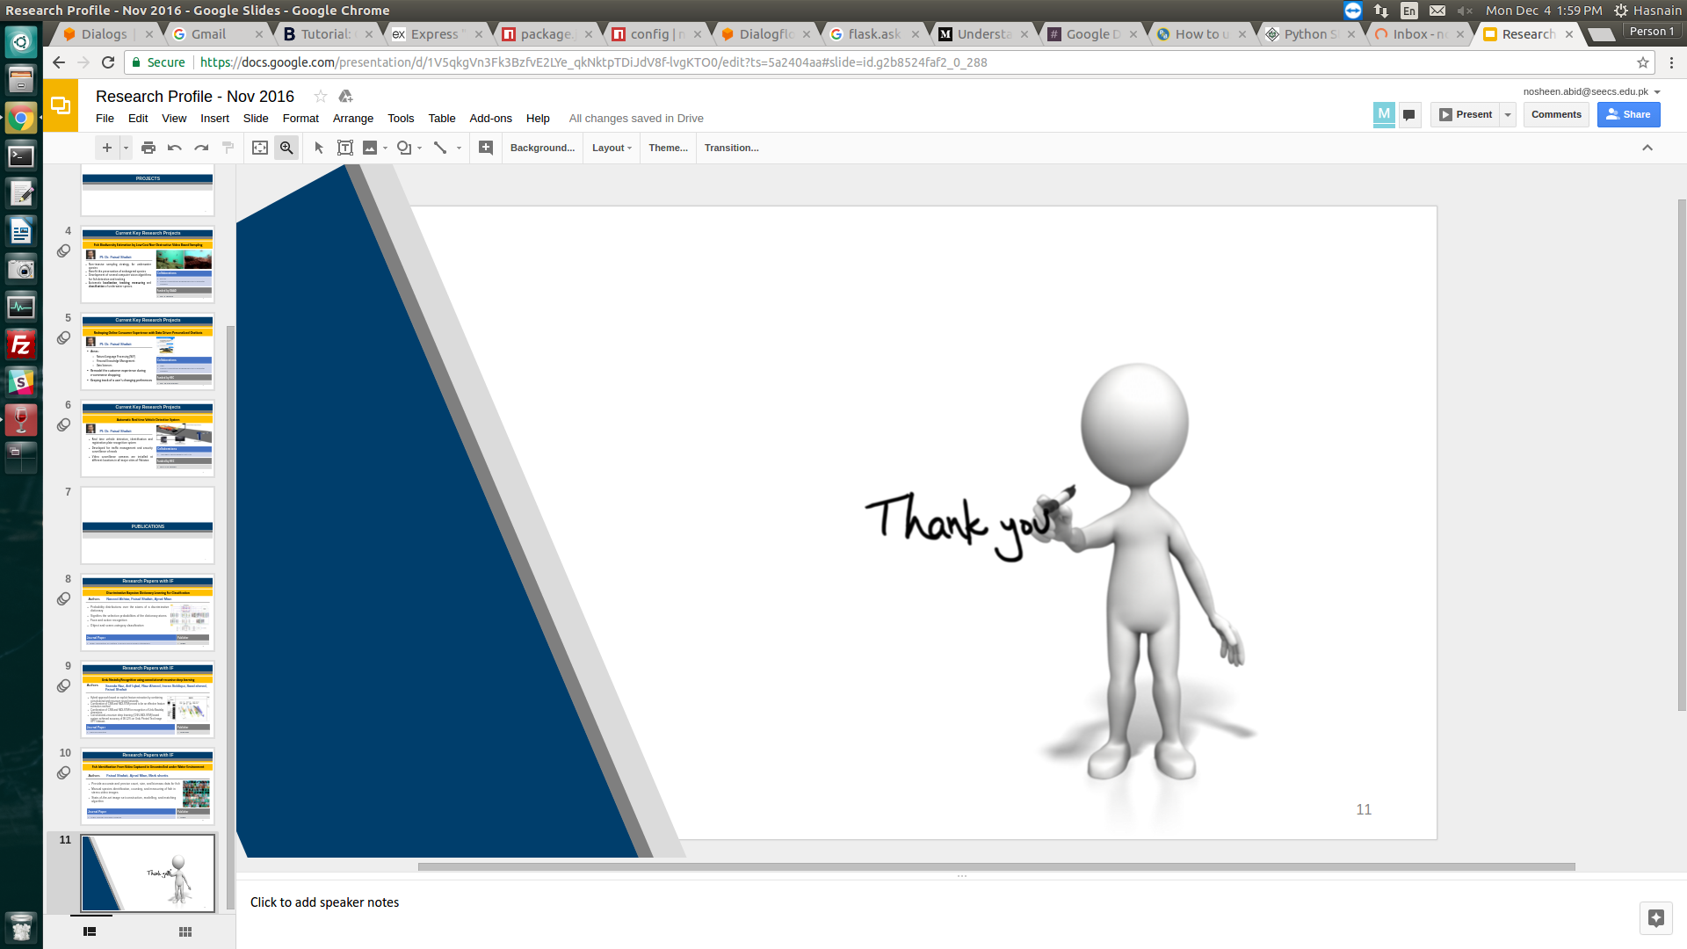


School of Electrical Engineering and Computer Science (SEECS) NUST
PrepVRse: Enhancing Communication Skills through Virtual Reality and Large Language Model based Feedback System
﻿
Funded by:
FYDP-1 Mid Defense
Startup Program

Slide 2
Group Members
Name | CMSID
Tanzeel Ur Rehman | 345510
Dawood Mehmood | 341706
Ali Raza Dar | 343375

Slide 3
Problem Statement
Bridging the gap between theoretical knowledge and practical application in communication skills development and training. In an increasingly communication-driven world, individuals often struggle to develop effective communication skills. Traditional methods lack immersive and personalized training. According to Gartner, poor communication is responsible for 70% of corporate errors.
Communication's Crucial Role:
Proficiency in communication across personal and professional settings.
Limitations of Traditional Methods:
Lack of immersive experience and personalized feedback.
Core Objective:
Revolutionize communication skill enhancement through VR and LLM-based feedback system.

Slide 4
Unmet Need & Target Audience
Unmet Need:
Filling the void in comprehensive communication skill development and training.
Significance:
Communication skills ranked among top desired qualities by employers and key to personal growth.
Target Audience:
Students, Professionals, Educational Institutions, Training Centers, Personal Development Enthusiasts.
Potential Market Size:
Millions of students, diverse industries, personal development seekers.

Slide 5
Project Objectives
Enhance communication skills
Provide realistic simulation of presentation & interview scenarios
Offer personalised feedback through fine-tuned Large Language model

Slide 6
Proposed Solution
PrepVRse offers VR environment for users to practice presentations and interviews while an LLM offers personalized feedback.
A mobile app enables users to review their performance, enhancing their communication skills.
The core solution involves:
A VR environment where users can engage in interactive simulations of presentations and interviews.
A combination of Computer Vision and LLM technologies continuously monitors the user's gestures, body language, tone, and speech patterns.
Feedback is provided through the LLM, enhancing the user's performance as they progress.

Slide 7
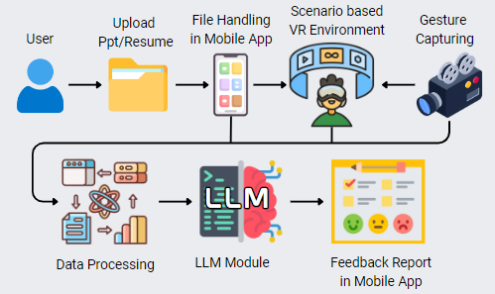
Development Methodology & Operational Workflow

Slide 8
Work Division:
Tanzeel Ur Rehman
VR Environment,
System Integration,
Project Video
Dawood Mehmood
Data Capture and Processing, Feedback System Integration,
Project Poster
Ali Raza Dar
Feedback Visualization and Mobile App Integration,
SRS document

Slide 9
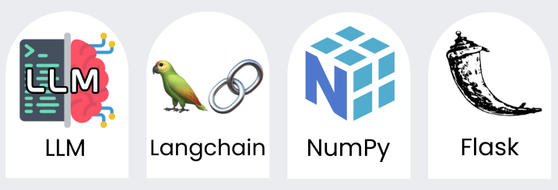
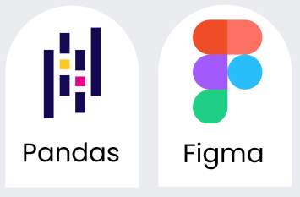
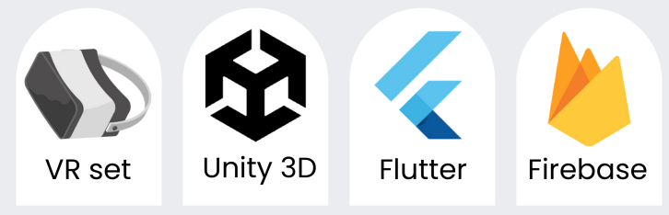
Tools & Technologies

Slide 10
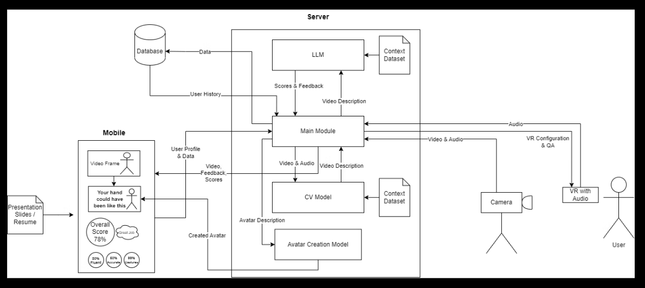
System Architecture

Slide 11
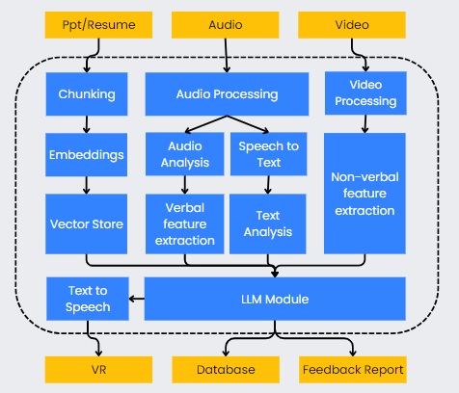
Feedback Generation Mechanism

Slide 12
Progress & Development
Literature Review completed
Locally deployed & configured models for inferencing
Llama 2 7b (Text to Text)
Falcon 7b (Text to Text)
Vosk model (Speech to Text)
gTTS (Text to Speech)
Flutter App started
VR environment setup
Dataset collection started
both for Audio & Video as well as Presentation slides & Resume samples

Slide 13
Next steps
Setting up OCR for text extraction from presentation slides & resumes
Dataset Collection & Preprocessing
Fine tuning models for our context
Scenario creation in VR environment
Flutter App Development & Models integration

Slide 14
Challenges
Resource constraints e.g. GPUs.
Multi model integration
Dataset collection
Realistic VR environment

Slide 15
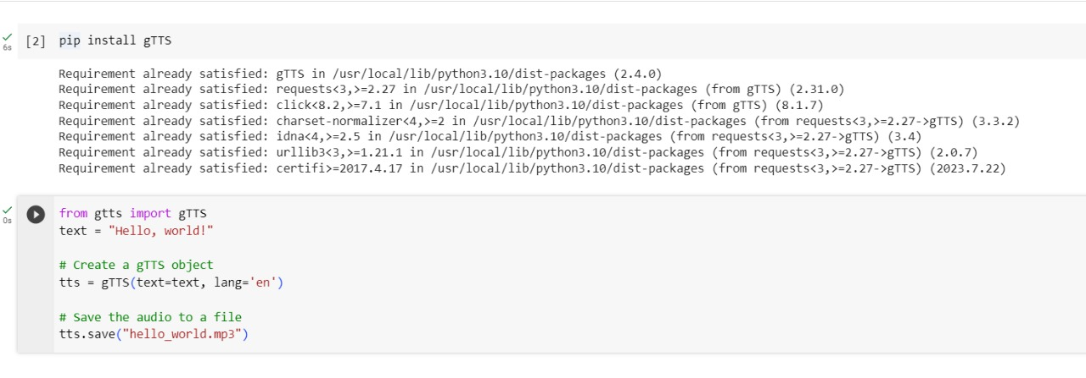
Text To Speech Model:

Slide 16
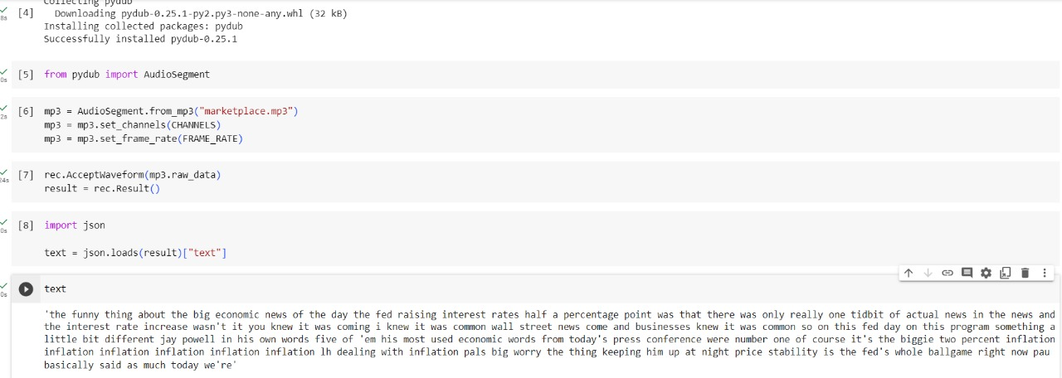
Speech to Text Model:

Slide 17
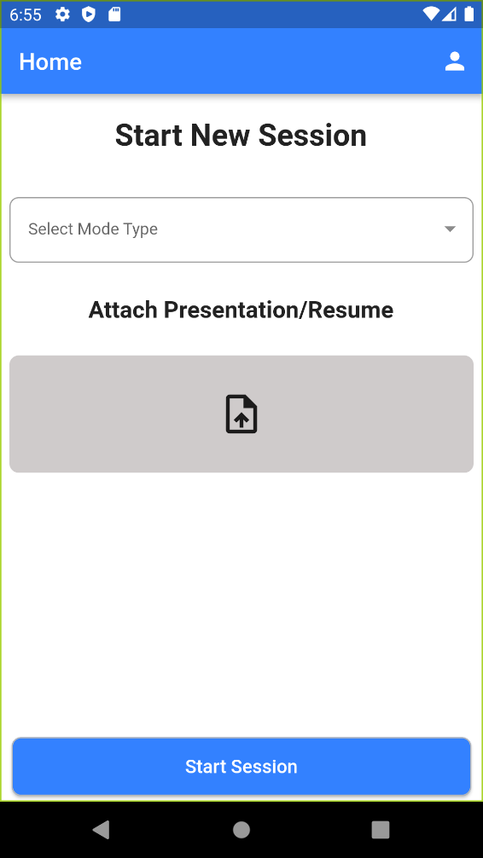
Mobile Home Screen

Slide 18
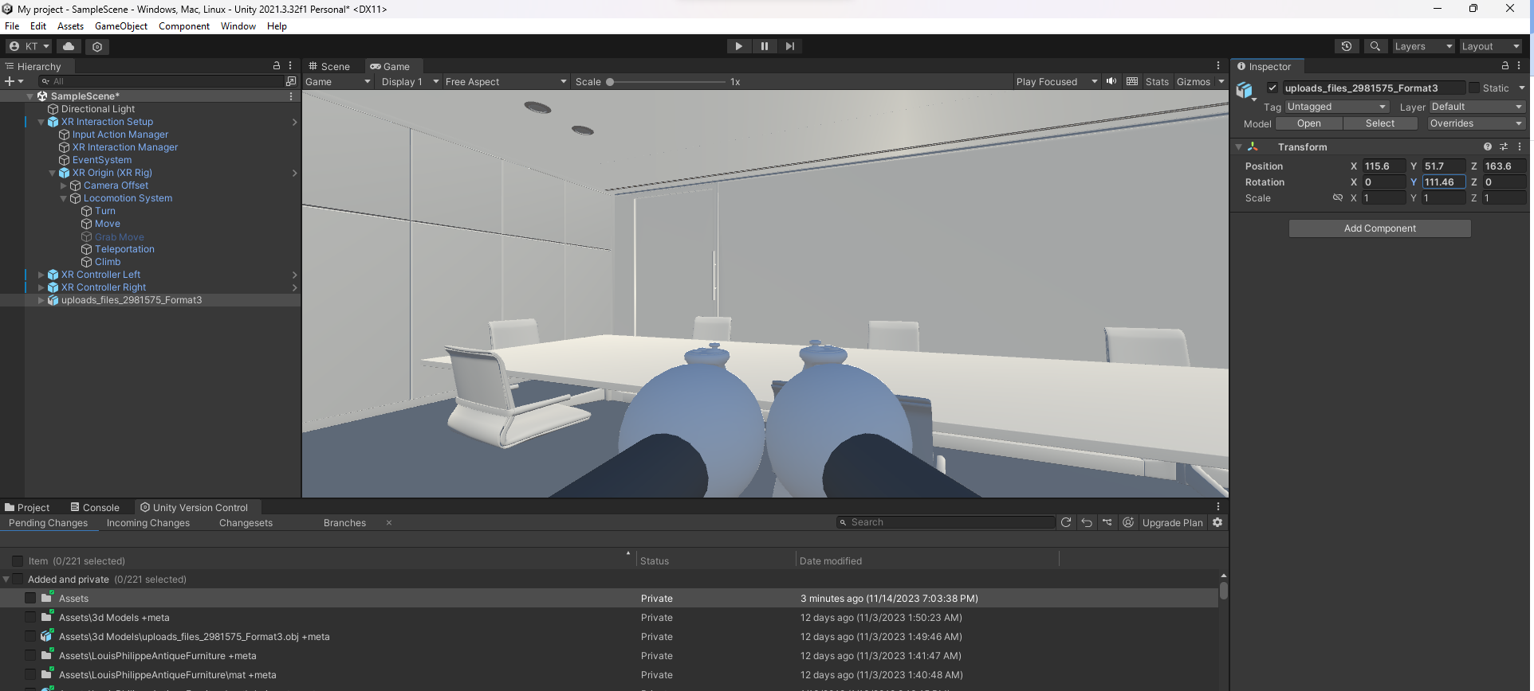
VR SETUP

Slide 19
THANK YOU

