Slide 1

Interpretability Natural language processing
Student: Ali Dankoob
40407024

Slide 2
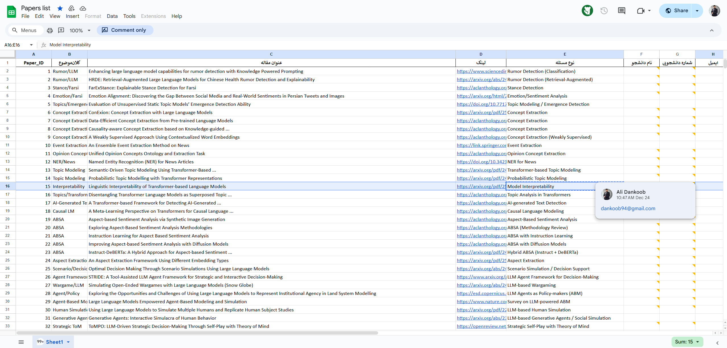

Slide 3
Introduction
Linguistic Interpretability of Transformer-based Language Models
Graduate Course: Natural Language Processing
Transformer-based language models such as BERT, GPT, and T5 have become the dominant paradigm in modern NLP
Despite their strong empirical performance, their internal decision-making mechanisms remain largely opaque
This presentation focuses on understanding how linguistic knowledge is represented and utilized inside these models
The project is conducted in the context of interpretability and explainable artificial intelligence (XAI)

Slide 4
Background and Motivation
Natural Language Processing has evolved from rule-based and statistical models to deep neural architectures
Transformers introduced self-attention, enabling effective modeling of long-range dependencies
This architectural shift significantly improved performance across NLP tasks
However, it also increased model complexity and reduced transparency
As models grow larger, understanding their internal behavior becomes increasingly critical

Slide 5
Problem Definition
Linguistic interpretability studies how linguistic knowledge is encoded within transformer-based models
It focuses on internal representations such as embeddings, layers, attention heads, and neurons
The goal is to map abstract neural representations to human-understandable linguistic concepts
Linguistic properties include syntax, semantics, morphology, and discourse-level information
The problem addresses the gap between high performance and limited explainability

Slide 6
Scope of the Problem
The scope goes beyond evaluating model outputs or accuracy metrics
It investigates how language understanding emerges inside the model
A key question is whether models truly learn linguistic structure or rely on statistical shortcuts
Another concern is distinguishing stored linguistic knowledge from knowledge actually used in predictions
This scope is relevant for both theoretical research and real-world deployment

Slide 7
Model Interpretability
Model interpretability refers to the ability to explain a model’s behavior in human terms
It aims to answer why a specific output or prediction was generated
Interpretability supports trust, transparency, and accountability
In deep neural networks, interpretability is challenging due to non-linearity and high dimensionality
Nevertheless, it is essential for debugging, validation, and responsible AI

Slide 8
Importance of Linguistic Interpretability
Linguistic interpretability is especially important because language models learn linguistic patterns implicitly, without explicit supervision or formal grammatical rules. Without interpretability, it is difficult to determine whether a model’s success is based on meaningful linguistic generalization or on exploiting spurious correlations in data. By revealing how linguistic structures are represented, interpretability helps identify biases, improve generalization, and ensure that models behave reliably in unseen or sensitive scenarios.

Slide 9
Real-world Relevance
In real-world applications, the need for interpretability is not merely theoretical. Content moderation systems must justify why certain texts are flagged or removed. Legal and medical NLP systems require transparent reasoning to support high-stakes decisions. Educational technologies also benefit from interpretable feedback that can be understood by learners. In all these domains, linguistic interpretability increases user trust and enables accountability.

Slide 10
Position within NLP
Linguistic interpretability occupies a central position within modern NLP research, bridging deep learning, linguistic theory, and explainable AI. Rather than focusing solely on performance improvements, this field aims to provide scientific insight into how language models function internally. By integrating linguistic concepts with neural analysis, interpretability research contributes to transforming NLP from a purely engineering-driven discipline into a more explanatory and theory-informed field.

Slide 11
Relation to Core NLP Tasks
Most core NLP tasks rely on linguistic knowledge at different levels. Tasks such as syntactic parsing and part-of-speech tagging depend on structural understanding, while semantic tasks such as named entity recognition and semantic role labeling require meaning representation. Higher-level applications, including natural language inference, summarization, and dialogue systems, combine multiple linguistic competencies. Linguistic interpretability enables systematic analysis of how transformer models handle these tasks internally.

Slide 12
Research Landscape
Research in linguistic interpretability can be broadly categorized into several complementary streams. These include probing-based approaches that examine encoded linguistic features, attention-based analyses that study structural alignment, causal methods that test the necessity of internal components, and mechanistic approaches that aim to reverse-engineer computation circuits. Together, these streams provide a comprehensive view of how linguistic knowledge emerges in transformer models.

Slide 13
Probing based Methods
Probing methods train lightweight classifiers on frozen model representations
They evaluate whether linguistic properties can be extracted from specific layers
Common probing tasks include POS tagging, dependency relations, and semantic roles
Layer-wise probing reveals where different types of linguistic information emerge
A key limitation is that probing measures correlation rather than causation

Slide 14
Concrete Examples of Linguistic Interpretability
Example 1: Attention Visualization
Sentence: "The cat sat on the mat."
Show attention heatmap from a BERT layer — highlight how cat attends strongly to sat (subject-verb relation).
Example 2: Probing for Part-of-Speech
Use a simple classifier to extract POS tags from different BERT layers — show accuracy per layer (e.g., lower layers capture surface forms, higher layers capture syntax).

Slide 15
Attention based Analysis
Attention analysis investigates how self-attention mechanisms distribute focus across tokens
Researchers examine whether attention heads correspond to syntactic or semantic relations
Some heads specialize in capturing subject–verb or modifier–head dependencies
These patterns suggest structural linguistic knowledge
However, attention weights do not always reflect causal importance

Slide 16
Causal Interpretability Methods
Causal interpretability aims to determine whether specific internal components are necessary for a model’s linguistic capabilities. This is achieved through interventions such as ablation of layers, attention heads, or neurons, as well as activation patching techniques that manipulate internal states. If modifying a component leads to significant performance degradation, it can be considered causally important. These methods offer stronger interpretability claims than purely correlational analyses.

Slide 17
Mechanistic Interpretability
Mechanistic interpretability focuses on understanding exact computational pathways
It attempts to identify circuits responsible for specific linguistic capabilities
This approach is similar to reverse engineering neural networks
It is often applied to smaller models or constrained tasks
Recent work explores extending this approach to large language models

Slide 18
Tools & Libraries for Interpretability
Captum (PyTorch): Model-agnostic attribution methods.
Transformers Interpret (Hugging Face): Attention and gradient-based explanations.
LIT (Language Interpretability Tool): Interactive exploration of model predictions.
Ecco (for GPT-like models): Visualization of generation and attention.
Why it matters: These tools lower the barrier to entry and support reproducible interpretability research.

Slide 19
Key Challenges
One of the main challenges in linguistic interpretability is that linguistic knowledge is distributed across many parameters rather than localized in individual neurons. This makes it difficult to associate specific components with clear linguistic concepts. Additional challenges include dependence on linguistic theory assumptions, high computational costs, and the absence of standardized evaluation benchmarks for interpretability research.

Slide 20
Limitations of Current Approaches
Many interpretability methods rely on statistical correlations
Results may not generalize across models or languages
Linguistic categories may not align cleanly with neural representations
Human interpretation introduces subjectivity
Scalability remains a major concern for LLMs

Slide 21
Future Research Directions
Future research in linguistic interpretability is expected to focus on developing more robust and scalable causal methods. Cross-lingual and multilingual interpretability will play an increasingly important role as models are deployed globally. Integrating linguistic theory into model architectures and incorporating human-in-the-loop evaluation frameworks are also promising directions. Interpretability for large language models remains a key open challenge.

Slide 22
Practical Applications
In practical settings, linguistic interpretability supports model debugging, error analysis, and bias detection. It helps practitioners assess dataset quality and understand model failures. Interpretability is also essential for ensuring robustness and for supporting responsible and ethical deployment of NLP systems in real-world environments.

Slide 23
Interpretability for Model Improvement
Error Analysis & Debugging: Use attention patterns to detect why NER fails on certain entities.Bias Detection: Identify stereotypical associations via probing (gender bias in coreference resolution).Data Augmentation: Use interpretability to find underrepresented linguistic phenomena and enrich training data.Interpretability-Guided Fine-tuning: Regularize models to align attention with linguistic heuristics (syntactic trees).Impact: Turns interpretability from a diagnostic into a tool for building better models.

Slide 24
Social Media, Content Analysis, and Security
Explainable hate speech and toxicity detection
Misinformation and propaganda analysis
Discourse and narrative structure analysis
Detection of extremist and malicious communication
Transparent automated moderation and monitoring systems

Slide 25
Conclusion
Linguistic interpretability is a core challenge in modern NLP
It bridges neural computation and human language understanding
Interpretability enhances transparency, trust, and safety
The field is essential for the future of language technologies
It plays a critical role in responsible deployment of NLP systems

Slide 26
References
1. Vaswani, A., Shazeer, N., Parmar, N., Uszkoreit, J., Jones, L., Gomez, A. N., Kaiser, Ł., & Polosukhin, I. (2017).Attention Is All You Need. Advances in Neural Information Processing Systems (NeurIPS). 2. Belinkov, Y., & Glass, J. (2019).Analysis Methods in Neural Language Processing: A Survey. Computational Linguistics. 3. Tenney, I., Das, D., & Pavlick, E. (2019).BERT Rediscovers the Classical NLP Pipeline. Proceedings of the 57th Annual Meeting of the Association for Computational Linguistics (ACL). 4. Hewitt, J., & Manning, C. D. (2019).A Structural Probe for Finding Syntax in Word Representations. Proceedings of NAACL-HLT. 5. Conneau, A., Kruszewski, G., Lample, G., Barrault, L., & Baroni, M. (2018).What You Can Cram into a Single Vector: Probing Sentence Embeddings for Linguistic Properties. Proceedings of ACL. 6. Hewitt, J., & Liang, P. (2019).Designing and Interpreting Probes with Control Tasks. Proceedings of EMNLP-IJCNLP.

Slide 27
7. Clark, K., Khandelwal, U., Levy, O., & Manning, C. D. (2019).What Does BERT Look at? An Analysis of BERT’s Attention. Proceedings of ACL. 8. Jain, S., & Wallace, B. C. (2019).Attention Is Not Explanation. Proceedings of NAACL-HLT. 9. Elhage, N., et al. (2021).A Mathematical Framework for Transformer Circuits. Transformer Circuits (OpenAI / Anthropic). 10. Manning, C. D., Clark, K., Hewitt, J., Khandelwal, U., & Levy, O. (2020).Emergent Linguistic Structure in Artificial Neural Networks. Proceedings of the National Academy of Sciences (PNAS). 11. Doshi-Velez, F., & Kim, B. (2017).Towards a Rigorous Science of Interpretable Machine Learning. arXiv preprint arXiv:1702.08608. 12. Danilevsky, M., Qian, K., Aharonov, R., Katsis, Y., Kawas, B., & Sen, P. (2020).A Survey of the State of Explainable AI for Natural Language Processing. Proceedings of ACL.

Slide 28
The End
Thank you for your attention

