Slide 1

Linguistic Interpretability
Natural language processing
Student: Ali Dankoob
40407024
Notes:
[Sources] - Primary paper (survey): https://arxiv.org/abs/2504.08001 [/Sources]

Slide 2
Linguistic Interpretability of Transformer-based PLMs
Systematic Review of 160 Articles + Roadmap (Prototype)
Problem and Motivation: Why is Linguistic Interpretability Important?
Systematic Review Method and Scope of the Article (PRISMA-like) Overview of Transformer and the Concept of layerwise interpretability Key results at 4 levels of Syntax/Semantics/Morphology/Discourse: Methods: Probing, Analysis, Attention, Geometry Analysis, Embedding, etc. Limitations + Prototype Idea Practical for Lesson Project
Notes:
[Sources] - Primary paper (survey): https://arxiv.org/abs/2504.08001 [/Sources]

Slide 3
1)Problem and motivation
Why Interpretability at all?
Black-box risk
Bias & safety
Transformer models perform great, but there's a "black box" inside. Without an understanding of the internal mechanism: it becomes difficult to detect errors, biases, and fragile behaviors. For practical NLP: Knowing which layer/head/neuron has what knowledge debugging and targeted improvement. For low-resource languages: If we understand where linguistic knowledge is encoded, it becomes easier to transfer/inject knowledge.
PLM
What did he learn where and how?
Why is "linguistics" within the model important?
If the model really learns linguistic structures, we expect better generalization and fewer errors.
If it only learns statistical correlation, it may remain dependent on frequency.
Objective: To summarize the evidence from 160 research papers on Syntax/Morphology/Semantics/Discourse in PLMs.
Page 3 / 19
Survey + Prototype-ready deck
Notes:
[Sources] - Survey (motivation + “black box” framing): https://arxiv.org/abs/2504.08001 - Stochastic parrots critique: https://luiscruz.github.io/green-ai/publications/2021-03-bender-parrots.html (DOI: 10.1145/3442188.3445922) [/Sources]

Slide 4
2) Definitions and Scope
Three Keywords
Explainability
Interpretability
Linguistic interpretability
Explain why this output is usually close to the output/behavior? It is often not model-agnostic and focuses on the importance of inputs.
Trying to understand the internal mechanisms (layers, attention heads, neurons, embeddings) and how they reach the output.
Focus on whether PLMs represent/code linguistic phenomena (syntax/morphology/semantics/discourse) similar to humans.
What exactly does this survey cover?
160 papers (2018 to Oct 2024), focusing on Transformer-based PLMs and internal representations.
Baseline models (pre-trained) without fine-tune for specific tasks; only black-box studies have been omitted
The four linguistic levels are Syntax, Semantics, Morphology, and Discourse
Methods: Probing Attention/Neurons Analysis, Embedding Geometry Analysis, Ablation/Pruning, etc.
Page 4 / 19
Survey + Prototype-ready deck
Notes:
[Sources] - Survey definitions + scope: https://arxiv.org/abs/2504.08001 [/Sources]

Slide 5
3) Systematic review method (PRISMA-like)
Selection of Pipeline Articles (Key Numbers)
Google Scholar search
≈ 5,580 results
After filters & sampling
876 candidate papers
Title/abstract screening
277 papers
Full analysis + exclusions
160 included studies
Delete/Important Details in Selection
Labeling Dimensions: Linguistic Level, Phenomena, Languages, Models, Methodology, Attitude toward PLM's Linguistic Ability, and (interpretability)
Compound keywords : probe/interpret/explain+ transformer/BERT +syntax/semantic/morphology...
Filter: Period 2018–Oct 2024, focusing on English articles and mainly
peer-reviewed articles
Eliminate black-box analyses only for the final output; focus on layerwise/internal.
Two stages of human annotation: (1) title/abstract, (2) accurate reading and dimensional labeling.
Survey → "What can be put into practice?“
The prototype must demonstrate an intrinsic interpretability technique (e.g., probing).
Output: Chart + Analysis + Reproducible Code.
Page 5 / 19
Survey + Prototype-ready deck
Notes:
[Sources] - Survey methodology + counts (5580→876→277→160): https://arxiv.org/abs/2504.08001 [/Sources]

Slide 6
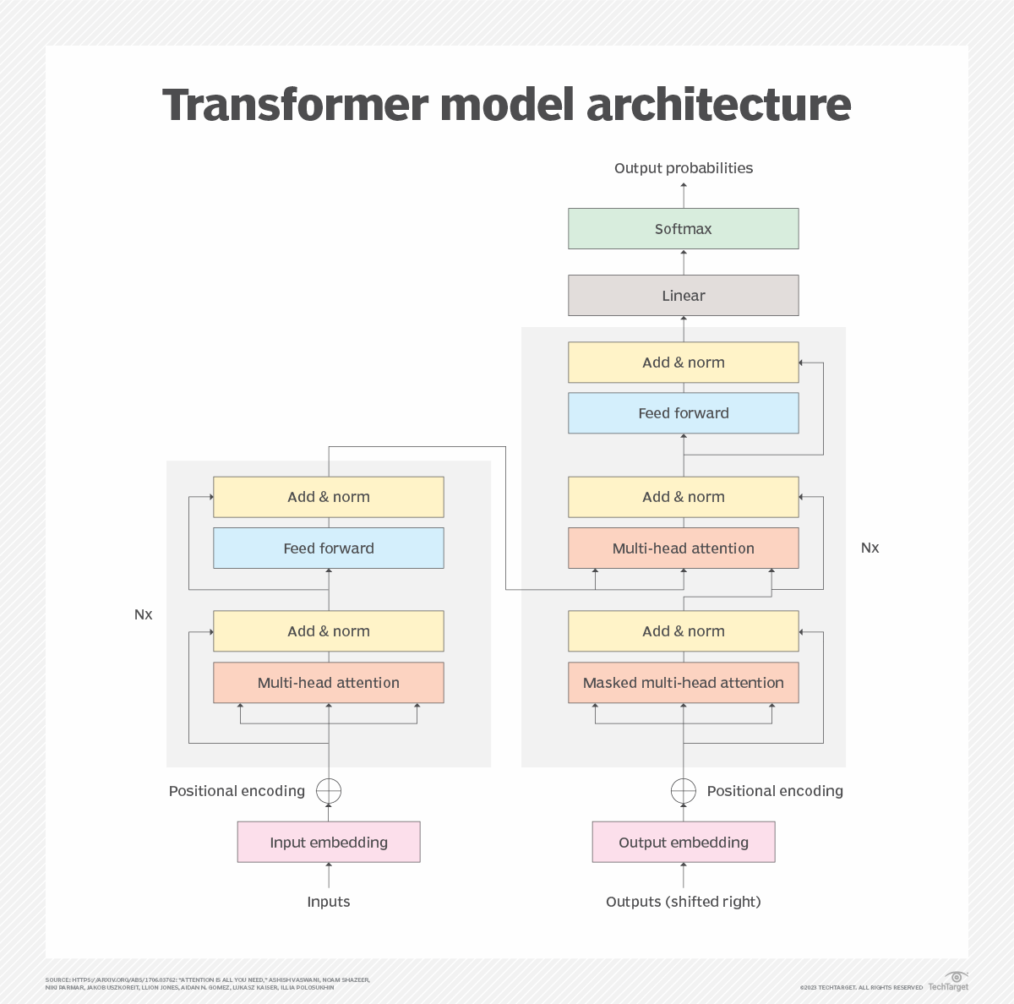
4) Transformer for Interpretability (Technical Summary)
Key components studied in the studies
Tokenization (BPE/WordPiece) → can make morphology difficult to study.
Embedding layer + L Transformer layers → contextual embeddings in each layer.
Self-attention heads → patterns of dependence, coreference, constituency...
Feed-forward (FFN) + residual/LayerNorm → "store/convert" knowledge in layers.
Layerwise view: lower (1–3), middle (4–7), upper (8–12) for BERT-base.
Encoder vs Decoder vs Encoder-Decoder → Difference in Attention (Masking) and Application.
Transformer model architecture (encoder/decoder)
Page 6 / 19
Survey + Prototype-ready deck
Notes:
[Sources] - Survey section “A brief overview of the Transformer architecture elements”: https://arxiv.org/abs/2504.08001 - Transformer architecture image (used in slide): https://www.techtarget.com/rms/onlineimages/transformer_model_architecture-f.png [/Sources]

Slide 7
5) Survey Data: Languages and Architectures Surveyed
Research focus: Still English-centric
145/160 studies include English, but other languages have been gradually added (e.g., German, French, Russian, Persian...).
Top languages in analyzed PLMs (count of studies)
Most studied model families (count of studies)
Insight: The heavy focus on BERT/RoBERTa is due to its "parameter availability" and lower cost of internal analysis.
Page 7 / 19
Survey + Prototype-ready deck
Notes:
[Sources] - Language counts (Table 1) + model-family counts (Table 2): https://arxiv.org/abs/2504.08001 [/Sources]

Slide 8
6) Common Methods of Discovering Language Knowledge
4 Family Method (Taxonomy Article)
How often each method appears (160 papers)
Feature attribution
The importance of each token/span relative to the output (gradient, perturbation, LIME...).
Example-based
Designed/Adversarial/Counterfactual sentences and view the output change/display.
Architecture elements
Analysisattention heads/neurons/FFN/embeddings + pruning/ablation/visualization.
Quick Withdrawal:
Probing
Probing is the dominant method (117 studies). A combination of several methods usually yields richer results. Probing risk: "Memorizing the task" rather than recognizing the knowledge of the model → requires control/causal probes.
Style classifier tutorial on intermediate representations to predict language labels (POS, dep, SRL...).
Page 8 / 19
Survey + Prototype-ready deck
Notes:
[Sources] - Method taxonomy + counts (Table 3): https://arxiv.org/abs/2504.08001 - Probe critique overview (background): https://aclanthology.org/N19-1419/ (structural probe as early catalyst mentioned in survey) [/Sources]

Slide 9
7) Findings — Syntax
Is syntax in PLMs? Probably yes — but with a caveat.
1) Positive evidence
2) Negative/ambiguous evidence
Discover dependency-like structure of embeddings (multiple studies).
Many report that syntax is more powerful than semantics code.
In mBERT there is evidence of syntactic transfer between languages.
Dependence on word order in some settings.
Weakness in Specific Phenomena: Agreement in Low-Frequency Forms, Reflexive Anaphora...
The syntax/semantics separation is not always clear (inconsistent results).
3) Layerwise & elements
4) Embedding geometry
BERT-base: Often important "middle layers" are reported (but not complete consensus).
Some tasks: the simultaneous role of lower+middle or distribution across the entire model.
Attention heads are sometimes specialized in dependency relationships.
Separate linear spaces are reported below for syntax and semantics.
Low-dimensional subspaces are reported for some syntactic variables (e.g., POS/agreement).
However, overlap between linguistic concepts has also been observed.
Page 9 / 19
Survey + Prototype-ready deck
Notes:
[Sources] - Survey synthesis of syntax findings (Section 5.1 + tables): https://arxiv.org/abs/2504.08001 - Structural probe catalyst (Hewitt & Manning, 2019): https://aclanthology.org/N19-1419/ (DOI: 10.18653/v1/N19-1419) [/Sources]

Slide 10
8) Findings — (Lexico)Semantics
Overall result: Semantics are largely present, but heterogeneous and sometimes weaker than syntax
Reported capabilities
Challenges and Cons
Layers and geometry
Polysemy and sense-level differences (monolingual is better than mBERT in some studies).
Knowledge of scale/number/date and some semantic roles.
Recognize the meaning of idioms (literal vs figurative) in some settings.
Negation: Mixed results; unstable in some models/sizes.
Context-dependent reasoning/factual abstraction has been reported in some works.
Domain semantics (e.g., scientific) are sometimes weak and cause chain errors (e.g., coref).
There is no definitive consensus on layerwise location (middle vs upper vs lower depending on the model).
The lower layers are often lexical.
The existence of separate subspaces is reported for semantics and syntax.
Page 10 / 19
Survey + Prototype-ready deck
Notes:
[Sources] - Survey synthesis of semantics findings (Section 5.2 + Table 6): https://arxiv.org/abs/2504.08001 [/Sources]

Slide 11
9) Findings — Morphology
Morphology is less studied, and tokenization is a serious obstacle
Key observations (from the Survey)
Implications for Prototype
Most studies examine morphology along with syntax (not independent).
Tokenization (WordPiece/BPE) makes morphemes not always equivalent to tokens.
Layerwise: Sometimes similar to syntax (middle/upper), but depending on the language and model.
Some phenomena (number/tense) are reported in linear subspaces.
Evidence of common 'morphosyntax' neurons in mBERT has been reported between languages.
If Persian/Turkish/Russian is selected: Be sure to report the sensitivity of the tokenizer.
For class work: Agreement (number/tense) is very implementable with probing.
It is possible to specify which layers are better for number/tense.
Sample Suggested Experiment (Quick)
Dataset: UD POS + Morph features (small subset).
Extract: embeddings of multiple layers (e.g., 1,4,8,12).
Probe: Logistic regression/small MLP for features like Number/Tense.
Output: accuracy per layer + chart + analysis.
Page 11 / 19
Survey + Prototype-ready deck
Notes:
[Sources] - Survey morphology synthesis (Section 5.3): https://arxiv.org/abs/2504.08001 [/Sources]

Slide 12
10) Discourse and Minor Issues
There is a lot of research that has been done on the subject (6 articles), but it has some interesting findings.
Discourse findings
Knowledge-domain neurons
Multilingual shared space
Coherence and discourse relationships are seen to some extent in embeddings.
The sensitivity to disfluency decreases with the depth of the layer (the representations become more similar).
RST: Some jobs report the intermediate layers more strongly.
Report the presence of "scoped" neurons (social media / science / noun-heavy ...).
Discovery by clustering the activation of neurons on sentences.
For the project: A simple simulation can be done with activation statistics.
Hypothesis: Common parameters → alignment of structures between languages.
Mixed evidence: Some phenomena are shared, some are not (e.g., agreement in masked LMs).
Word order plays a key role in several studies.
review this slide as "Lesser-said but interesting".
Page 12 / 19
Survey + Prototype-ready deck
Notes:
[Sources] - Survey discourse section (5.4) + “knowledge neurons” + multilingual discussion (5.5): https://arxiv.org/abs/2504.08001 [/Sources]

Slide 13
11) Caveats, pitfalls, open problems
Why aren't interpretability results always "proven"?
Correlation ≠ Causation
Why have new LLMs become harder to analyze?
Linguistic information may be "extractable" in embedding, but the model may not use it in inference.
Probes may learn the task rather than recognize the knowledge of the model.
Solutions: control tasks, causal probes (amnesic/information-theoretic/dropout...).
Limited metric (accuracy only) can be misleading.
Model size ↑ → Cost of extraction/internal analysis ↑Some models are closed (parameters/heads are not available).
Tendency to prompting in studies ↑, but transparency/internal analysis ↓
Conclusion: Research is still very much focused on the BERT-family.
Page 13 / 19
Survey + Prototype-ready deck
Notes:
[Sources] - Survey discussion on correlation/causation + causal probes + probing pitfalls (Section 6): https://arxiv.org/abs/2504.08001 [/Sources]

Slide 14
12) Prototype – What Was Implemented
Prototype Overview
Model: bert-base-multilingual-cased (Transformer encoder)
Data: Universal Dependencies (UD) – POS annotations
Method: Layer-wise probing of contextual embeddings
Analysis: Extraction of hidden states from multiple Transformer layers
Goal: Demonstrate how syntactic information is distributed across layers
> This prototype is inspired by the dominant interpretability methods identified in the survey.
Page 14 / 19
Survey + Prototype-ready deck
Notes:
[Sources] - Prototype choices derived from survey taxonomy and findings: https://arxiv.org/abs/2504.08001 [/Sources]

Slide 15
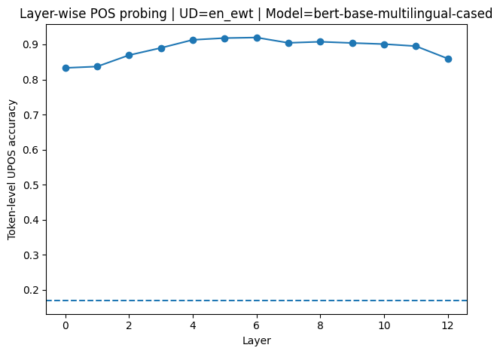
13) Demo Results – Layer-wise Probing
Prototype Overview
Key Observations Syntactic information is not uniformly distributed across layers Middle layers tend to show stronger POS predictability Lower layers capture more lexical information Upper layers show more abstract representations
layer-wise accuracy plot
Page 15 / 19
Survey + Prototype-ready deck
Notes:
[Sources] - Prototype choices derived from survey taxonomy and findings: https://arxiv.org/abs/2504.08001 [/Sources]

Slide 16
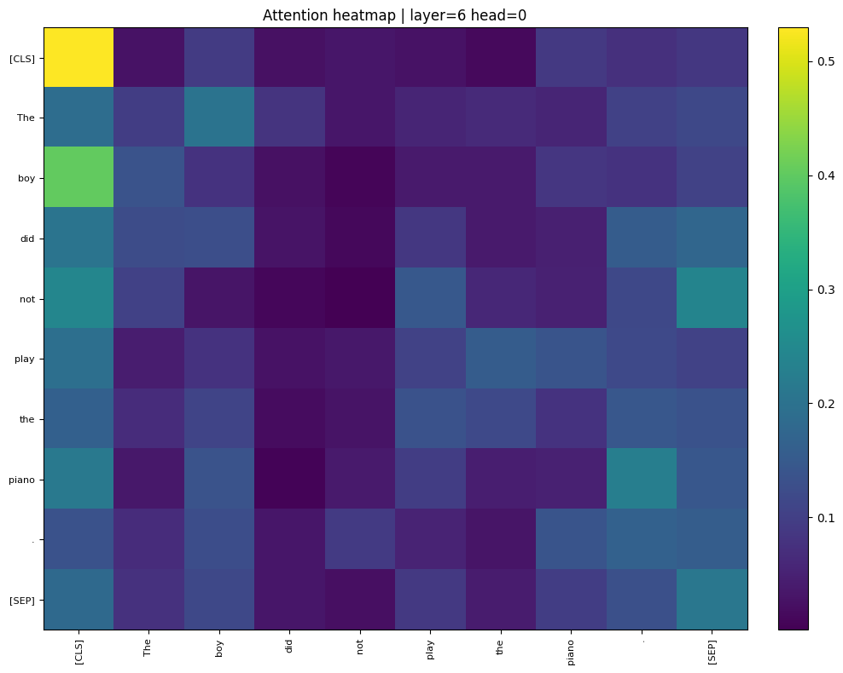
14) Attention Visualization (Example)
Attention-Based Analysis
Data
(UD subset)
Tokenizer
(BPE/WordPiece)
PLM
(bert-base)
Extract
layer embeddings
Probe
(LogReg/MLP)
attention heatmap image
Selected attention heads show structured patterns Some heads align with syntactic relations (e.g., local dependencies) Attention analysis complements probing but does not replace it
Page 16 / 19
Survey + Prototype-ready deck
Notes:
[Sources] - Prototype evaluation inspired by survey’s emphasis on layerwise representations and probing pitfalls: https://arxiv.org/abs/2504.08001 [/Sources]

Slide 17
15) Limitations & Disclaimer
Why This Prototype Is Valid for the Course (16
Justification
Important Caveats
This is a survey-based prototype, not a replication study
Probing measures extractability, not causal usage
Results are illustrative and educational
Small-scale experiment with limited data and models
The reference paper is a survey, not an experimental benchmark
The prototype directly implements core methods identified in the survey
Demonstrates practical feasibility of interpretability techniques
Fully reproducible and aligned with course requirements
Interpretability results should be interpreted with caution
Page 17 / 19
Survey + Prototype-ready deck
Notes:
[Sources] - Survey conclusions and discussion: https://arxiv.org/abs/2504.08001 [/Sources]

Slide 18
17) Takeaways
Prepared Answers (18
Final Takeaways
Transformer-based PLMs encode linguistic information internally
Probing is a practical and widely used interpretability method
Linguistic knowledge varies across layers and models
Small, well-designed prototypes are sufficient for educational analysis
Why probing?→ Because it is the most common and practical method identified in the survey.
Does extraction mean usage?→ No. Extractability does not imply causal reliance.
Why BERT?→ Open architecture, lower computational cost, and widespread use in interpretability studies.
Page 18 / 19
Survey + Prototype-ready deck
Notes:
[Sources] - Survey conclusions and discussion: https://arxiv.org/abs/2504.08001 [/Sources]

Slide 19
The end
Thank you for your attention
Notes:
[Sources] - Primary paper (survey): https://arxiv.org/abs/2504.08001 [/Sources]

