Slide 1
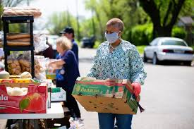


FoodUBank
"Servicing one community at a time"
Andy Louis Jean
Email
andylouisjean@gmail.com
linkedin
https://www.linkedin.com/in/and-louis-jean-6a61b4119
Github
https://github.com/ALJUnion

