Slide 1
Multiple 3D RNA structure superposition using neighbor joining
Cultural Assignment By Alex Kaiser
CSCE 221-501

Slide 2
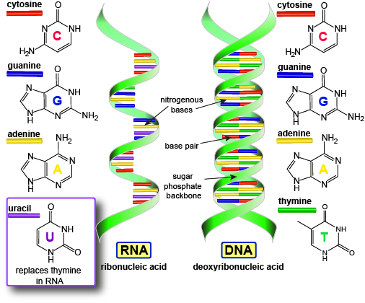
DNA vs. RNA
DNA is double stranded.
RNA is single stranded.
RNA can be matched with other strands of RNA that are alike.
Both hold genetic information.

Slide 3
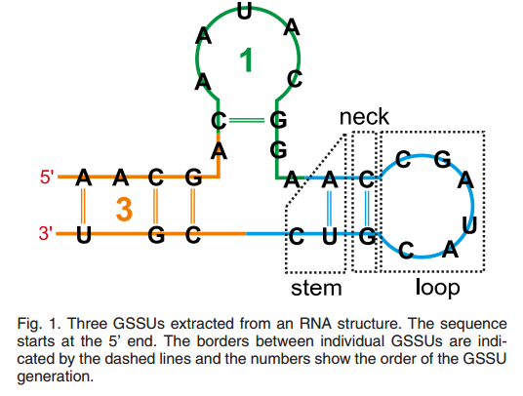
SETTER
SETTER uses the loop, stem and neck of RNA to match non-overlapping strands.
These three parts of the RNA together are called Generalized Secondary Structure Units (GSSU).

Slide 4
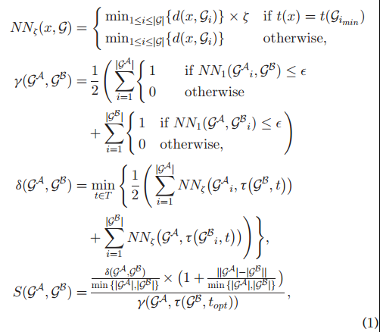
Setter formula
SETTER can be reduced to an algorithm to calculate the similarities in RNA strands.

Slide 5
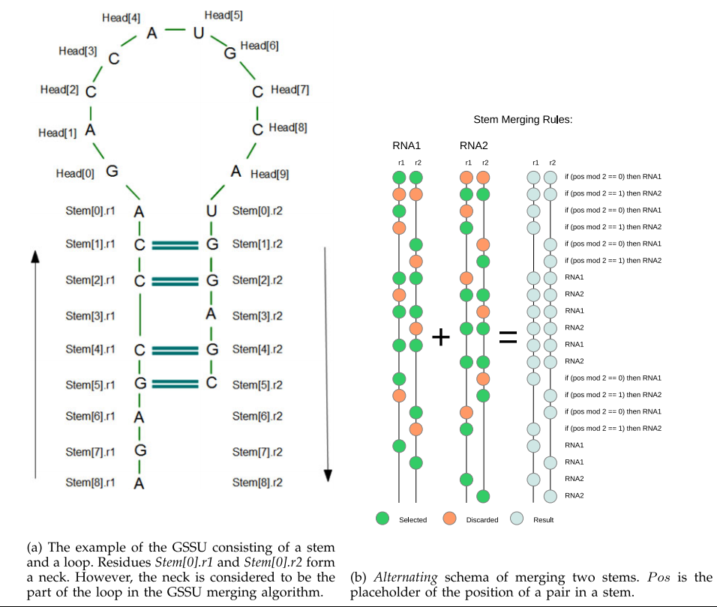
Multisetter
Updated version of SETTER with multiple structure alignment.
Uses guide trees to match RNA strands.
Process of matching two RNA strands is called merging.

Slide 6
What does this sound a lot like?????????

Slide 7
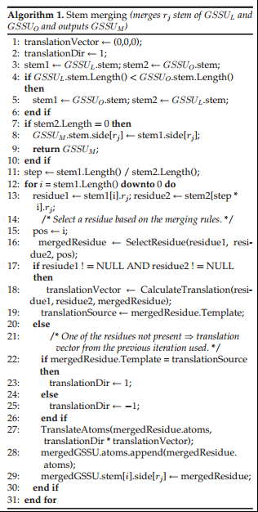
Multisetter as an else if statement
Matches GSSUs between the strands of RNA.
Program checks models for similarities and if none are found then it moves on to the next one.

Slide 8
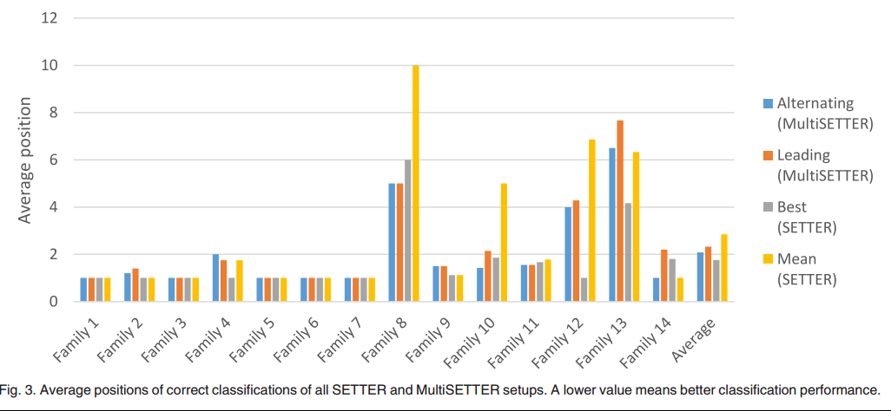
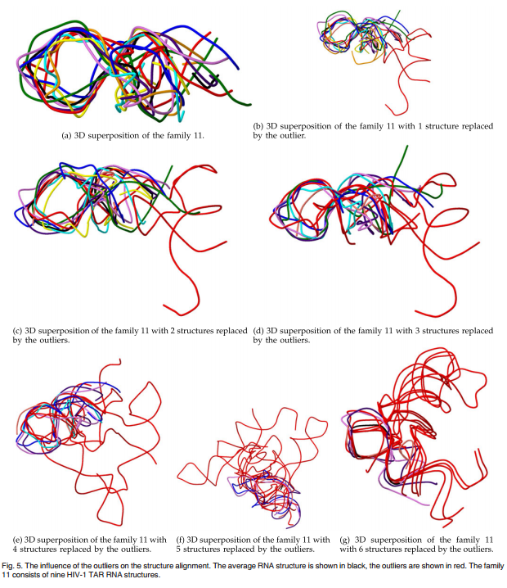
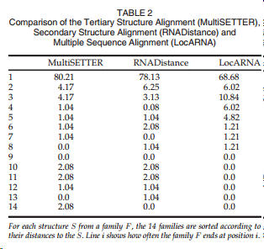
Upgrade from setter
Increase in performance and accuracy.
Less skewed by outliers.
Decrease in Runtime.

Slide 9

What does this mean?
Increased research in genomic medicines.
Faster runtime means more time for other research.
Increased research in genetic disorders.

Slide 10
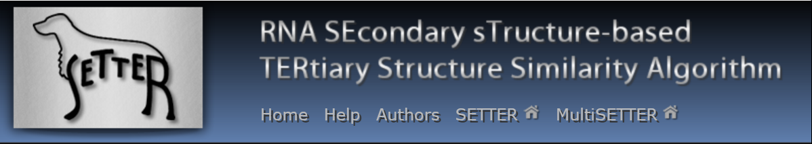
Power of c++
Did you know that this program was made with C++?
Free download at http://siret.cz/multisetter.
Shows us that the possibilities of C++ are endless.

Slide 11
Thank you for listening
☺
References
Hoksza, David, and Daniel Svozil. "Multiple 3D RNA Structure Superposition Using Neighbor Joining." IEEE/ACM Trans. Comput. Biol. and Bioinf. IEEE/ACM Transactions on Computational Biology and Bioinformatics 12.3 (2015): 520-30. Web.

