Slide 1

“Exploratory Data Analysis of Electric Vehicle Dataset.”

Slide 2
About me
Name: ALLAM SRIDHAR
Education: MSc(Computer Science) 2022-24 batch.
Current Status: Fresher, Aspiring Data Scientist
Why Data Science?
As a fresher, I am eager to explore the world of data science because it combines my intrest in technology and problem-solving.
I believe that the data science has potential to transform industries by making data-driven decisions.
Though I am new to this field, I am passionate about learning and improving my skills in areas such as data analysis, visualization, and machine learning.
I see the data as a field where I can grow and make significant impact by applying what I learn to real-world problems.
GitHub Link: https://github.com/ALLAM-SRIDHAR/Electric-Vehicles.git
LinkedIn Profile: www.linkedin.com/in/ALLAM-SRlDHAR

Slide 3
Agenda
1. Introduction
2. Data Description
3. Univariate Analysis
4. Bivariate Analysis
5. Task Questions
6. Conclusion

Slide 4
Introduction
Context: The rise of Electric Vehicles (EVs) is a significant development in the automotive industry. With increasing focus on sustainability, many automakers are shifting towards EV production. This dataset contains information on EV makes and their adoption over different model years.
Objective: The goal of this analysis is to explore the trends in EV manufacturing, understand the distribution of different makes across model years, and analyze key patterns in the growth of EVs.
Key Focus: The analysis will focus on understanding the spread of EVs by model year, identifying the most prominent manufacturers, and how the market for EVs has evolved over time.

Slide 5
Data Description
Dataset Overview: The dataset includes information on EV makes and their respective model years,Location (Country, State, County, City, Zip Codes), Electric Vehicle type, CAFV eligibility, etc... There are around 17 columns and 112634 rows in the dataset.
Columns: (Total 17 columns)
State: State where the vehicle is registered
Model Year: Year the vehicle model was manufactured
Make: Manufacturer of the vehicle
Model: Model of the vehicle
Electric Vehicle Type: Type of electric vehicle (BEV, PHEV, etc.)
Electric Range: The electric range of the vehicle in miles
Base MSRP: Base Manufacturer's Suggested Retail Price
Vehicle Location: Geographic coordinates of the vehicle's registered location
etc… are some of the columns
The dataset covers a range of years, focusing on the period from 1997 to 2023, with limited data for 2023.

Slide 6
Data Cleaning and Data Manipulation
Step1: Handling Missing values:
Since Model, Electric Utility Columns are Categorical I imputed values with Most frequent values(i.e. Mode).
Since Vehicle Location Column contains coordinates of location, so I replaced null values with ‘Unknown’
Step2: Transformation:
Converted columns like Postal Code, Model Year, DOL Vehicle ID, 2020 Census Tract from numeric to String/Object columns.
Legislative District column is by default taken as float, so first I converted it to string and then removed the .0 from the values and then converted it to Category columns.
Step3: Outlier Detection:
Using IQR method I did Outlier Detection.

Slide 7
Univariate Analysis
In order to perform univariate analysis first I separated numerical columns and categorical columns separately, into numerical_cols and categorical_cols columns.
numerical_cols=df.select_dtypes(include=[np.number]).columns
categorical_cols=df.select_dtypes(include=['object','category']).columns
Numerical Columns:
For numerical columns I did find the min, max, mean, median, skewness, kurtosis, range, IQR, STD
Also plotted Histogram and Box plots for each column
Categorical Columns:
For categorical column I did find the unique(), nunique() and value_counts()
also plotted the Count plot (or bar plot) for each column

Slide 8
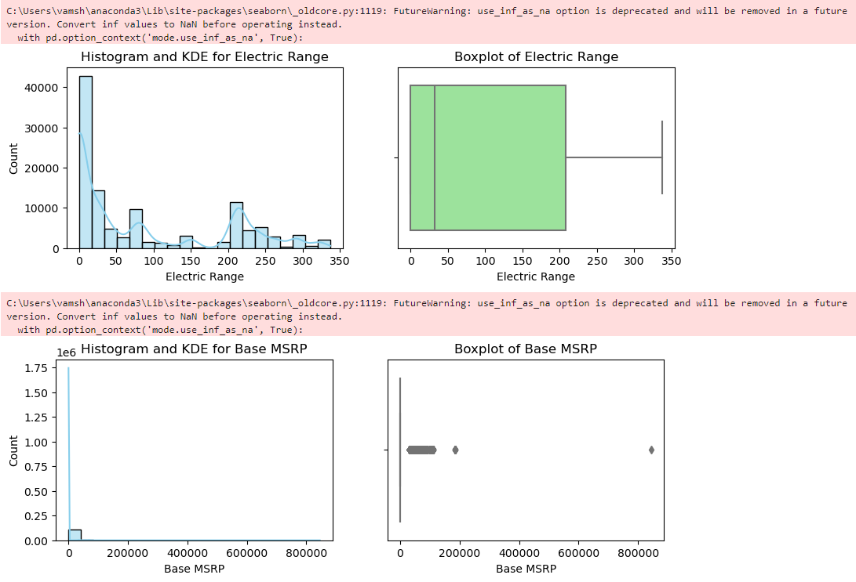
Univariate Analysis:
For Numerical Columns:
Electric Range:
The data suggests that most vehicles in the dataset are either hybrids or short-range electric cars.
Vehicles with longer ranges, such as Teslas or other higher-end EVs, are present but less frequent.
The right-skewness of the data indicates a few vehicles have exceptionally high electric ranges, possibly high-performance models.
Given the concentration of values around 0-50 miles, the market for EVs appears to be dominated by vehicles with limited electric capabilities, potentially pointing towards hybrid cars.
Base MSRP:
The high number of $0 values in the MSRP column is a concern, indicating missing or incomplete data.
These should either be treated as missing values or investigated further for clarification.
The distribution shows that most cars are affordable, but a few luxury cars drive up the maximum MSRP significantly, creating extreme outliers.

Slide 9
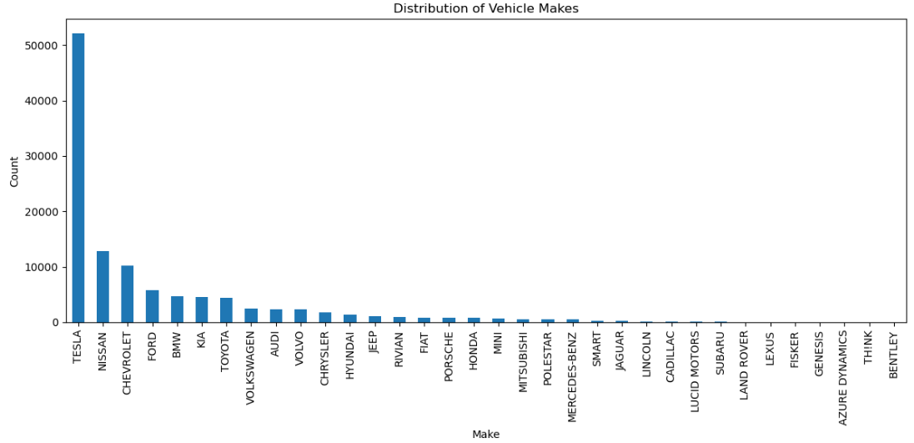
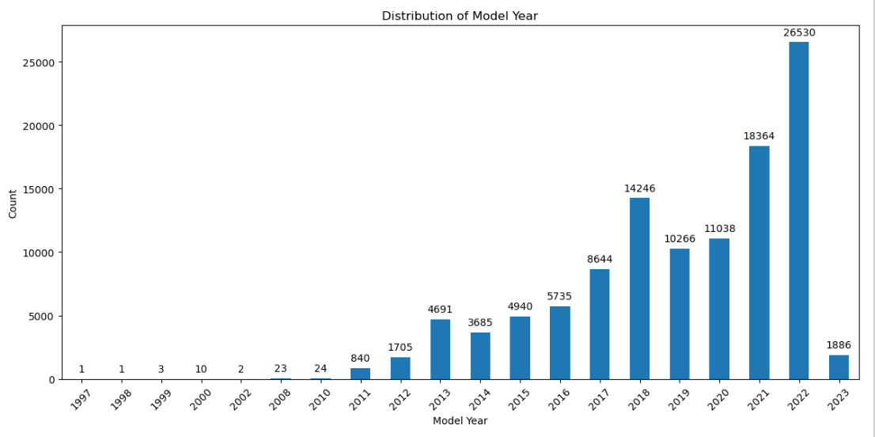
For Categorical columns:
Make:
Unique values: 34 distinct vehicle manufacturers.
Most common manufacturers: Tesla dominates the dataset with 52,078 entries, followed by Nissan (12,880) and Chevrolet (10,182).
Less common manufacturers: Some manufacturers, like Bentley and TH!NK, appear rarely with only 3 entries each, indicating niche or luxury models.
Model Year:
Unique values: 20 model years ranging from 1997 to 2023.
The most frequent model years are 2022 (26,530 entries), 2021 (18,364), and 2018 (14,246), showing a bias toward more recent models.
The least frequent years include 1997, 1998, and 1999, each with only 1–3 entries.

Slide 10
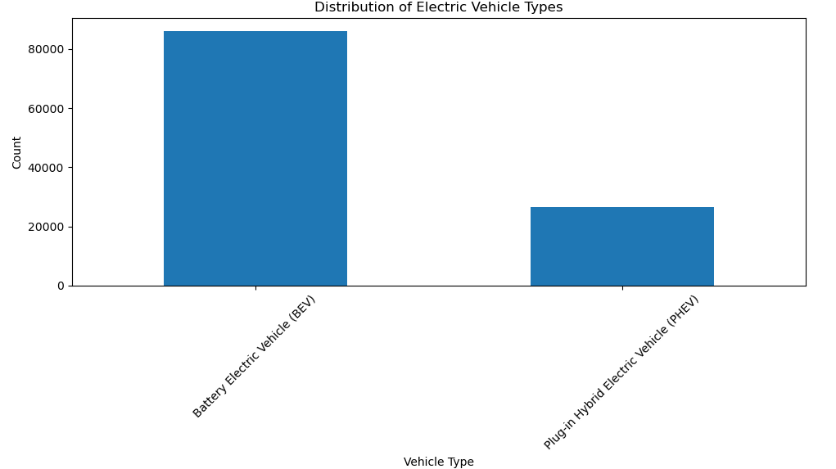
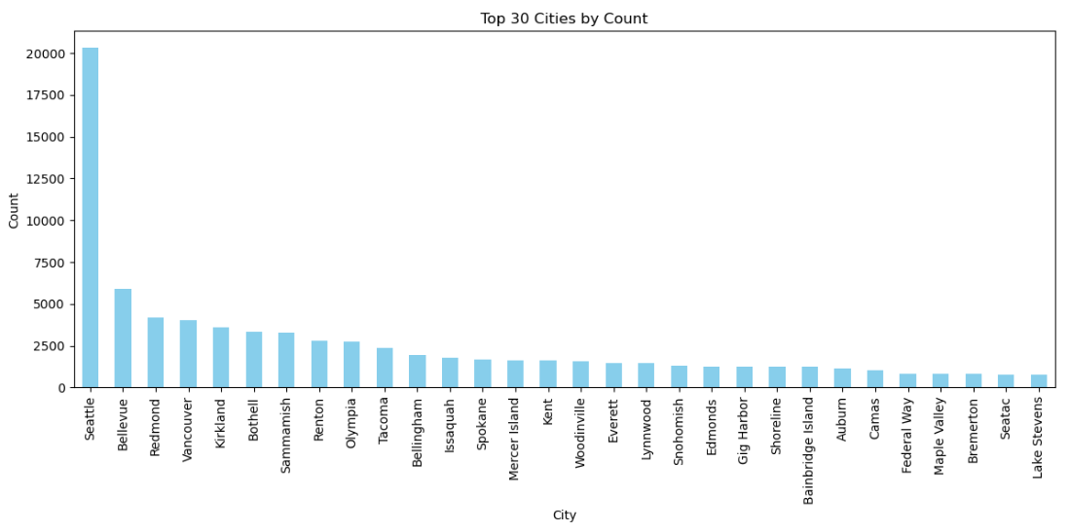
Electric Vehicle Type:
Unique values: 2 (Battery Electric Vehicle (BEV) and Plug-in Hybrid Electric Vehicle (PHEV)).
BEVs dominate the dataset with 86,044 entries, while PHEVs account for 26,590.
This suggests that full electric vehicles are more common than hybrids in this data.
City Column:
Unique Values: 629 cities are present in the dataset.
The top cities in terms of vehicle registrations are: Seattle: 20,305 vehicles, Bellevue: 5,921 vehicles, Redmond: 4,201 vehicles
Urban centers such as Seattle and Bellevue dominate the dataset, reinforcing the idea that the vehicle data is concentrated in and around major Washington cities.
Please note that since I cannot keep all my analysis in ppt, you can go through my repository link which is given on the 2nd slide.

Slide 11
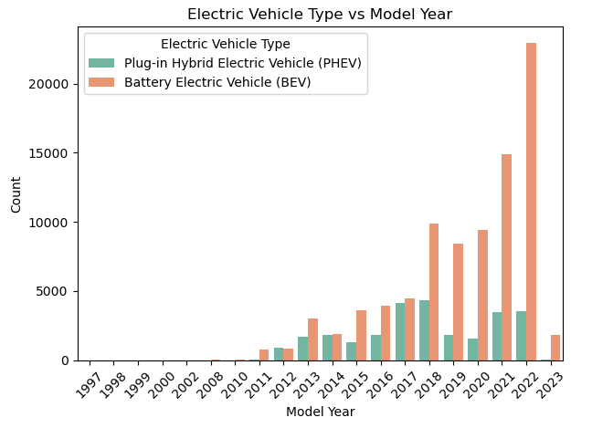
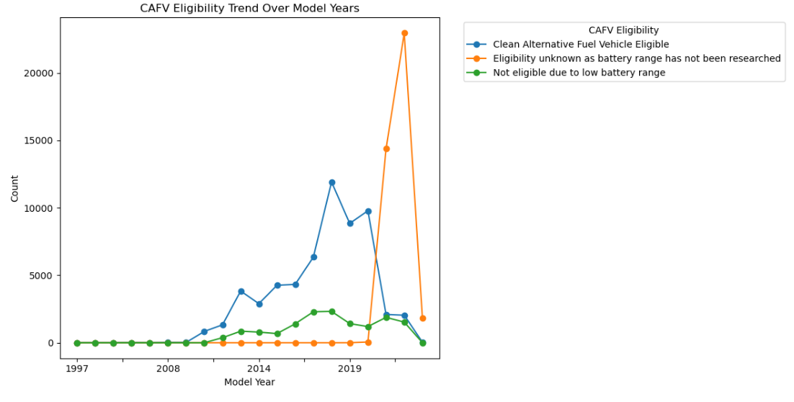
Bivariate Analysis
Electric Vehicle Type vs Model Year:
There's a clear increase in both Battery Electric Vehicles (BEVs) and Plug-in Hybrid Electric Vehicles (PHEVs) over time, with a significant spike in recent years.
BEVs consistently outnumber PHEVs across all model years, indicating a stronger market preference for fully Electric vehicles.
The most dramatic increase in both BEVs and PHEVs occurs in the most recent years (2020-2022), suggesting rapid market adoption.
There are some electric vehicles dating back to the late 1990s and early 2000s, but in much smaller numbers compared to recent years.
While not as pronounced as BEVs, PHEVs also show a steady increase over time, particularly from 2012 onwards.
CAFV Eligibility Trend Over Model Years:
The number of Clean Alternative Fuel Vehicle (CAFV) eligible models increased significantly from 2014 to 2019.
There's a sharp drop in known CAFV eligible vehicles after 2020, replaced by a large number of vehicles with unknown eligibility.
The number of vehicles not eligible due to low battery range has remained relatively low and stable since 2014.The peak of CAFV eligible vehicles was around 2018-2019.
The data for 2021-2023 shows a mix of eligible, unknown, and ineligible vehicles, suggesting ongoing changes in the EV market or eligibility criteria.

Slide 12
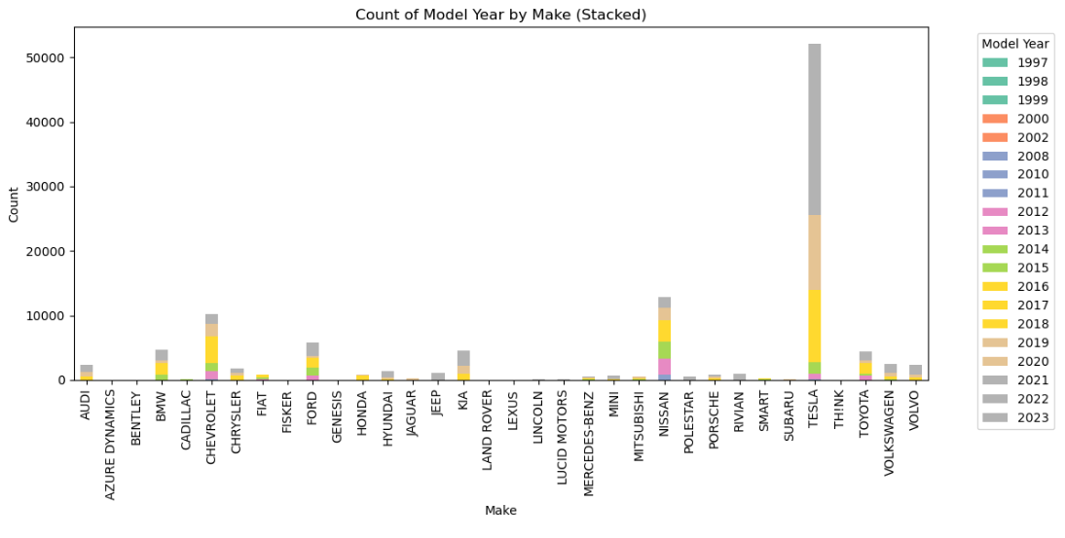
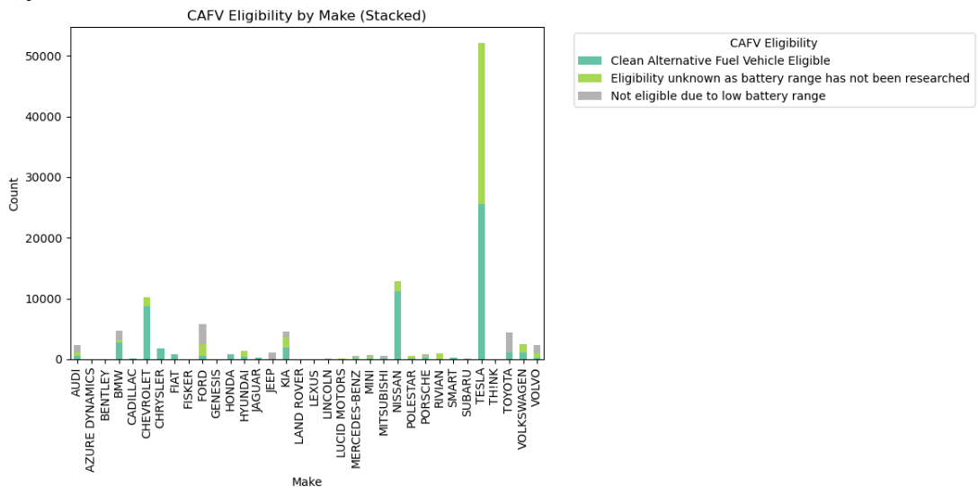
Count of Model Year by Make (Stacked):
Tesla dominates in terms of the number of models across various years, especially in more recent years.
Traditional automakers like Ford, Chevrolet, and Nissan have been consistently producing EVs over a longer period.
Many manufacturers started significant EV production around 2018-2019, as indicated by the increased stacking for those years.
Luxury brands like BMW, Mercedes-Benz, and Audi have a smaller but consistent presence across years.Some brands (e.g., Rivian, Lucid, JEEP) only appear in the most recent years, representing new entrants to the EV market.
CAFV Eligibility by Make (Stacked):
Tesla has the highest number of CAFV eligible vehicles by a large margin.
Many manufacturers (e.g. Audi, BMW, Ford, Kia, etc) have a mix of eligible, unknown, and ineligible vehicles.
Some manufacturers (e.g., BMW, Nissan, Chevrolet) have a significant number of CAFV eligible vehicles.
Newer entrants like CHRYSLER, Rivian and FIAT have mostly eligible vehicles, though in smaller numbers.
Some manufacturers (e.g., Toyota, JEEP,FORD) have more vehicles with unknown eligibility or ineligibility due to low battery range.
Some brands (e.g., Porsche, Audi) have a higher proportion of vehicles with unknown eligibility.
A few manufacturers (e.g., Fiat, Smart) have a notable number of vehicles not eligible due to low battery range.

Slide 13
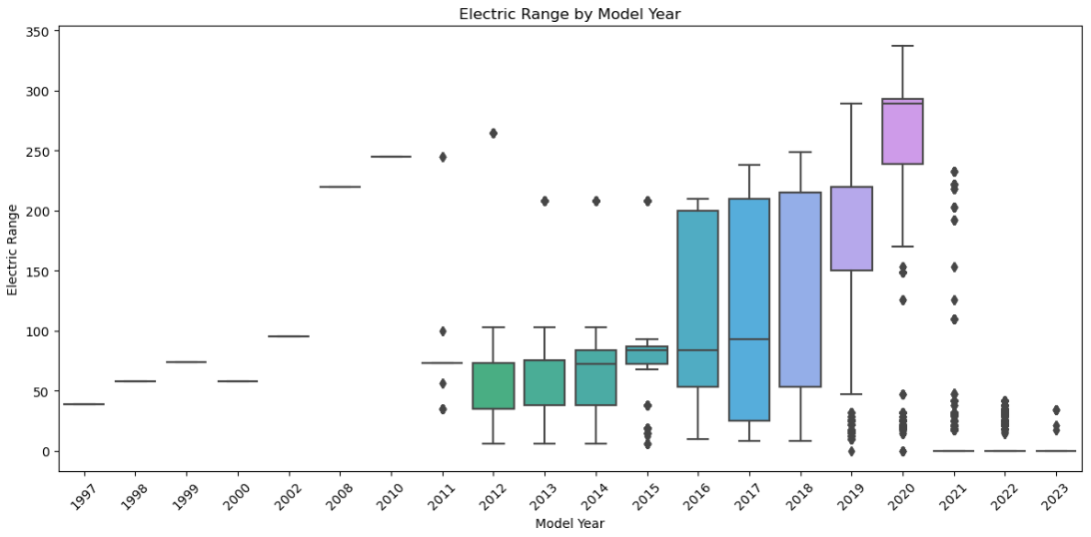
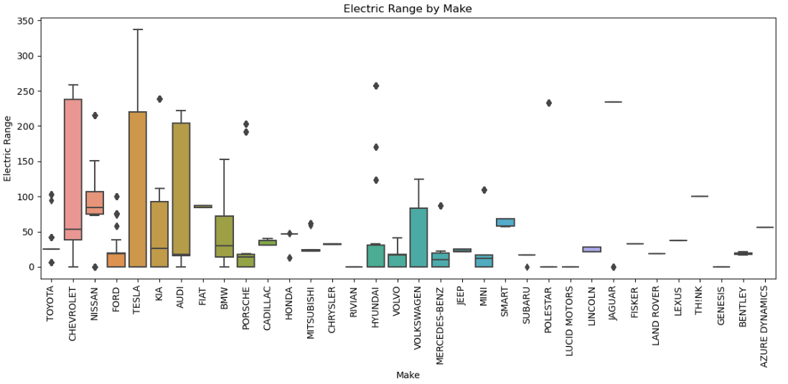
Electric Range by Model Year:
There's a clear trend of increasing electric range over time, with significant improvements starting around 2016.
The median range has increased substantially from about 100 miles in 2015 to over 250 miles by 2023.
The variation in range has also increased in recent years, likely due to a wider variety of EV models (from economy to luxury).
There are some high-range outliers in earlier years (2008-2014), possibly representing early long-range EV prototypes or limited production models.
The most recent years (2021-2023) show the highest median ranges and largest range variations.
Electric Range by Make:
Tesla stands out with the highest median and maximum electric range, reaching up to about 350 miles.
There's significant variation in range across manufacturers, with some like Tesla, Chevrolet and Ford showing wide ranges, while others like BMW, KIA and Audi have more compact distributions.
Many manufacturers have outliers above their main range distribution, suggesting premium or long-range models.
Some manufacturers (e.g., Toyota, Nissan) have relatively low median ranges but with occasional high-range outliers.
Newer entrants like Lucid and Rivian show competitive ranges, often exceeding established manufacturers.
Please note that since I cannot keep all my analysis in ppt, you can go through my repository link which is given on the 2nd slide.

Slide 14
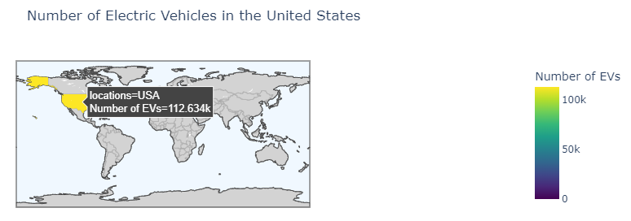
Task Questions
Q. Create a Choropleths using plotly.express to display the number of EV vehicles based on location. (Country, States, County, City, Zip Codes)
Please note I cannot directly add Choropleth plots in ppt , am uploading the snapshot of the plot I got as output, you can always go to my github repository to see the visualization.

Slide 15
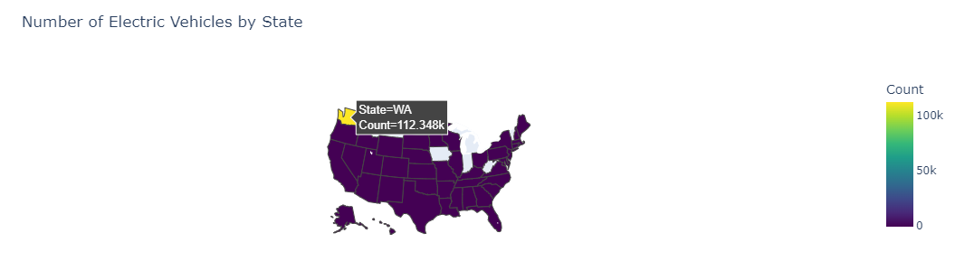
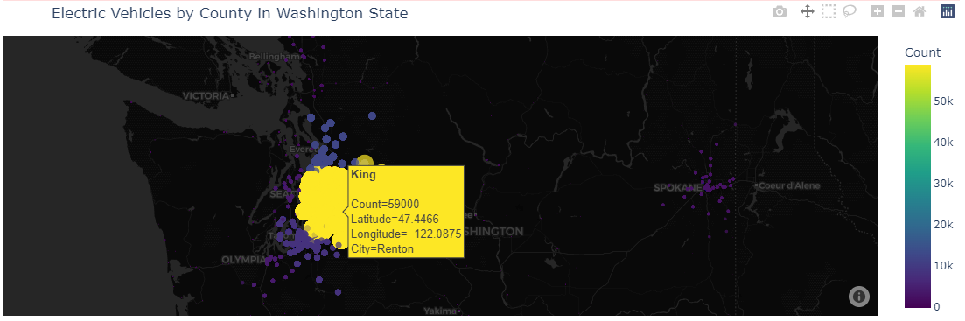
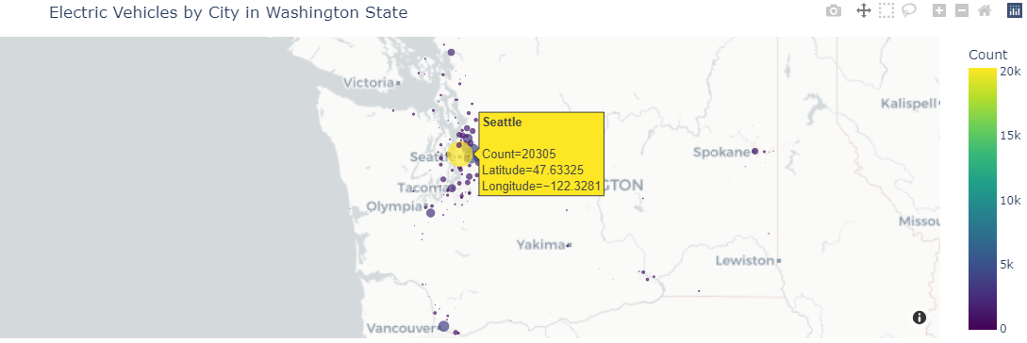
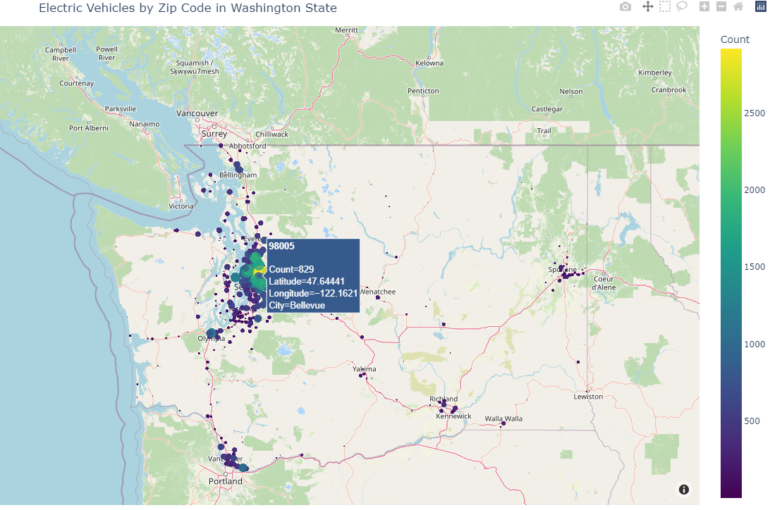

Slide 16
Q2. Racing Bar Plots (using Bar_Chart_Race)

Slide 17
Racing Bar Plot (alternative)

Slide 18
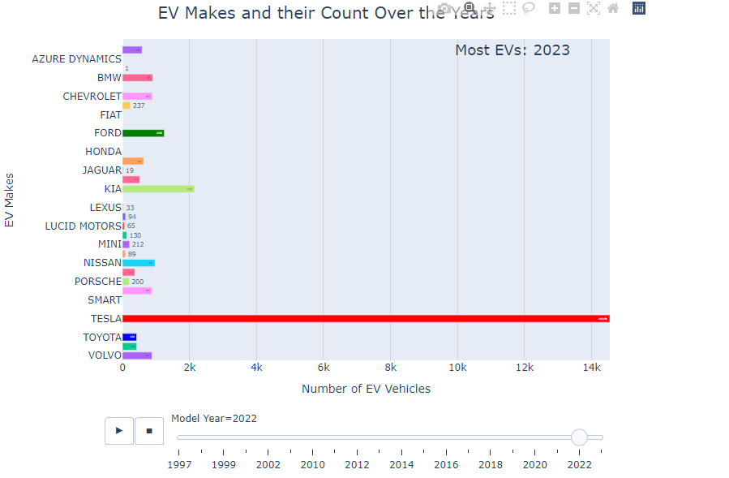
Racing Bar plot (using PlotlyExpress)
Please note due to some constraints I couldn’t download the animation of this plot, so I am uploading the snapshot of the animation, but the animation is available in my repository you can check it from there.

Slide 19
Conclusion:
Observations:
Price Range Distribution:
Most electric vehicle manufacturers have their base MSRP concentrated in the $30,000 to $80,000 range.
There's significant variation in pricing across different makes, indicating diverse market segments.
Luxury Brands:
Brands like Tesla, Porsche, and Audi tend to have higher median prices and larger price ranges, reflecting their focus on premium and luxury electric vehicles.
These brands also show larger boxes in the boxplot, indicating more variability in their pricing.
Affordable Options:
Manufacturers like Chevrolet, Nissan, and Hyundai have lower median prices, suggesting they're targeting the more affordable end of the EV market.
These brands typically have smaller boxes, indicating less variability in their pricing.

Slide 20
Price Variability:
Some brands (e.g., BMW, Mercedes-Benz) show large price ranges, suggesting they offer EVs across various market segments, from more affordable to luxury models.
Others (e.g., Fiat, Smart) have very small ranges, indicating a focused product line with limited price variability.
Emerging Patterns:
There seems to be a clustering of brands in the mid-price range, possibly indicating intense competition in this segment.
A few outliers still exist for some brands, which could represent special edition or high-performance models.
Market Positioning:
The visualization clearly shows how different manufacturers are positioning themselves in the EV market, from budget-friendly options to high-end luxury vehicles.
New Entrants:
Some newer entrants to the EV market (e.g., Rivian, Lucid) appear to be positioning themselves in the premium segment, with higher median prices.
Traditional vs. EV-Only Brands:
Traditional auto manufacturers (e.g., Ford, Volkswagen) seem to offer a wider range of prices, possibly leveraging their experience to cater to various market segments.
EV-only brands (e.g., Tesla, Rivian) often have higher median prices, possibly due to their focus on technology and performance.

Slide 21
Analysis:
Market Trends:
The EV market is showing rapid growth, especially in recent years (2018-2022).
BEVs are more popular than PHEVs, possibly due to improving battery technology and range.
Tesla's dominance suggests strong brand loyalty and first-mover advantage in the EV space.
Geographic Distribution:
EV adoption is concentrated in specific counties, likely urban and suburban areas with better charging infrastructure.
This suggests a need for expanded infrastructure and incentives in other regions to promote wider EV adoption.
Manufacturer Strategies:
Traditional automakers are increasing their EV offerings, but still lag behind Tesla.
Some manufacturers focus more on PHEVs (e.g., Toyota), while others emphasize BEVs.
Luxury brands are entering the EV market, indicating growing demand in premium segments.
Policy Implications:
CAFV eligibility affects a large portion of EVs, suggesting that such incentives may be driving adoption.
The presence of non-eligible PHEVs indicates a need for clearer standards or improved technology to meet eligibility criteria.
Future Outlook:
The rapid growth in recent model years suggests continued expansion of the EV market.
Increasing competition from traditional automakers may challenge Tesla's dominance in the future.
The shift towards BEVs over PHEVs may continue as battery technology improves and charging infrastructure expands.

Slide 22
Experience and Challenges
Experience: The project involved cleaning a large dataset, performing thorough EDA, and interpreting various relationships within the data. Learned to identify patterns and outliers through visualizations.
Challenges: Creating the Choropleth graphs and Racing Bar Plots in were very a bit tough and took most of my time in this project.

Slide 23

THANK YOU

