Slide 1
Web Automation using Selenium with Python
Capstone Project Presentation
Presented by: Alle Sujan Kumar Reddy
Course/Internship: Selenium With Python Automation
Date: 11th March 2026

Slide 2
Problem Statement
Manual Testing is Slow
Flight booking on phptravels.net requires repetitive manual steps for every test scenario, making it error-prone and time-consuming.
No Regression Coverage
No automated suite to validate end-to-end booking flows — regressions go undetected across one-way and round-trip journeys.
Complex Multi-Step Flows
Search to Stripe Payment is a complex 9-step flow requiring robust automation with dynamic element and iframe handling.
Need for Structured Framework
A reusable, maintainable Page Object Model framework with Excel test data and HTML reporting was needed.

Slide 3
Project Objectives
01 Build Page Object Model Framework
Implement reusable POM with BasePage, FlightSearchPage, BookingPage, PaymentPage
02 Automate 12 Test Cases
TC-01 to TC-12 covering smoke, one-way, round-trip, and end-to-end booking flows
03 Excel-Driven Test Data
Manage test data via openpyxl with separate sheets for OneWayFlight and RoundTripFlight
04 Stripe Payment Integration
Automate Stripe card entry, form submission, and verify payment confirmation on invoice page
05 HTML Reports and Screenshots
Generate pytest-html reports with screenshots captured at each step for traceability
06 Parallel Test Execution
Support pytest-xdist parallel execution with isolated Chrome sessions per worker

Slide 4
Tools and Technologies Used
Python 3.13
Core Language
Selenium 4.18
Browser Automation
Pytest 8.1
Test Framework
openpyxl
Excel Test Data
pytest-html
HTML Reports
pytest-xdist
Parallel Execution
webdriver-manager
ChromeDriver Setup
Application Under Test: phptravels.net/flights
Live travel booking site — search, book, pay, invoice
IDE & OS: PyCharm | Windows 11 | Chrome 145
Python 3.13.12 — All 12 tests pass in ~18 minutes

Slide 5
Automation Framework Architecture
TEST LAYER — tests/test_end_to_end_booking.py
TC-01~05 Smoke
TC-06~08 OneWay
TC-09~10 RoundTrip
TC-11 E2E OneWay
TC-12 E2E RoundTrip
PAGE OBJECT LAYER — pages/
BasePage
driver, screenshot
FlightSearchPage
search, cities, date
FlightResultsPage
results, Book Now
BookingPage
guest, passenger, confirm
PaymentPage — invoice, Stripe fill, Download Invoice, Back to Homepage
SUPPORT LAYER — utils/ | conftest.py | test_data/
excel_utils.py
logger.py
conftest.py
test_data.xlsx
APPLICATION UNDER TEST
Chrome 145 | phptravels.net/flights | Stripe Checkout

Slide 6
Project Workflow
STEP 1
Read Excel Test Data
STEP 2
Launch Chrome + Load phptravels.net
STEP 3
Search Flight BOM to DEL
STEP 4
Select Flight + Book Now
STEP 7
Stripe Payment + Pay
STEP 6
Confirm Booking + Invoice
STEP 5
Fill Guest + Passenger Details
STEP 8
Verify: Confirmed + Paid
STEP 9
Download Invoice
STEP 10
Report + Screenshot Log
12 PASSED
in ~18 minutes

Slide 7
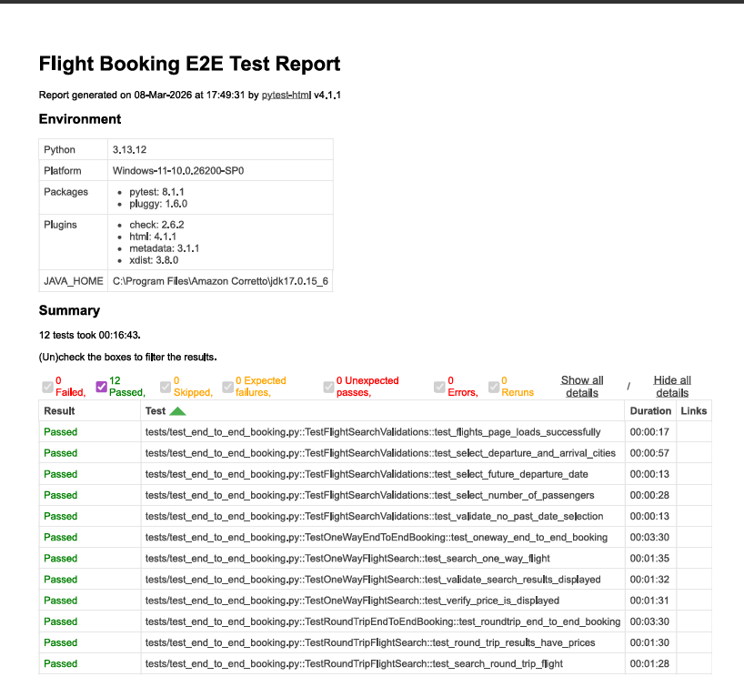
Project Test Output – Screenshots

Slide 8
Project Output
12
Tests Passed
0
Tests Failed
18:01
Total Run Time
Test Results Summary
TC-01 ✓ Page Loads | TC-02 ✓ Select Cities | TC-03 ✓ Future Date | TC-04 ✓ Passengers
TC-05 ✓ No Past Date | TC-06 ✓ OneWay Search | TC-07 ✓ Results Shown | TC-08 ✓ Price Shown
TC-09 ✓ RoundTrip Search | TC-10 ✓ RoundTrip Prices | TC-11 ✓ E2E OneWay | TC-12 ✓ E2E RoundTrip
TC-11 OneWay E2E: Invoice #75700246 | USD 28,490.70 | John Doe | Booking Confirmed | Payment Paid
TC-12 RoundTrip E2E: Invoice #90514852 | USD 56,463.32 | Jane Smith | Booking Confirmed | Payment Paid

Slide 9
Challenges Faced
1. Dynamic Autocomplete Dropdowns (BOM / DEL)
Angular ng-select dropdowns did not fire on send_keys. Resolved with 4-second WebDriverWait + fallback to URL construction (bom/del/oneway).
2. Stripe Checkout iframe + Card Entry
Stripe fields require JS click + Ctrl+A+Delete + send_keys with ActionChains fallback to type card number correctly.
3. Download Invoice Button Not Found
SVG icon inside button caused textContent mismatch. Fixed by using JS innerText scan which returns only visible rendered text.
4. Passport Field React Controlled Input
React nativeInputValueSetter + dispatchEvent required to set passport value when send_keys was blocked by framework.
5. Parallel Execution — Screenshot File Collisions
pytest-xdist workers overwrote each other’s screenshots. Fixed with per-worker directories: screenshots/gw0/, screenshots/gw1/.

Slide 10
Future Enhancements
📌 CI/CD Pipeline Integration — GitHub Actions / Jenkins auto-trigger on every code push
📌 Cross-Browser Testing — Extend to Firefox and Edge using WebDriver parameterization
📌 Expand to Hotels and Car Rentals — Add page objects and test cases for other phptravels.net modules
📌 Allure Reporting + Headless Mode — Rich Allure dashboards and headless Chrome for server execution

Slide 11
Conclusion
This project successfully built a production-quality Selenium + Python automation framework
for end-to-end flight booking on phptravels.net. All 12 test cases pass consistently,
covering smoke validation, search flows, and full E2E booking with Stripe payment.
The Page Object Model architecture, Excel data management, parallel execution,
and detailed HTML reports make this framework ready for real-world QA use.
12 / 12
Tests Passing
5
Page Object Classes
9 Steps
E2E Booking Flow

