Slide 1


KHETHA
Helping South African learners make informed career and study choices.
Team: ALLiNiT
Notes:
“Khetha means choose. Our goal is to help young South Africans make better-informed choices about their future by connecting who they are, what they are good at, what they want to become, and the opportunities available to them.”
Khetha is a digital career guidance platform that helps learners discover careers that match their interests, strengths and aspirations — and connects those career choices to relevant study opportunities.

Slide 2
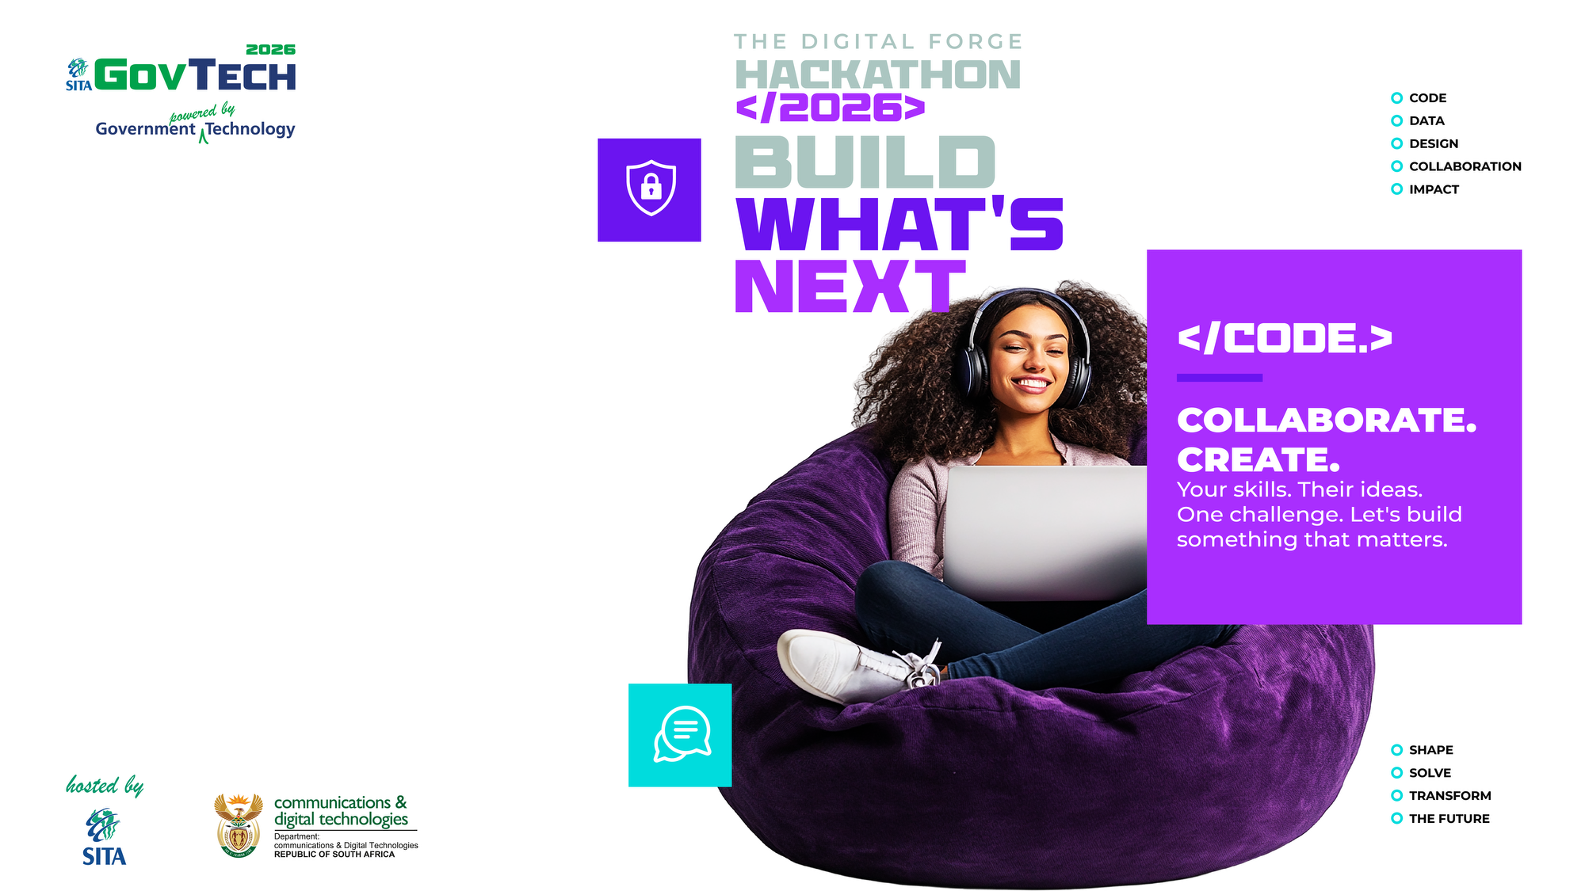
THE PROBLEM
1. Career information is often fragmented and difficult to navigate.
2. Outdated Desktop-oriented Website.
Learners don't just need more information, they need information connected into a clear pathway.
Notes:
Learners struggle to:
Understand which careers match their interests and strengths.
Know what qualifications different careers require.
Find relevant higher-education institutions.
Understand the relationship between subjects → qualifications → careers.
Navigate the large amount of career information available online.

Slide 3

KHETHA: FROM SELF-DISCOVERY TO CAREER PATHWAY
Discover yourself
Check Career fit
Explore careers
Find study opportunities
Plan the next step
Notes:
1. 👤 Understand Yourself
The learner provides information about their interests, preferences and strengths.
↓
2. 🎯 Check Career Fit
Khetha evaluates the learner's responses and identifies careers that align with their profile.
↓
3. 💼 Explore Careers
The learner can explore career information, including career options and areas of demand.
↓
4. 🎓 Find Study Opportunities
Khetha helps the learner identify relevant qualifications and higher-education institutions.
↓
5. 🚀 Plan Your Future
The learner leaves with a clearer pathway from career interest → education → opportunity.

Slide 4
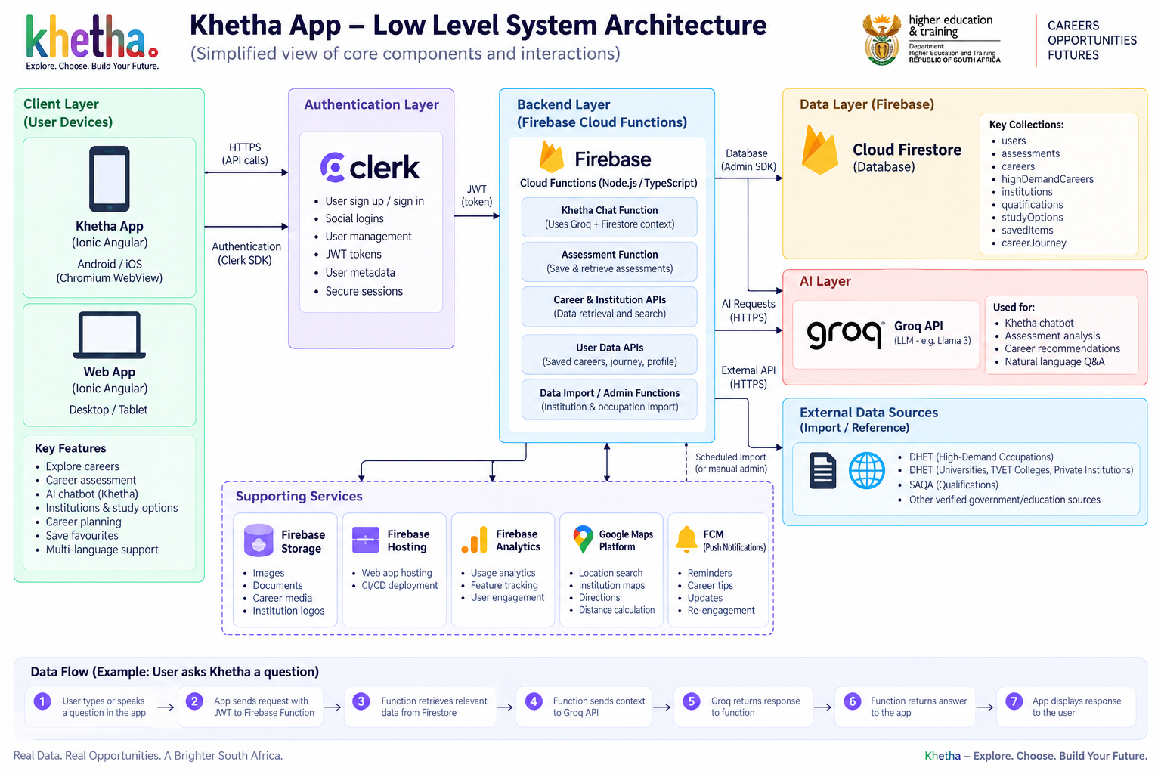
SYSTEM ARCHITECTURE DIAGRAM

Slide 5
FROM PROTOTYPE TO REAL-WORLD IMPACT
Our next steps
1. Validate
2. Expand the data
3. Improve
4. Scale
Notes:
. 01 — VALIDATE
Test Khetha with learners and career-guidance stakeholders.
↓
02 — EXPAND THE DATA
Continue building and validating:
Career information
Qualifications
Higher-education institutions
High-demand careers
Career pathways
↓
03 — IMPROVE
Develop more personalised career guidance and improve accessibility.
↓
04 — SCALE
Prepare Khetha for implementation through schools and relevant education/public-sector partnerships.

