Slide 1
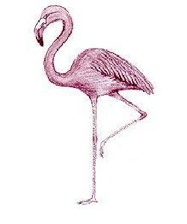




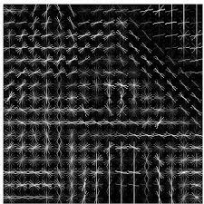
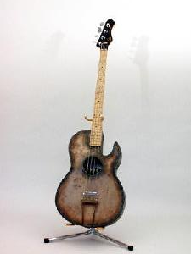
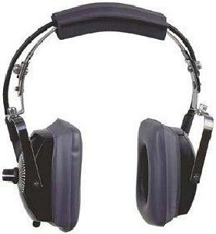
RGB-array
Group on image-hash
Plot or move
(near-)identical images
Pre-processing
Compute Hash
Decolorize
Scale
Resize
Image-hash
Grouping
Path to image directory

