Slide 1

DEPARTMENT OF INFORMATION TECHNOLOGY
BE(IT) VIII Sem A.Y: 2025-2026
Technical Seminar
Digital Entity Management Methodology for Digital Twin Implementation
Guide:
Dr. Pragati Priyadashinee
Assistant Professor, IT Dept.
160122737320 : Allurkar Sushanth

Slide 2
Abstract
Efforts to reduce costs through simulations have long been a focus in the cyber-physical systems (CPS) and manufacturing domains. Recently, digital twins have emerged as a promising solution for optimizing operations across areas such as smart cities, factory systems, architecture, and industrial processes. However, practical implementation remains challenging, particularly in effectively managing the diverse and complex digital entities within these systems. This limitation hinders scalability and efficient system operation. To address this, the proposed work introduces a class-level digital entity management methodology that structures reusable entities into well-defined classes. By leveraging abstraction, inheritance, and upcasting, this approach reduces complexity and enables the scalable and efficient implementation of digital twin systems.

Slide 3
Sl.No | Authors | Title | Type | Publication | Description | Outcome | Limitation | Link
1 | D.-Y. Jeong et al. | Digital twin: Technology evolution stages and implementation layers with technology elements | Journal | IEEE Access | Investigates the evolution stages and implementation layers of digital twin technology. | Identifies five distinct evolution stages of digital twins, from basic mirroring to autonomous optimization. | Implementing a digital twin is still a challenging task as the technology remains in early development stages. | 10.1109/ACCESS.2022.3174220
2 | S. Mihai et al. | Digital twins: A survey on enabling technologies, challenges, trends and future prospects | Journal | IEEE Communications Surveys & Tutorials | Surveys enabling technologies, future prospects, and challenges for digital twins. | Demonstrates how digital twins can simulate situations for cost reduction and system optimization. | Highlights a general lack of consensus on the nature of a digital twin and its core components. | 10.1109/COMST.2022.3208773
3 | D. Guo et al. | Synchronization of shop-floor logistics and manufacturing under IIoT and digital twin-enabled graduation intelligent manufacturing system | Journal | IEEE Transactions on Cybernetics | Focuses on the synchronization of digital twins in the manufacturing sector and shop-floor logistics. | Shows improved production processes through virtual representation and simulation. | Primarily focuses on manufacturing, lacking a methodology for broad multi-domain digital entity management. | 10.1109/TCYB.2021.3108546
4 | K. Gai et al. | Blockchain-enabled service optimizations in supply chain digital twin | Journal | IEEE Transactions on Services Computing | Explores service optimizations using digital twins within supply chain operations. | Demonstrates the application and expansion of digital twins into non-manufacturing fields. | Practical implementation presents complex technical integration and operational challenges. | 10.1109/TSC.2022.3192166

Slide 4
Sl.No | Authors | Title | Type | Publication | Description | Outcome | Limitation | Link
5 | F. Arraño-Vargas and G. Konstantinou | Modular design and real-time simulators toward power system digital twins implementation | Journal | IEEE Transactions on Industrial Informatics | Discusses real-time simulators and modular design for implementing digital twins in power systems. | Highlights the active use of digital twins for energy and power system applications. | Existing systems struggle with the complexity of defining and organizing digital entities as they scale. | 10.1109/TII.2022.3178713
6 | R. Minerva, G. M. Lee & N. Crespi | Digital twin in the IoT context: A survey on technical features, scenarios, and architectural models | Journal | Proceedings of the IEEE | Surveys technical features, scenarios, and architectures of digital twins in IoT. | Shows synergy between IoT and digital twins. | Digital twin technology still in early developmental stages. | 10.1109/JPROC.2020.2998530
7 | D. Menon, B. Anand & C. L. Chowdhary | Digital twin: Exploring the intersection of virtual and physical worlds | Journal | IEEE Access | Explores synchronization between physical and cyber worlds. | Outlines how digital twins solve physical-world problems via simulations. | Major challenge is lack of structured approaches to managing diverse entities. | 10.1109/ACCESS.2023.3294985
8 | L. Li, S. Aslam, A. Wileman & S. Perinpanayagam | Digital twin in aerospace industry: A gentle introduction | Journal | IEEE Access | Investigates digital twin concepts in the aerospace industry. | Shows growing adoption of digital twins in aerospace. | Large-scale systems struggle to model complex physical processes. | 10.1109/ACCESS.2021.3136458
9 | S. Liao et al. | Digital twin consensus for blockchain-enabled intelligent transportation systems in smart cities | Journal | IEEE Transactions on Intelligent Transportation Systems | Discusses digital twin consensus in blockchain-enabled smart transportation. | Demonstrates adoption in smart cities for predictive modeling. | Managing numerous digital entities at scale remains costly and complex. | 10.1109/TITS.2021.3134002
10 | B. R. Barricelli, E. Casiraghi & D. Fogli | A survey on digital twin: Definitions, characteristics, applications, and design implications | Journal | IEEE Access | Surveys definitions, characteristics, and applications of digital twins. | Provides broad conceptual overview. | Lacks clear reusable methodologies for entity management at scale. | 10.1109/ACCESS.2019.2953499

Slide 5
Problem Statement
This work aims to address the absence of a structured approach for managing the diverse digital entities that underpin such systems. It seeks to overcome the challenges associated with defining, organizing, and efficiently managing these entities, particularly as systems scale to represent complex processes or entire cities. To achieve this, a clear and reusable methodology is proposed, leveraging class-based abstraction and inheritance to enable scalable and efficient entity management.

Slide 6
Digital Entity Definitions & Properties
​Cyber & Physical Worlds: A digital twin synchronizes physical entities (Pes) in the physical world to digital entities (Des) in the cyber world. ​Elementary Digital Entity (E-DE): The smallest unit of a DE that interacts with the physical world. It is a replica of a PE, such as a sensor or actuator, exchanging simple data. ​Complex Digital Entity (C-DE): Includes all Des that are not E-Des. C-Des can combine multiple E-Des or include pure virtual entities like AI models and processes for advanced simulations.

Slide 7
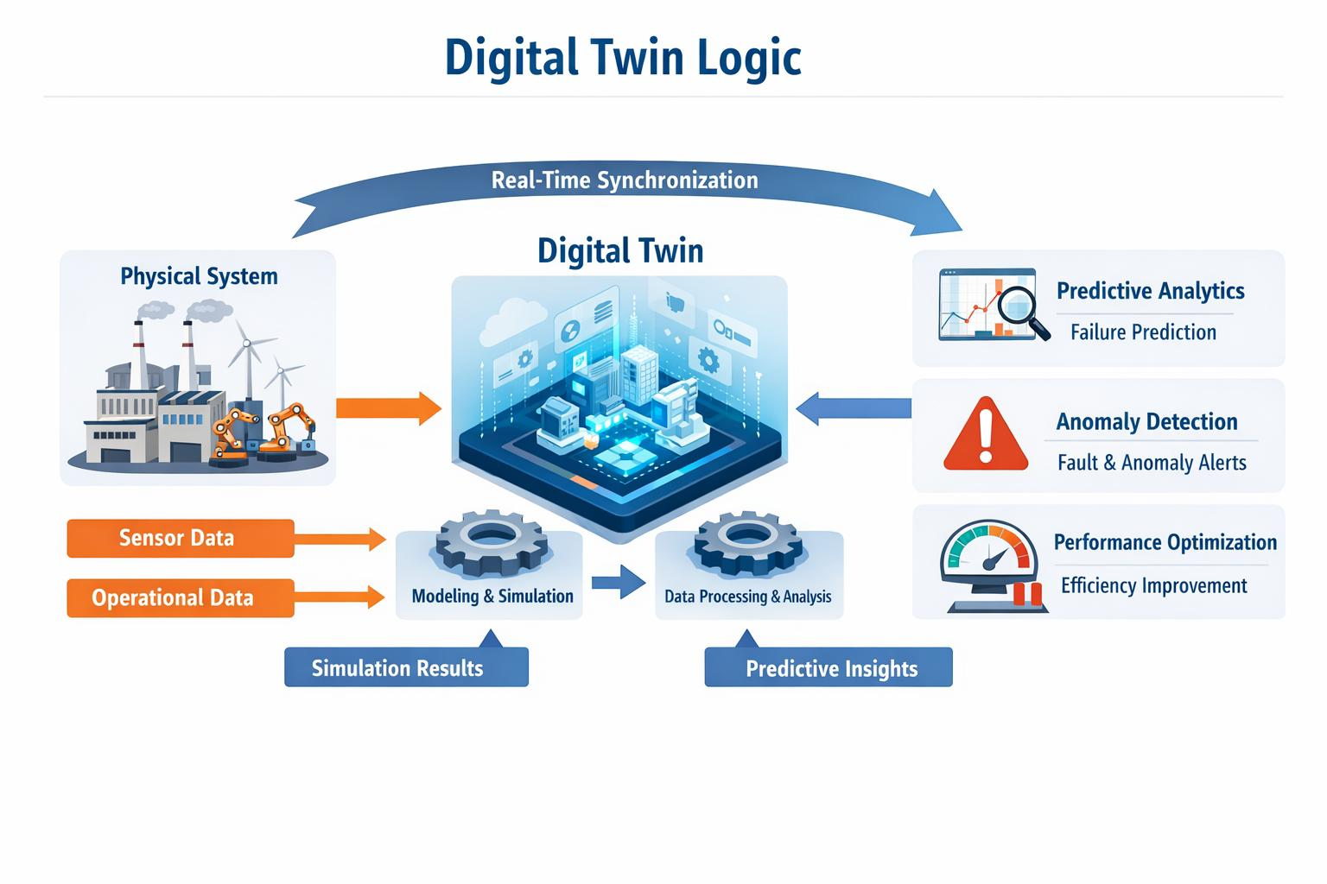

Slide 8
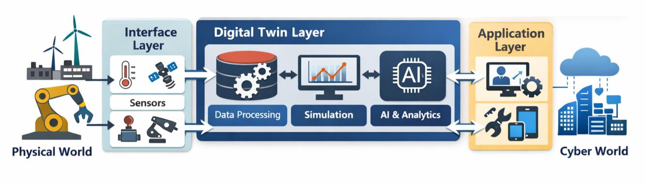
Architecture Overview
Physical World Layer: Contains the physical space and the PEs required to model and interact with the system.
​Sensor/Actuator Interface: Connects the physical world and the cyber world, exchanging data and commands.
​Cyber World (Digital Twin System Layer): Manages various DEs that monitor, analyze, simulate, and optimize the physical space's state.
​Application Layer: Offers services tailored to the user's needs, enabling monitoring and interaction.

Slide 9
Results & Analysis
Characteristics | E-DE | C-DE
Definition | The smallest unit of a DE aims to connect to a PE in the physical world. | The functional DE can provide complex functions to monitor and simulate various situations.
Data Processing | Basic data collection and simple commands. | Complex data integration, analysis, prediction, optimization, etc.
Complexity | Low | High
Flexibility and Scalability | Low | High
Cost | Low | High
Management and Maintenance | Easy | Difficult
Autonomy and Learning | Limited | Enable

Slide 10
Fidelity & Inheritance Findings Advantages of Multiple Inheritance: By inheriting from multiple parent classes, DE classes can reuse existing functionalities (code reusability), allowing dynamic configurations (flexibility) and creating advanced Des (scalability). Disadvantages: Can cause inheritance conflicts when properties with the same name are inherited from multiple parents, leading to increased complexity and development overhead. Solution: Creating a new abstract DE class helps mitigate multiple inheritance conflicts when dealing with frequently instantiated complex entities.

Slide 11
Conclusions
​Categorized digital entities into elementary digital entities (E-Des) that mirror the physical world and complex digital entities (C-Des) that enable advanced modeling. ​Introduced a class-level management method for complex digital entities, providing a systematic definition methodology. ​This method successfully improves the reusability of digital entities, increases scalability, and facilitates the maintenance of complex digital twin systems.

Slide 12
Future Scope
Expand class-level management across broader fields such as aerospace, healthcare, energy, transportation, and smart cities. ​Manage dynamic inheritance structures for real-time adjustments and autonomous recognition in federated digital twins. ​Further develop robust automated failure detection systems to continuously monitor data across C-Des and isolate anomalies.

Slide 13
References
[1] Y. Lee, M.-S. Baek, and K. Yoon, “Digital Entity Management Methodology for Digital Twin Implementation,” IEEE Transactions on Broadcasting, vol. 71, no. 1, pp. 19–29, Mar. 2025. [2] F. Tao, M. Zhang, Y. Liu, and A. Y. C. Nee, “Digital Twin Driven Smart Manufacturing,” IEEE Transactions on Industrial Informatics, vol. 15, no. 4, pp. 2405–2415, Apr. 2019. [3] S. Mihai et al., “Digital Twins: A Survey on Enabling Technologies, Challenges, Trends and Future Prospects,” IEEE Communications Surveys & Tutorials, vol. 24, no. 4, pp. 2255–2291, 2022. [4] K. M. Alam and A. El Saddik, “C2PS: A Digital Twin Architecture Reference Model for Cyber-Physical Systems,” IEEE Access, vol. 5, pp. 2050–2062, 2017. [5] R. Minerva, G. M. Lee, and N. Crespi, “Digital Twin in the IoT Context: A Survey on Technical Features and Applications,” Proceedings of the IEEE, vol. 108, no. 10, pp. 1785–1824, 2020. [6] A. Fuller, Z. Fan, C. Day, and C. Barlow, “Digital Twin: Enabling Technologies, Challenges and Open Research,” IEEE Access, vol. 8, pp. 108952–108971, 2020.

Slide 14
[7] M. Attaran, “Digital Twin: Benefits, Use Cases, Challenges, and Opportunities,” Journal of Industrial Information Integration, vol. 33, pp. 100445, 2023. [8] R. Stark and T. Damerau, “Digital Twin in Manufacturing: A Systematic Review,” CIRP Journal of Manufacturing Science and Technology, vol. 27, pp. 1–13, 2020. [9] B. Mao, X. Zhou, J. Liu, and N. Kato, “Digital Twin Satellite Networks: Motivations and Challenges,” IEEE Network, vol. 38, no. 1, pp. 24–31, 2024. [10] A. Thelen et al., “A Comprehensive Review of Digital Twin: Modeling and Enabling Technologies,” IEEE Access, vol. 10, pp. 123456–123478, 2022.

Slide 15

Question & Answers

