Slide 1
Minimize blast zone by deploying ring, by ring
USER TYPES
Users
PROD
Early Adopters
BETA
Canaries
DEV
RING NAMES 

Slide 2

Funnel features with feature flags
Early Adopters
Volatility
Production users 
Stability 
Rings
Exposed feature set
Exposed feature set is smaller in production
Set of users with custom feature exposure
ON
Default feature exposure
Feature
OFF

Slide 3





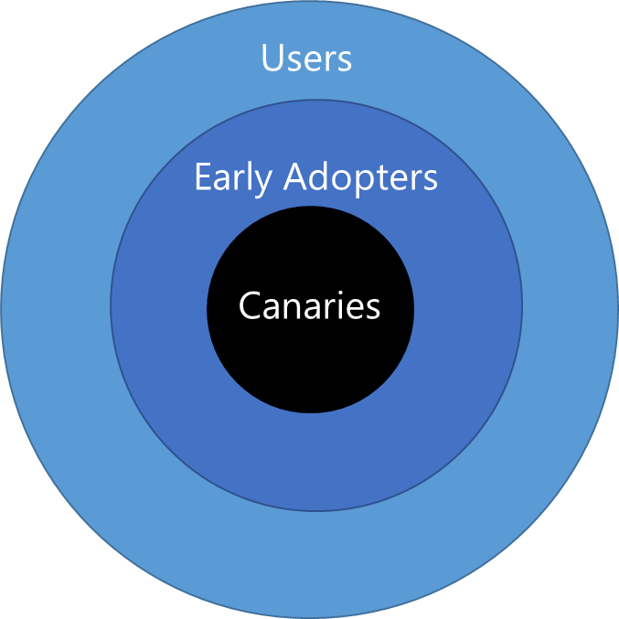
Team Services Pipeline with DEV, BETA, and PROD environments
Continuous Integration (CI)
Continuous Delivery (CD)
checkin
auto trigger
approval
approval
PIPELINE
Users
IMPACT RADIUS
Early Adopters
Canaries
RINGS
PRODUCTION

Slide 4


One build in VSTS or TFS
checkin
build
unit tests
deploy code
functional tests
deploy to production
PIPELINE

Slide 5


Multiple environments
checkin
build
unit tests
deploy code
sampling of tests
BUILD PIPELINE
DEV environment
Q&A environment
PROD environment
trigger
deploy code
functional tests
deploy code
integration tests
deploy
RELEASE PIPELINE

Slide 6
Microservices
User Interface (UI) CI Build
Mocked Dependencies CI Build
Integration CI Build (UI + Back-end)
Back-end CI Build
Mocked Dependencies CI Build

Slide 7

Manage database upgrades
Continuous Integration (CI)
Continuous Delivery (CD)
checkin
auto trigger
approval
approval
PIPELINE
DB1
DB2
DB2

Slide 8

APPLICATION LEVEL – HYPOTHETICAL
PRESENTATION LAYER
LOGIC LAYER
PERSISTENCE LAYER
Inventory API
Customer API
Single Page Application
Order API
Database

Slide 9
APPLICATION LEVEL – VSTS EXTENSIONS
PRESENTATION LAYER
LOGIC LAYER
PERSISTENCE LAYER
Core Client API
REST Client API
Web Application Extension Point
REST API
Database
Extension Data Service

Slide 10

INFRASTRUCTURE LEVEL - HYPOTHETICAL
PRESENTATION LAYER
LOGIC LAYER
PERSISTENCE LAYER
Inventory
Database
Orders
Customers

Slide 11
INFRASTRUCTURE LEVEL – VSTS EXTENSIONS
PRESENTATION LAYER
LOGIC LAYER
PERSISTENCE LAYER
SQL Azure
Extension Data Service
VSTS Extension
Extension Points

Slide 12








BEFORE  |  AFTER
BUILD
RELEASE
TTB (time to build)
TTR (time to release)
ISSUE DETECTION
ISSUE RESOLUTION
MANUAL ERROR PRONE
AUTOMATED
CONSISTENT
MANUAL ERROR PRONE
AUTOMATED
CONSISTENT
HOURS
SECONDS
DAYS
MINUTES
CALL FROM USER
PROACTIVE
DAYS - WEEKS
MINUTES - DAYS

Slide 13






Feature Flag
ON
ON
Run-time call to FF management service
OFF
OFF
if ( flag )
else
ON
OFF
ON
OFF

Slide 14


A|B Testing with Feature Flag
ON
hypothesis
A
67%
OFF
if ( flag )
else
B
33%

Slide 15


Extension | FF architecture
SaaS Management
LaunchDarkly VSTS Service EndPoint
VSTS Extension
ON
query flag
get flag
OFF
if ( flag )
else
SaaS Management
LaunchDarkly VSTS Service EndPoint
VSTS Extension
ON
query flag
get flag
OFF
if ( flag )
else
Azure Function
REST API calls
set flag

Slide 16
Users
Early Adopters
Canaries

Slide 17




Continuous Integration (CI)
Continuous Delivery (CD)
checkin
auto trigger
approval
approval
PIPELINE
❶
❷
❸
❹
❺
❻
❼
❽
❾
PRODUCTION
RINGS
Users
Early Adopters
BLAST RADIUS
Canaries

Slide 18
Early Adopters
Volatility
Production users 
Stability 
Rings
Exposed feature set
Exposed feature set is smaller in production
Set of users with custom feature exposure
ON
Default feature exposure
Feature
OFF

Slide 19


PRESENTATION LAYER
LOGIC LAYER
PERSISTENCE LAYER
Core Client API
REST Client API
Web Application Extension Point
REST API
Database
Extension Data Service

Slide 20


PRESENTATION LAYER
LOGIC LAYER
PERSISTENCE LAYER
SQL Azure
Extension Data Service
VSTS Extension
Extension Points

Slide 21

A
67%
if ( flag )
else
B
33%

Slide 22
ON
OFF

Slide 23
ON
OFF

Slide 24
ON
OFF

Slide 25
Call to feature flag service to query value
ON
if ( flag )
else
OFF

Slide 26
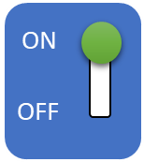
VSTS Extension
LaunchDarkly SDK
SaaS Management
query flag
get flag
if ( flag )
else

Slide 27
LaunchDarkly SDK
Azure Functions
VSTS Extension
SaaS Management
get / set
flag
get / set
flag
get/set
flag
if ( flag )
else

