Slide 1
Minimize blast zone by deploying ring, by ring
USER TYPES
②
Users
PROD
Early Adopters
BETA
Canaries
DEV
①
ENVIRONMENT TYPES

Slide 2

Funnel features with feature flags
Early Adopters
Volatility
Production users 
Stability 
Rings
Exposed feature set
Exposed feature set is smaller in production
Set of users with custom feature exposure
ON
Default feature exposure
Feature
OFF

Slide 3





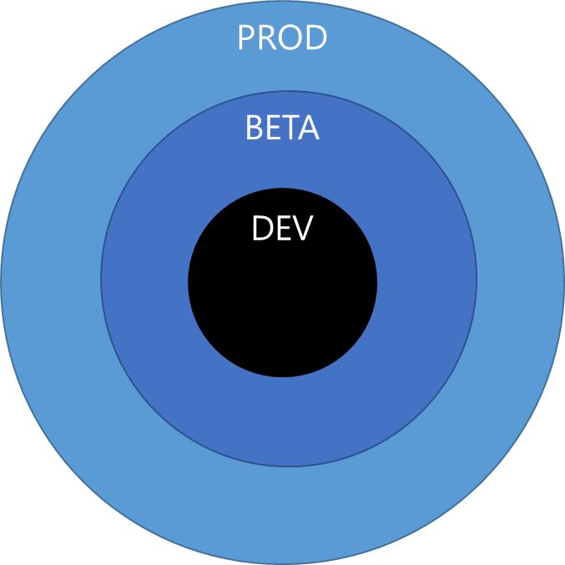
Team Services Pipeline with DEV, BETA, and PROD environments
Continuous Integration (CI)
Continuous Delivery (CD)
checkin
auto trigger
approval
approval
PIPELINE
PROD
IMPACT RADIUS
BETA
DEV
RINGS
PRODUCTION

Slide 4


One build in VSTS or TFS
checkin
build
unit tests
deploy code
functional tests
deploy to production
PIPELINE

Slide 5

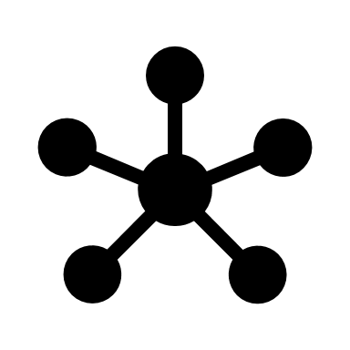
Multiple environments
checkin
build
unit tests
deploy code
sampling of tests
BUILD PIPELINE
DEV environment
Q&A environment
PROD environment
trigger
deploy code
functional tests
deploy code
integration tests
deploy
RELEASE PIPELINE

Slide 6
Microservices
User Interface (UI) CI Build
Mocked Dependencies CI Build
Integration CI Build (UI + Back-end)
Back-end CI Build
Mocked Dependencies CI Build

Slide 7
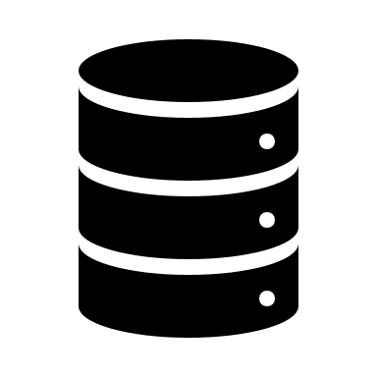
Manage database upgrades
Continuous Integration (CI)
Continuous Delivery (CD)
checkin
auto trigger
approval
approval
PIPELINE
DB1
DB2
DB2

Slide 8

APPLICATION LEVEL – HYPOTHETICAL
PRESENTATION LAYER
LOGIC LAYER
PERSISTENCE LAYER
Inventory API
Customer API
Single Page Application
Order API
Database

Slide 9
APPLICATION LEVEL – VSTS EXTENSIONS
PRESENTATION LAYER
LOGIC LAYER
PERSISTENCE LAYER
Core Client API
REST Client API
Web Application Extension Point
REST API
Database
Extension Data Service

Slide 10

INFRASTRUCTURE LEVEL - HYPOTHETICAL
PRESENTATION LAYER
LOGIC LAYER
PERSISTENCE LAYER
Inventory
Database
Orders
Customers

Slide 11
INFRASTRUCTURE LEVEL – VSTS EXTENSIONS
PRESENTATION LAYER
LOGIC LAYER
PERSISTENCE LAYER
SQL Azure
Extension Data Service
VSTS Extension
Extension Points

