Slide 1
Pseudologia Fantastica
(Pathological Lying)
Fall 2022
SP&E 316 – Computational & Agent-Based Modeling
Alfredo Lorenzo Mendiola
PhD Student, Economics

Slide 2

Background
Deception in experiment design is taboo in Economics and will result in your research being written off
Deception in experiment design is accepted in Psychology if it is deemed necessary for the purpose of the research question
Both allow for withholding info if necessary for research question
Spillover Effects to subject pool

Slide 3
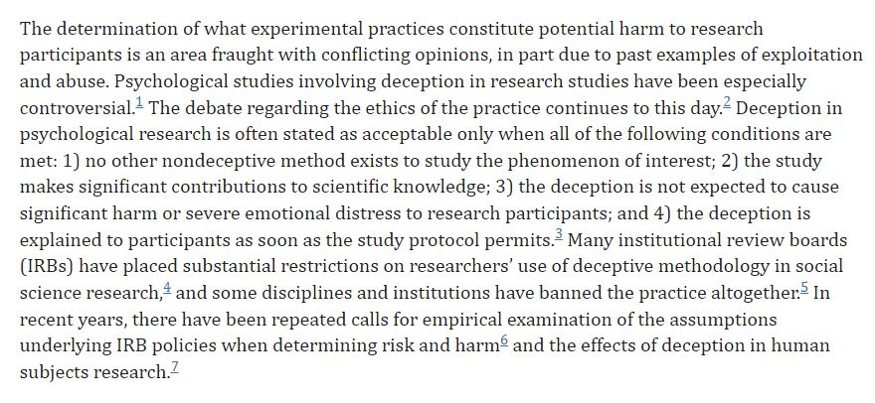
Background
Boynton MH, Portnoy DB, Johnson BT. Exploring the ethics and psychological impact of deception in psychological research. IRB. 2013 Mar-Apr;35(2):7-13. PMID: 23672145; PMCID: PMC4502434.

Slide 4

Primary Research Question
How does deception affect a subject pool’s trust through spillover effects?
Using ABM will supply an effective picture in multiple environments without the cost of running an experiment with each parameter variation.
A few experiments and current university data can be used to gauge the baseline and the realistic parameters. Then use the model to see estimates of variations of all the other environments.
Having ranges for inputs will also allow for more chaos to be put into the system

Slide 5

ODD
2 person imperfect information games
One shot games
Built to easily be able to update payoffs in setups
To model spillover effects in universities
Anonymous and non-anonymous play with varying consequences
Agents move around and are assigned as player 1 or 2 at random each iteration
Strategy is set on the extremes but mixed in the middle
Updates to payoff, lie, and trust are done every time agents play (agents can skip if no available other player in range)
Agents die at random every Y ticks

Slide 6
Variables/Inputs
Sliders
initial_pop – # of agents that spawn at setup
percent_liars – % of agents that lie 100% of games
percent_liars_new – % of agents that lie 100% in new spawns
trust_low / trust_high – trust range
lie_low / lie_high – lie range (excludes liars)
new_pop – # of agents that spawn every new_ticks
die_pop – # of agents that die every die_ticks
new_ticks – # of tick increments when spawns occur
die_ticks – # of tick increments when deaths occur
move_range – range that agents can move every tick
play_range – range that agents can pair up within
trust_fall_range – range that trust falls with lies (non-anonymous play)
die_after – # of ticks that an agent will die after
trust_fall_low / trust_fall_high – range % that trust falls when lied to
trust_rise_low / trust_rise_high – range % that trust rises when told the truth
lie_fall_low / lie_fall_high – range % that lie falls when lies are unsuccessful
lie_rise_low / lie_rise_high – range % that lie rises when lies are successful

Slide 7
Variables/Inputs
Switch
non_anon_play? – activates non-anonymous play
show_lie? – shows agent’s lie as a label
Turtles-own variables
trust – % that agent believes the other agent (P2 play)
lie – % that agent lies about what they will play (P1 play)
age – # of ticks the agent has been alive
payoff – individual payoff that agents have accumulated
game_count – # of times agent has played
lied_to – # of times agent has been to lied
partner – other agent for the 2 person games
player – P1/P2 within agent partners
play_actual – what P1/P2 plays
play_tell – what P1 tells P2 they will play

Slide 8
Monitors
Population – total # of current agents
Liars – # of liars currently in play
Highest Trust – population’s current highest trust %
Average Trust – population’s current average trust %
Lowest Trust – population’s current lowest trust %
Highest Lie – population’s current highest lie %
Average Lie – population’s current average lie %
Lowest Lie – population’s current lowest lie %
Highest Payoff – population’s current highest payoff
Average Payoff – population’s current average payoff
Lowest Payoff – population’s current lowest payoff
Total Payoff – population’s current total payoff
Average Age – population’s average age of current agents

Slide 9
Graphs
Games Played – histogram (# agents by games played in 25 segments)
Times Lied To – histogram (# agents by times lied to in 25 segments)
Trust v Lie – plot (average trust and average lie over time)
Trust t Lie – plot (average trust by average lie)
Trust Spread – histogram (trust percentages in 10 segments)
Lie Spread – histogram (lie percentages in 10 segments)
Wealth Spread – histogram (# agents by payoff in 10 segments)

Slide 10

Baseline Values
percent_liars – 5%
< 5% of population are Pathological Liars according to Dr. Paul Ekman
lie_low & lie_high – 7%
“Lying comprised 7 % of total communication and almost 90 % of all lies were little white lies” (Docan-Morgan 2021 [https://www.uwlax.edu/post/fbff1575-62fa-4f32-af24-554b24823f86])
Rest of variables are assigned as a logical starting part

Slide 11
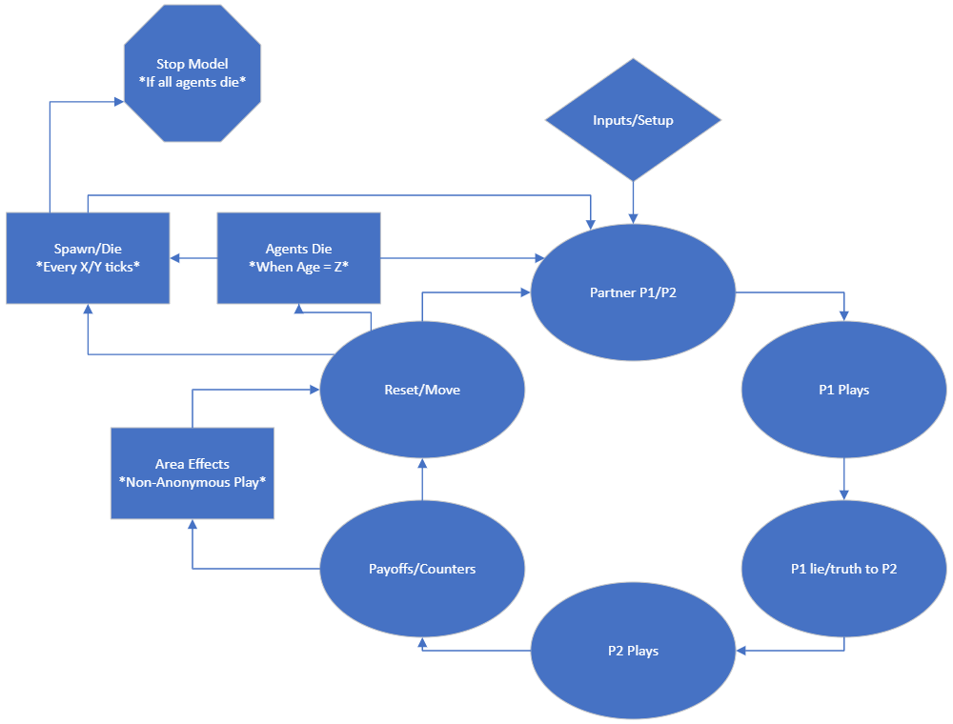
CONOPS

Slide 12
Design/Flow
Overlord
choose # of initial agents
choose # of agent spawns every X ticks
choose # of agents to die every Y ticks
choose X ticks used for new spawns
choose Y ticks used for deaths
choose % of liars (initial/new spawns)
choose range for trust
choose range for lie (non-liar spawns)
choose range for play
choose range for movement
Setup
setup 1 game for entire run
agents spawn randomly
Gameplay
agents match up within a range and randomly get assigned p1/p2 (if agent is without partner, it skips the turn)
p1 chooses what they will play (A/B)
p1 lies/tells truth to p2 about (A/B)
p2 does/doesn’t believe p1 about (A/B)
p2 chooses to play (C/D)
p2 finds out if p1 lied about (A/B)
payouts are distributed, trust goes up or down, lie goes up or down
*(non-anonymous play) area effects take place when p1 lies about (A/B)
*(every X/Y ticks) # of agents spawn/die
agents move randomly w/in a range
tick

Slide 13
Games
P.D. | C | D
A | (-6,-6) | (0,-10)
B | (-10,0) | (-1,-1)
G.E. | C | D
A | (2,2) | (0,3)
B | (3,0) | (1,1)
Prisoner’s Dilemma
P1 always says they will play B
High lie will play A assuming P2 will play D
Low lie will play A assuming P2 will play D
Neutral lie is a 50/50 of what they play
P2 will depend on their trust percentage
High trust will play D believing P1 will play B
Low trust will play C not believing P1 will play B
Neutral trust is 50/50 of what they play
Gift Exchange
P1 always says they will play A
High lie will play B assuming P2 will play C
Low lie will play A assuming P2 will play C
Neutral lie is a 50/50 of what they play
P2 plays D in high and low trust to maximize with AD or at least get 1 in BD
Neutral trust is a 50/50 of what they play

Slide 14

Model Demonstration

Slide 15

Analysis – Lie Inputs
## ## Call: ## lm(formula = df$mean..trust..of.turtles ~ df$lie_fall_high + ## df$lie_rise_high + df$lie_high) ## ## Residuals: ## Min 1Q Median 3Q Max ## -74.149 -14.907 -1.089 14.625 60.717 ## ## Coefficients: ## Estimate Std. Error t value Pr(>|t|) ## (Intercept) 84.213397 0.454173 185.42 <2e-16 *** ## df$lie_fall_high 4.063337 0.012138 334.75 <2e-16 *** ## df$lie_rise_high -4.275662 0.012138 -352.25 <2e-16 *** ## df$lie_high -0.298425 0.006069 -49.17 <2e-16 *** ## --- ## Signif. codes: 0 '***' 0.001 '**' 0.01 '*' 0.05 '.' 0.1 ' ' 1 ## ## Residual standard error: 18.81 on 76860 degrees of freedom ## Multiple R-squared: 0.7563, Adjusted R-squared: 0.7563 ## F-statistic: 7.952e+04 on 3 and 76860 DF, p-value: < 2.2e-16
## ## Call: ## lm(formula = df$mean..lie..of.turtles ~ df$lie_fall_high + df$lie_rise_high + ## df$lie_high) ## ## Residuals: ## Min 1Q Median 3Q Max ## -49.977 -7.179 -0.537 5.965 47.132 ## ## Coefficients: ## Estimate Std. Error t value Pr(>|t|) ## (Intercept) 16.508671 0.221813 74.43 <2e-16 *** ## df$lie_fall_high -2.940835 0.005928 -496.08 <2e-16 *** ## df$lie_rise_high 3.149789 0.005928 531.32 <2e-16 *** ## df$lie_high 0.322283 0.002964 108.73 <2e-16 *** ## --- ## Signif. codes: 0 '***' 0.001 '**' 0.01 '*' 0.05 '.' 0.1 ' ' 1 ## ## Residual standard error: 9.188 on 76860 degrees of freedom ## Multiple R-squared: 0.8754, Adjusted R-squared: 0.8754 ## F-statistic: 1.801e+05 on 3 and 76860 DF, p-value: < 2.2e-16

Slide 16

Analysis – Trust Inputs
## ## Call: ## lm(formula = df$mean..trust..of.turtles ~ df$trust_fall_high + ## df$trust_rise_high + df$trust_high) ## ## Residuals: ## Min 1Q Median 3Q Max ## -89.084 -7.118 -0.623 6.816 52.102 ## ## Coefficients: ## Estimate Std. Error t value Pr(>|t|) ## (Intercept) 32.611415 0.159739 204.2 <2e-16 *** ## df$trust_fall_high -3.436169 0.007258 -473.4 <2e-16 *** ## df$trust_rise_high 4.062128 0.007258 559.7 <2e-16 *** ## df$trust_high 0.133832 0.001434 93.3 <2e-16 *** ## --- ## Signif. codes: 0 '***' 0.001 '**' 0.01 '*' 0.05 '.' 0.1 ' ' 1 ## ## Residual standard error: 11.48 on 80076 degrees of freedom ## Multiple R-squared: 0.8721, Adjusted R-squared: 0.8721 ## F-statistic: 1.82e+05 on 3 and 80076 DF, p-value: < 2.2e-16
## ## Call: ## lm(formula = df$mean..lie..of.turtles ~ df$trust_fall_high + ## df$trust_rise_high + df$trust_high) ## ## Residuals: ## Min 1Q Median 3Q Max ## -9.6824 -1.1481 0.2676 1.4721 7.2014 ## ## Coefficients: ## Estimate Std. Error t value Pr(>|t|) ## (Intercept) 48.3816024 0.0314205 1539.81 <2e-16 *** ## df$trust_fall_high 0.2218209 0.0014276 155.38 <2e-16 *** ## df$trust_rise_high -0.2118301 0.0014276 -148.38 <2e-16 *** ## df$trust_high -0.0142127 0.0002822 -50.37 <2e-16 *** ## --- ## Signif. codes: 0 '***' 0.001 '**' 0.01 '*' 0.05 '.' 0.1 ' ' 1 ## ## Residual standard error: 2.258 on 80076 degrees of freedom ## Multiple R-squared: 0.3781, Adjusted R-squared: 0.3781 ## F-statistic: 1.623e+04 on 3 and 80076 DF, p-value: < 2.2e-16

Slide 17

Insights/Lessons
Coding strategies and finding games to fit this method of P1 telling P2 what they will play is more cumbersome than rewarding. Maybe find a dictator style way of modeling the deception.
Coding it without any constants in the main code is a must to allow for easy updates and changes to the format of the games
Make it completely modular and slider input based for complete customization to different universities
When anonymous play is disabled, trust drops dramatically in world. This seems counter intuitive but may be due to not having a worthy punishment for lying. Could also be due to multiple drops in 1 round for 1 agent from multiple lies in radius.
Model is more for cooperation style games that do not have to be simultaneous

Slide 18

Alfredo Lorenzo Mendiola
PhD Student, Economics
alfredo.mendiola@cgu.edu

