Slide 1
AI Product Review
Intelligence System
Multi-Agent System · Fine-Tuned DistilBERT · CrewAI · Gemini API · Streamlit
Team Members:
Abdallah Alnajjar
Mohamed Houssam Eljabbar
Fahd Chaib
Nassim Sehli
· AI & Deep Learning Project · 2025–2026
1
Notes:
Today, we are going to present our project called AI Product Review Intelligence System.
The goal of this project is to build an intelligent system capable of automatically analyzing customer product reviews.

Slide 2




The Problem
Why Automation Matters
Context & Business Need
93%
Millions of customer reviews generated daily across platforms
of consumers read online reviews before purchasing
Manual analysis is impossible at scale — too slow, too costly
87%
of companies say review monitoring is a competitive priority
Valuable business insights buried in unstructured text
Companies lack automated sentiment & complaint extraction
3.5B
product reviews analyzed daily by top e-commerce platforms
Our solution: AI-powered automated review intelligence
2
Notes:
Today, companies receive millions of customer reviews every day across platforms like Amazon or other e-commerce websites
These reviews are very valuable because they contain customer opinions, complaints, expectations, and product strengths.
Manual analysis is almost impossible at scale. It is too slow, too expensive, and not efficient enough when we have a large amounts of reviews.
This is why automation matters. By using AI, companies can automatically transform raw customer reviews into clear and actionable business insights.
The statistics on the right show that online reviews strongly influence purchasing decisions. (then read the statistics)

Slide 3



Project Objectives
End-to-End Automated Review Intelligence Workflow
1
2
3
4
5
▶
▶
▶
▶
Collect
Analyse
Extract
Validate
Report
Gather product reviews from Amazon or user input
Run fine-tuned DistilBERT for sentiment classification
Identify strengths, complaints & key patterns
Human-in-the-loop approval checkpoint
Auto-generate structured intelligence reports
➜ Final Output: Actionable Business Intelligence Report
3
Notes:
Based on this problem, we put some objectives
The main one for our project is to create an end-to-end automated review intelligence workflow.
The system follows five main steps.
First, it collects product reviews, mainly from a review source, but the user also has the choice to manually enter reviews if wanted.
Second, it analyzes each review using our fine-tuned DistilBERT sentiment model.
The model classifies reviews as positive or negative, with a confidence score.
Third, the system extracts key business insights, such as common complaints, product strengths, and repeated customer patterns.
Fourth, we added a human-in-the-loop validation step. Before generating the final report, the user must approve the analysis results.
Finally, the system generates a structured business intelligence report.

Slide 4
Requirements Compliance
All project requirements satisfied ✓
Requirement
Implementation Detail
Status
Fine-Tuned Deep Learning Model
DistilBERT fine-tuned on amazon_polarity — 92.97% accuracy
✓ DONE
Multi-Agent Architecture
Collector · Sentiment · Insight · Report agents
✓ DONE
Orchestrator
Central coordinator manages all agent execution flow
✓ DONE
Human-in-the-Loop Checkpoint
Approval required before report is generated
✓ DONE
Streamlit Application
Interactive web UI with full review analysis interface
✓ DONE
CrewAI Framework
Agents organized as a CrewAI crew with role-based tasks
✓ DONE
Gemini API Integration
Insight & Report agents powered by Gemini 2.5 Flash
✓ DONE
JSON / JSONL Logging
Every agent action timestamped and logged to .jsonl file
✓ DONE
Error Handling
Centralized exception capture with safe fallback mechanisms
✓ DONE
GitHub Collaboration
Shared repository with branching and commit history
4
✓ DONE
Notes:
This slide show how our project meets all the academic requirements.
First, we used a fine-tuned Deep Learning model. The sentiment model is based on DistilBERT and was fine-tuned on the Amazon Polarity dataset, reaching around 92.97% accuracy.
Second, we implemented a multi-agent architecture. The system includes a Collector Agent, a Sentiment Agent, an Insight Agent, and a Report Agent.
These agents are coordinated by a central orchestrator using CrewAI.
We also implemented a human-in-the-loop checkpoint. The final report is only generated after user approval.
The application is integrated with Streamlit, which provides an interactive interface with full review analysis.
We have the CrewAI Framwork that is used buy the Orchestrator.
The Gemini API used for rapport generation.
We also added JSONL logging with timestamps, as well as error handling to make the application more stable.
Finally, the project was organized on GitHub with a modular structure, which allowed the application part and the machine learning part to be developed in parallel.

Slide 5



Global System Architecture
End-to-End Agent Pipeline
USER
COLLECTOR AGENT
Inputs product name
Fetches reviews from Amazon Reviews 2023
↓
SENTIMENT AGENT
↓
DistilBERT sentiment classification
STREAMLIT APP
→
↓
Interactive web interface
INSIGHT AGENT
Extracts business insights from sentiment results
↓
↓
HUMAN APPROVAL
ORCHESTRATOR
Validates analysis before final report generation
Coordinates full workflow
↓
REPORT AGENT
Generates the final report using Gemini API
5
Notes:
Our project is based on a multi-agent architecture coordinated by an orchestrator agent. The user interacts with the system through a Streamlit web application by entering a product name. The Collector Agent gathers and prepares the review data, then the Sentiment Agent analyzes the reviews using our fine-tuned DistilBERT deep learning model. After sentiment classification, the Insight Agent extracts patterns and generates analytical insights from the sentiment results. Before generating the final report, the workflow passes through a Human Approval checkpoint to validate the output. Finally, the Report Agent uses Gemini to generate the final intelligence report delivered to the user.”

Slide 6
Machine Learning Pipeline
1
2
3
4
5
6
Dataset
Preprocessing
Train / Val Split
Tokenisation
Fine-Tuning
Evaluation
amazon_polarity
20,000 reviews
(balanced)
→
title + content
→ review_text
field merged
→
80% train
(16,000)
20% val (4,000)
→
DistilBERT
tokenizer
max_length = 128
→
2 epochs
AdamW optimizer
LR: 2e-5
→
92.97% acc
Precision 0.93
Recall 0.93
DistilBERT Architecture
• 6 transformer layers — 40% smaller than BERT-base
• 66M parameters — fast inference, low memory
• Retains 97% of BERT performance via knowledge distillation
• Binary classification head: Positive / Negative
6
Notes:
This slide presents the complete machine learning pipeline used in our project. First, we selected the amazon_polarity dataset and reduced it to 20,000 balanced product reviews for faster training. Then we performed preprocessing by merging the review title and content into a single review_text field. After that, we split the dataset into 80% training data and 20% validation data. We used the DistilBERT tokenizer with a maximum sequence length of 128 tokens. Next, we fine-tuned DistilBERT for 2 epochs using the AdamW optimizer and a learning rate of 2e-5. Finally, we evaluated the model and achieved around 93% validation accuracy with strong precision and recall scores. We specifically chose DistilBERT because it is a compressed version of BERT using knowledge distillation. It has 6 transformer layers instead of 12, making it around 40% smaller and faster while still retaining about 97% of BERT’s performance. This made it ideal for our project because it provides strong NLP accuracy with lower memory usage and faster inference time.

Slide 7
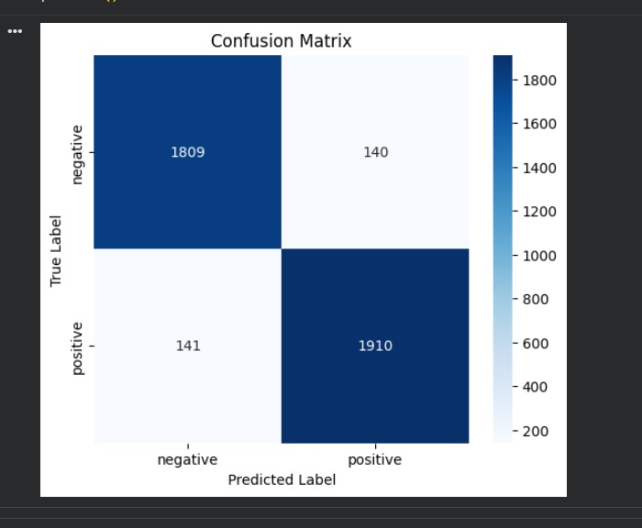
Model Choice & Evaluation Results
Why DistilBERT?
Performance Metrics
92.45%
92.98%
Confusion Matrix
40% Smaller
Epoch 1 Accuracy
Epoch 2 Accuracy
vs BERT-base — fits project constraints
92.97%
0.198
2× Faster
Final Accuracy
Loss
inference speed for real-time analysis
0.93
0.93
Precision
Recall
97% BERT perf
retains performance via distillation
0.93
F1 Score
GPU-friendly
Strong balanced performance for binary sentiment classification
trains effectively on limited resources
7
Notes:
Here we present the final evaluation of our sentiment analysis model after fine-tuning DistilBERT on Amazon product reviews. The model achieved around 93% validation accuracy with balanced precision, recall, and F1-score values, which indicates strong and stable performance for binary sentiment classification. The confusion matrix also shows that the number of incorrect predictions is relatively low compared to the correctly classified reviews. Overall, the results demonstrate that DistilBERT provides an efficient balance between speed, lightweight architecture, and high NLP performance, making it suitable for integration into our multi-agent AI system.

Slide 8
Multi-Agent Application Layer
ORCHESTRATOR
Coordinates all agent execution
↓
↓
↓
↓
Collector Agent
Sentiment Agent
Insight Agent
Report Agent
CrewAI Agent
ML Inference Agent
Business Insight Agent
Report Generation Agent
• Collects reviews from available sources
• Loads fine-tuned DistilBERT
• Extracts key strengths
• Compiles all insights
• Accepts manual user-provided input
• Classifies each review
• Identifies complaints
• Formats intelligence report
• Validates & normalises raw data
• Returns confidence scores
• Finds recurring topics
• Logs final report output
8
Notes:
Four specialized agents form the application layer. The Orchestrator coordinates their execution. The Collector fetches reviews, Sentiment Agent runs DistilBERT inference, Insight Agent uses Gemini to extract patterns, and the Report Agent generates the final deliverable. All agents are defined as CrewAI roles.

Slide 9
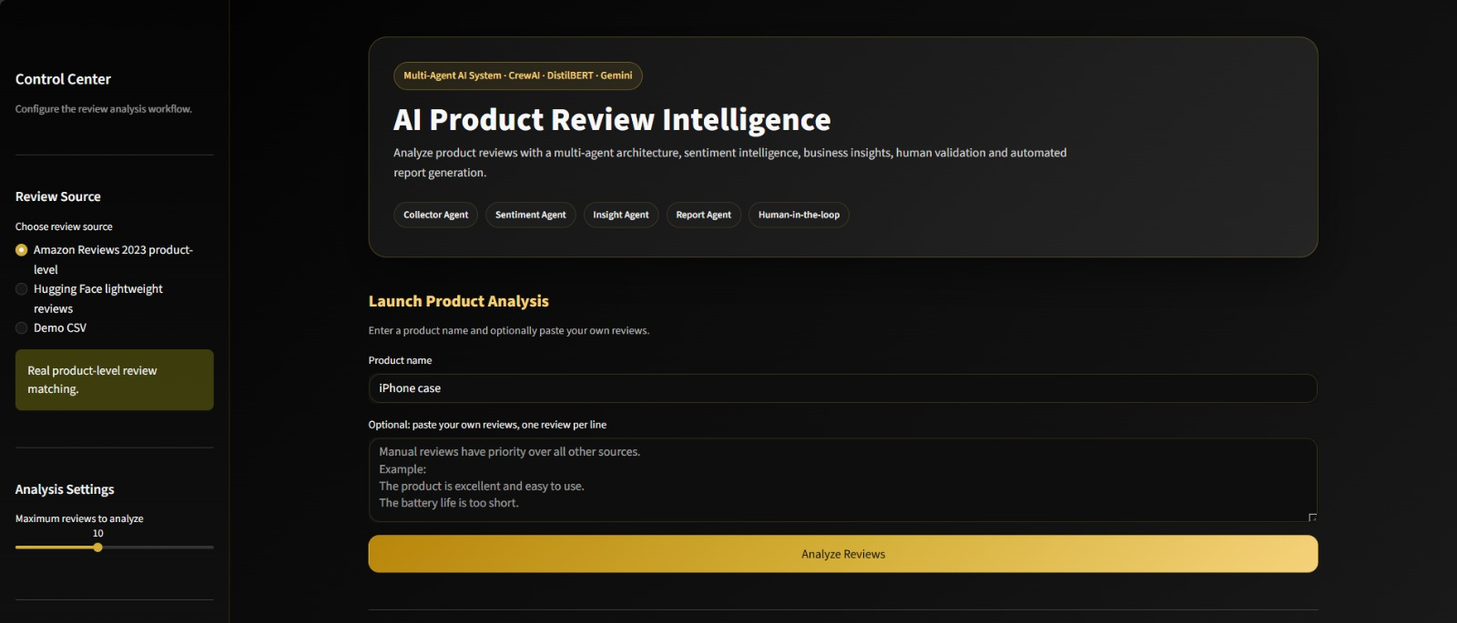
Streamlit Interface
Interactive Web Application
Key Features
Product name input
Review source selector
Sentiment analysis metrics
Sentiment distribution chart
Reviews table with scores
Human approval checkbox
Final report generation
JSON logs viewer
9
Notes:
The Streamlit application provides a complete interactive interface. Users enter a product name, choose the review source, view sentiment metrics and charts, and then trigger the multi-agent pipeline. The human approval checkbox must be checked before the final report is generated.

Slide 10

Logging, Error Handling & Human Validation
Live JSON Log Viewer — Streamlit UI
JSONL Logging
Error Handling
Human Validation
Every agent action logged in a JSON file
Centralized exception capture layer
Approval checkbox in Streamlit UI
Timestamped entries for full traceability
API failures handled with safe fallbacks
Report generation blocked until approved
Structured JSON format per log line
Safe fallback when no reviews are found
User reviews sentiment & insights
Viewable inside Streamlit UI
Graceful degradation at every step
Ensures quality control before delivery
10
Notes:
Three key reliability mechanisms: structured JSONL logging for auditability, centralized error handling with safe fallbacks, and a mandatory human approval step before any report is generated. This ensures both technical robustness and business process integrity.

Slide 11
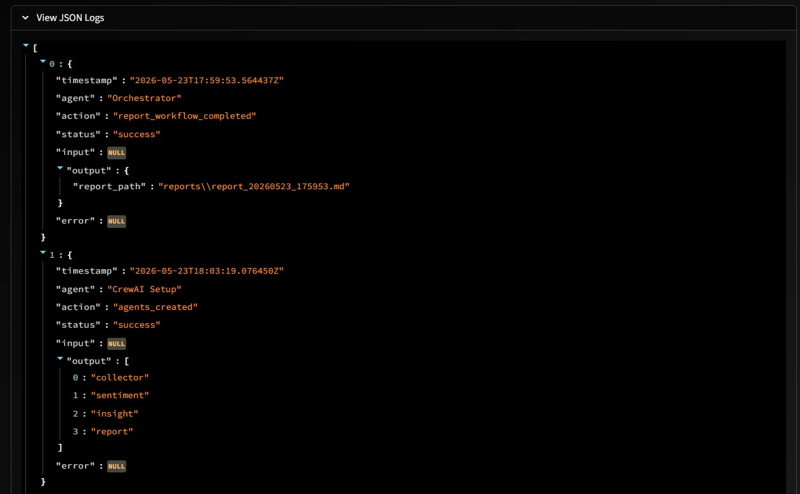
Live JSON Log Viewer
Traceability · Agent Actions · Debugging
Structured JSONL logs capture timestamp, agent, action, status, input, output and errors.
11

Slide 12

Limitations & Future Improvements
Current Limitations
Future Improvements
✕ Model file size
→ Git LFS / Cloud Storage
model.safetensors too large for standard GitHub push — requires Git LFS
Store model weights on Git LFS or HuggingFace Hub for easy sharing
✕ Review retrieval latency
→ Local review index
Amazon Reviews 2023 dataset retrieval can be slow due to dataset size
Pre-index reviews locally to reduce retrieval latency
✕ Binary sentiment
→ Neutral sentiment class
Only Positive / Negative — no neutral class supported yet
3-class sentiment (Positive / Neutral / Negative) for richer analysis
✕ Product matching
→ Semantic search
Approximate name matching — semantic search not yet implemented
Use sentence embeddings for precise product & review matching
12
Notes:
Our main limitations are the large model file size, API rate limiting, and the binary-only sentiment classification. Future work will address these with Git LFS, local indexing, a 3-class sentiment model, and semantic search embeddings.

Slide 13
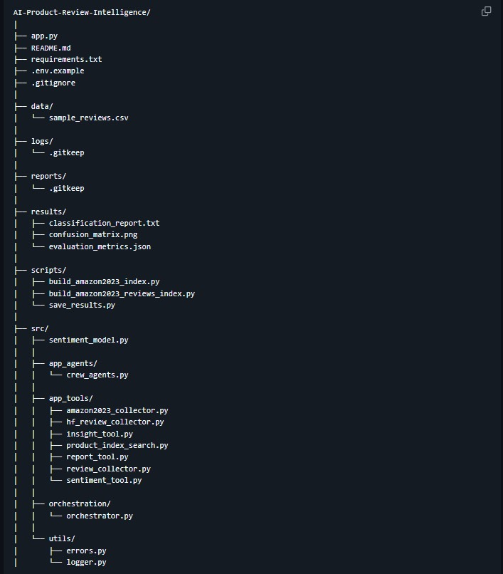
Modular Project Architecture
Clean codebase · ML + App separation
13
The project is organized into app, model, agents, tools, orchestration, utilities, logs, results and scripts.

Slide 14

Conclusion
Deep Learning
Multi-Agent AI
Streamlit UI
DistilBERT fine-tuned — 92.98% accuracy
4 specialist agents + orchestrator
Full interactive web application
Human Validation
Business Reports
Approval checkpoint before final report
Gemini-powered intelligence documents
This system goes beyond sentiment classification by converting customer opinions into actionable insights for decision-making.
Thank You
Questions & Discussion
14
Notes:
To conclude: we built a complete AI system that fine-tunes DistilBERT for sentiment analysis, coordinates 4 intelligent agents with CrewAI, provides an interactive Streamlit interface with human approval, and generates actionable business intelligence. This goes well beyond basic sentiment classification.

