Slide 1
Arduino ADC

Slide 2
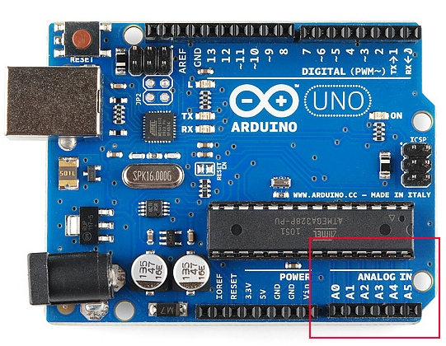
ADC
Translate analog voltage value into different digital levels
Analog Sensor output is connected to analog input pins.
6 analog pins A0 to A5

Slide 3
Analog to Digital Conversion
Arduino has inbuilt 10 Bit ADC- 1024 discrete analog values.
0 for 0V
1023 for 5V
Example-Temperature sensor
Sensor output range 0 to 100 °C
0 °C corresponds to digital value 0
100 °C corresponds to digital value 1023
What will be the value corresponding to 50 °C??

Slide 4
analogRead()
Reading analog value
int x = analogRead(A3);
// Reads the analog value on pin A3 into x

Slide 5
LM35 - Temperature Sensor
Accurate than thermistor
Caliberated to an accuracy of 1 °C
Measurement range from -55 °C to 150 °C
1 °C corresponds to 10mV
Advantages
Low cost
Low supply current
Low output impedance

Slide 6
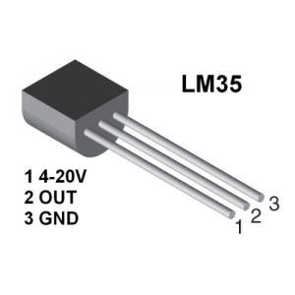
lm35 Pins

Slide 7
TASKS
Write a program to turn on led when the temperature is greater than or equal to 35 degree Celsius.
Write a program to control the speed of a fan according to temperature.

