Slide 1
Enterprise Data warehouse Analysis
Presented By: Team Alpha

Slide 2
Index
Team Member
Team Size
Introduction
Needs and Benefit
Cluster Details
Versions
Project Flow
RDS Data Validation
Table Creation in HBase
as well as in Hive.
10.Data Validation in HBase
11. Hive Stagging Count
12. Hive Final Count
13. Data Load Processing
14. Delta Hive Final Table Count
15. S3 Final Report
16. Optimization Technique
17. Data Validation/Reconciliation
18. Roles and Responsibilities
19. KPI’s

Slide 3
Team Members
Komal Maher
Payal Bhalerao
Sakshi Rathod
Sulochana Mishra
Vaishnavi Kale
Ashish Rananaware
Ganesh Sonwane
Nikhil Yenurkar
Sachin Kale
Sushant Wandhekar

Slide 4
Team Size
Total 9
Mgr -1
TL/ Scrum Master – 1
HE/Dev – 2
MidE/Dev -4
Infra -1

Slide 5
Introduction
In the fast-paced and dynamic world of telecommunications, the rapid rise in the use of smartphones and the ever-increasing demand for high-speed connectivity, spanning customer interactions, network operations, billing, and many more. It is necessary that the operators process, store, and extract insights from the available data.
The Role of Enterprise Data Warehousing(EDW): In this dynamic environment, the Telecom EDW plays a pivotal role in gathering, storing, and analyzing diverse datasets. It acts as a centralized hub where structured, semi-structured, and unstructured data from various sources converge. This wealth of data encompasses call records, customer profiles, network logs, and IoT-generated information, among others.
The role of Big Data analytics: It can help them to increase profitability by helping optimize network usage and services, enhance customer experience, innovation, drives operational efficiency and improve security.
The Telecom Enterprise Data Warehouse (EDW) stands at the heart of this transformation, serving as a robust repository of invaluable information that empowers telecom companies to make informed decisions, optimize network performance, and deliver cutting-edge services.
The potential of Big Data, however, poses a challenge: how can a company utilize data to increase revenues and profits across the value chain, spanning network operations, product development, marketing, sales, and customer service

Slide 6
Needs and Benefits
High speed connectivity
Making smarter investment decisions
Reducing fraud
Improved risk management
Increased sales
Smoother network operation
Fast economical growth in market
Technological advancement
Making the operations more efficient
Increased average revenue per user

Slide 7
Cluster Details
Daily Data Size :~ 200 GB
Input File Type :- .csv
Delimiter :- |
Daily 1 file for each transactional Table.
Total Number of tables :~ 300
(220 TX , 60 REF , 20 Hist.)
Total Number of Jobs :- Around 340 jobs
Total Number of nodes : 9
Masters : 3 (ANN,PNN,RM)
Slaves : 6
Total RAM : 256 GB * 6 ~ = 1.35 TB
HDFS Size ~ = 120 TB (100 TB Process)
Total Cores = 64 * 6 = 350 cores
Cluster retention: 1 year
Replication Factor: 3
Block Size: 128 MB

Slide 8
Versions
Hadoop = 2.10.1
Spark = 2.4.8
HBase = 1.4.13
Zookeeper = 3.4.14
Hive = 2.3.9
Hue = 4.10.0
Phoenix = 4.14.3
RDS – Postgre = PostgreSQL 12.5-R1
EMR = 5.33
Airflow = 2.0
Workbench = Build 127
Java = 1.8.0

Slide 9









Project Flow

Slide 10
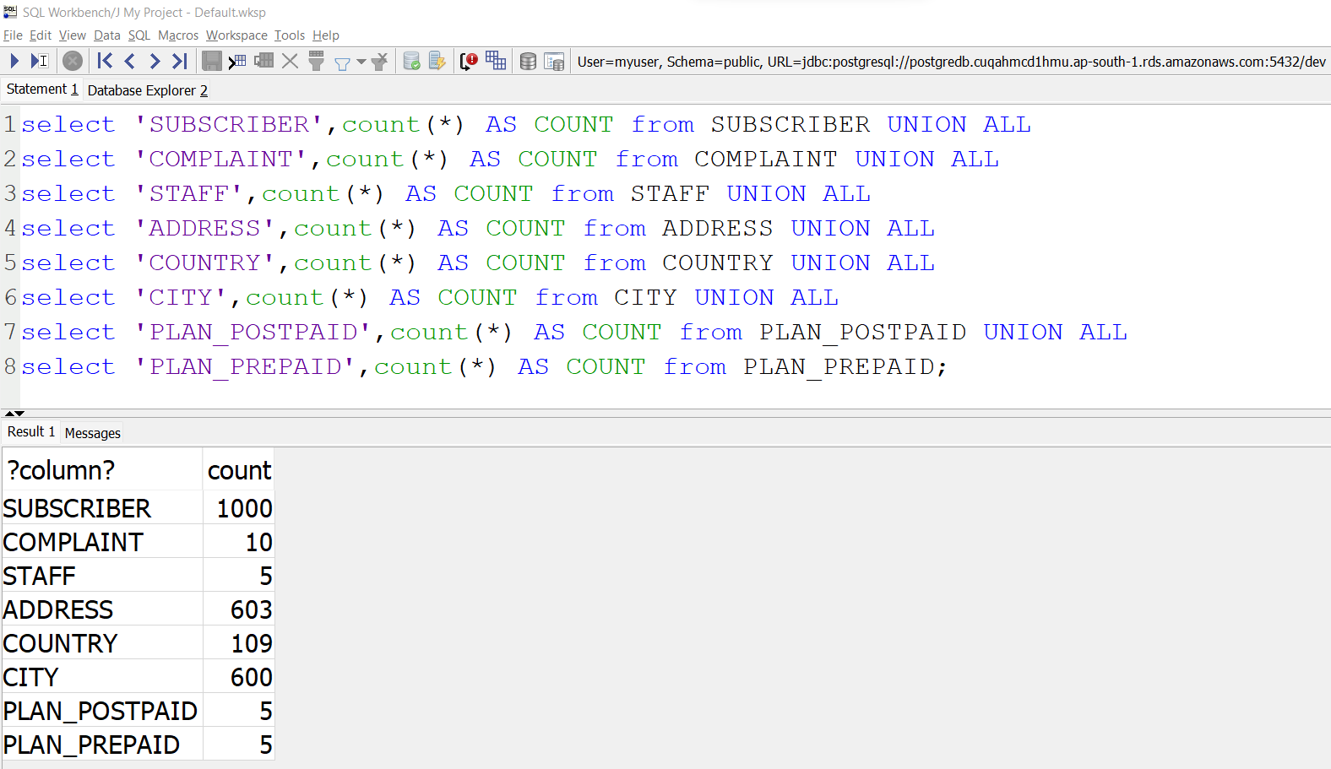
RDS Data Validation

Slide 11
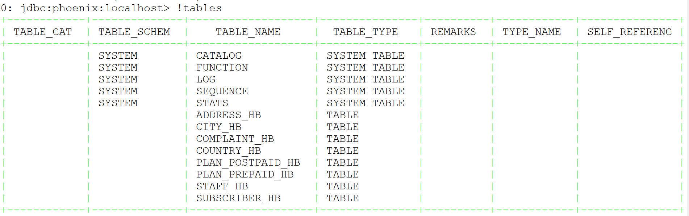
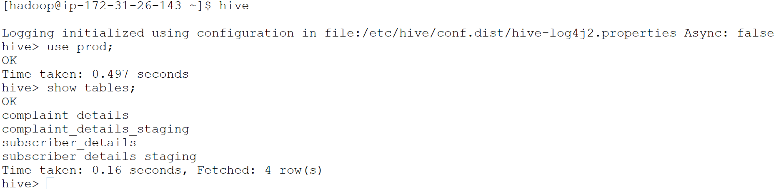
Table Creation in HBase as well as in Hive

Slide 12
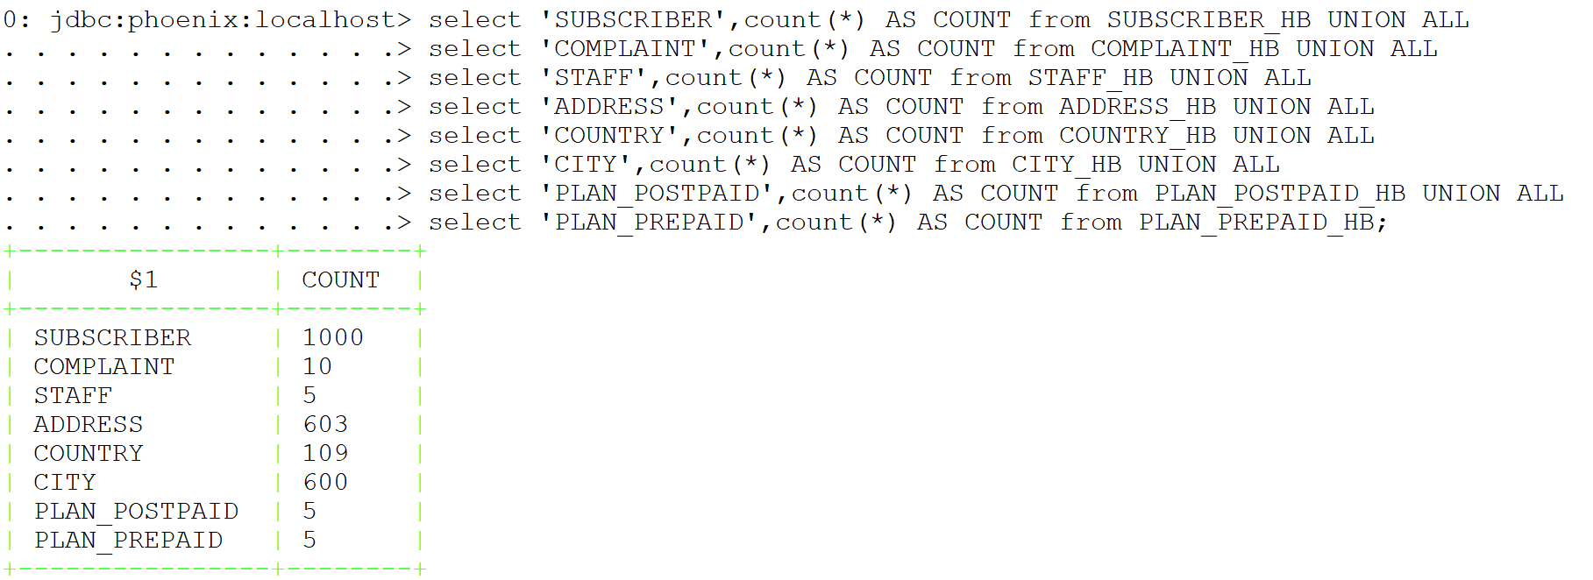
Data Validation in HBase

Slide 13
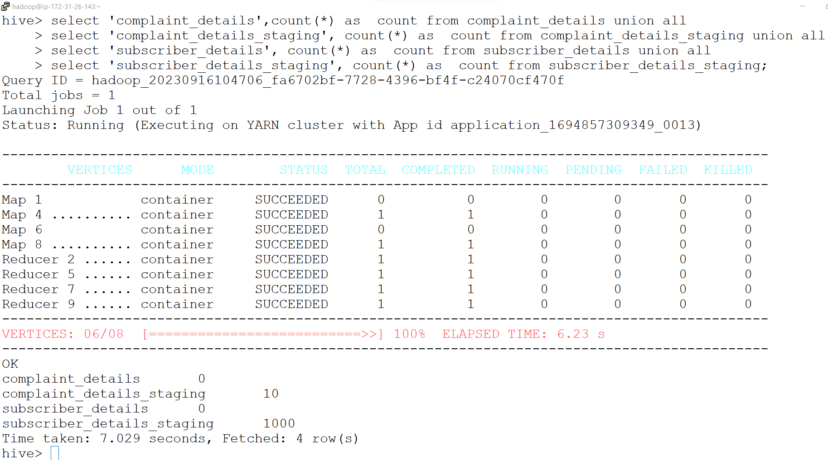
Hive Stagging Count

Slide 14
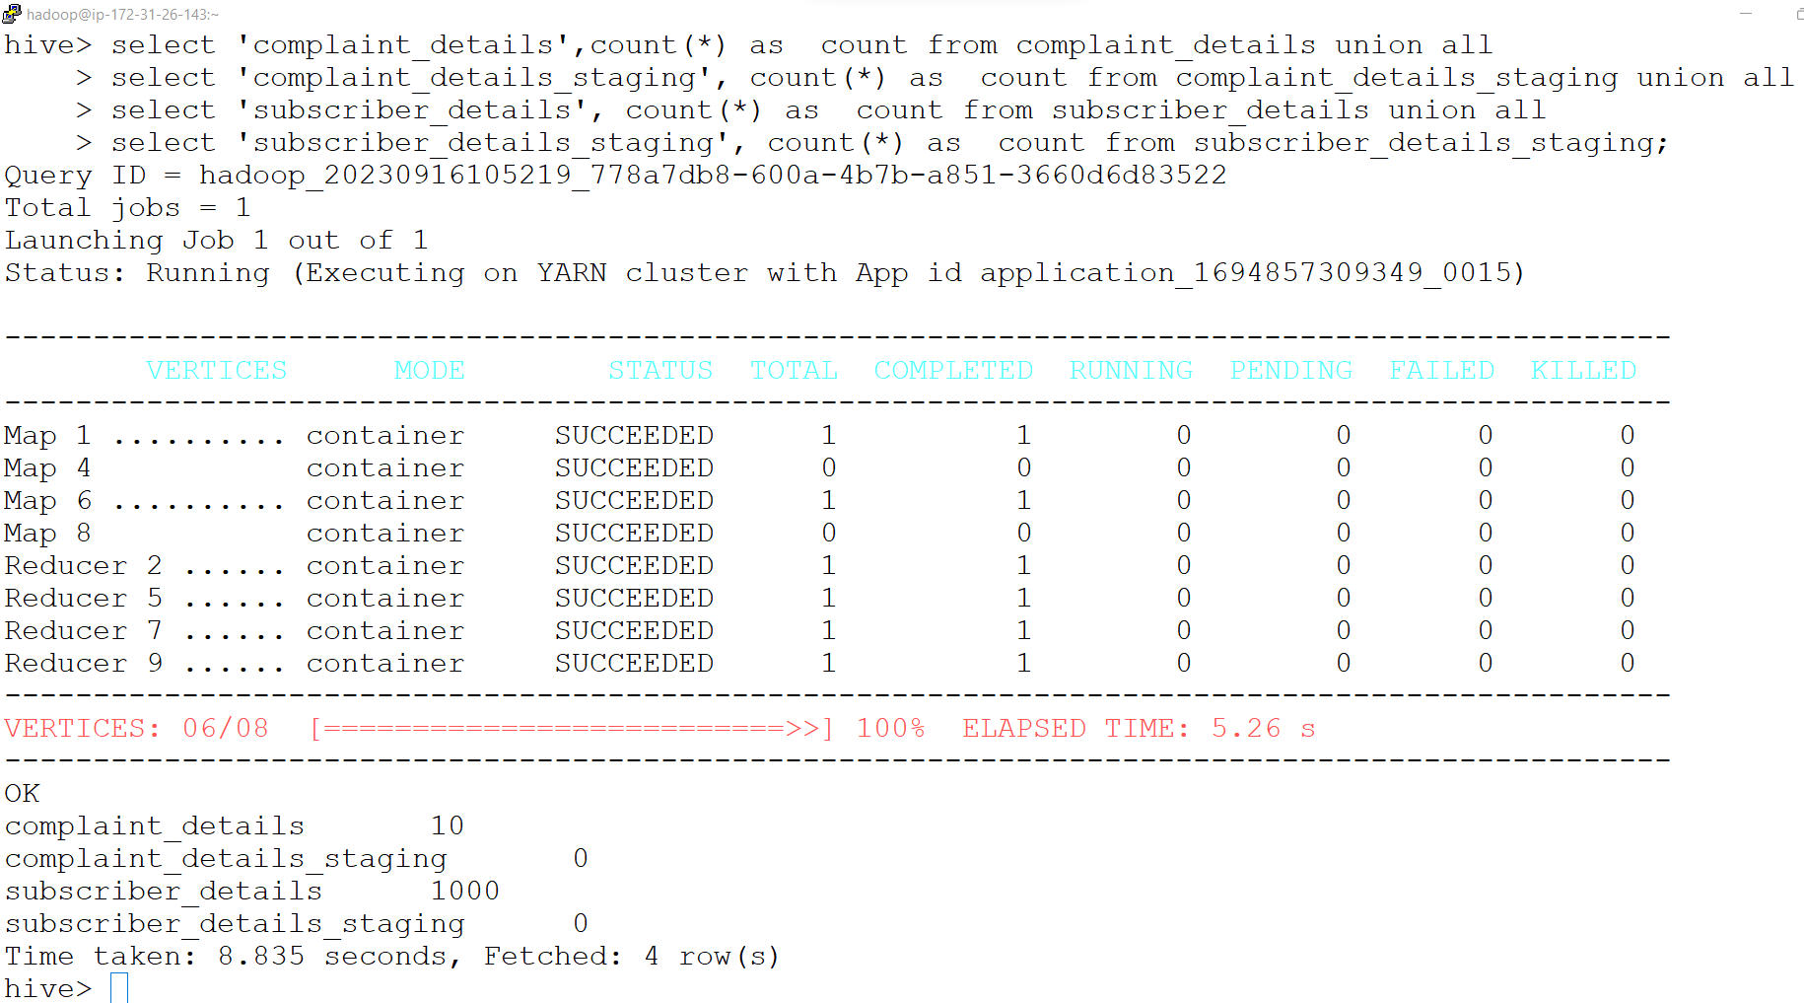
Hive Final Count

Slide 15
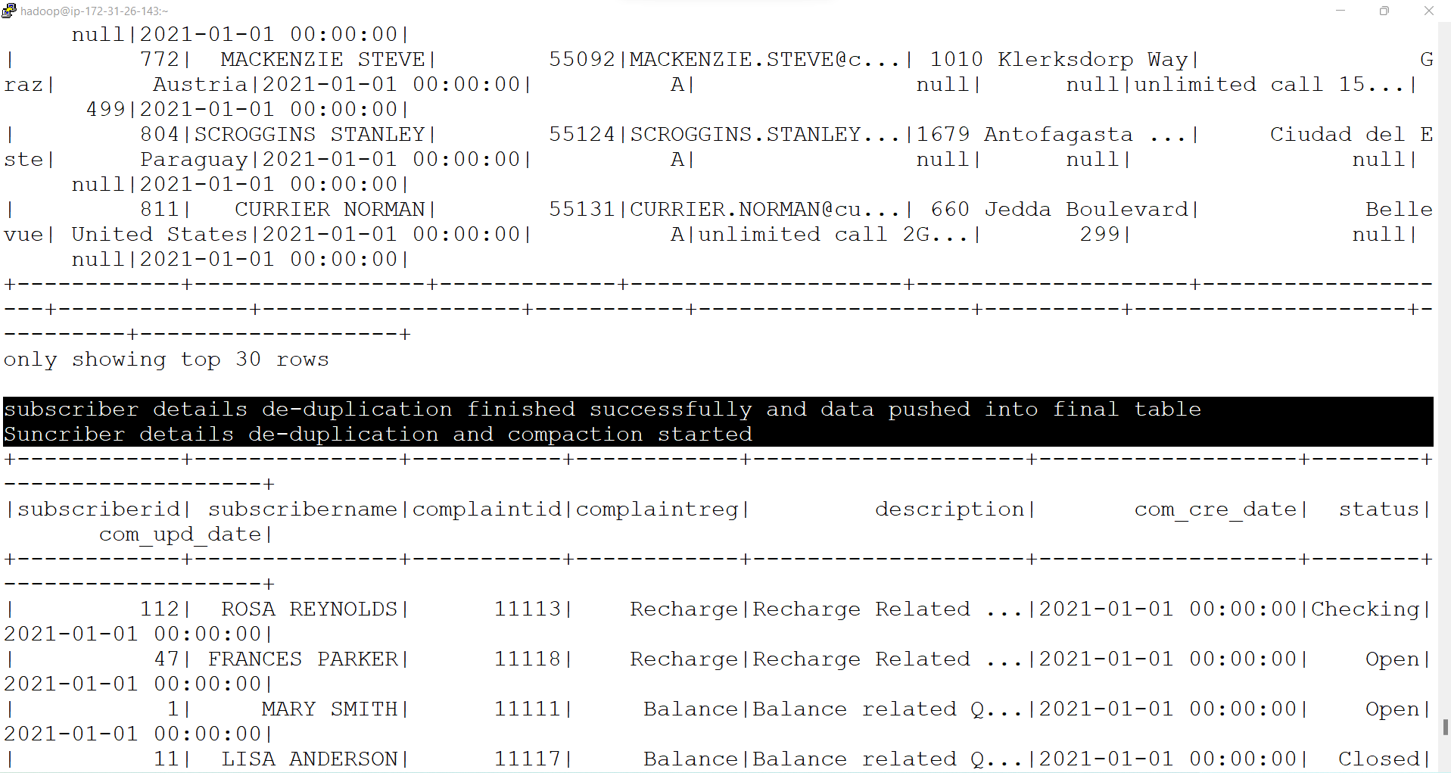
Delta Load Processing (Delta Hivestg to Hive Final)

Slide 16
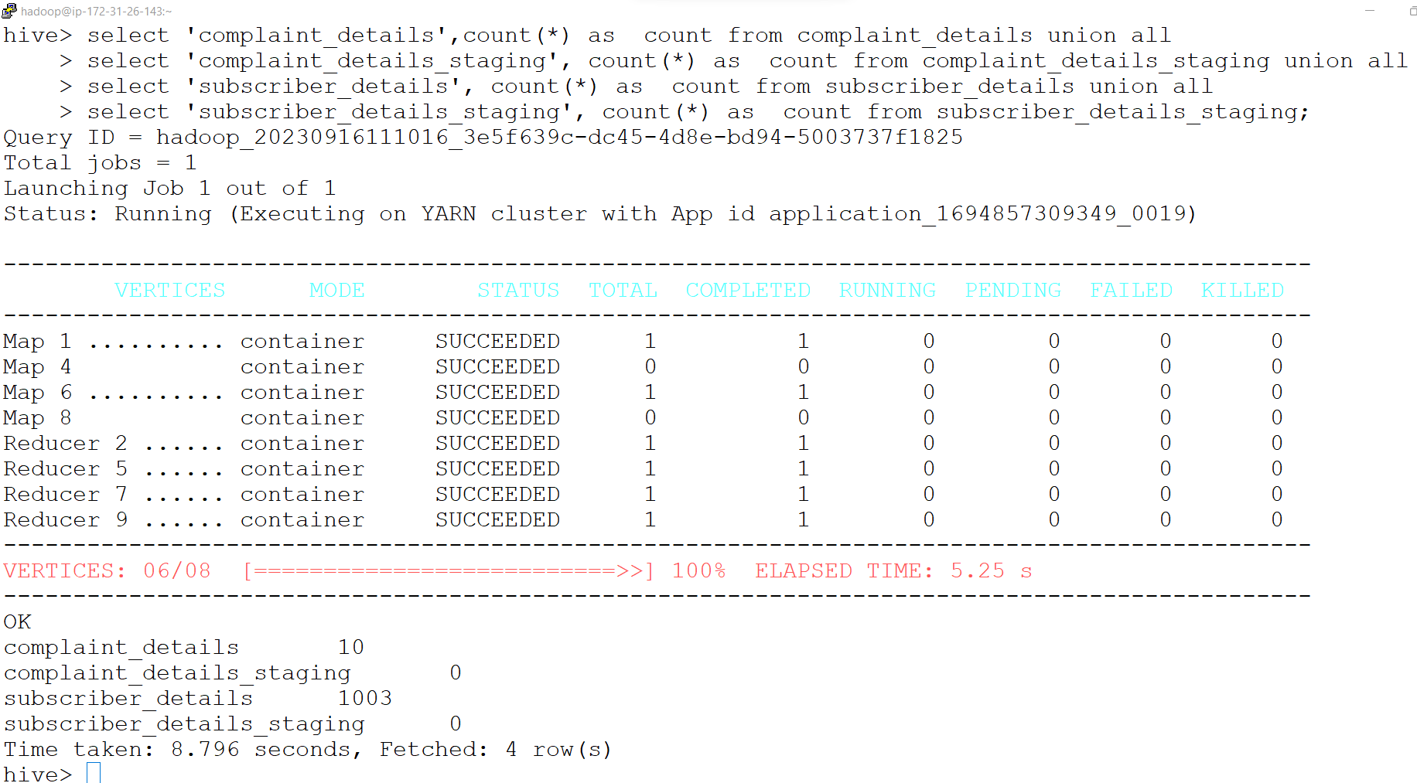
Delta Hive Final Table Count (Daily Data Load into Data Warehouse)

Slide 17
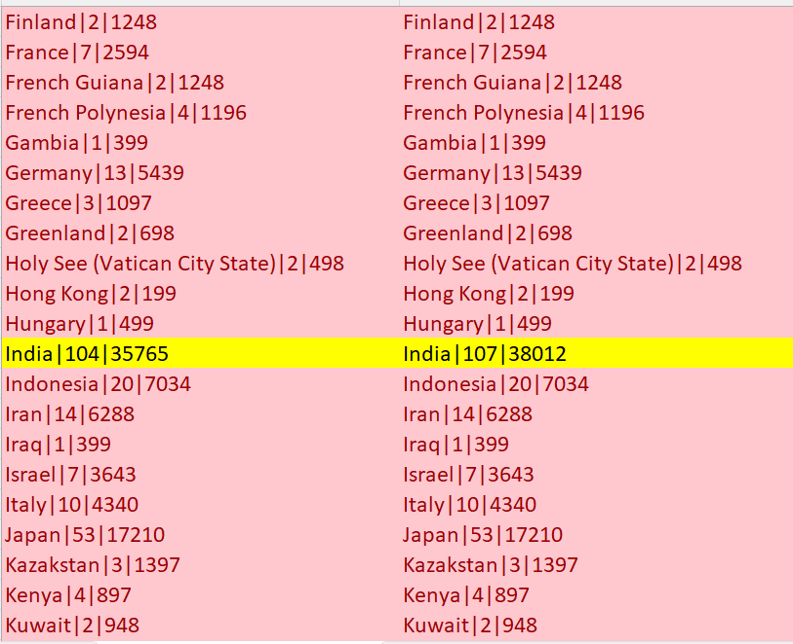
S3 Final Report

Slide 18
Optimization Techniques
Spark
Code level optimization-
Broadcast join
Coalesce
Repartition
Persist
Cache
Catalysist optimizer
File format Parquet
Execution level optimization-
True some parameter
Driver memory
Executor memory
No. of executor
Shuffle partition
Hive
Partition
Bucketing
Cast Base Optimizer
Order By
Vectorization
Hive Indexing
Map Join
Execution Engine

Slide 19
Data Validation/Reconciliation
Count Check: Check source & target count validation.
Null Check: Identify null record in target.
Duplicate Check: Check the data should not be duplicate in target
Referral integrity Check (RI): The logical dependency of foreign key on a primary key.
Detailed Check: Check imported data should be accurate.

Slide 20
Roles and Responsibilities
Understand customer queries and their requirements.
Understand the upstream source nature and work with business cases.
Write the script and process the data.(Scripting)
Automate the given task.(Automation)
Monitor and optimize the job.(Monitorization & Optimization)
Reconcile | Reporting | Deduplication | data extraction.
Do Analysis.

Slide 21
Key Performance Indicators
Project Goal :
Business & Marketing
To get insight of data
Active customer/subscriber
Popular plan
Faults and Complaints
Customer Satisfaction

Slide 22


