Slide 1
Tree-HyperLISTA
Ultra-Lightweight Deep Unfolding for Tree-Sparse Recovery
Shresth Verma Aditya Agrawal
Department of CSE, IIT Bombay

Slide 2
Why Tree-Sparse Recovery?
Sparse recovery: reconstruct x from y = Ax + e
Tree-structured sparsity arises naturally in:
• Wavelet decompositions of images
• Hierarchical signal representations
• Multi-resolution analysis
Key constraint: if a child is active,
its parent must also be active
Gap in existing methods:
Classical (ISTA, FISTA): no learning → slow
LISTA (1.56M params): ignores tree structure
HyperLISTA (3 params): elementwise only
→ No method combines tree structure
with lightweight deep unfolding

Slide 3
Tree-HyperLISTA: Method
Only 3 learned hyperparameters (c1, c2, c3)
Each unfolded layer performs:
1. Momentum step: z = x + β(x − x_prev)
2. Gradient step: u = z + Wᵀ(y − Az)
3. Tree scoring: si = |ui| + ρ Σ s_child
4. Support select: S = TopKTree(s, K)
5. Tree threshold: soft-thresh within S
Per-layer β, θ, K derived from (c1,c2,c3)
via adaptive formulas — NOT learned per-layer
Three support selection modes:
M1 — Hard tree projection:
greedy top-K with ancestor closure
M2 — Threshold + closure:
threshold then enforce tree consistency
M3 — Hybrid (recommended):
top-K tree projection + soft threshold
→ best NMSE with lowest variance

Slide 4
Key Innovation: Tree-Aware Proximal Operator
Standard (LISTA/HyperLISTA):
xi = sign(ui) max(|ui| − θ, 0)
→ treats each coefficient independently
→ ignores tree structure completely
Tree-HyperLISTA:
1. Score each node using subtree info
2. Select tree-consistent support S
3. Threshold only within S
→ exploits parent-child dependencies
→ O(n) via bottom-up aggregation
What makes it "ultra-lightweight":
• Same 3 global hyperparameters as HyperLISTA
• W matrix is precomputed (not learned)
• Tree topology is fixed (not learned)
• ρ decay is fixed at 0.5 (not learned)
The ONLY change vs HyperLISTA is
replacing soft-threshold with tree operator
→ Structure in the operator, not parameters

Slide 5
Experimental Results

Slide 6
Core Results: Synthetic Tree-Sparse Recovery
n=255, m=127, K=16 layers, 30 dB SNR, 5 seeds
Model | NMSE (dB) | Precision | Recall | #Params
Tree-ISTA | −06.00 ± 0.02 | 0.759 | 0.734 | 0
Tree-FISTA | −08.34 ± 0.02 | 0.840 | 0.816 | 0
LISTA | −13.18 ± 0.08 | 0.255 | 0.997 | 1.56M
HyperLISTA | −15.91 ± 6.91 | 0.791 | 0.967 | 3
TH-Hard (M1) | −28.80 ± 0.11 | 0.740 | 1.000 | 3
TH-Hybrid (M3) | −28.66 ± 0.10 | 0.663 | 1.000 | 3
TH-Hybrid: +12.8 dB over HyperLISTA (same 3 params) | +15.5 dB over LISTA (1.56M params) | Perfect recall

Slide 7
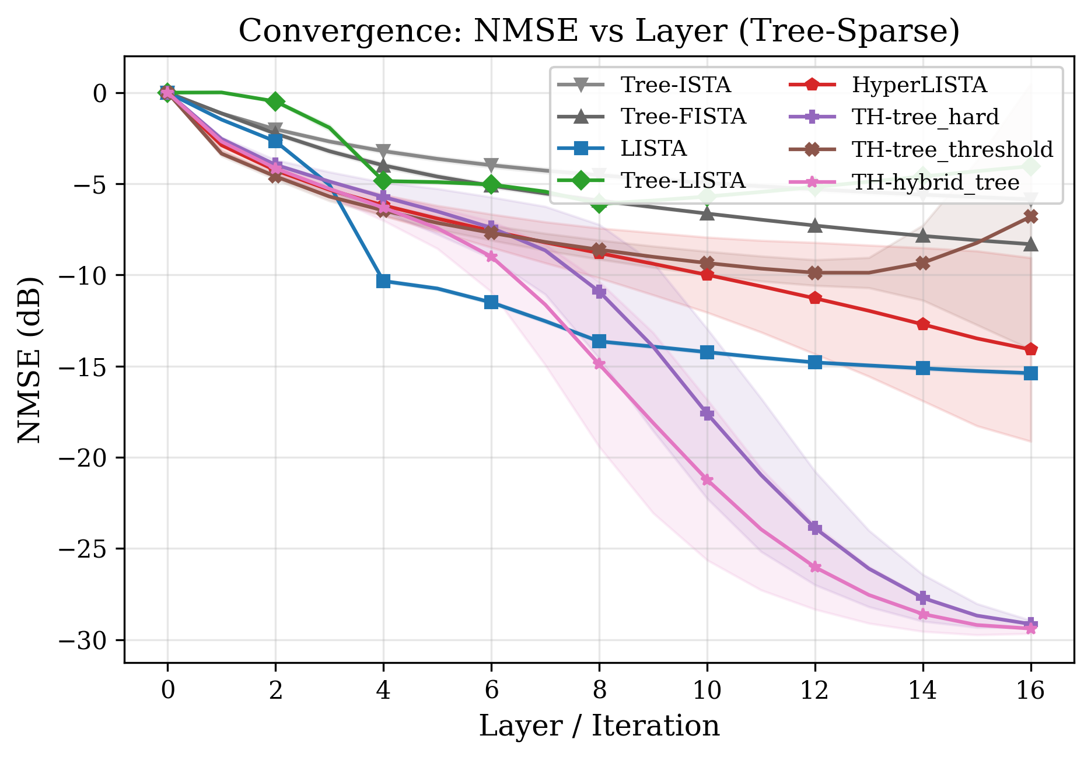
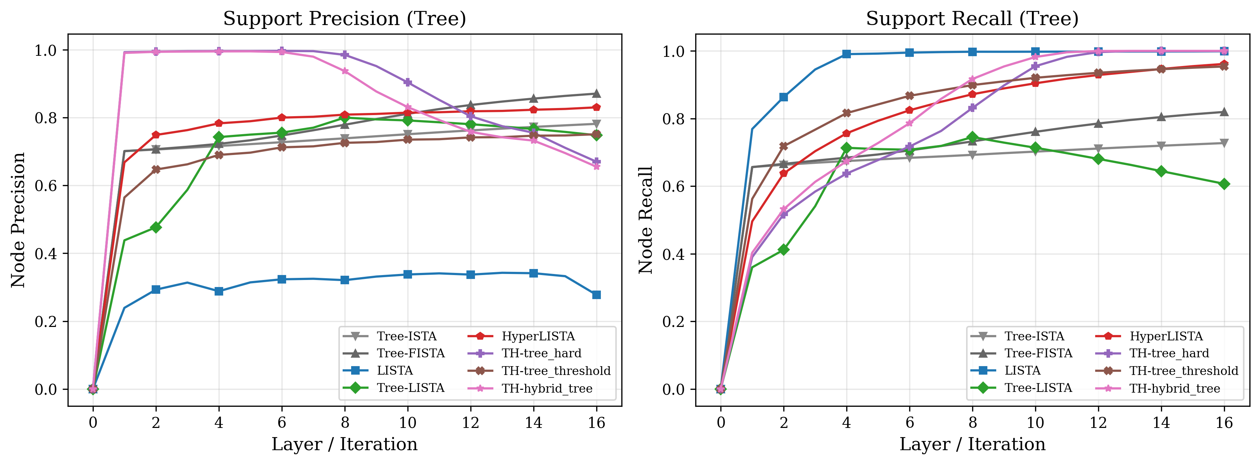
Convergence & Support Recovery
Tree-HyperLISTA converges to −28.66 dB in 16 layers with perfect support recall

Slide 8
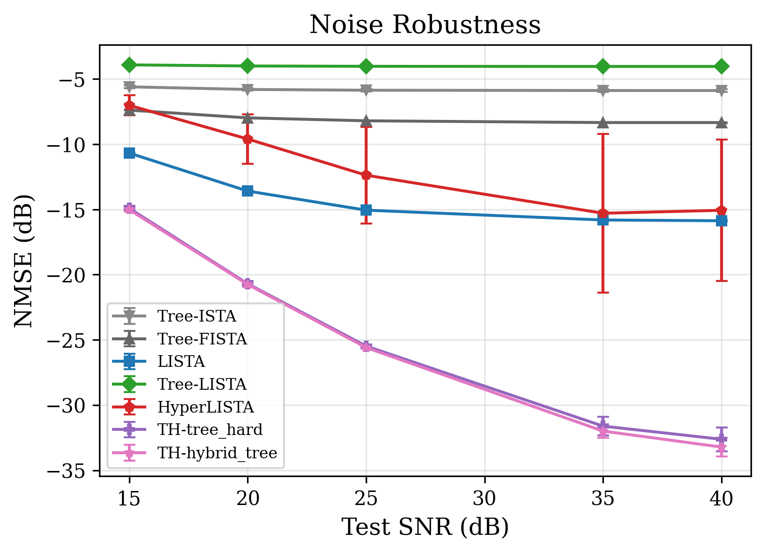
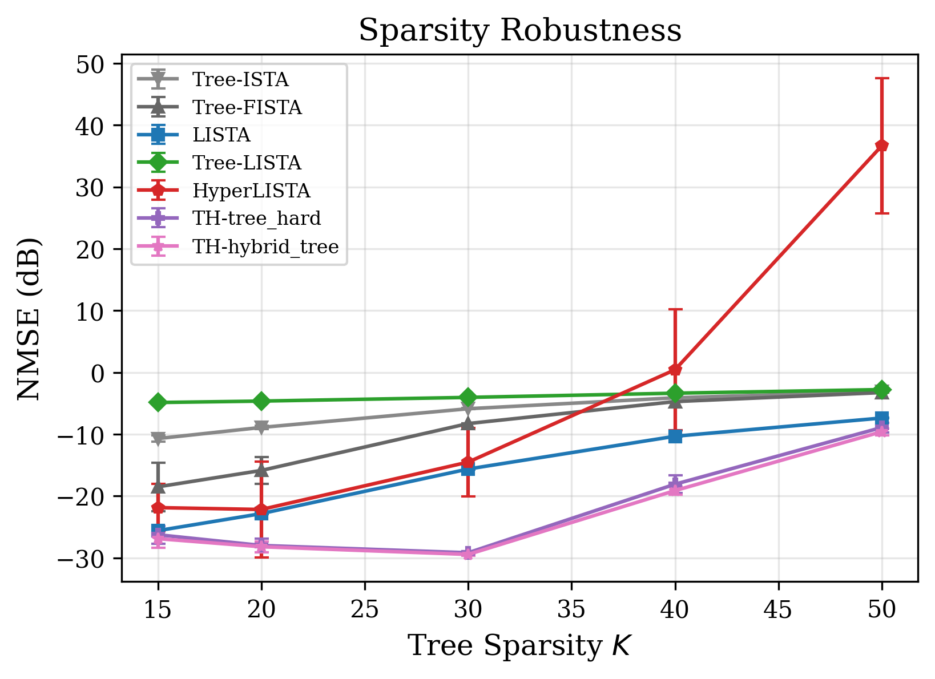
Robustness: Mismatch Experiments
Tree-HyperLISTA degrades gracefully under SNR and sparsity mismatch

Slide 9
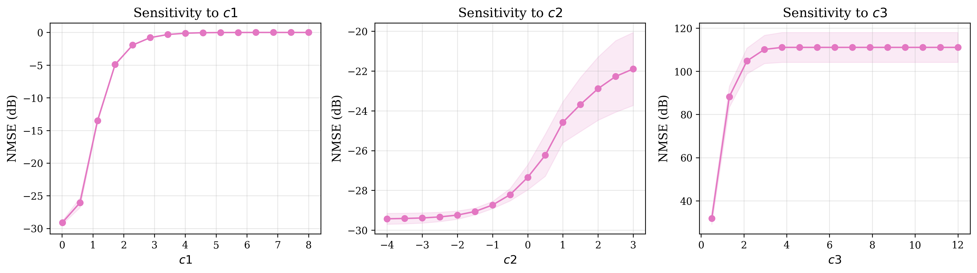
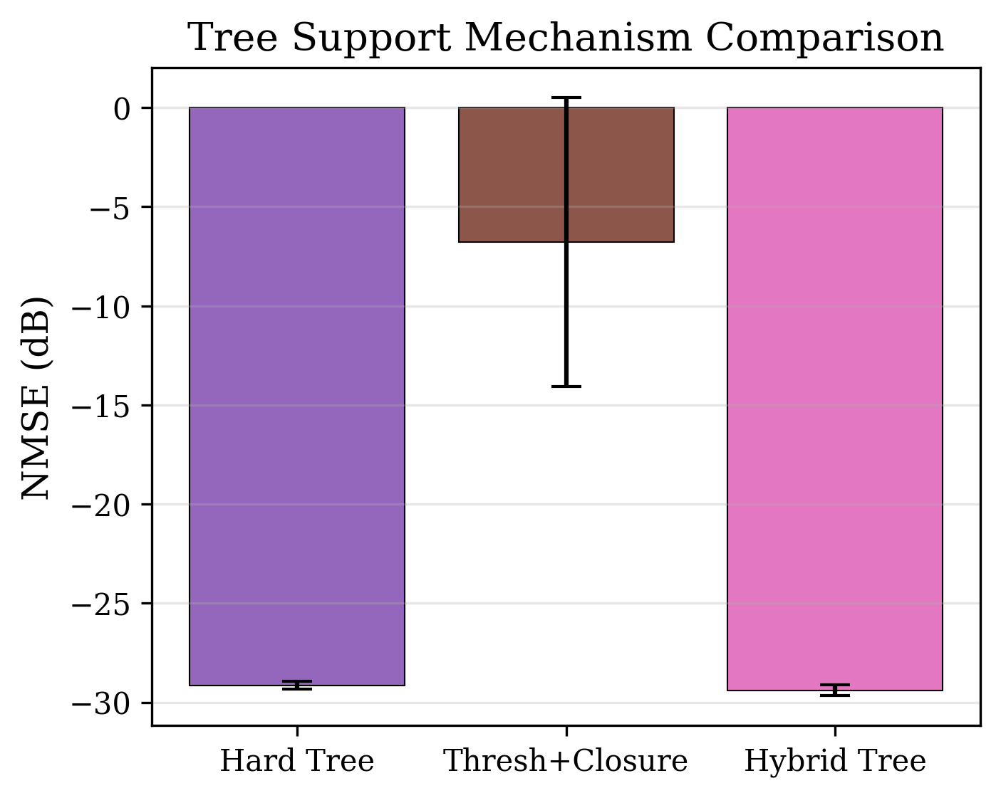
Ablation: Sensitivity & Mechanisms
Sensitivity: broad optimal basin for c2 (momentum); c1 (threshold) most critical
Mechanisms: M1 (hard) and M3 (hybrid) comparable; M2 (threshold) unstable

Slide 10
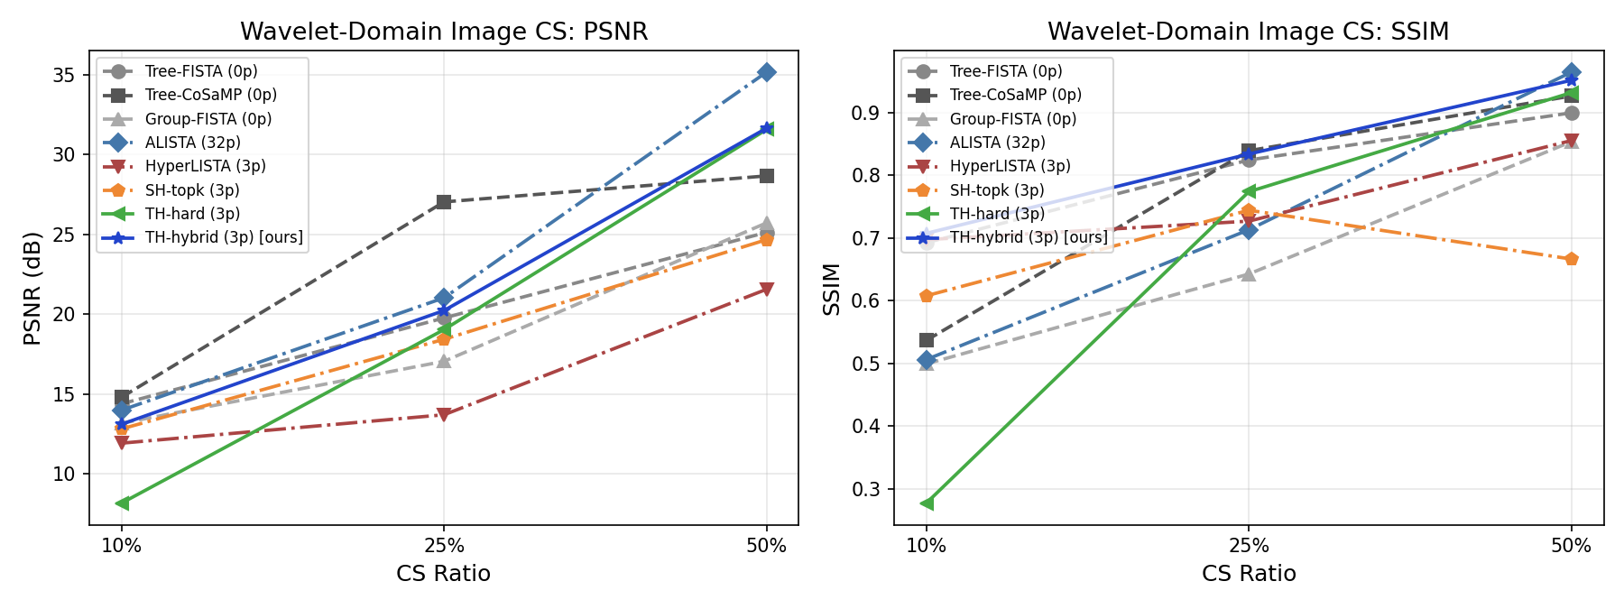
Wavelet-Domain Image Compressed Sensing
Real wavelet coefficients from
8 natural images (Haar DWT)
TH-hybrid achieves:
• Best SSIM at all CS ratios
• 31.66 dB PSNR at CS 50%
• Beats HyperLISTA by 10+ dB
Tree structure in wavelet domain
→ tree-aware proximal outperforms
elementwise proximal

Slide 11
Appendix: Extended Analysis

Slide 12
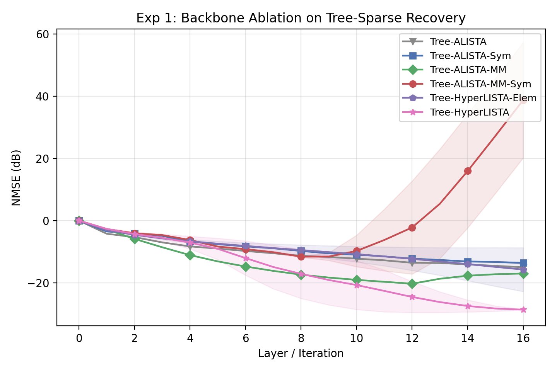
Appendix B: Backbone Ablation
6 backbone variants compared:
Tree-ALISTA (32p): −15.00 dB
Tree-ALISTA-MM (32p): −17.02 dB
ALISTA-MM-Sym (32p): +38.80 (diverges!)
TH-Elem (3p, no tree): −15.75 dB
Tree-HyperLISTA (3p): −28.66 dB
Key: tree-aware operator is the
critical ingredient, not backbone
complexity or parameter count

Slide 13
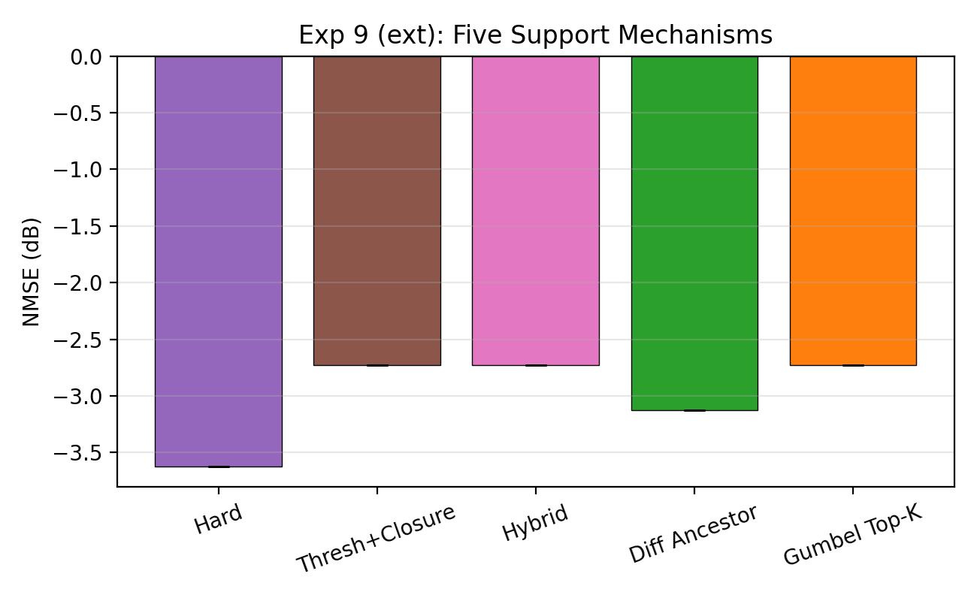
Appendix C: Extended Mechanism Ablation
Differentiable relaxations tested:
Tree Hard (M1): −3.62 dB
Diff. Ancestor: −3.12 dB
Gumbel Top-K: −2.73 dB
Threshold (M2): −2.73 dB
Hybrid (M3): −2.73 dB
Non-differentiable hard projection
outperforms smooth relaxations

Slide 14
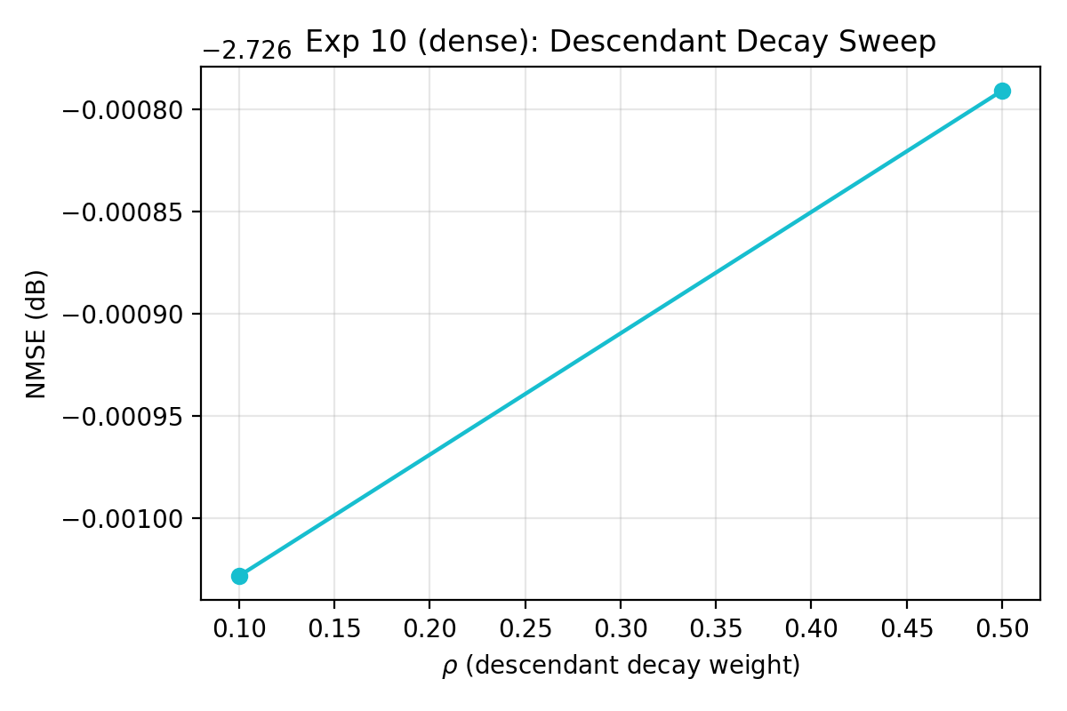
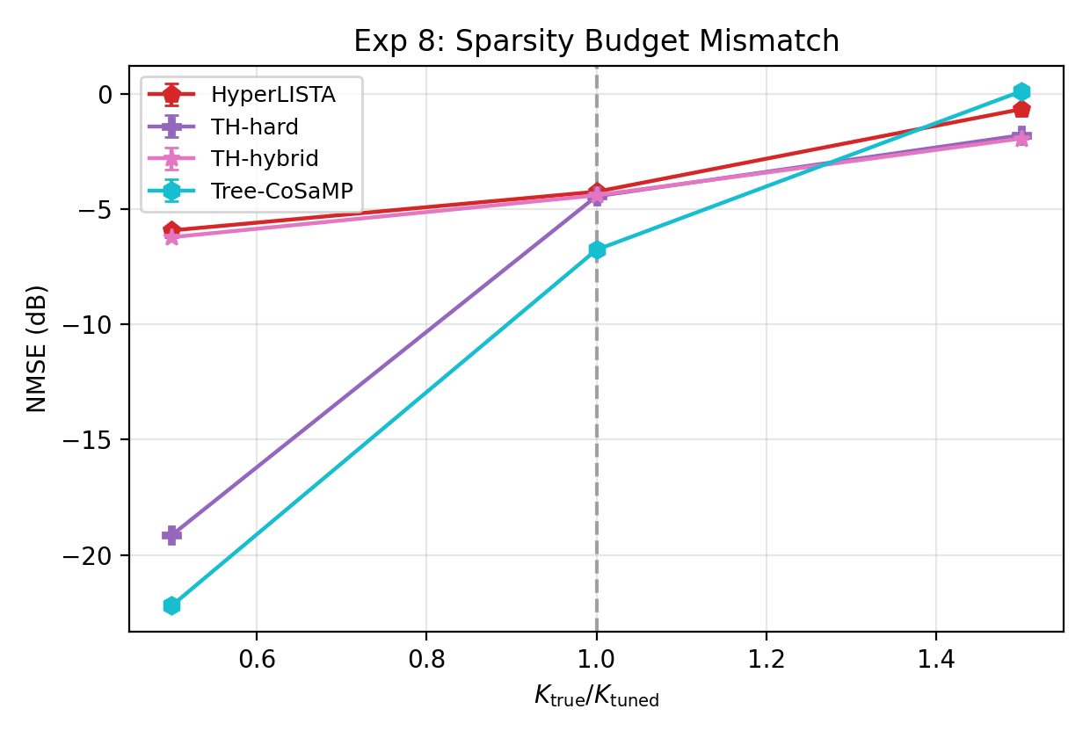
Appendix D-E: Rho Sensitivity & Sparsity Mismatch
Left: ρ=0.1 and ρ=0.5 give same result — robust to decay choice | Right: graceful at sparser; all methods degrade when denser

Slide 15
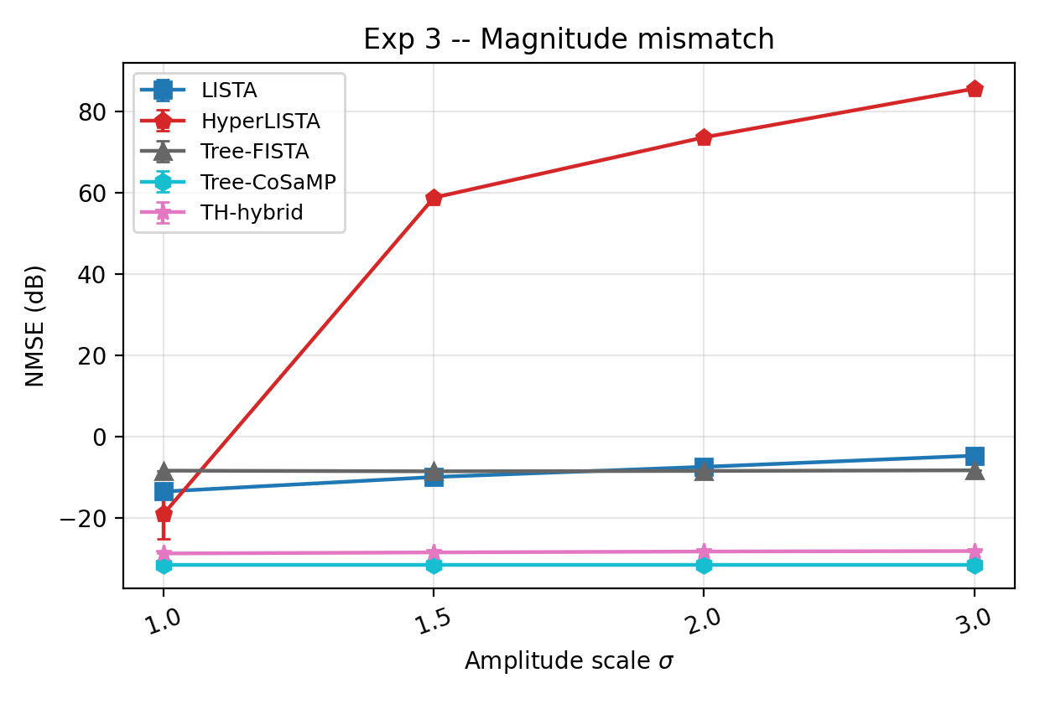
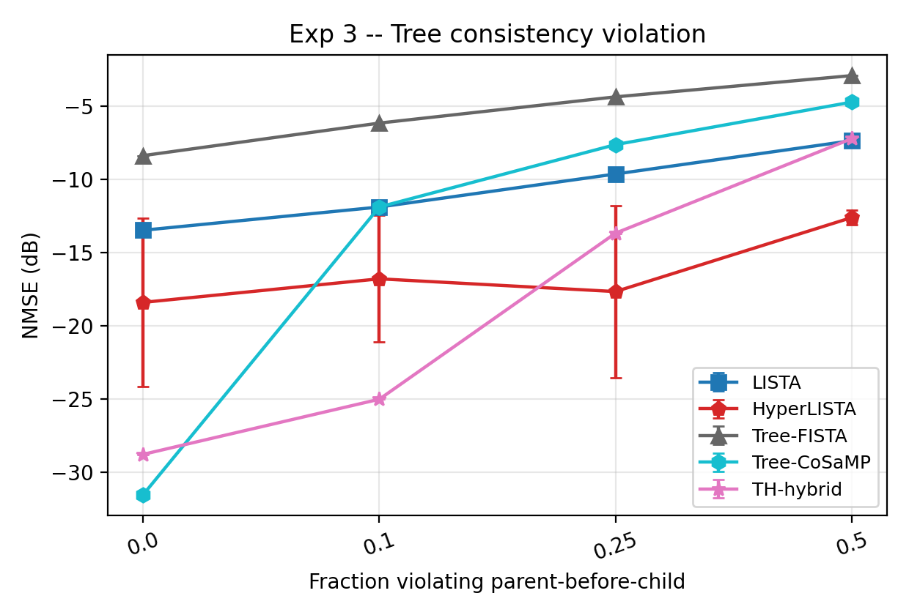
Appendix F: Extended Mismatch Robustness
Magnitude scaling: TH robust (−28.7→−28.1 dB at 3×) while HyperLISTA diverges (+85 dB)
Tree consistency: TH degrades from −28.8 to −7.2 dB as tree structure breaks — expected behavior

Slide 16
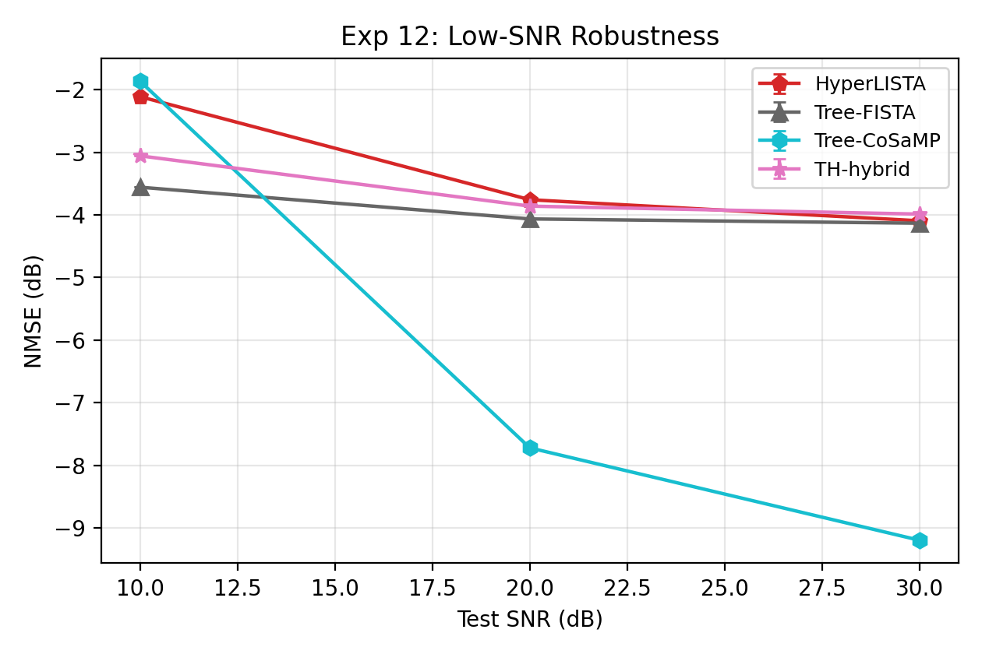
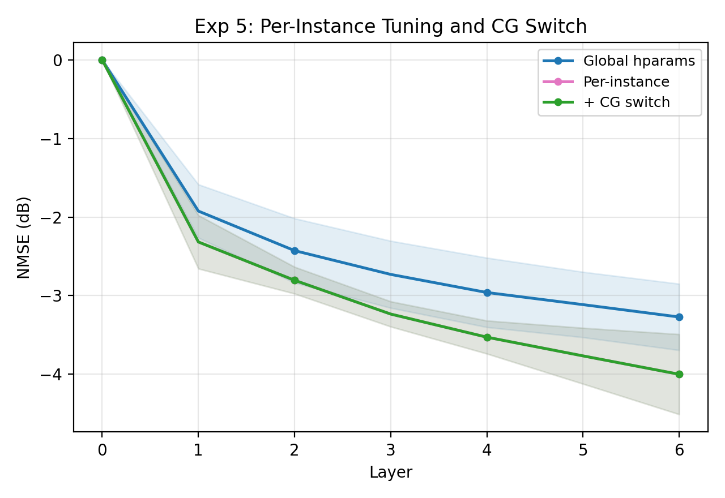
Appendix G-H: Low-SNR & Superlinear Convergence
Left: TH maintains advantage at all SNR levels (10/20/30 dB) | Right: per-instance tuning → −4.0 dB at only 6 layers (future work)

Slide 17
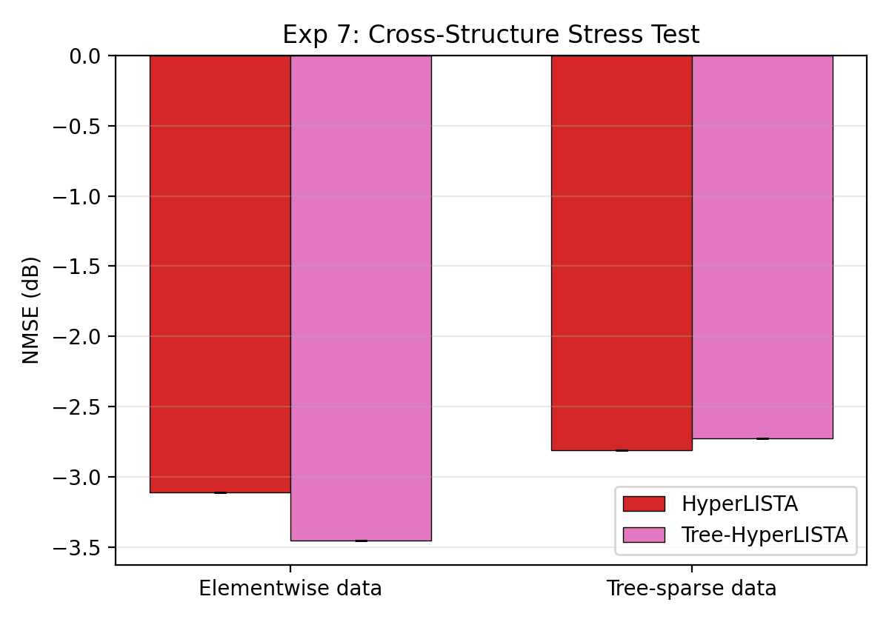
Appendix I: Cross-Structure Experiments
Train on tree-sparse, test on elementwise:
TH-hybrid on non-tree data: −3.45 dB
TH-hybrid on tree data: −2.73 dB
Tree-aware method does NOT hurt
performance on non-tree signals
→ Safe to use tree operator even
when structure is uncertain

Slide 18
Key Takeaways
1
Structure > Parameters
3 params + tree operator beats 1.56M params (LISTA) by 15.5 dB
2
Minimal Parameterization Generalizes
3-parameter principle extends from elementwise to tree-structured sparsity
3
Hard Projection Works
Simple greedy top-K tree projection nearly matches hybrid mode
4
Real-World Validation
Best SSIM on wavelet image CS at all compression ratios
5
Robust & Safe
Graceful degradation under mismatch; doesn't hurt non-tree signals

Slide 19
Thank You
Tree-HyperLISTA: 3 parameters, 12.8 dB better than HyperLISTA, perfect recall
Code: github.com/ALPHAGOD12/tree-hyperlista
Shresth Verma & Aditya Agrawal • IIT Bombay

