Slide 1
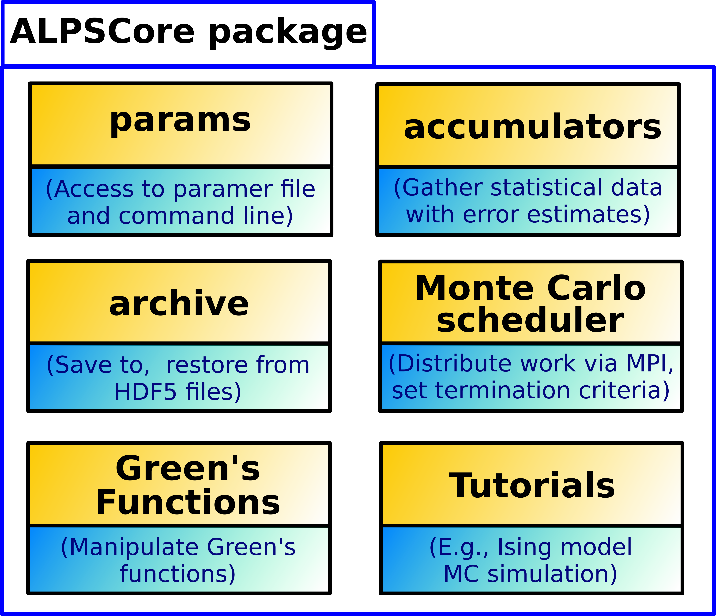
ALPSCore: Core libraries of ALPS project
Website: http://alpscore.org/
(Based on Algorithms and Libraries for Physics Simulations, alps.comp-phys.org)
Open-source libraries for
physics HPC simulations.
Aims to provide generic algorithms and utilities
for physics problems.
Compact C++ implementation, frequent releases.
Tutorials and documentation.
Features:
Built-in statistical accumulators with proper error propagation.
Checkpointing and restarting.
Easy MPI parallelization
of Monte Carlo simulations.
C++ Green's Functions objects.

