Slide 1
ALPSCore Tutorial
Simons Foundation
Many Electron Collaboration
Summer School Coding Workshop
June 16 – June 18
2017
Alexander Gaenko
7/14/2017

Slide 2
ALPSCore tutorial: links
Login information:
https://git.io/simons-2017-login
These slides:
https://git.io/alpscore-tut-2017-02-24
Accompanying code:
https://github.com/galexv/ALPSCore_Tutorial2
ALPSCore website:
http://www.alpscore.org/

Slide 3
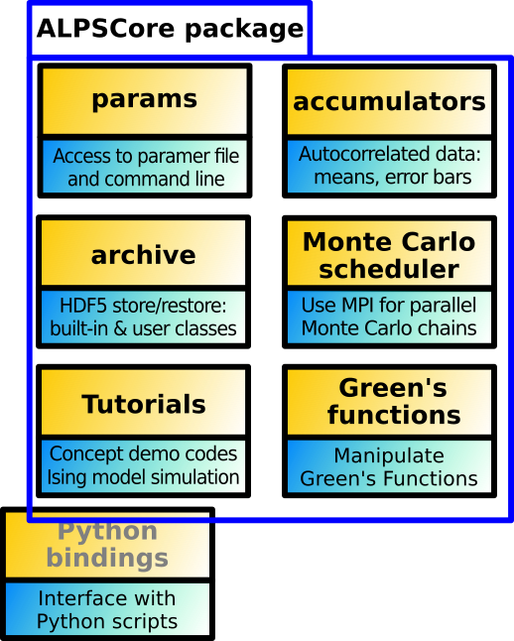
What is ALPSCore?
Software library for writing
physics simulation codes
Primarily for Monte Carlo methods
(as of now).
However...
Has support for Green's Functions;
Other functionality is in works.

Slide 4
Brief history of ALPSCore
ALPSCore is the "core ALPS library"
ALPS is "Algorithms and Libraries for
Physics Simulations" (see http://alps.comp-phys.org)
ALPSCore goals:
Be more compact
Faster development cycle
More extensive documentation.
Focuses on the most often used components.

Slide 5
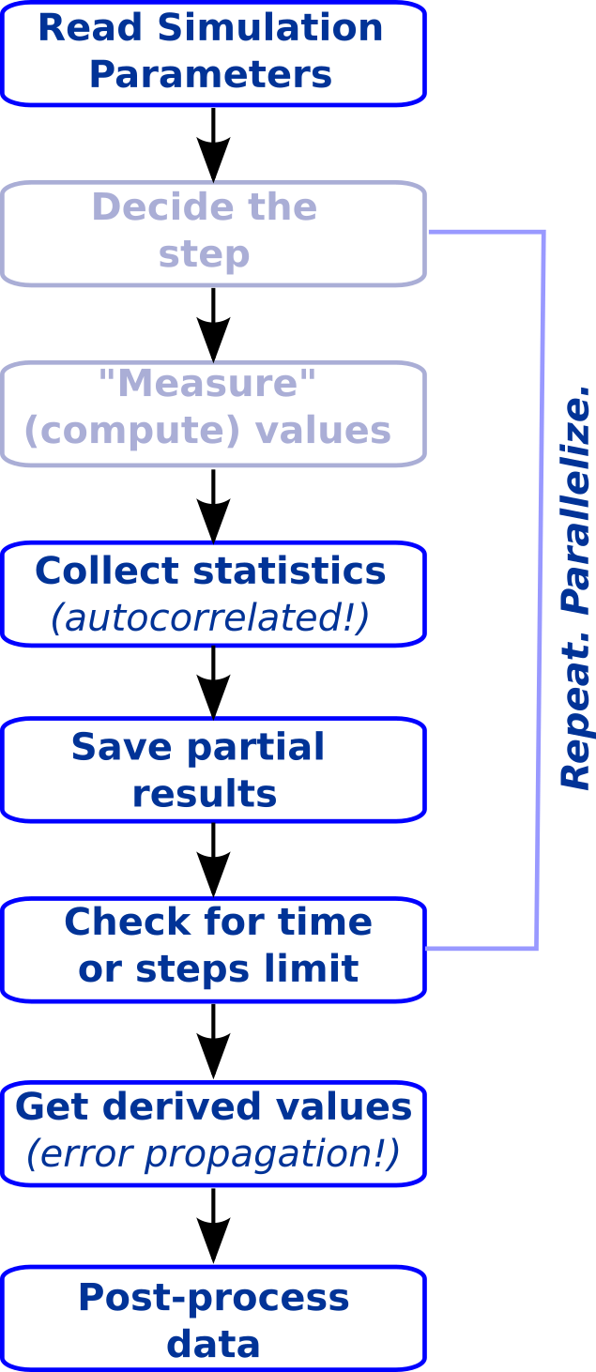
Why use ALPSCore?
Look at a typical simulation:
A lot of „boilerplate“ code;
Often non-trivial;
Performance is important!
Python (or other scripting):
hard to combine with C++
ALPSCore helps
to focus on science!

Slide 6
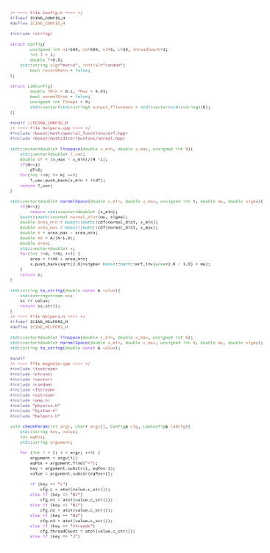
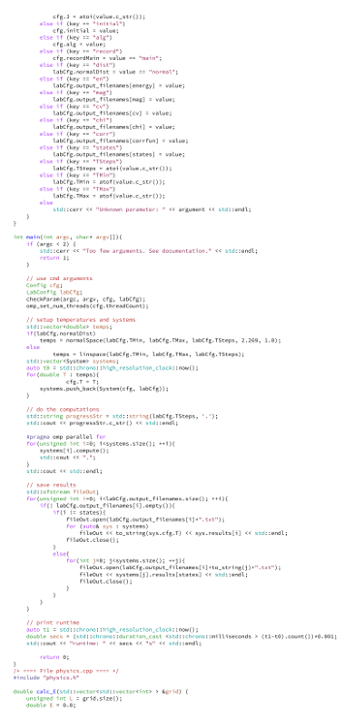
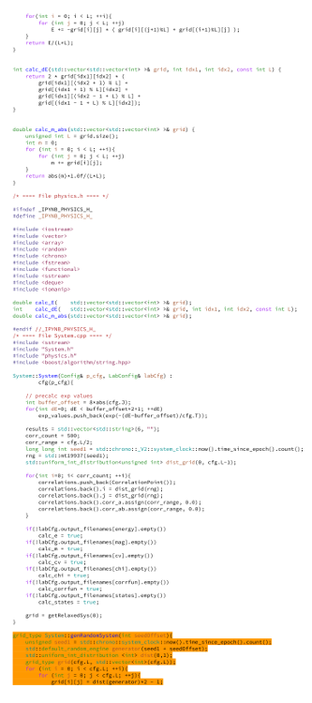
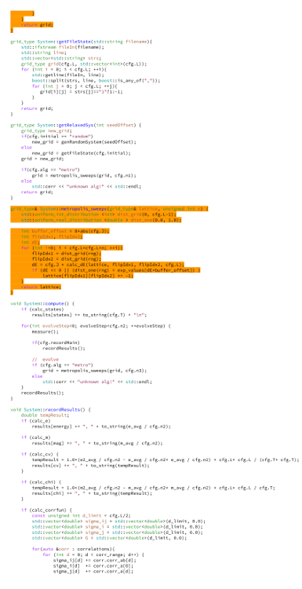
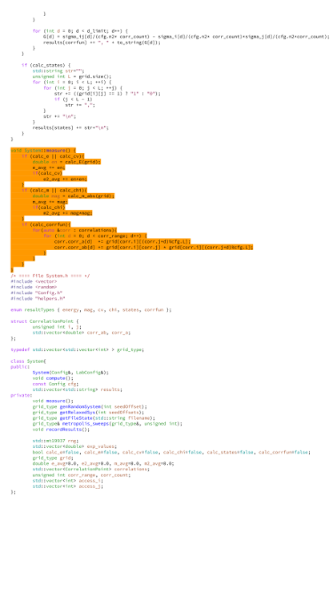
2D Ising simulation code: "from scratch"
~430 lines of C++ code
~50 lines do "science"
No error estimation.
Series of simulations
OpenMP parallel
Caveat: it's "apple to oranges" comparison, but gives us some idea.
(Adapted and simplified from: https://github.com/s9w/magneto/)

Slide 7
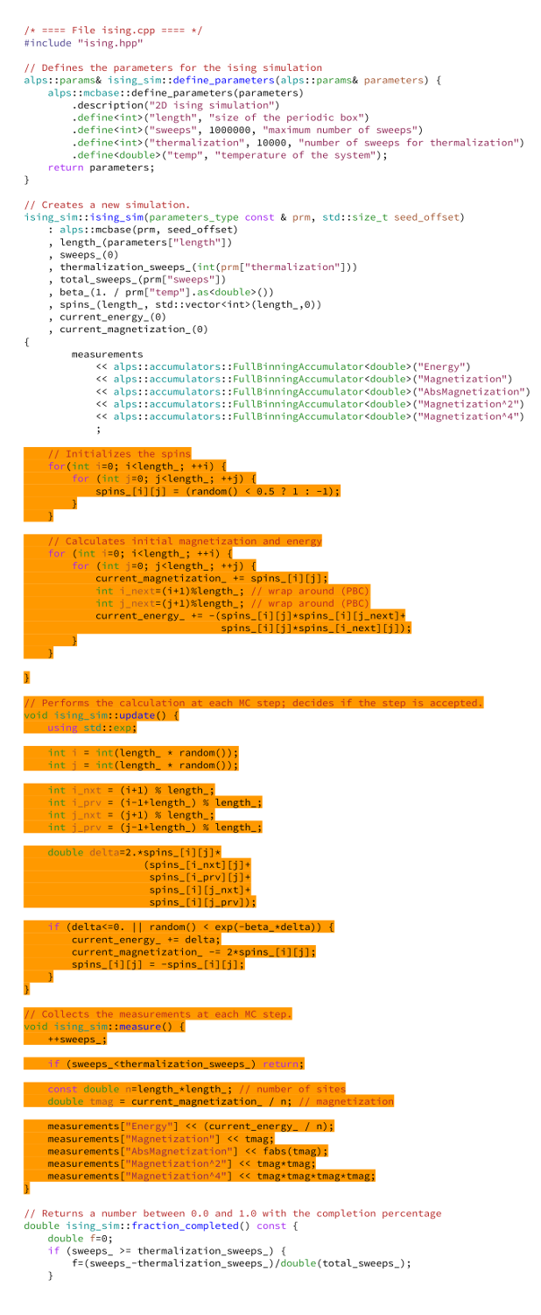
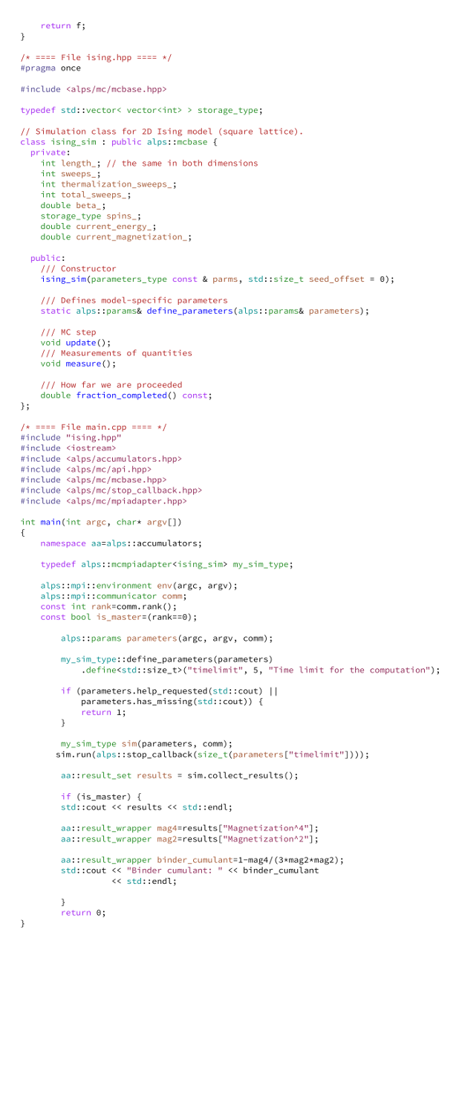
2D Ising simulation code: Using ALPSCore
~150 lines of C++ code
~50 lines do "science"
Error bars for autocorrelated data!
Proper error propagation!
MPI parallel (thousands of cores!)
Graceful exit on signal or timeout!
Built-in usage help message

Slide 8

Using ALPSCore: Pro & Contra
Ready-to-use framework;
A lot of features "for free";
Correct statistics;
Concentrate on the
"science part";
Easy to link with your application.
You have to install it;
Trivial problems require
more code;
Some learning curve;
Insists on preferred build system: CMake;
Introduces library dependence.
Not unlike Make vs manual compilation, or CMake vs Make...

Slide 9
What is the plan for this tutorial?
Assume that ALPSCore is installed!
Make a very simple Monte Carlo simulation demo.
Parallelize the demo.
Make a 2D Ising model simulaton code.

Slide 10

Exercise 1: Preface
Task: Compute π by Monte Carlo method.
h(r)=0
h(r)=1
h(r)=1
"hit function"
h(r)=1
It is not hard to write the program to compute the mean ⟨h⟩.
But...
What about error bars?
Do you really remember those formulas?

Slide 11
Exercise 1: Hands-on
Task: Computing π by Monte Carlo method.
1. Build the program:
4. Timed runs, varying trial count:
$ mkdir 000build
$ cd 000build
$ cmake ..
$ make
$ time -p ./alpsdemo --trials=100
5. Timed runs, varying time limits:
$ time -p ./alpsdemo \
--trials=999999 \
--timelimit=10
2. Run :
$ ./alpsdemo --trials=1000
3. Request help:
6. Start a long run; then press Ctrl-C;
observe graceful termination!
$ ./alpsdemo --help

Slide 12
Exercise 1: Implementation specifics
Directory: step1_pi/
simulation.hpp
describes simulation class (the model)
simulation.cpp
implements the model
constructor:
constructs the model
update():
performs MC trial
This is where the "science" is.
measure():
measures the quantities
fraction_completed():
are we done yet?
main.cpp
sets up and runs the simulation
Let's look at the code!
CMakeLists.txt
specifies application structure
(orange and blue
are clickable – try!)

Slide 13
Exercise 1: Hands-on, continued
Task: Use parameter file; play with the code.
7. Use parameter file:
File "demo.ini" :
# how long to run?
timelimit = 100
# how many trials?
trials = 1000
$ ./alpsdemo ../demo.ini
8. Override params from file:
$ ./alpsdemo ../demo.ini \
--trials=9999
9. Change the code:
--trials=0 should mean "till timeout"
(solution)
(remember,
orange is clickable!)

Slide 14
Exercise 1: Implementation specifics
simulation.cpp
main.cpp
Code uses parameters : to allow user to pass input data
Each parameter has:
Name (e.g. "trials")
Type (e.g. int)
Description (e.g. "Number of trials")
Optionally: a default value
Let's look at the code!
is responsible for defining
simulation-specific parameters
define_parameters()
(remember,
orange and blue
are clickable!)

Slide 15
Exercise 1: Take-home message
Linking ALPSCore to your application
is very simple.
Most of the framework is ready-made for you;
you only code "science";
You get parameters, scheduling,
graceful termination, and error bars — all
provided by the library.

Slide 16
Exercise 2: Preface
Point throwing can be done independently!
Start
Start
Start
Completion check requires occasional communications ;
Results are collected from all processes;
The rest is completely parallel!
Throw
point
Throw
point
Throw
point
Are we
done?
Are we
done?
Are we
done?
Collect
results
Collect
results
Collect
results

Slide 17
Exercise 2: Hands-on
Task: Compute π in parallel.
Let's look at the code!
1. Examine the differences (main.diff):
MPI is initialized.
A few operations are parallel-aware:
params ctor simulation ctor
An adapter class is used.
Only master process should print.
Directory:
step2_parallel_pi/
2. Build and run the program:
3. Do timed runs:
$ mkdir 000build
$ cd 000build
$ cmake ..
$ make
$ ./alpsdemo --help
$ time -p mpiexec -n 1 \
./alpsdemo --trials=999999
$ time -p mpiexec -n 2 \
./alpsdemo --trials=999999

Slide 18
Exercise 2: Take-home message
Once you implemented serial MC,
it's easy to make it parallel.
The requested MC steps are distributed
among the parallel processes.
The processes occasionally communicate,
to check if it's time to stop.

Slide 19
Exercise 3: Preface
Task: "Physics" problem: 2D Ising model.
Energy:
Magnetization:
Temperature T;
β=1/T
Boltzmann distribution:
Mean values:
Binder Cumulant:

Slide 20
Exercise 3: Approach
Task: "Physics" problem: 2D Ising model.
Directory: step3_ising/
Problem: Measurements are correlated.
Naive approach: too narrow error bars;
Use LogBinningAccumulator
for the correlated data;
Use FullBinningAccumulator
if you need arithmetic.
Monte Carlo step:
Flip a random spin;
Update energy;
Update magnetization;
Accept or reject update.
Let's look at the code!
More on this later!

Slide 21
Exercise 3: Hands-on
Task: Try different simulation parameters and accumulators.
1. Build and run the code ($ cmake .. && make)
2. Use parameter file with different accumulators:
$ ./ising2_mc ../ising.ini --acc=nobin
$ ./ising2_mc ../ising.ini --acc=logbin
$ ./ising2_mc ../ising.ini --acc=fullbin
Look at energy, magnetization, and Binder Cumulant.
Try decrease the temperature.
Note different error bars!
3. Extra points: parallelize!
1) Use mcmpiadapter
3) Pass communicator to:
➤ params
➤ simulation constructors
4) Make sure only
master prints.
2) Initialize MPI

Slide 22
Exercise 3: Accumulators
Accumulatorname | Mean? | Error bar? | Auto­correlation? | Nonlinear error propagation? | Memory cost
Mean | ✔ | ✗ | ✗ | ✗ | O(D)
NoBinning | ✔ | ✔ | ✗ | ✗ | O(D)
LogBinning | ✔ | ✔ | ✔ | ✗ | O(D logN)
FullBinning | ✔ | ✔ | ✔ | ✔ | O(D min(N,128))
D: size of data
N: number of data points

Slide 23
Exercise 3: Take-home message
ALPSCore provides means to collect
statistics properly;
Neglected autocorrelation results in too optimistic
(polite speak for "wrong") error bars;
Use binning accumulators (preferably
FullBinning) for your Markov chain simulations;
Accumulators work automagically for
MPI parallelized simulations.

