Slide 1
MEDICA -Master Project
Orange Coding Academy

Slide 2
What is MEDICA?
New system which means Health Care Professionals can see patients health records while they are treating you. I.e. Hospital doctor can see info from GP.
They can only do this if the patient has given permission.
It allows health and care professionals to make the best decisions about patients health.

Slide 3

Whay Medica ?

Slide 4
What information will be seen?
Patient name, address, ID number and phone number.
Medication.
Results of tests.
Copies of letters.
What has happened in the past.
Appointment s.
** Social care lead co-ordinator and your care plan.

Slide 5
Who can see my record?
Only health and care professionals who are involved in the patients care can see the records AND You.
They need permission before they can see it.
WHAT IS THE BENEFIT FOR THE PATIENT?
Health and care professionals will work together better to give the patient the best care.
Doctors can work quicker.
Less paperwork.
Patients will not be asked the same questions so often.
Patients may need less tests.

Slide 6
GOALS
To deliver a fully functional website and that have a nice user experience..
DIFFICULTIES
Understanding the requirement for such a project as I don't have any background in any medicine related fields..
Choosing the best way to apply the registration proses.
Some technical difficulties that have been solved with doing some researches on it.

Slide 7



TECHNOLYGES USED ( FRONT-END )
HTML
CSS
Js
Bootstrap

Slide 8


TECHNOLYGES USED ( BACK-END )
PHP – Laravel

Slide 9


TECHNOLYGES USED ( DATABASE )
MySQL databases.
phpMyAdmin as a database management tool.
XAMPP Control panel

Slide 10
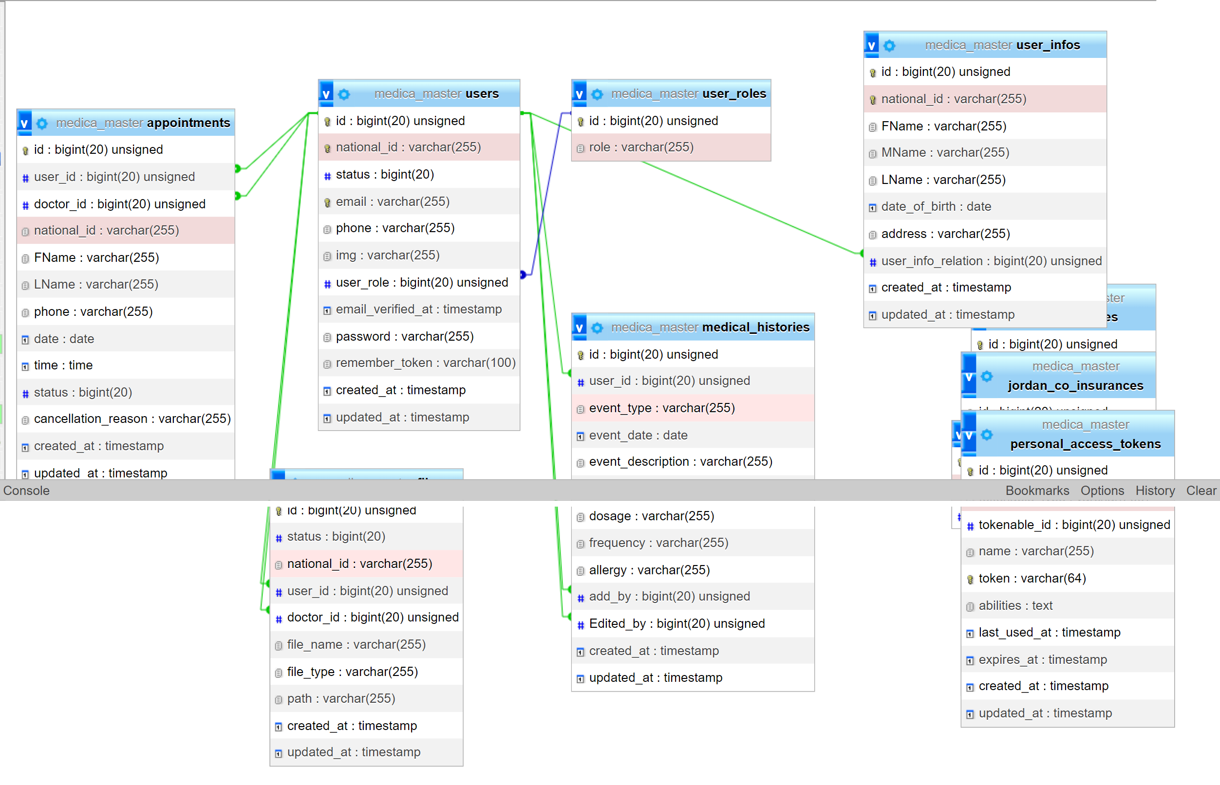
TECHNOLYGES USED ( DATABASE )

Slide 11
WEBSITE STRUCTURE?
Landing Page.
Log in & Register Page.
About us Page.
Contact Us Page.
Privacy Policy Page.
Admin Dash – User Dash – Doctor Dash

Slide 12
The end

