Slide 1

RT-LAB Solution for
Real-Time Applications
Hardware-In-Loop
introduction
Opal-RT Technologies
2012
3/20/09
Notes:
<number><number>

Slide 2
Outline
- Introduction to Real-Time simulation: HIL vs RCP
- Simulation type:
- EMT
- Phasor
- Solver type:
- Nodal approach
- State-Space approach
- Decoupling technique
- Switching function
- STUBLINE
- Distributed Parameter Line
- Closing the loop:
- Delays issues
- Modeling errors
- Using PMU for HIL

Slide 3
Introduction to Real-time simulation
Q: How many reasons are there to use real-time simulation?
Q: How many purposes are there to use real-time simulator?
A: One and only one, connecting real-hardware to a simulated model
A: Meanly three:
- Pure simulation
- Rapid Controller Prototyping (RCP)
- Hardware-In-Loop (HIL)

Slide 4
Introduction to Real-time simulation
- Pure simulation
This is usually the first step toward real-time simulation.
Only requires the software.
Allows to verify the model to be simulated.
Identify time-step for.
  Stability
  Hardware
Notes:
Time step for stability means the largest time-step you can use with the model being still stable.
Time step for hardware is the time required by the hardware to solve 1 time step of your model.
Regardless of the stability time-step, the hardware time-step remain the same

Slide 5
Introduction to Real-time simulation
- Pure simulation
According to the time step required for stability and the one for hardware you can achieve three different mode:
Tsstability < Tshardware = Simulation slower than real-time
Tsstability => Tshardware = Real-Time simulation
Tsstability > >Tshardware = Simulation faster than real-time
Notes:
Ts_s = Ts_{stability} = Stability time step
Ts_h = Ts_{hardware} = hardware time step
If Ts_s=50µs and Ts_h=100µs it would take 2 minutes to make a 1 minute simulation.
If Ts_s=Ts_h it would take 1 minute to make 1 minute of simulation
If Ts_s=50µs and Ts_h=5µs it would take 12 second to make 1 minute simulation.

Slide 6
Introduction to Real-time simulation
- Rapid Controller Prototyping
This is used during the preliminary design of the controller.
It requires the software, the simulator and real-hardware.
Allows to implement various version of a controller.
Identify the maximum control delay
Verifying the simulated model

Slide 7
Introduction to Real-time simulation
- Hardware In the Loop
This is used once the controller is implemented in an embedded system.
It requires the software, the simulator and embedded controller.
Allows to test real controller:
Identify the maximum delay
You need to trust the model since.
  Even if the real hardware does not exist.
  Make test that could be destructive or dangerous.
  Having different controller tested
Notes:
3.I = if you are developing the hardware, you can test your controller even if the hardware prototype is not built
3.II = You don’t want to test a DC+ to DC- short-circuit on a real 100kV/100kA HVDC converter
3.III = to different group can use the same simulator to test different controller. If you built a downsize prototype, you need a prototype for each topology. It is cheaper just to make a simulation model.

Slide 8
Outline
- Introduction to Real-Time simulation: HIL vs RCP
- Simulation type:
- EMT
- Phasor
- Solver type:
- Nodal approach
- State-Space approach
- Decoupling technique
- Switching function
- STUBLINE
- Distributed Parameter Line
- Closing the loop:
- Delays issues
- Modeling errors
- Using PMU for HIL

Slide 9
Simulation type
Simulation can be divided in two type:
- Electromagnetic Transient simulation
- Phasor simulation
Q: Which of these simulation is the best?
A: Depend of your application and of your hardware.

Slide 10
Simulation type
-Phasor simulation
- Uses a large time step (few millisecond).
- Used for very large model.
- Only simulate the positive sequence.
- General application are:
- Integration of distributed energy resources and load models to the simulator
- Operator Training Simulator (OTS)
- Dynamic Security Assessment (DSA)
- Test, tune, and optimize setting of control devices
- Test SCADA systems with PMU measurements
- Test and adjustment local control systems such as transformer tap- changer, capacitor banks

Slide 11
Simulation type
-EMT simulation
- Uses a small time step (from microsecond up to nanosecond).
- More representative harmonic content.
- General application are:
- Simulation of switching devices (power converter, STATCOM…)
- Development of low level controller
- Multi-domain simulation

Slide 12
Simulation type
-Mixed simulation
- Uses a different time-step (from millisecond up to nanosecond).
- Allows sufficient precision according to the simulated component.
e.g.: Simulation of the Brazilian transmission system (in phasor) with distribution and STATCOM (in EMT)

Slide 13
Outline
- Introduction to Real-Time simulation: HIL vs RCP
- Simulation type:
- EMT
- Phasor
- Solver type:
- Nodal approach
- State-Space approach
- Decoupling technique
- Switching function
- STUBLINE
- Distributed Parameter Line
- Closing the loop:
- Delays issues
- Modeling errors
- Using PMU for HIL

Slide 14
Solver type
-Algebraic constraints and adapted solvers
The two most critical components of a real-time power system simulators are:
The simulation solver is capable of iterating the power system equations with:
- Accuracy
- Stability
The hardware platform is capable of doing these iterations fast enough:
- Running a real-time Operating System
  - With sufficient I/O capability

Slide 15
Solver type
-Algebraic constraints and adapted solvers
Key characteristics of power systems:
Contains a wide range of frequency mode
  - Stiff circuit
Time constants are small in electrical systems
  - Requires small time step to obtain accurate results. 50 µs is a typical value but could be smaller depending on the PWM switching and the circuit resonance frequencies.
Contains a lot of PWM-driven power electronics
  - The simulator must avoid sampling effect when computing IGBT pulse “events” internally or when reading PWM pulses from its I/Os
Notes:
Stiff circuit is a circuit with very large and very small time constant in the same model.
50µs is generally the time-step used for power system. For Power electronic the time-step is closer to 25µs (STATCOM and AC/DC converter) up to 100ns (PMSM drive)
Even at 25µs, interpolation within a time-step is required to ensure accuracy on the PWM

Slide 16
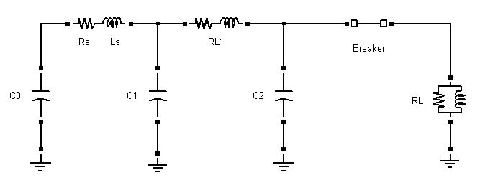
Solver type
-Algebraic constraints and adapted solvers
Methods to simulate electric systems:
  - Nodal approach
  - State-Space approach

Slide 17
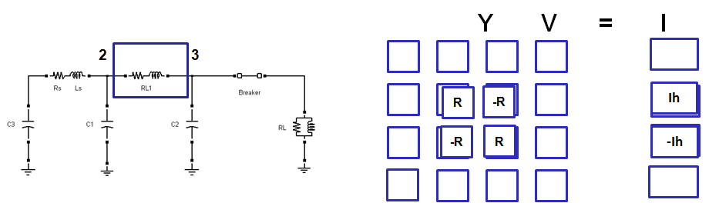
Solver type
-Nodal approach
  All branches resistance ratio R=v_{n}/i_{n} , are built into a nodal matrix
  Known term Ih=i_{n-1}1+(T/2L)v_{n-1} are built into a vector I
  For all nodes, a global matrix of admittance is built: YV=I
  Nodal voltages are found by solving this matrix problem, either by direct inversion or LU decomposition
  Re-solving of Y required if a switch changes position
Notes:
Using nodal approach, the size of the matrix depend of the number of nodes in the circuit.
Historical terms of the current of reactive components are calculated using trapezoidal method.
Using higher order method would make the solving the matrix very difficult and long, not suitable for real-time simulation.

Slide 18
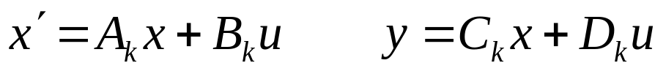
Solver type
-State-Space approach
  We can also find the exact state-space solution
  With k, matrix set index for switch permutations
  This can be discretized with the trapezoidal method like in SimPowerSystems for Simulink, (Trapezoidal method: order 2)
  It can also be discretized by higher order methods higher order methods (Art5 method: order 5)
Notes:
Size of the matrices depend of the number of reactive components

Slide 19
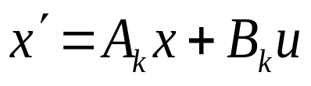
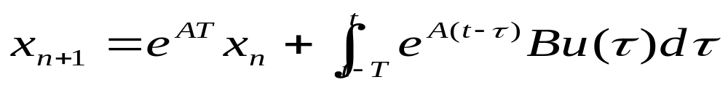
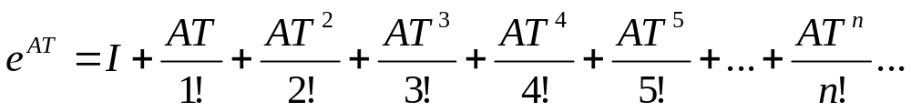
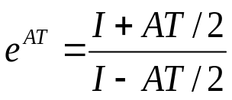
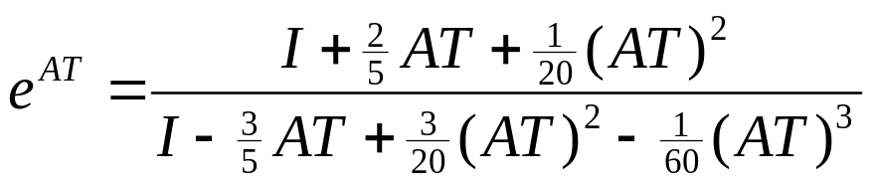
Solver type
-State-Space approach
  Continuous time state-space:
  Solution for time step T:
  Using the Taylor expansion to solve e^{AT}:
Notes:
Adding term doesn’t require much more calculation versus the gain you get on the Stability and the time-step.

Slide 20
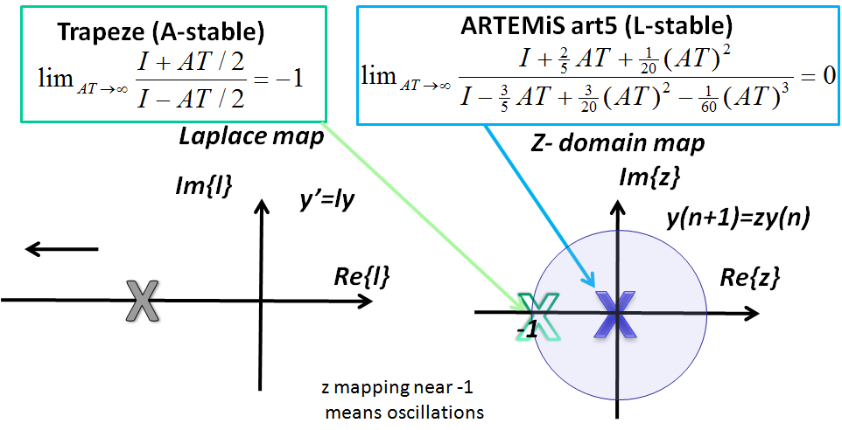
Solver type
-State-Space approach
  Now looking at the stability of these 2nd and 5th order
Notes:
This demonstrate the increase of stability
Z-domain for 5th order is close to 0, which means it is less oscillatory then Trapeze which is close to -1.

Slide 21
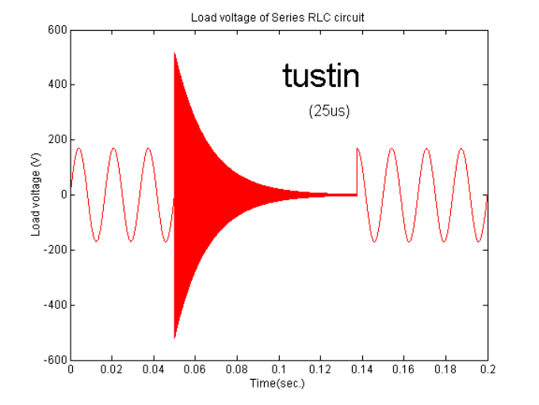
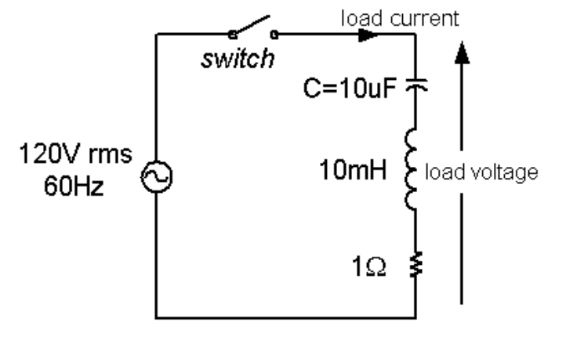
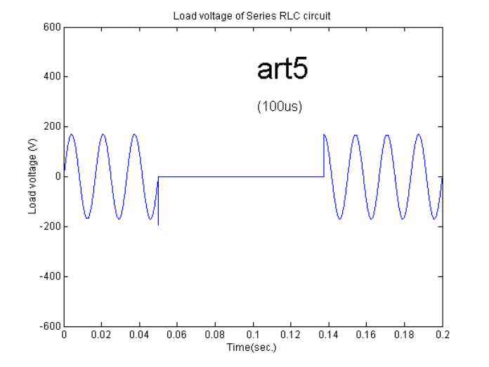
Solver type
-State-Space approach
  If we look at the response for a simple RLC circuit to see the difference between the A-Stable and L-Stable solver
Notes:
At T₀ the switch is open. 2nd order is oscillatory with a Ts of 25µs, but it eventually reach stability
With the 5th order there is no oscillation even with a Ts of 100µs

Slide 22
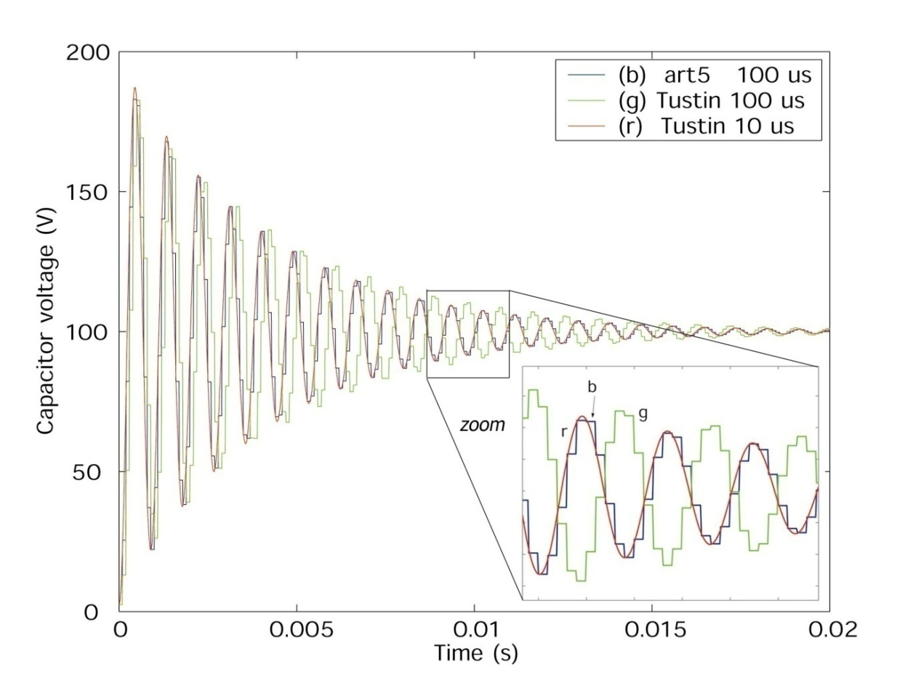
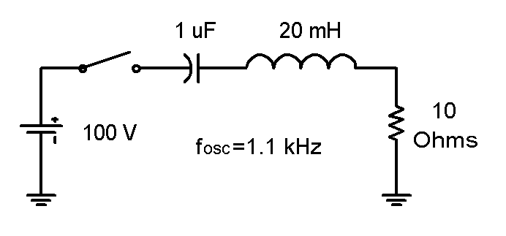
Solver type
-State-Space approach
  Further more transient response is much more accurate when using an higher order solver
Notes:
At T0 the switch is close. The circuit should be oscillating at 1.1kHz, theoretical value.
2nd order, Ts=10µs is the reference and is oscillating at 1.1kHz
5Th order, Ts=100µs follows the reference.
2nd order, Ts=100µs is not oscillating at the right frequency, the oscillation is slower.

Slide 23
Outline
- Introduction to Real-Time simulation: HIL vs RCP
- Simulation type:
- EMT
- Phasor
- Solver type:
- Nodal approach
- State-Space approach
- Decoupling technique
- Switching function
- STUBLINE
- Distributed Parameter Line
- Closing the loop:
- Delays issues
- Modeling errors
- Using PMU for HIL

Slide 24
Decoupling technique
-Switching function
  Switching function is an implementation that can be added to either the Nodal or the State-Space approach.
  It consist representing switching device, like power switch, by its average model.
  Switching function can add unnatural delay which have minimal impact if properly implemented.
  Controlled voltage and current source are added as input/output of the switching function. This allows to decouple one system in two smaller systems.

Slide 25
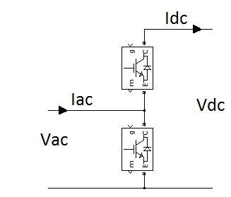
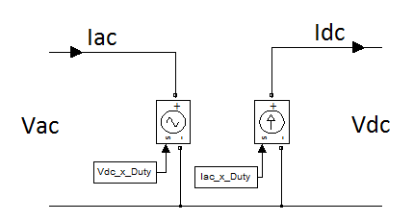
Decoupling technique
-Switching function
  Lets take a single arm to demonstrate the concept.
Notes:
There is 2 inputs (Iac and Vdc) and 2 outputs (Vac and Idc) to this system.
Idc is equal to Iac multiplied by the duty cycle of the upper switch
Vac is equal to Vdc multiplied by the duty cycle of the upper switch

Slide 26
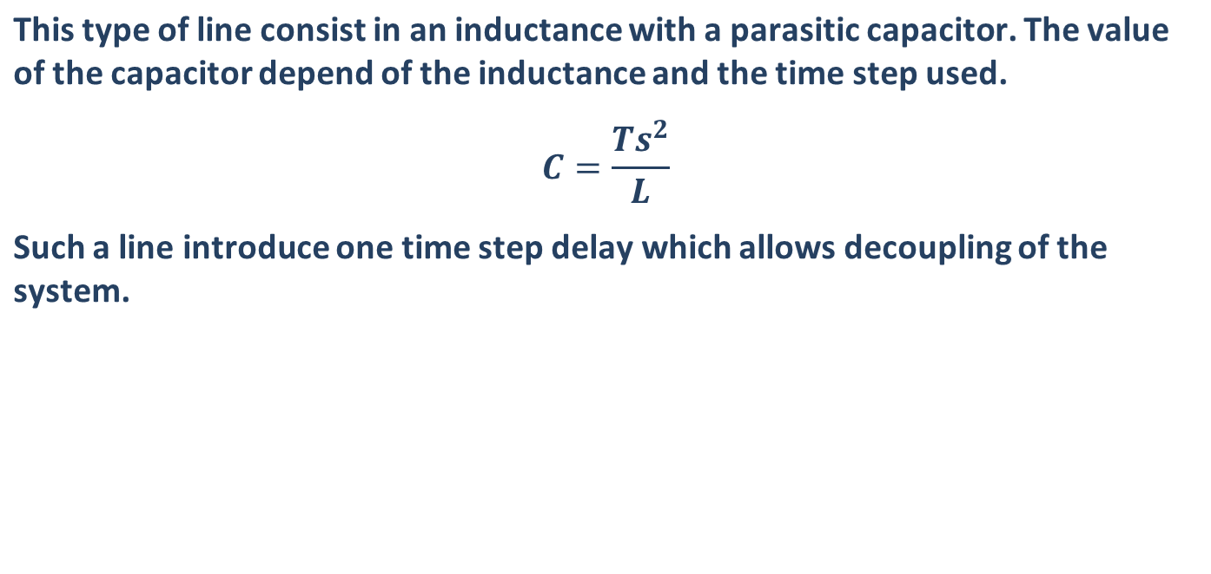
Decoupling technique
-STUBLINE
Notes:
The idea in decoupling is to add a time-step delay so the matrices on each side of the STUBLINE can be computed in parallel.

Slide 27
Decoupling technique
-Distribute Parameter Line
  This type of line has all parameter then a standard line. For symmetrical lines, impedance can be specified using sequence parameters or the N-by-N matrix; for asymmetrical lines, it must be specified using the N-by-N matrix.
  The minimum length of the line is 30000*Ts Km
Notes:
If the line is smaller then 30000*Ts km, the signal would have to travel faster then the speed of light to be able to compute in parallel both matrices of the distribute parameter line.

Slide 28



Decoupling technique
  What is real-time simulation in the end?
  Meaning it works using tricks

Slide 29
Decoupling technique
  The key of real-time digital simulation is to achieve computation of large system.
  Using a higher order solver, accurate simulation can be achieved with large time step.
  Using tricks like switching function and distributed parameter line, large system can be decoupled to distribute computation over multiple computing unit

Slide 30
Outline
- Introduction to Real-Time simulation: HIL vs RCP
- Simulation type:
- EMT
- Phasor
- Solver type:
- Nodal approach
- State-Space approach
- Decoupling technique
- Switching function
- STUBLINE
- Distributed Parameter Line
- Closing the loop:
- Delays issues
- Modeling errors
- Using PMU for HIL

Slide 31
Closing the loop
- Rapid Controller Prototyping
Most of the time, you would start from an offline simulation model.
Afterward you add IO to connect the controller to the plan, this introduce delays that you encounter when using embedded controller.
Once the model works with decoupled IO, you can now connect the IO to a real-hardware.
e.g.: Simulation of a wind farm using a DFIG and a variable voltage source.

Slide 32
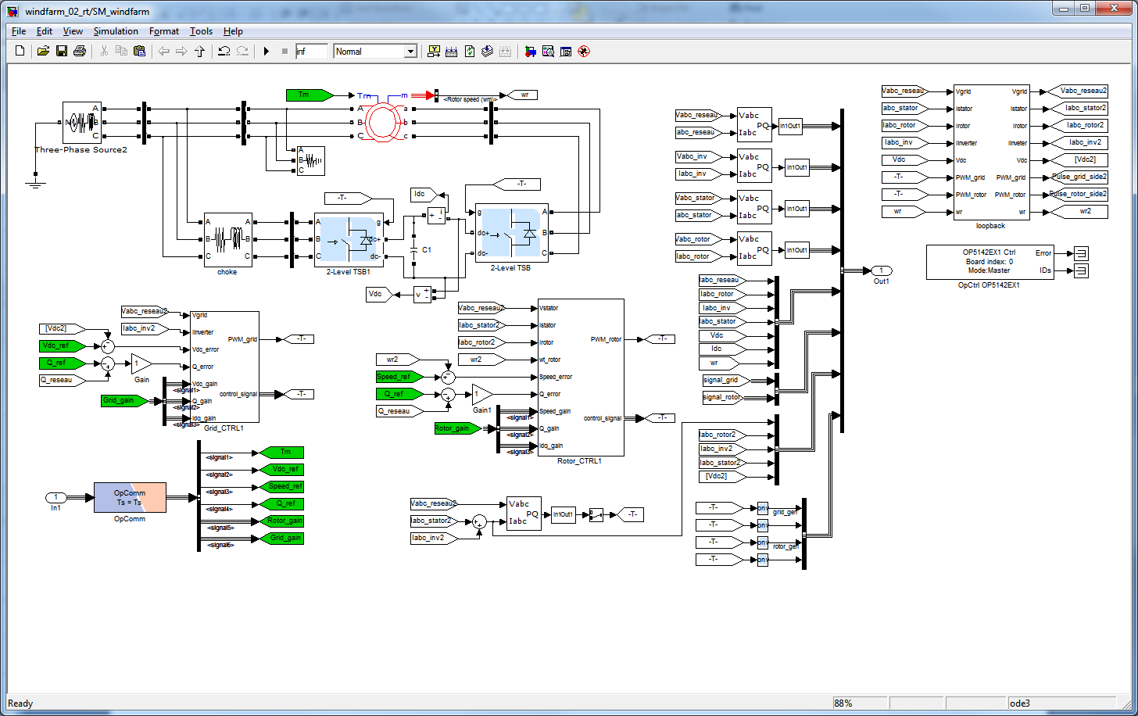
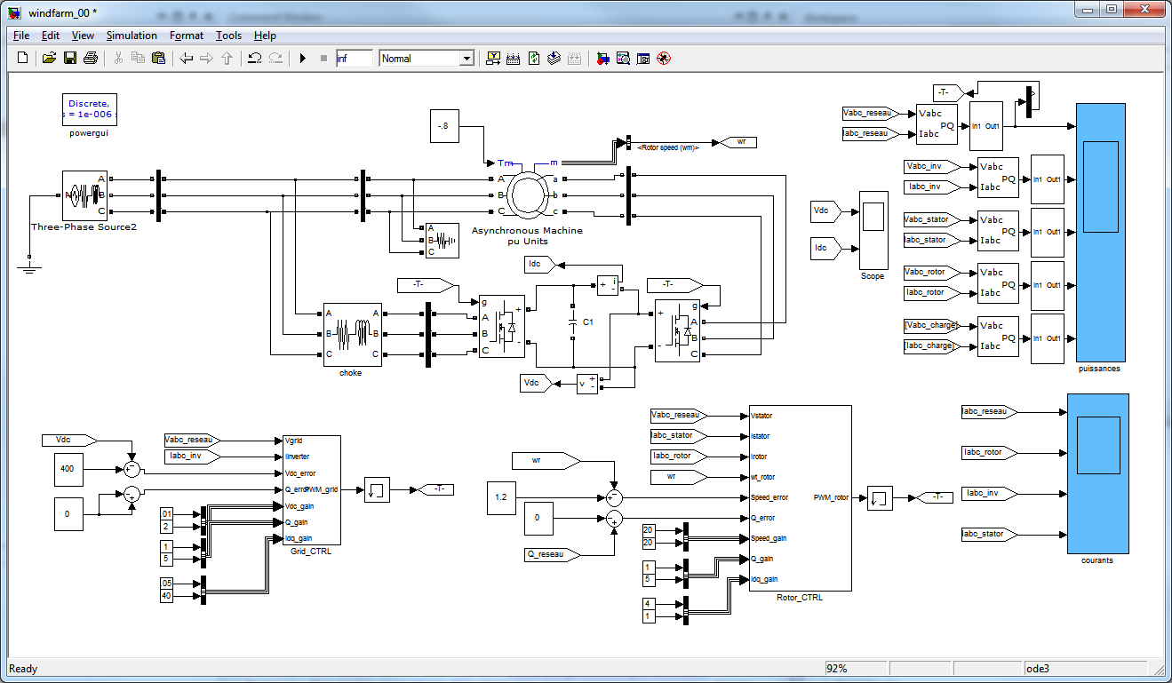
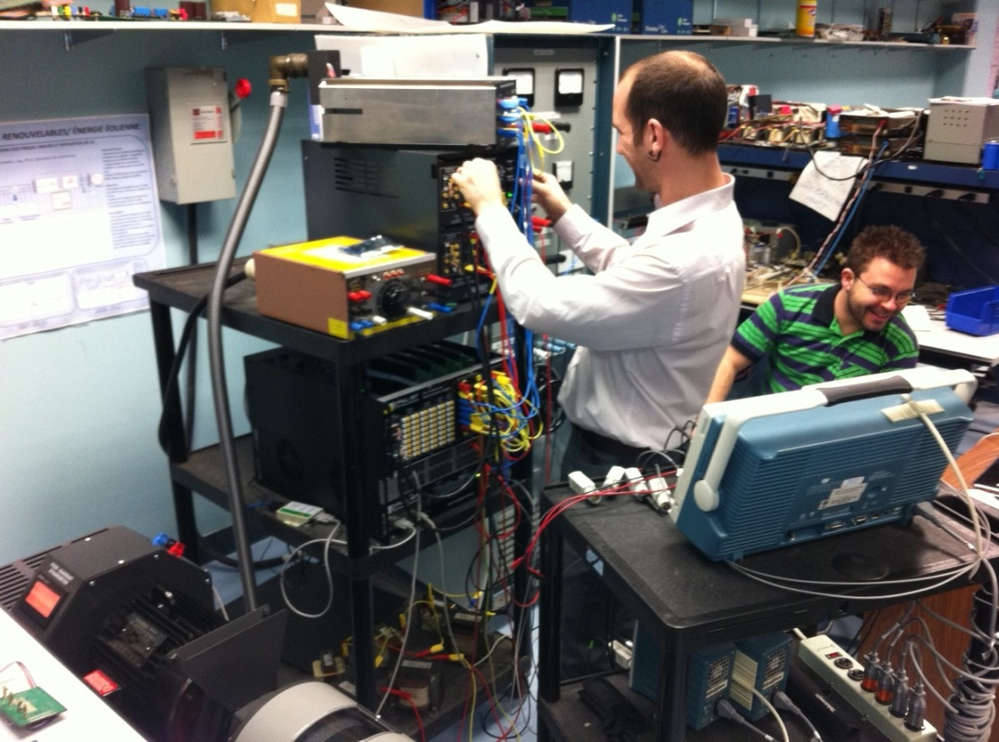
Closing the loop
- Rapid Controller Prototyping
Notes:
In this example, we first start by the model in full simulation with Ts at 1µs. The voltage source start from 0 to 1pu. The controller is adjust to be able to work with the source at any voltage. This is more realistic since we will be using a variable voltage source with the real DFIG and we won’t start it a full voltage.
Then we replace the IGBT bridge by the IGBT bridge switching function with interpolation with Ts at 25µs. Also all the measurements are sent to the controller from the simulated plant through Analog input/output to the controller. The controller send the pulses to the IGBT bridge using digital input/output. This will add the delay that are present between a real plant and a real controller. After adding these delays, the gain of the controller had to be readjusted.
Now that the model with loop-back IO is working, the pulses are sent to the real IGBT bridge and the voltage measurement comes from the real DFIG.
When increasing the voltage, the controller behave strangely and couldn’t control the DFIG properly. This means the simulated model is different then the real plant.
The problem is that the voltage source as a variable transformer with variable impedance. This variable impedance was neglected in the simulated model.

Slide 33
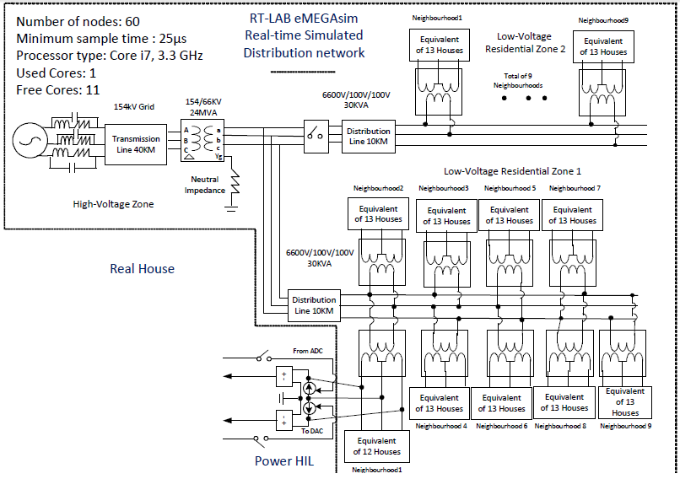
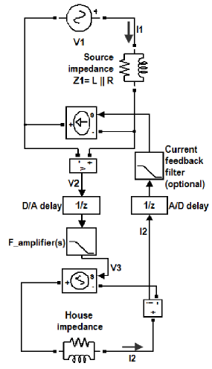
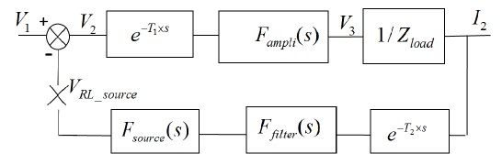
Closing the loop
- Hardware In the Loop
When simulated model is coupled using power amplifier delay can change the phase of the signal and cause instability.
e.g.: A simulated network is coupled with a real smart house using to study the impact of the smart house on the network.
The open loop gain must be smaller then 1 to stay stable
Notes:
In this example a real house is connected to a simulated grid. The house is couple to the simulator using current injection. The voltage is measure in the model and sent to an amplifier to power the real house. The real current is measured and injected in the model.
Taking into account the delay of the analog-to-digital and the response of time of the amplifier, the circuit can become oscillating if the power exchange becomes to large.
The open loop gain of the transfer function has to be smaller then 1 to be stable.
In order to increase the power exchange, a filter can be added to the current measurement.

Slide 34
Closing the loop
- Hardware In the Loop
Detailed results were presented at IECON2011 in the paper
“A Smart Distribution Grid Laboratory”
Yamane, A.; Wei Li; Belanger, J.; Ise, T.; Iyoda, I.; Aizono, T.; Dufour, C.; , "A Smart Distribution Grid Laboratory," IECON 2011 - 37th Annual Conference on IEEE Industrial Electronics Society , vol., no., pp.3708-3712, 7-10 Nov. 2011
http://ieeexplore.ieee.org/stamp/stamp.jsp?tp=&arnumber=6119912&isnumber=6119266

Slide 35
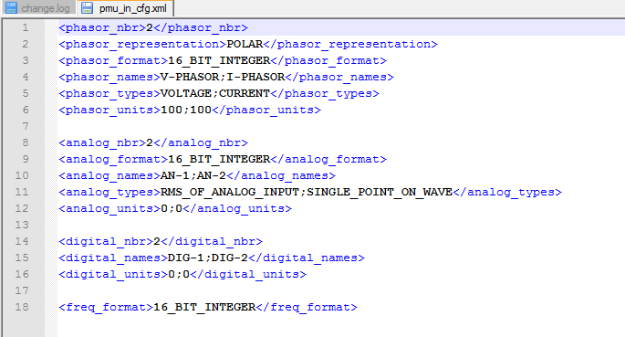
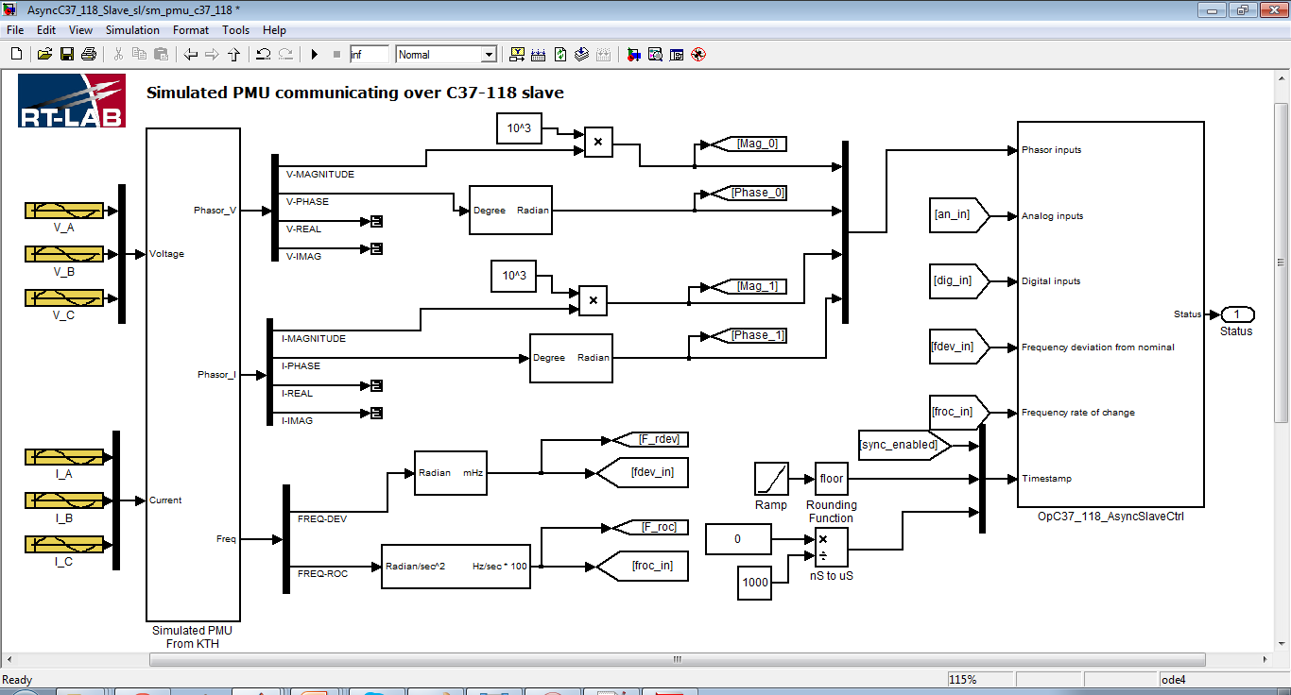
Closing the loop
- Hardware In the Loop
Another example of application is the design of a PMU using C37.118 protocol
Notes:
In this case, PMU can be simulated and virtual Ethernet port are generated. Using the simulator, up to 400 PMU with 400 Ethernet port can be simulated Then an external PDC can be tested.
XML file has to be filled to configured the Ethernet port under the C37.118 protocol.

