Slide 1

Evaluation of the impact of post-combustion CO₂ capture on power plant performance
Dynamic model of a 725 MW combined cycle gas turbine power plant with a CO₂ post-combustion capture unit
Baligh El Hefni
Eric Joos
Anatole Weill EDF/R&D baligh.el-hefni@edf.fr ; eric.joos@edf.fr
09-10 Oct., 2018 Modelica USA

Slide 2




Overview
Introduction to ThermoSysPro
Dynamic model of the Combined-Cycle Power Plant with CO₂ capture unit
Simulation scenario and results
Conclusion

Slide 3

Introduction
to ThermoSysPro
EDF Modelica Library

Slide 4
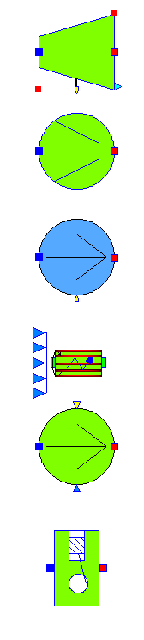
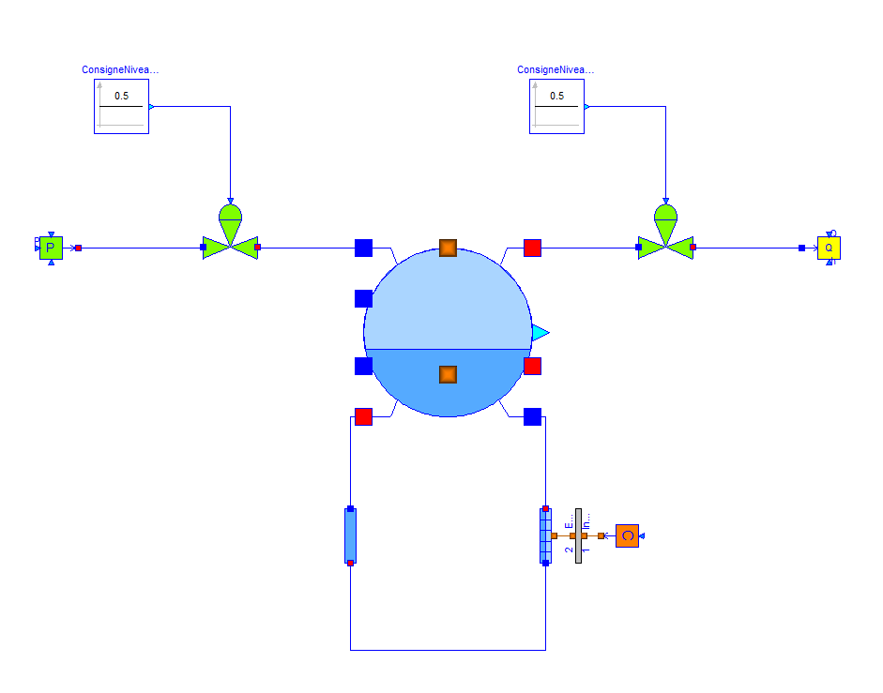
ThermoSysPro: General principles
ThermoSysPro is a generic library for the modeling and simulation of power plants and other kinds of energy systems.
Multi-domain modelling: thermal-hydraulics (water/steam and flue gases), combustion, solar, neutronic, control, …
The level of detail of the models is flexible
Steady-state and dynamic modelling
Based on first physical principles: mass, energy, and momentum conservation equations
One and two-phase flow
State-of-the-art correlations for two-phase flow
Incompressible and compressible flow
Handling of flow reversal

Slide 5
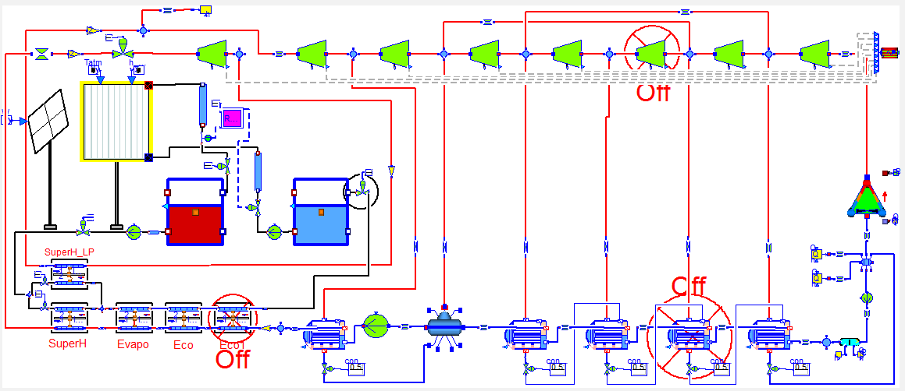
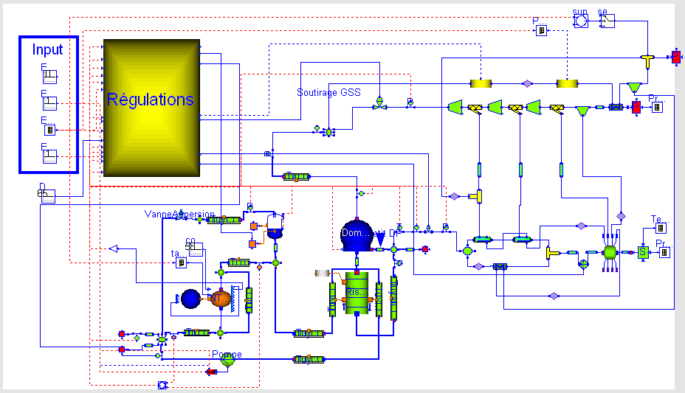
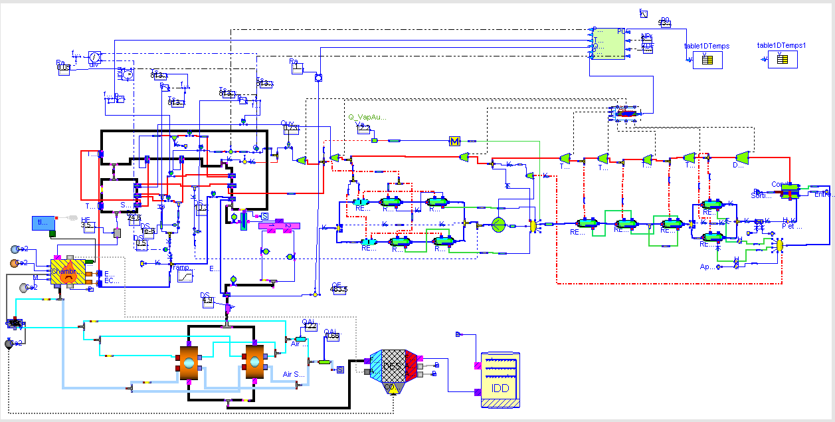
ThermoSysPro: General principles
Open source released under Modelica 2 license
Designed to be tool independent
Current reference tool: Dymola
Can be used with SimulationX and OpenModelica
Designed to be easily understood and modifiable
Validated against real applications:
Concentrated solar power plants
Fossil fuel fired power plants
Biomass power plants
Nuclear power plants
etc.
Concentrated solar power plant Tower receiver, molten salt storage
Steam generator
Pulverized coal power plant
P4 power plant
GV

Slide 6
ThermoSysPro: The library organization
Contains about 200 model components

Slide 7
ThermoSysPro: Carbon Capture Package
The components of the CO₂ post-combustion capture unit has been developed within the framework of a project funded by the Energy Technologies Institute (ETI) .
Column model: the transport model is based on mass and energy balance equations for liquid and gas phases, in order to represent the dynamic of the different fluids flowing vertically through the absorption and desorption columns. The model take into account other phenomena such:
The mass transfer at the interphase gas-liquid as well as diffusion limitation in gas and liquid phases,
The heat transfer between the two phases,
Column model: Assumptions
Capture process based on MEA solvent (30 wt %),
The equilibrium is reached, between the liquid and gas streams at each stage of the absorber (using performance correction factors),

Slide 8






ThermoSysPro: Carbon Capture Package
Column model: Assumptions
The two film theory model has been used, for the mass transfer models with the generalized Fick’s law equation (the reactions in the film were taken into account with, the use of the enhancement factor model for a pseudo-first order reaction with respect to the concentration of CO₂),
No accumulation takes place in the film between the two phases, that chemical reactions only take place in the liquid bulk, and that the bulks of both phases are well mixed,
Vapor Liquid Interface
Gas bulk
Gas film
Liquid film
Liquid bulk
Pressure of component $i$
$$C_{i}^{I}$$
Concentration of component $i$
$$p_{g,i}$$
$$C_{l,i}$$
$$p_{i}^{I}$$
The key performance indicators provided by this model were compared to the experimental indicators and Aspen software.
Mass transfer direction
This absorption column model is detailed in ETI report: Anatole Weill, “Milestone 20 WP5 Internal Deliverables 5.3.5b, Modelica post-combustion CO₂ capture models description and validation”, March 2014”.

Slide 9

Dynamic model of the Combined-Cycle Power Plant with CO₂ capture unit

Slide 10
Dynamic model of the Combined-Cycle Power Plant with CO₂ capture unit: objectives
The objectives of this study are:
Developing a detailed dynamic model of a GCC power plant with CO₂ capture unit, in order to simulate the power plant performance,
Evaluate the impact of the addition of a CO₂ capture unit, on the GCC power plant dynamic behavior, at full load and at load reduction,
Quantify the power plant performance at the part load (plant efficiency).
Compare the performance provided by the ThermoSysPro model, with the performance provided by some projects and software,

Slide 11
Dynamic model of the Combined-Cycle Power Plant with CO₂ capture unit : nominal data
Technical characteristics of the Combined-Cycle Power plant:
Configuration | Characteristics
Gas Turbine: Nominal power | 2*230 MW (Two Gas Turbine)
Steam Turbine: Nominal power | 265 MW ( Two HRSG “two trains”)
High pressure circuit at nominal power | 127 bar, 567°C
Intermediate pressure circuit at nominal power | 27 bar, 568°C
Low pressure circuit at nominal power | 4.9 bar, 259°C,
Condenser: Thermal power | 423 MW
Condenser: Steam mass flow rate | 193.4 kg/s
Condenser: Vacuum pressure: | 6100 Pa
Compressor: Compression rate | 13,8

Slide 12
Dynamic model of the Combined-Cycle Power Plant with CO₂ capture unit: data
Technical characteristics of the capture unit
Configuration | Characteristics
Absorber: Diameter | 15 m
Packing Height | 15 m
Packing Type | Mellapak 250Y
Inlet Cold Solvent Temperature | 40 °C
Desorber: Diameter | 5 m
Packing Height | 20 m
Packing Type | Mellapak 250Y
Inlet Cold Solvent Temperature | 100 °C
Reboiler: Pressure | 1,86 bar
Temperature | 117,9 °C
Solvent Tank: Diameter | 5 m

Slide 13
Dynamic model of the Combined-Cycle Power Plant with CO₂ capture unit: CO₂ capture unit model
Diagram of CO₂ capture model
Outlet CO₂
Control systems
Condenser
Boundary conditions
MEA solvent
Absorber
or scrubber
Desorber
or stripper
Heat Exchanger
Flue gases from the GCC after cooling
Reboiler
Steam from the GCC
Modelica USA| 09/10/2018

Slide 14
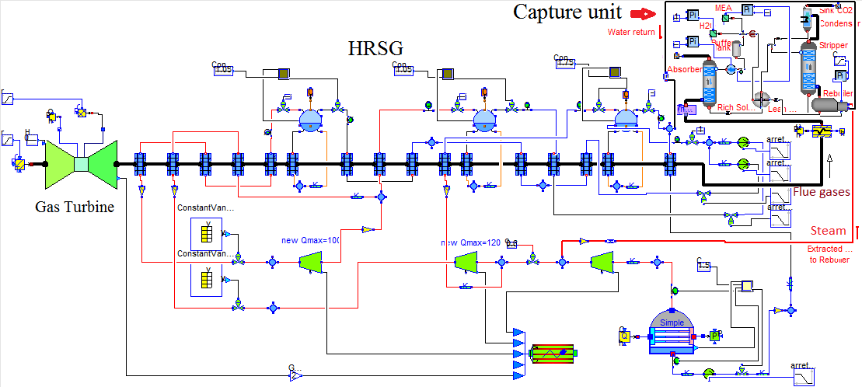
Dynamic model of the Combined-Cycle Power Plant with CO₂ capture unit: (one train model)
Detailed dynamic model of the Combined-Cycle Power Plant, with a CO₂ capture unit.
Statistics:
1771 Components, 21683 Variables,
11586 Equations, 700 Differentiated variables
Hydraulic loop is closed via condenser

Slide 15
Dynamic model of the Combined-Cycle Power Plant with CO₂ capture unit: calibration
A preliminary calibration of the model was made against measurement or design data at 100% load.
Variables imposed in the model | Parameters computed by the model
Pressure at the outlet of the pumps | Characteristics of the pumps
Pressure at the inlet of the steam turbines | Ellipse law coefficients of the steam turbines
Liquid level in drums and in condenser and pressure | CV of the valves (characteristics) and the valves positions (openings)
Overall heat exchangers coefficients | Heat exchangers fouling coefficients
Isentropic efficiency of the compressor | Nominal isentropic efficiency of the compressor
Exhaust temperature of the gas turbine | Nominal isentropic efficiency of the turbine

Slide 16

Simulation Scenario and Results

Slide 17
Dynamic model of the Combined-Cycle Power Plant with CO₂ capture unit: simulation scenario
Simulation scenario
The scenario is a power generator step reduction from 100 to 50% load:
Initial state (combined cycle): 100 % load
Final state (combined cycle): 50% load (800 s slope).
The simulation runs were done using Dymola tool

Slide 18
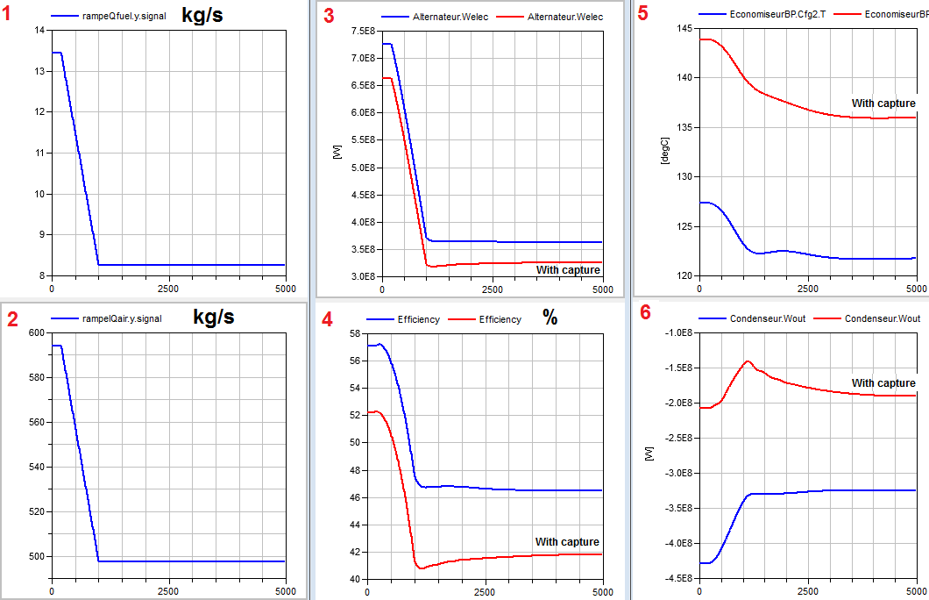
Dynamic model of the Combined-Cycle Power Plant with CO₂ capture unit: simulation results
Without capture
Without capture
Without capture
Without capture
(1) The natural gas mass flow rate, (2) Air mass flow rate, (3) Power generator blue (without capture) red (with capture), (4), Power plant efficiency, (5) Flue gases exhaust temperature (HRSG) at the outlet, and (6) Power evacuated by the condenser

Slide 19
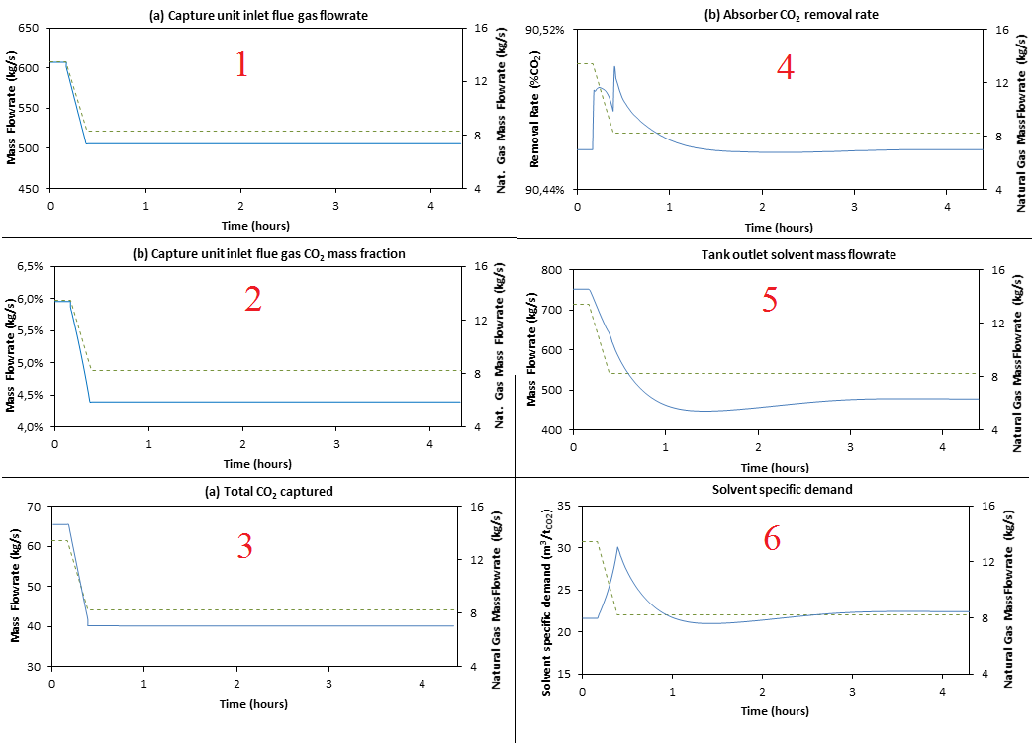
Dynamic model of the Combined-Cycle Power Plant with CO₂ capture unit: simulation results
(1) flue gases mass flow rate, (2) CO₂ mass fraction, (3) total mass flow rate of CO₂ captured by the two capture trains, (4) the absorber removal rate (in percentage of the total inlet CO2 flow rate), (5) the solvent mass flow rate, and (6) the solvent specific demand.

Slide 20
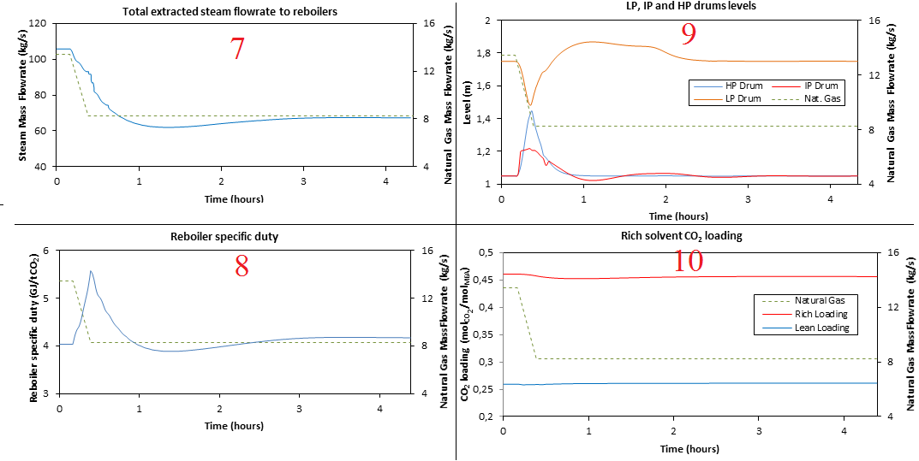
Dynamic model of the Combined-Cycle Power Plant with CO₂ capture unit: simulation results
(7) extracted steam mass flow rate for the two capture trains, (8) the reboiler specific duty, (9) the variations of level for the three drums, and (10) the variations of rich and lean solvent CO₂ loadings (the variation of natural gas mass flow rate is represented with a dashed green line),

Slide 21
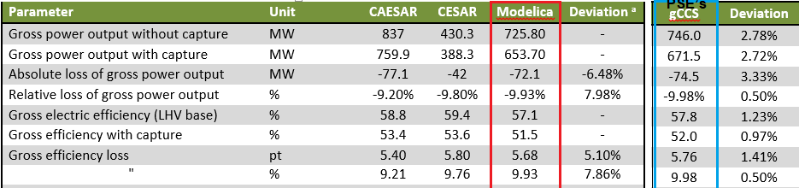
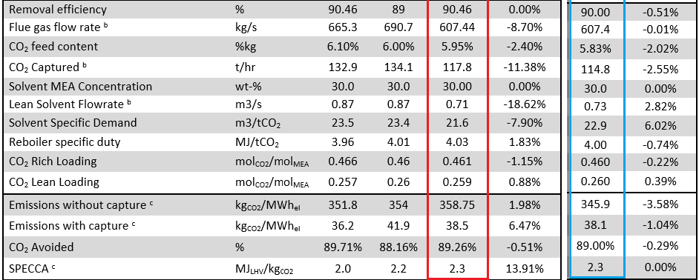
Dynamic model of the Combined-Cycle Power Plant with CO₂ capture unit: simulation results
The model results has been compared with CAESAR project and with simulation results of the PSE’s gCCS model (gPROMS) (at 100 % load).
13.3 %
14 %
2,9 %
3.6 %
^{b} : For one train only; ^{c} : These values only take into account the steam cycle auxiliary electric losses,

Slide 22
Conclusion

Slide 23
Dynamic model of the Combined-Cycle Power Plant with CO₂ capture unit: Conclusion
A detailed dynamic model of a combined cycle power plant with a CO₂ post-combustion capture unit, has been developed and validated,
Most of the ThermoSysPro model values are in consistent with the CAESAR project results. However, several differences are observed, due in the difference in the power plants characteristics:
The solvent specific demand is 8% lower compare to CAESAR,
The total flow of CO2 captured is 11.4% lower, due to the differences in the power plants characteristics (lower flue gases flow rate, etc.),
The solvent flow rate is 18.6% lower,
Also, the model results has been compared with PSE’s model (gPROMS). The results are in quite good agreement, for most key performance indicators (under 1%), except solvent specific demand is 6% higher,
The numerical robustness of the model has been verified.

Slide 24
References

Slide 25
Dynamic model of the Combined-Cycle Power Plant with CO₂ capture unit: References
[1] https://cordis.europa.eu/result/rcn/53969_en.html
[2] https://cordis.europa.eu/result/rcn/58752_en.html
[3] Anatole Weill. Milestone 20 WP5 Internal Deliverables 5.3.5b, Modelica post-combustion CO2 capture models description and validation” Revision 1.1, March 2014.
[4] Milestone 18 – WP5 Deliverable 5.1.4F, Final Case Study 1 Report, PSE-gCCS-R-ETI-WP5-MS18-20130918, Revision 1.0, 25 October 2013.
[5] Milestone 18 – WP5 Internal Deliverables 5.3.1, Case Study 3 Definitions, Revision 2.0, 14 October 2013.
[6] “Milestone 19 – WP5 Internal Deliverables 5.3.2, Case Study 3 Interim Modelling Report” Revision 2.0, 6 January 2014.
[7] Sipocz N. et al. Natural gas combined cycle power plants with CO2 capture – Opportunities to reduce cost, Internation Journal of Greenhouse Gas Control 7, pp 98-106, 2012.
[8] European Best Practice Guidelines for Assessment of CO2 Capture Technologies, CESAR Project, Deliverable D2.4.3, March 2011.
[9] Anatole Weill. Milestone 20 – WP5 Internal Deliverables 5.3.1-4 Case Study 3 Modelling and Simulation Report; ETI CCS Project Report 2014.

Slide 26
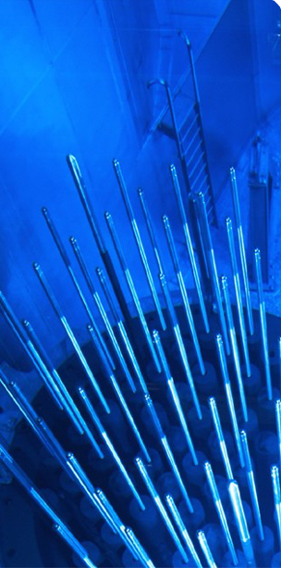
Thank you for your attention

