Slide 1
PSS/E CIM to MO
Basic Training for using XSLT

Slide 2
Agenda for Today
Action Items to achieve 500 Bus System validation
Introduce XSLT Translation
Paper –
XSLT CIM V2.docx
PowerPoint Status
XSLT.pptx
Distribution Modeling in Modelica.pptx
Validation Process Discussion
Wolfram System Modeler 12.3

Slide 3
Action Items
Note: All files referenced are in Dropbox Deliverable
NYPA Model Transformation
Unable to download project
Would be helpful to use Github
Account for all Modelica components
Which components should I investigate further?
Next slides
Simulate (compile) and Validate
Maybe start with IEEE 9Bus?
MO directory

Slide 4
Equipment Parameters Transformed Need Validation
Base Voltage
AC Line Segment
Busbar Section
Conform Load
Linear Shunt Compensator
Power Transformer
Power Transformer End
Ratio Tap Changer
Synchronous Machine
Terminal

Slide 5
Equipment Parameters Not Transformed
Connectivity Node
Current Limit or Voltage Limit
Hydro Generating Unit
Operational Limit Set
Operational Limit Type
Phase Tap Changer Table, Table Point, Tabular
Ratio Tap Changer Table Point
Regulating Control
Tap Changer Control
Wind Generating Unit

Slide 6
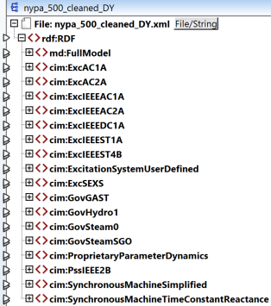
500 Bus
Dynamic Parameters

Slide 7
XML Structure
Elements
Either <tag> open tag and </tag> close tag (ie ‘<tag>value</tag>’)
Or <tag /> empty tag
Attributes
<tag attribute=“attribute value” />
Namespace provides a way to avoid name collisions when two XML elements have the same name.
Tree Structure – root to trunk/branches to leaves

Slide 8
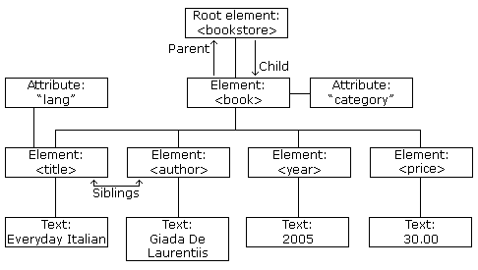

Slide 9
Common Grid Model Exchange Standard (CGMES)
CGMES adds more rules to the XML structure
Triples derived from Resource Descriptor Framework (RDF)
Subject = Synchronous Machine
Predicate = SynchronousMachine.qPercent
Object = 100
<cim:SynchronousMachine rdf:ID="_49e4fbf3-6d10-11eb-a65a-74e5f963e191">
<cim:SynchronousMachine.maxQ>193</cim:SynchronousMachine.maxQ>
<cim:SynchronousMachine.minQ>-96.5</cim:SynchronousMachine.minQ>
<cim:SynchronousMachine.qPercent>100</cim:SynchronousMachine.qPercent>

Slide 10
CGMES Namespace and Attributes
Namespaces provide a way to avoid name collisions when two XML elements have the same name.
‘<xsl:stylesheet xmlns:rdf…’ identifies a ‘rdf’ namespace
‘cim’, ‘entsoe’, ‘pti’, ‘md’ are other common namespaces within ENTSO-E CIM.
Attributes are designed to contain data related to a specific element.
Key: Primary and Foreign
Enumeration: SynchronousMachine.type
<cim:SynchronousMachine rdf:ID="_49e4fbf3-6d10-11eb-a65a-74e5f963e191">
<cim:SynchronousMachine.maxQ>193</cim:SynchronousMachine.maxQ>
<cim:SynchronousMachine.minQ>-96.5</cim:SynchronousMachine.minQ>
<cim:SynchronousMachine.qPercent>100</cim:SynchronousMachine.qPercent>
<cim:SynchronousMachine.type rdf:resource="http://iec.ch/TC57/2013/CIM-schema-cim16#SynchronousMachineKind.generator" />

Slide 11

XSLT Structure
Namespaces
Variables and Custom Functions at the top
template (always to start)
Match the root node, then all the children nodes are in scope
<xsl:template match=“/rdf:RDF”>
apply-template
<xsl:apply-templates select=“cim:SynchronousMachine” />
Looping is similar to Apply-Template
<xsl:for-each select=“cim:ACLineSegment”>

Slide 12

Output
Type is Text for MO file right after Namespace definitions
<xsl:output indent="no" method="text"/>
Direct output uses the xsl:text tag
<xsl:text>model </xsl:text>
Object output uses the xsl:value-of tag
<xsl:value-of select=“cim:ACLineSegment.r” />
Apply functions together with the xsl:value-of tag
<xsl:value-of select=“format-number(cim:ACLineSegment.bch, ‘0.0#’)” />

Slide 13
Parameters
Templates can have parameters
<xsl:template match=“cim:SynchronousMachine”> <xsl:variable name=“GName”>
To output the parameter
<xsl:copy-of select=“$GName” />
To call the template with parameters
<xsl:call-template name=“MakeMachineForCode”> <xsl:with-param name=“code” select=“concat(‘#’,@rdf:ID)”/> <xsl:with-param name=“GenName” select=“$GName” />

Slide 14
Tree Navigation
$dynamic variable from function looking in DY File rdf:RDF root node cim:SynchronousMachineTimeConstantReactance cim:SynchronousMachineDynamics.SynchronousMachine @rdf:resource is attribute
<xsl:choose>
<xsl:when test="$dynamic/rdf:RDF/cim:SynchronousMachineTimeConstantReactance/cim:SynchronousMachineDynamics.SynchronousMachine[@rdf:resource=$code]">
<xsl:apply-templates select="$dynamic/rdf:RDF/cim:SynchronousMachineTimeConstantReactance/cim:SynchronousMachineDynamics.SynchronousMachine[@rdf:resource=$code]/..">
<xsl:with-param name="MainName" select="$GenName"/>
</xsl:apply-templates>

Slide 15
Template MakeMachineForCode
Pulls Modelica parameters from both EQ and DY files
EQ Parameter Inputs
Code as concat(‘#’,rdf:ID)
#_703939f0-9562-11e7-9e89-b46d83638f70
Changes the primary key to a foreign key to match same entity in DY file
GenName as SM + gkh:transformerName(cim:IdentifiedObject.name)
SM1_G1

Slide 16
Template MakeMachineForCode (continued)
Runs the appropriate template in DY file tree
SynchronousMachineTimeConstantReactance template
GENROU for RotorType = roundRotor
GENSAL for RotorType = salientPole
SynchronousMachineSimplified template
GENCLS
Synchronous GLEN typically means that the wrong file is selected
<xsl:variable name="dynamic" select="document('IEEE_9bus_DY.xml')"/>

Slide 17
Template PowerTransformer
Requires the PowerTransformerEnd
key function will lookup Transformer primary key in End
<xsl:key name="PTend" match="cim:PowerTransformerEnd/cim:PowerTransformerEnd.PowerTransformer" use="substring(@rdf:resource,2)"/>
<xsl:for-each select="cim:PowerTransformer">
<xsl:text>OpenIPSL.Electrical.Branches.PSSE.TwoWindingTransformer </xsl:text>
<xsl:value-of select="gkh:transformerName(concat('XF-',cim:IdentifiedObject.description))"/>
<xsl:text>(CZ = </xsl:text>
<xsl:value-of select="gkh:defaultNumbers(pti:PowerTransformer.cz,1.0)"/>
<xsl:text>, CW = </xsl:text>
<xsl:value-of select="gkh:defaultNumbers(pti:PowerTransformer.cw,1.0)"/>
<xsl:apply-templates select="key('PTend',@rdf:ID)"/>
<xsl:text>);
</xsl:text>
</xsl:for-each>

