Slide 1

WP4.3 Impact Assessment towards final Deliverable
Rafael Segundo and Luigi Vanfretti – KTH
Oct 2nd 2013, Oslo, Norway

Slide 2
Review
From last meeting in Nice, illustrative examples of the following indexes were presented:
Overload
Over/under Voltage
Transient stability
Two more indexes has been implemented since last meeting:
Small-signal Stability
Voltage Stability
The witting of the final deliverable along with the Matlab functions will be completed within October

Slide 3
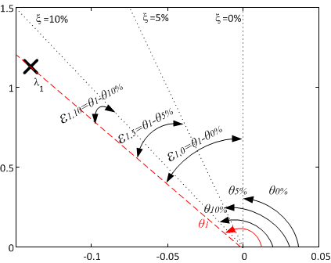
Small-Signal Stability
This index provides a measure of stability of the system based in the damping ratio of the relevant modes of the system. The measure is the angular distance (radians) from each mode to a pre-defined damping ratio.
The final index has three layers:
Single mode index (SMI)-matrix
All modes index (AMI) - vector
Global modes index (GMI)- gain
Is the individual distance of each mode to each pre-defined damping, i.e. 0%, 5%, 10%
Is the minimum distance among all the modes respect to each of the pre-defined damping.
Is the minimum distance among all modes respect to all pre-defined damping.

Slide 4
Overview of SSS index
The SMI is the most detailed source of information, but for a system with multiple number of modes, its not easy to interpret it (matrix of data).
AMI facilitates the interpretation of SMI.
This index gives the minimum distance of the modes with respect to a damping ratio. If one value the AMI vector is negative, this means that at least one mode has a damping less than the one required.
GMI gives a global interpretation of the modes respect to all pre-defined damping ratios.
.

Slide 5
Interpretation Rules
The following rules, to be used in data mining, must be applied also for interpretation:
If GMI >0 all modes are within the pre-defined damping
else GMI<0 at least one mode is violating the damping criteria and AMI has to be used to identify the violated damping.
If AMI(i)>0 All modes are within the predefined damping
else AMI(i)<0 At least one mode is violating the pre-defined damping and SMI has to be used to identify the specific modes violating the criteria
If SMI(j,i)>0 The mode is within the criteria
else SMI(j,i)<0 The mode is violating the criteria
Where i is the ith element of AMI representing a damping ratio and j is the number of the mode.

Slide 6
Example
M3
M3
M2
M3
M2
M3
M2
M2
M1
M1
M1
M1
GMI | 0.0318
GMI | -0.0215
GMI | -0.0781
GMI | -0.1086
AMI | 0.1319 | 0.0819 | 0.0318
AMI | 0.0787 | 0.0287 | -0.0215
AMI | 0.0220 | -0.0280 | -0.0781
AMI | -0.0085 | -0.0585 | -0.1086
SMI | ζ=0% | ζ=5% | ζ=10%
M1 | 0.1748 | 0.124 | 0.0746
M2 | 0.1567 | 0.1067 | 0.0566
M3 | 0.1319 | 0.0819 | 0.0318
SMI | ζ=0% | ζ=5% | ζ=10%
M1 | 0.0833 | 0.0333 | -0.0169
M2 | 0.0787 | 0.0287 | -0.0215
M3 | 0.1335 | 0.0835 | 0.0334
SMI | ζ=0% | ζ=5% | ζ=10%
M1 | 0.0220 | -0.0280 | -0.0781
M2 | 0.0437 | -0.0063 | -0.0564
M3 | 0.0842 | 0.0342 | -0.0160
SMI | ζ=0% | ζ=5% | ζ=10%
M1 | 0.0238 | -0.0262 | -0.0763
M2 | -0.0085 | -0.0585 | -0.1086
M3 | 0.0661 | 0.0161 | -0.0340

Slide 7
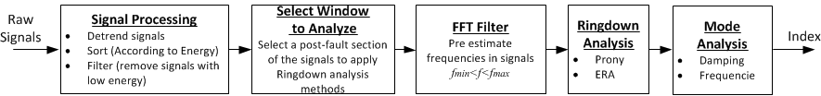

Validation (RTE’s System)
Active Power flows (P) of critical lines
SMI, AMI, GMI
Feb2012_WARAN1_P_60sec.mat

Slide 8
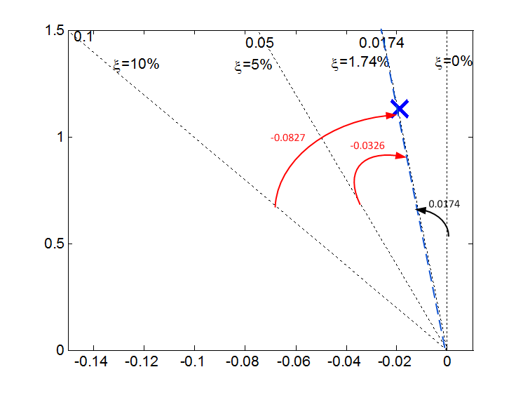
Analyzing results
GMI<0
Violation of criteria
GMI | -0.0326
AMI(2) & AMI(3)<0
Violation of 5% and 10% damping
AMI | 0.0174 | -0.0326 | -0 .0827
SMI(1,2) & SMI(1,3)<0
Mode 1 violating damping 5 and 10%
SMI | ζ=0% | ζ=5% | ζ=10%
M1 | 0.0174 | -0.0326 | -0 .0827

Slide 9
Voltage Stability Indexes
This index provides a measure of how far the system is from the maximum loadability limit
At least, 3 sets of time series data with the same contingency are required:
The Load level is low
The Load level is OK
The Load level is in the limits (unacceptable for operational standards)
Combining this data, 2 curves can be estimated:
Pre-contingency curve (using green data)
Post-contingency curve (using light-blue data)

Slide 10
Overview of the VS indexes
Similarly to the SSS index, the voltage stability index comprise 3 layers
Single Bus Index (SBI)
All Buses Index (ABI)
Global Bus Index (GBI)
Single Bus Index (SBI) is a matrix and provides:
the distance in pre and post contingency for each loading level (low, ok and limit) to the maximum loadability (Pmax) and voltage (Vlim) limits for a selected bus(i).
The SBI index will increase two rows each time that the analysis of a different bus for the same contingency is included.

Slide 11
All Bus Index (ABI) is a vector that provides the minimum distance among all buses for each loading level (low, ok and limit) to the loadability (Pmax) and the voltage (Vlim) limits.
The ABI index helps to identify if a loading level is violating a limit in pre or post contingency.
Global Bus Index (ABI) is a 2 element vector that provides the overall minimum distance to the loadability (Pmax) and the over all voltage (Vmax) limits respect to all buses.
The GBI index indicates if a limit has been violated.

Slide 12
Interpretation Rules
If GBI(ΔP, ΔV) >0 all loading levels are within the limits
else GBI(ΔP, ΔV)<0 at least one loading or voltage level is violating criteria and ABI has to be used to identify the problem.
If ABI(ΔPabc, ΔVabc)>0 All loading levels are within the limits
else ABI(ΔPabc, ΔVabc)<0 At least one bus is violating one limit and SBI has to be used to identify the problem
If SBI(i, Δpabc, Δvabc, Δpabc, Δvabc)>0 The load levels are within the limits
else SBI(i, Δpabc, Δvabc, Δpabc, Δvabc)<0 The load leve is violating the limits
^
^
^
^
^
Where i is the ith bus.

Slide 13
Ideal Example Pre-contingency analysis
Ideal Case
The measured data are used to estimate the pre-contingency curve.
All distances are calculated respect to the pre contingency limits (Pmax, Vlim).
The distances are calculated to the average value of each loading level.

Slide 14
Post-contingency analysis
Ideal Case
The measured data are used to estimate the post-contingency curve (red).
The post-contingency curve is used to measure the new distances of loading level respect to the post-contingency new limit (Pmax).
The distances are calculated to the average value of each loading level.

Slide 15
GBI | ΔPs | ΔVs
 | -0.050 | -0.091
GBI(ΔP, ΔV)<0
At least one limit is violated
ABI( ΔPc, ΔVc)<0
The limit loading level has been violated in pre or post contingency
ABI | ΔPa | ΔPb | ΔPc | ΔVa | ΔVb | ΔVc
 | 0.192 | 0.067 | -0.050 | 0.143 | 0.069 | -0.091
^
^
SBI( Δpc, Δvc)<0
The limit loading level at post-contingency has been violated
SBI |  | ΔPa | ΔPb | ΔPc | ΔVa | ΔVb | ΔVc
Bus n | Pre | 0.239 | 0.120 | 0.009 | 0.179 | 0.128 | 0.052
 | Post | 0.192 | 0.067 | -0.050 | 0.143 | 0.069 | -0.091

Slide 16
Validation (RTE’s System)
In order to compute a good approximation, the variation among the loading levels must be significant !
GBI | ΔPs | ΔVs
 | 0.440 | 0.313
ABI | ΔPa | ΔPb | ΔPc | ΔVa | ΔVb | ΔVc
 | 0.527 | 0.483 | 0.440 | 0.313 | 0.304 | 0.294
SBI |  | ΔPa | ΔPb | ΔPc | ΔVa | ΔVb | ΔVc
Bus 10 | Pre | 0.563 | 0.522 | 0.483 | 0.313 | 0.306 | 0.296
 | Post | 0.527 | 0.483 | 0.440 | 0.313 | 0.304 | 0.294

Slide 17
Provisional Matlab Dependency Table
Index | Toolbox | Function | Called Functions (Dependency) | Brief description
Under/over voltage | ----- | Functions and scripts | horline.m* | Add a horizontal line in plots
Overload | ----- | Functions and scripts | horline.m* | Add a horizontal line in plots
Transient stability | ----- | ----- | ----- | No external functions required
Voltage stability | Optimization Toolbox Version 6.0 (R2011a) | Least Squares (Curve Fitting) functions | lsqnonlin.m | Solve nonlinear least-squares (nonlinear data-fitting) problems
 | ----- | Functions and scripts | EstimateE_and_X.m** | Estimate the voltage E and the reactance X
 |  |  | Estimate_a_and_b.m** | Estimate the parameters α and β
 |  |  | verline.m* | Add a vertical line in plots
Small-signal stability | Control System Toolbox Version 9.1 (R2011a) | Linear Model Identification | ss.m | Convert linear models to Control System Toolbox LTI models
 |  |  | impulse.m | Plot impulse response with confidence interval
 |  | Conversions | c2d.m | Convert from continuous- to discrete-time models
 |  |  | d2c.m | Convert from discrete- to continuous-time models
 | ----- | Functions and scripts | fiximp.m** | Helper function to convert the 3D output of MATLAB impulse function to 2D socit ver
 |  |  | era.m** | Simple ERA system identification routine
 |  |  | prony.m** | Prony analysis program for fitting to a ringdown
 |  |  | fft_get.m* | Retrieve frequencies from given signals
 |  |  | energy_sort.m* | Detrend signals and sort according to its energy
MATLAB Version 7.12.0.635 (R2011a) MATLAB License Number: 308809 Operating System: Microsoft Windows 7 Version 6.1 (Build 7601: Service Pack 1) Java VM Version: Java 1.6.0_17-b04 with Sun Microsystems Inc. Java HotSpot(TM) 64-Bit Server VM mixed mode
* | The function was created entirely for iTesla, full code available.
** | Background software developed for other project or other researchers. Available only in pre-compiled form (MATLAB .p files).
---- | No dependency

Slide 18
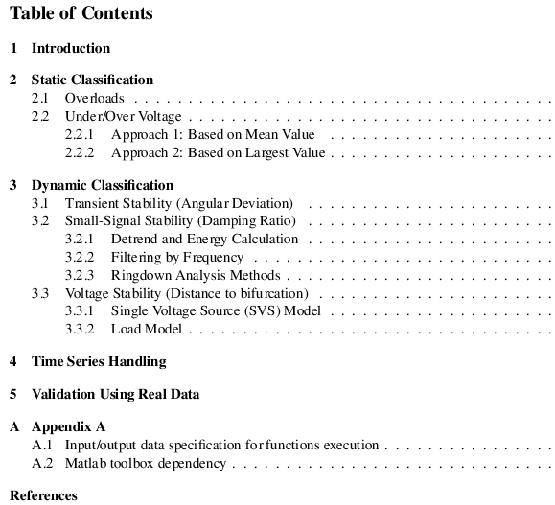
Provisional Deliverable Content

Slide 19
Summary
The last two indexes has been developed, minor details for each index need to be finalized.
The following indexes has been validated using data from partners
Overload
Over/under Voltage
Transient stability
Small-signal stability
The voltage stability index requires more accurate set of data in order to be validated using real measurements
The deliverable along with the Matlab functions will be provided within October.

