Slide 1

WP4.3 Deliverable D4.3 “Power System Stability Impact Assessment using Time Series from Phasor-Time-Domain Simulations”
Rafael Segundo and Luigi Vanfretti – KTH
January 15 2014, Brussels, Belgium

Slide 2
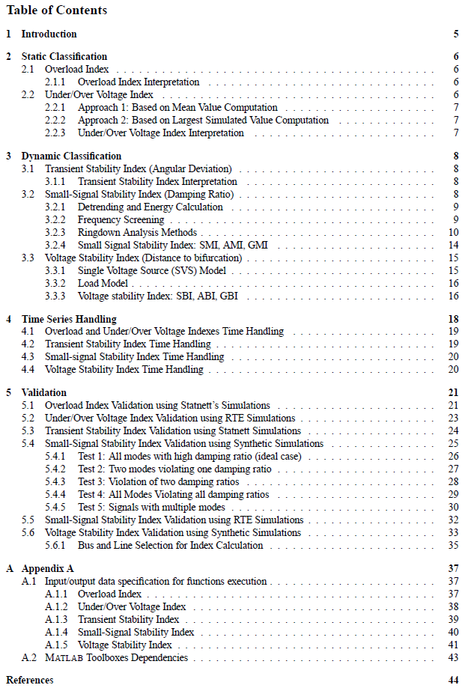
Summary
5 indexes where developed as Matlab functions by KTH.
A detailed report was written to illustrate the use of each of the functions.
The first draft of the deliverable was available the 10th of October 2013.
After some interaction and reviews of RTE and Quinary, the final deliverable was realized the 4th of November 2013.
In order to contribute with the final integration of the indexes, KTH will have a meeting with Quinary and others to answer any possible question regarding the functions.

Slide 3
Results and Dissemination
As part of the dissemination process, the results of WP4.3 have been and will be presented in the following platforms:
Poster in the Real-Smart Conference organized by Imperial College 28-29 November 2013. “Power System Stability Impact Assessment using Time-Series from Phasor-Time-Domain Simulations” (Presented)
Conference Publication in the next IEEE PES General Meeting 2014, Washington DC, USA “A Small-Signal Stability Index for Power System Dynamic Impact Assessment using Time-domain Simulations” (Submitted)
Conference Publication in the next IEEE ISGT 2014, Istanbul, Turkey, “A Voltage Stability Index for Dynamic Impact Assessment in Energy Systems using Time-domain Simulations” (In Process)

Slide 4
Results and Dissemination
Conference Publication in the next IEEE PES T&D 2014, Medellin, Colombia, “Static Stability Indexes for Dynamic Impact Assessment” , (In Process)
Journal Publication in one of the IEEE Transactions magazine, “ Dynamic Stability Indexes for Power System Dynamic Impact Assessment using Time-domain Simulations” , (To be written, simulations results required)

Slide 5
Remaining Work for WP4.3
Contribute with the final integration, providing support to Quinary during this set of meetings.
Finish and submit the remaining conference and journal publications
Since no more months available, WP4.3 is done.

