Slide 1

“PSAT vs Eurostag on the KTH-Nordic32”
Rafael Segundo and Luigi Vanfretti – KTH
April 07 2014, Paris, France

Slide 2
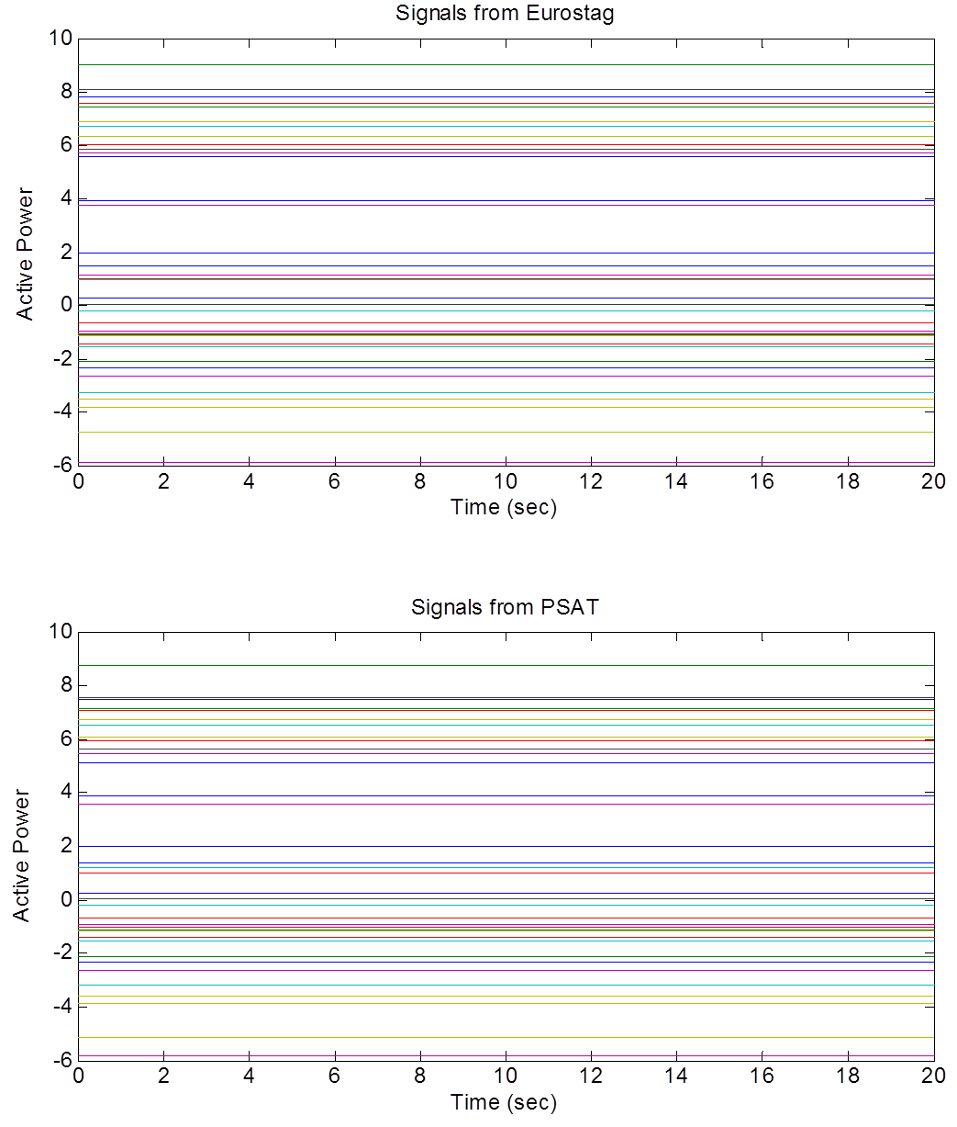
No-disturbance on the system
Although the system response looks very similar on the two platforms, they are actually different

Slide 3
One-by-one comparison of signals randomly selected

Slide 4
Three-Phase fault at Bus N4041
Although the system response looks very similar on the two platforms, they are actually different

Slide 5
Differences on the models lead to different results

