Slide 1

WP4.3 “Integration of SSS index into iTesla platform”
Rafael Segundo and Luigi Vanfretti – KTH
Tuesday 08 2014, Paris, France

Slide 2
Results and Dissemination
As part of the dissemination process, the results of WP4.3 have been and will be presented in the following platforms:
Posters
Real-Smart Conference, Imperial College, November 2013. “Power System Stability Impact Assessment using Time-Series from Phasor-Time-Domain Simulations” (Presented)
Conferences
IEEE PES General Meeting 2014, Washington DC, USA “A Small-Signal Stability Index for Power System Dynamic Impact Assessment using Time-domain Simulations” (Accepted)
IEEE ISGT 2014, Istanbul, Turkey, “Voltage Stability Index for Dynamic Impact Assessment using Time-domain Simulations” (Finished, ready to be submitted)
IEEE ISGT 2014, Istanbul, Turkey, “Static Stability Indexes for Classification of Power System Time-domain Simulations” , (Almost finished)
Journals
IEEE Transactions on Power Systems, “ Dynamic Stability Indexes for Power System Dynamic Impact Assessment using Time-domain Simulations” , (To be written, simulations results required)

Slide 3
Information required to complete journal
Some information from our different partners have to be provided in order to complete the journal
Different simulation results of different case studies on real systems (e.g. French network)
Index results from the iTesla platform

Slide 4
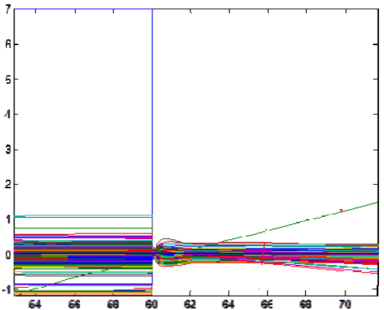
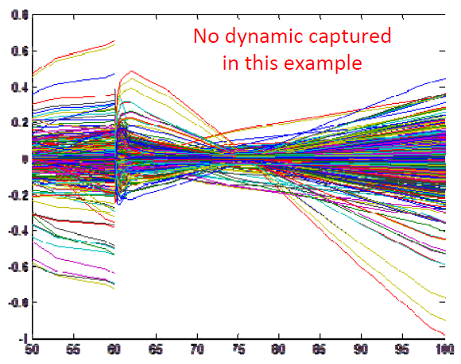
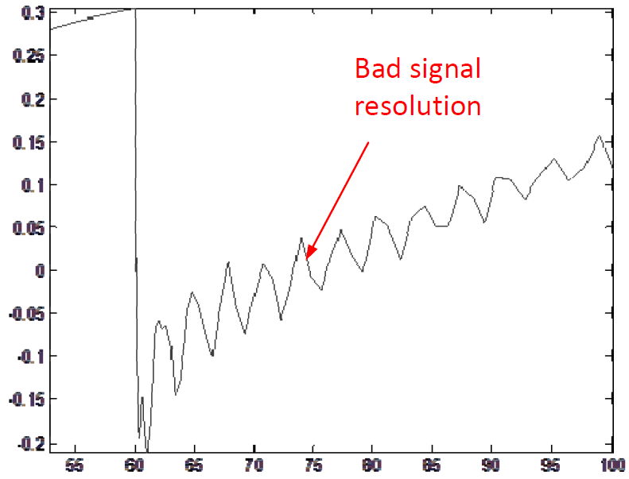
Integration of the SSS index
KTH is providing support to Quinary in the integration of the SSS index.
Initial problems faced with Quinary to test and integrate the index
Not appropriate case studies used
Bad data resolution (parameters of simulation used)
difficult to determine exactly the issues without full knowledge of the input into the routine.

Slide 5
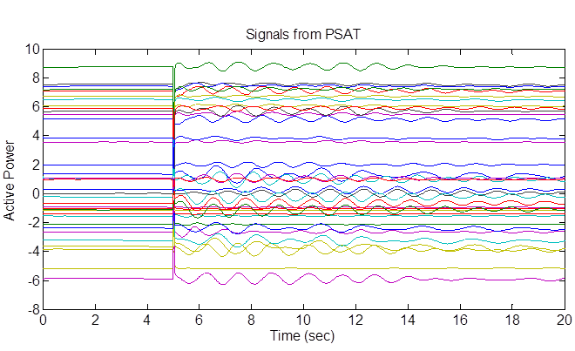
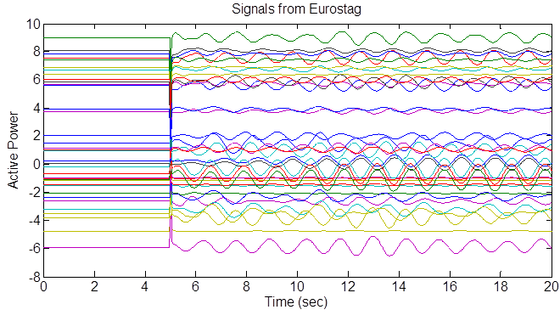
We have agree with Quinary with the following procedure:
KTH will perform simulations on the KTH-Nordic 32 and run the SSS index
Quinary have to reproduce KTH results
Determine the actual problems in a more precise way
Some issues has been identified when compering simulations results using PSAT (KTH) and EUROSTAG (Quinary) on the KTH-Nordic32 system
Look the similar but they are actually different !

Slide 6
One-by-One Signal Comparison
Differences lead to different results between KTH and Quianry

Slide 7
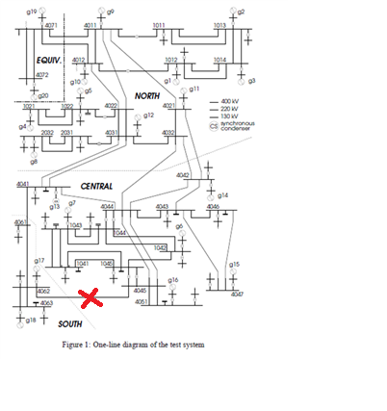

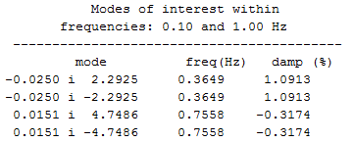
Provitional Solution
KTH has to use Eurostag to produce adequate simulations and compare results with Quinary
3-phsae fault on line N4045-N4062-1 at 5sec and line trip at 5.04 sec
Table 1 Identified modes, frequencies and damping ratios

Slide 8
Integration of SSS index
Different case studies in the KTH-Nordic32 (Eurostag) are under analysis to coordinate the integration of the index.
Specific simulation parameters are used:
Global relative accuracy: 0.0001
Global absolute accuracy: 0.0001
Accuracy for algebraic equation restoration: 0.001
Relative accuracy for macro-automatons: 0.0001
Absolute accuracy for macro-automatons: 0.0001
Minimum step used in the integration method: 0.00001
Maximum step used in the integration method: 0.02
Initial Time: 0
Stop Time: 40

Slide 9
Next steps
Test multiple case studies
Compare results with Quinary
Find bugs and any other integration related issue
Fix problems

