Slide 1




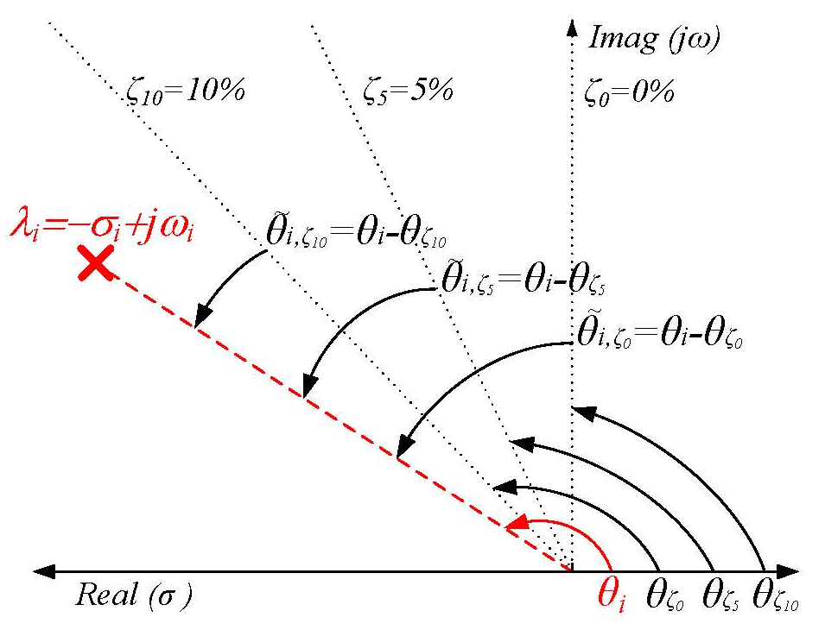
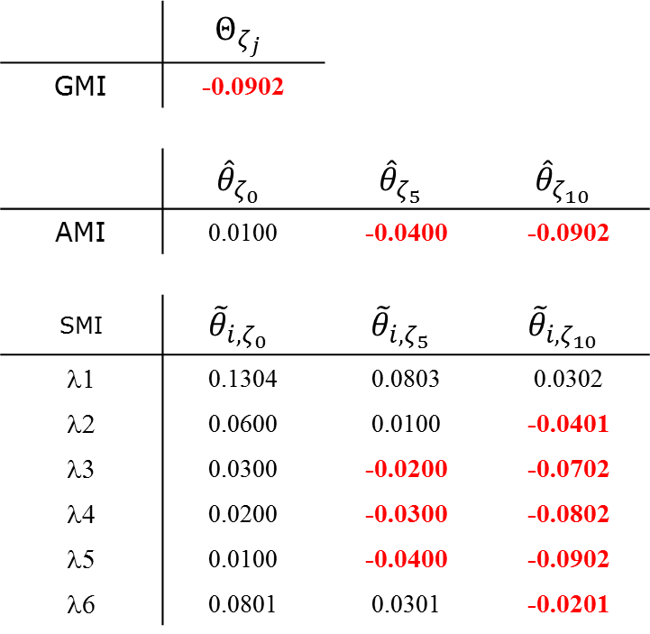
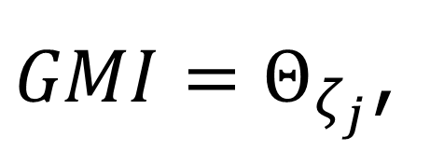
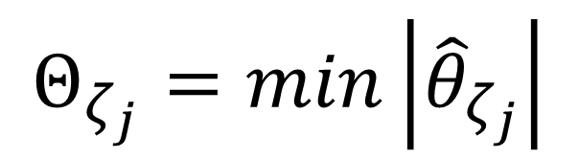
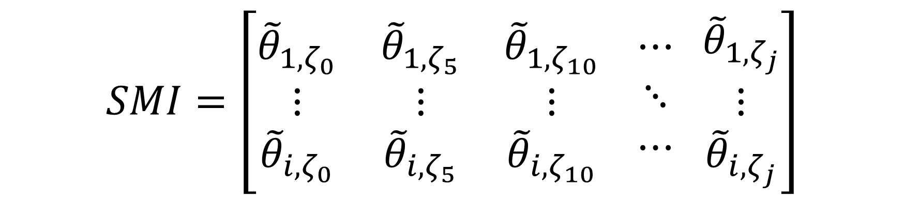
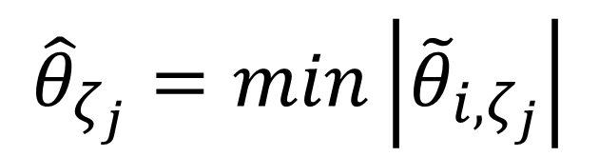
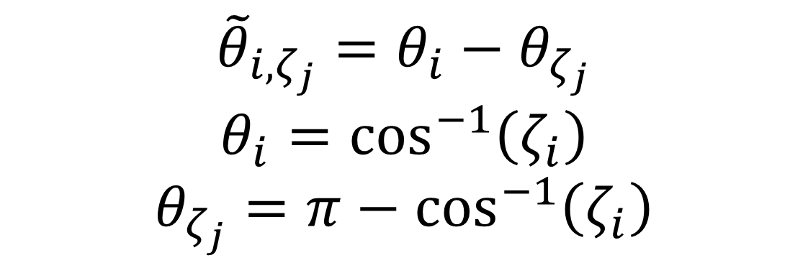
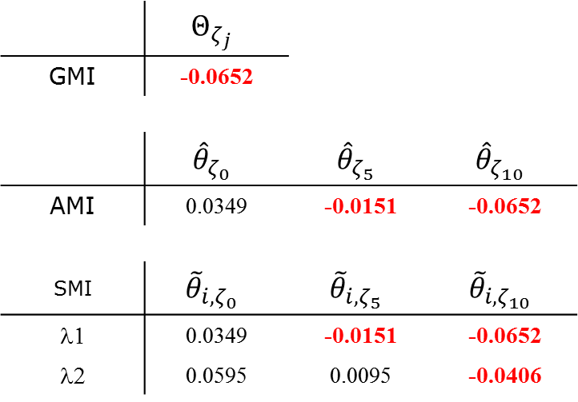
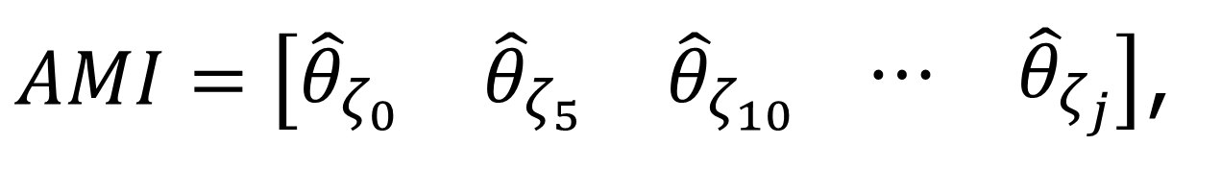
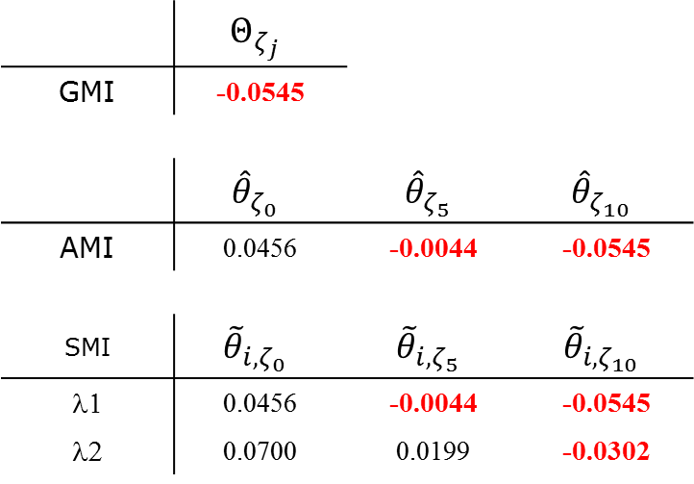
A Small-Signal Stability Index for Power System Dynamic Impact Assessment using Time-domain Simulations
Felix Rafael Segundo Sevilla^{1,3} and Luigi Vanfretti^{1,2} ¹KTH Royal Institute of Technology, Sweden, ²Statnett SF, Norway and ³Zurich University of Applied Science, Switzerland
Abstract— A small-signal stability index of three layers,
which is used to assess power system dynamic simulations is presented.
The index is calculated from an estimate of the eigenvalues of the system, which are determined using time-series from dynamic simulations. The methodology assumes that no other information about the system (model) is available.
In the first layer, which is the main future of the index, a scalar indicates if any of the modes have a damping ratio less than a predefined value. In the second layer, a vector is used to specify which pre-defined damping ratios were violated and finally, in the third layer a matrix is used to retrieve precise information about which mode has violated the pre-defined damping requirements of the system.
I. Motivation
IV. Illustrative Example
To develop offline criteria to support online analysis functions within the iTesla toolbox.
To classify events on time-series performed from dynamic simulations.
Fast computation and good measure of how severe the contingency affected the stability of the system.
Simple to interpret without compromising information about the cause of the problem.
Two artificial signals, shown on Figure 3 (a), with 3 different frequencies and damping ratios were generated.
The procedure described on Figure 1, was applied and the results are depicted on Table 1.
Figures 3 (b), (c) and (d) describe the different steps of the method.
II. Small-signal Stability Index
The index is based on the damping ratio of the estimated system’s modes.
The measure is the angular distance (in radians) from each mode to a pre-defined damping ratio.
The index has three layers to facilitate its interpretation: the matrix Single Mode Index (SMI), the vector All Modes Index (AMI) and the scalar Global Modes Index (GMI)
Time-series
Figure 3. (a) Analyzed time series, (b) Detrended and selected data, (c) Signal estimation from ringdown analysis and (d) Estimated modes
Pre-processing signals
Detrend & sort according to energy
 | $$Θ_{ζ_{j}}$$
GMI | -0.0902
 | $${\hat{θ}}_{ζ_{0}}$$ | $${\hat{θ}}_{ζ_{5}}$$ | $${\hat{θ}}_{ζ_{10}}$$
AMI | 0.0100 | -0.0400 | -0.0902
SMI | $${\tilde{θ}}_{{i,ζ}_{0}}$$ | $${\tilde{θ}}_{{i,ζ}_{5}}$$ | $${\tilde{θ}}_{{i,ζ}_{10}}$$
λ1 | 0.1304 | 0.0803 | 0.0302
λ2 | 0.0600 | 0.0100 | -0.0401
λ3 | 0.0300 | -0.0200 | -0.0702
λ4 | 0.0200 | -0.0300 | -0.0802
λ5 | 0.0100 | -0.0400 | -0.0902
λ6 | 0.0801 | 0.0301 | -0.0201
Frequency screening (FFT)
Filter signals within an interest range of frequencies fmin<f<fmax
Ringdown Analysis
Prony
Eigensystem Realization Algorithm
Matrix Pencil
Index Calculation
Single Mode Index (SMI)
All Modes Index (AMI)
Global Modes Index (GMI)
λi, fi, ζi
Table 1. The three layer small-signal stability index
V. Application to the KTH-Nordic32 system
(a) Case A: One 3-phase fault of 100msec at each bus (32 simulations)
(b) Case B: Five 3-phase faults of random duration at each bus (160 sim)
Dr Rafael Segundo is with KTH Royal Institute of Technology, Stockholm, Sweden, e-mail:
rafael.segundo@ee.kth.se
and with Zurich University of Applied Science, Winterthur, Switzerland email:
felixrafael.segundosevilla@zhaw.ch
Dr Luigi Vanfretti is with Statnett SF, Research and Development Division in Oslo, Norway, e-mail: luigi.vanfretti@statnett.no
and with KTH Royal Institute of Technology, Stockholm, Sweden e-mail: luigiv@kth.se
SMI, AMI, GMI
Figure 1. Flow chart of the index calculation
III. THE THREE-LAYER SSS INDEX
The SMI provides the individual distance of each mode to a predefined damping ratio, e.g. ζ0=0%, ζ5=5% and ζ10=10%.
AMI is a vector that gives the minimum distance of the modes with respect to each of the pre-defined damping ratios.
GMI gives a global interpretation of the modes respect to all pre-defined damping ratios, is the minimum distance among all modes respect to all pre-defined ratios.
Figure 4. Estimated modes λ1 in red and λ2 in blue and median values in
black for both: (a) Case study A and (b) Case study B
Figure 2. Angular distance from each mode to a pre-defined damping ratio
Figure 5. Fitted normal distribution of the estimated frequencies and damping
ratios for both modes λ1 in blue and λ2 in red and both case studies
$$SMI=\left[\begin{matrix}{\tilde{θ}}_{1, ζ_{0}} & {\tilde{θ}}_{1, ζ_{5}} & {\tilde{θ}}_{1, ζ_{10}} \\ ⋮ & ⋮ & ⋮ \\ {\tilde{θ}}_{i, ζ_{0}} & {\tilde{θ}}_{i, ζ_{5}} & {\tilde{θ}}_{i, ζ_{10}}\end{matrix} \begin{matrix}⋯ \\ ⋱ \\ ⋯\end{matrix} \begin{matrix}{\tilde{θ}}_{1, ζ_{j}} \\ ⋮ \\ {\tilde{θ}}_{i, ζ_{j}}\end{matrix}\right]$$
Case A
Case B
Mode | f(Hz) | ζ(%) | std
λ1 | 0.4763 | 4.56 | 0.0681
λ2 | 0.7609 | 6.99 | 0.1006
Mode | f(Hz) | ζ(%) | std
λ1 | 0.4698 | 3.98 | 0.0054
λ2 | 0.7566 | 5.94 | 0.0938
$${\tilde{θ}}_{i, ζ_{j}}=θ_{i}−θ_{ζ_{j}}$$
$$θ_{i}=\cos^{−1}\left(ζ_{i}\right)$$
$$θ_{ζ_{j}}=π−\cos^{−1}\left(ζ_{i}\right)$$
Table 2. Median of the estimated modes, frequencies and damping
 | $$Θ_{ζ_{j}}$$
GMI | -0.0545
 | $${\hat{θ}}_{ζ_{0}}$$ | $${\hat{θ}}_{ζ_{5}}$$ | $${\hat{θ}}_{ζ_{10}}$$
AMI | 0.0456 | -0.0044 | -0.0545
SMI | $${\tilde{θ}}_{{i,ζ}_{0}}$$ | $${\tilde{θ}}_{{i,ζ}_{5}}$$ | $${\tilde{θ}}_{{i,ζ}_{10}}$$
λ1 | 0.0456 | -0.0044 | -0.0545
λ2 | 0.0700 | 0.0199 | -0.0302
 | $$Θ_{ζ_{j}}$$
GMI | -0.0652
 | $${\hat{θ}}_{ζ_{0}}$$ | $${\hat{θ}}_{ζ_{5}}$$ | $${\hat{θ}}_{ζ_{10}}$$
AMI | 0.0349 | -0.0151 | -0.0652
SMI | $${\tilde{θ}}_{{i,ζ}_{0}}$$ | $${\tilde{θ}}_{{i,ζ}_{5}}$$ | $${\tilde{θ}}_{{i,ζ}_{10}}$$
λ1 | 0.0349 | -0.0151 | -0.0652
λ2 | 0.0595 | 0.0095 | -0.0406
$AMI=\left[\begin{matrix}{\hat{θ}}_{ζ_{0}} & {\hat{θ}}_{ζ_{5}} & {\hat{θ}}_{ζ_{10}}\end{matrix} \begin{matrix}⋯ & {\hat{θ}}_{ζ_{j}}\end{matrix}\right]$,
$${\hat{θ}}_{ζ_{j}}=min\left|{\tilde{θ}}_{i,ζ_{j}}\right|$$
$GMI=Θ_{ζ_{j}}$,
$$Θ_{ζ_{j}}=min\left|{\hat{θ}}_{ζ_{j}}\right|$$
Table 3. Small-signal stability indexes for median values of the Nordic system

