Slide 1


RaPId : a Parameter Identification Toolbox iTesla Model Validation SW Mock-Up Prototype for WP3.3 and WP3.4 used for Component Parameter Estimation and Aggregate Model Validation RaPId Toolbox User Manual A Quick start GUIde for the RaPId toolbox
Achour Amazouz and Prof. Dr.-Ing. Luigi Vanfretti
E-mail: luigiv@kth.se Web: http://www.vanfretti.com
luigiv@kth.se
Associate Professor, Docent
Electric Power Systems Dept.
KTH Stockholm, Sweden
Luigi.Vanfretti@statnett.no
Special Advisor in Strategy and Public Affairs
Research and Development Division Statnett SF
Oslo, Norway
June 2013

Slide 2
What is RaPId?
RaPId is a toolbox providing a framework for parameter identification.
A Modelica model, made available through a Flexible Mock-Unit (i.e. FMU) in the Simulink environment, is characterized by a certain number of parameters whose values can be independently chosen.
The model is simulated and its outputs are measured.
RaPId attempts to tune the parameters of the model in Simulink so as to obtain the best curve fitting between the outputs of the Simulation and the experimental measurements of the same outputs provided by the user.

Slide 3
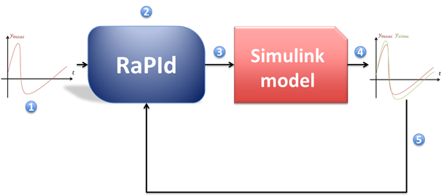
What is RaPId doing?
1
Output (and optionally input) measurements are provided to RaPId by the user.
2
At initialisation, a set of parameter is generated randomly or preconfigured in RaPId.
3
The model is simulated with the parameter values given by RaPId.
4
The outputs of the model are recorded and compared to the user-provided measurements.
5
A fitness function is computed to judge how close the measured data and simulated data are to each other
2’
Based on the fitness computed in (5) a new set of parameters is computed by RaPId

Slide 4
What is RaPId doing?
1
2
The iterations go on until a minimal fitness or a maximal number of iterations are reached.
3
4
5
2’

Slide 5
Objective
The model, written in Modelica, is characterised by a vector of parameters
Find a vector allowing close matching of the Model’s output to outputs measured experimentally
Parameter Id for a load characterised by two parameters and four outputs

Slide 6
Requirements
FMI Toolbox and Matlab must be installed in the 32bit versions.
The *.fmu container allowing import of the Modelica model in simulink needs to be compatible with Model Exchange (ME).
If the *.fmu file is generated with Dymola
With local license or sharable license of Dymola, the license needs to be in the machine running the FMU
A runtime license of Dymola may be needed for FMI to be able to run the simulations in the machine excec the FMU
If FMU generated by a ”Binary model export license” of Dymola, the FMU will run anywhere
The output (resp. input) user-provided data needs to be given in a *.mat file. Both time and value for every measured quantity needs to be provided.

Slide 7
Preparation of the Simulink Model
Warning: We have experienced some problems when using the Simulink models given as example in the RaPId toolbox on different computers with different versions of the FMI toolbox. The content describe here was tested with FMI Toolbox 1.5
You might have to build the model yourself if a problem is encountered when simulating the Simulink model

Slide 8
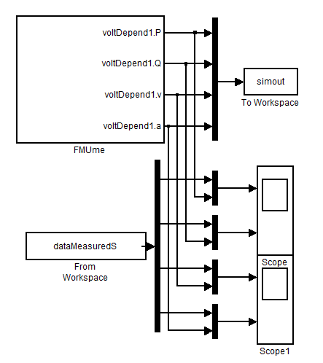
Preparation of the Simulink Model
The simulink model given in example contains:
The FMU me block where the modelica model is loaded
A ”To Workspace” component saving the simulated output. RaPId will fetch the data saved by this component into workspace
A ”From Workspace” block allowing to include the measured outputs in the model
Scopes ploting both the measured and simulated output while the computation are running. If the scopes are open before starting the toolbox every iteration of the optimisation will be displayed

Slide 9
Preparation of the Simulink Model
The toolbox always loads in workspace a struct with time dataMeasuredS based on the data user-provided. This name should normally not be changed from the ”From Workspace” component.
The name of the variable created by the ”To Workspace” component can be parametrised in the toolbox
i.e. the name of simout can be changed, but it must be modified through the GUI in the ”path” sub-GUI.
The number of outputs (4 in this example) may vary. It’s for the user to change the settings of the scopes, mux and demux components accordingly.

Slide 10
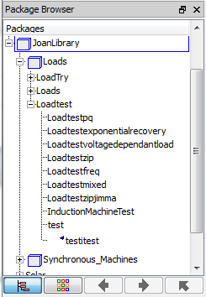
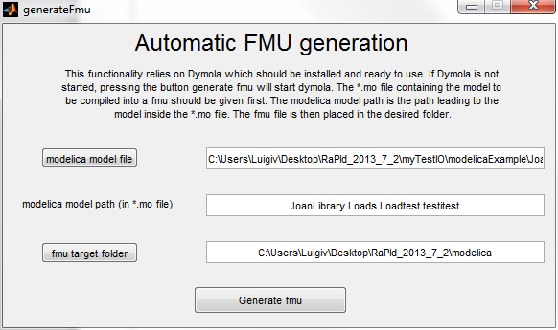
Generate the FMU
Select the .mo file containing the Modelica description for the model
Type the Modelica path to the model to be used
Select the folder where you want to place the FMU
Click to generate the FMU
The FMI Toolbox will need to be provided (Load FMU) with the FMU generated

Slide 11
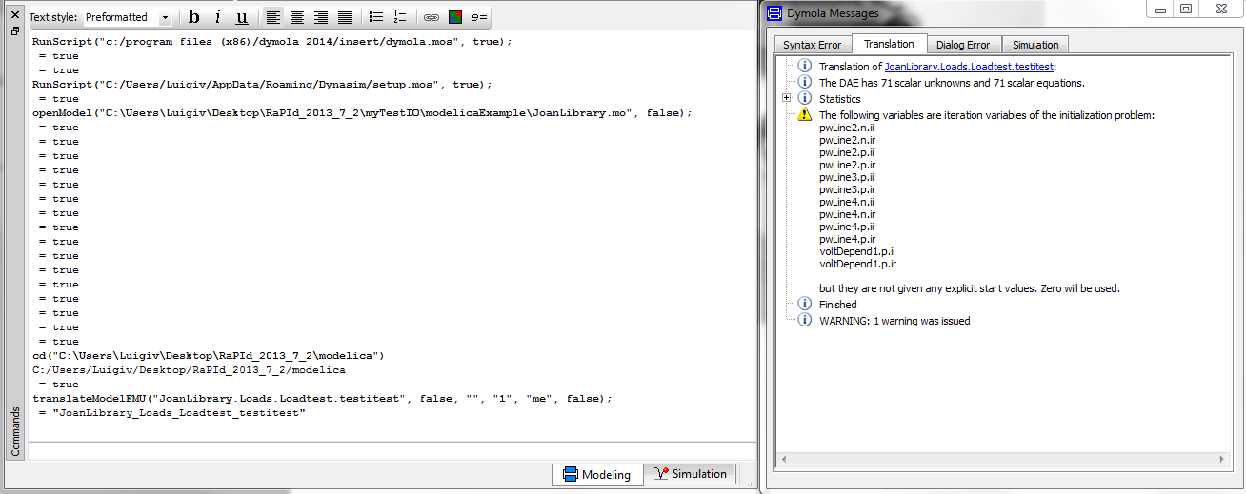
Generate the FMU
Dymola will launch automatically and compile the FMU placing it in the selected folder.
You can check this in the Dymola translation log and the Commands window.

Slide 12
Import the *.fmu in Matlab
Once the FMI toolbox from Modelon is imported to the matlab path, two blocks are available in Simulink:
FMI ME: for model exchange
the fmu file only contains the system’s equation
The standard simulink solvers and settings are used
FMI CS: for co simulation
Include the solvers’ binaries for simulation purposes
Corresponds to an external model run with its own solver
Here we use the ME block
Import using the ”Load fmu” button after clicking on the FMU block in simulink

Slide 13
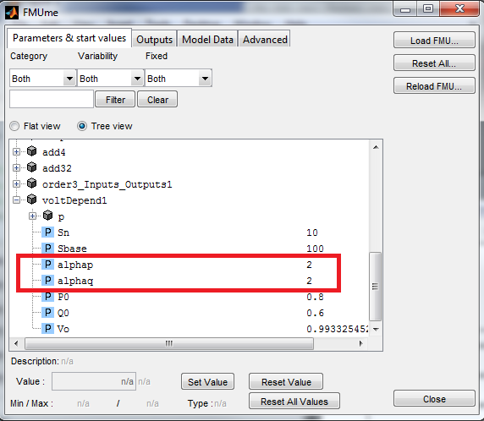
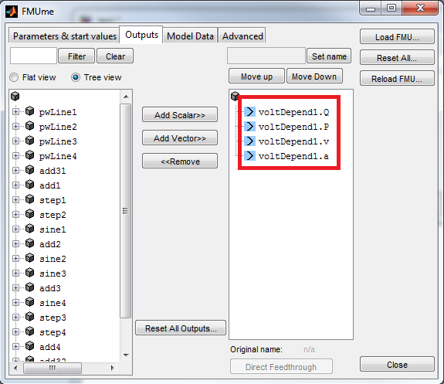
Setting up the *.fmu
In the first tab, note the complete names of the parameters that will be identified. In this example, we note voltDepend1.alphap and voltDepend1.alphaq
In the second tab, select the outputs in the same order as provided in the measurement data. These outputs are selected among the all the variables of the modelica model.

Slide 14
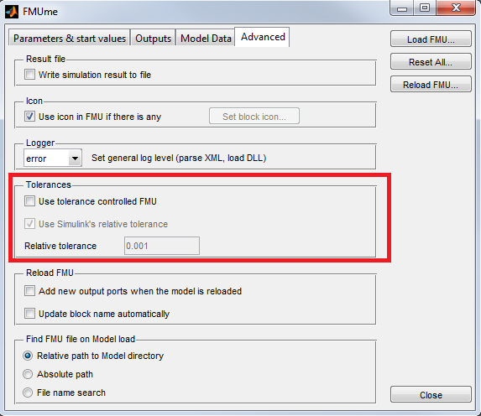
Setting up the *.fmu
Basic Solver Configuration
If you will simulate the system with a constant step solver (for example ’ode1’), you need to disable the use of tolerance controlled FMU in the fourth tab.
You can let it enabled as long as you specify a variable step solver in the toolbox (for example ode45). This setting will be showed later on.

Slide 15
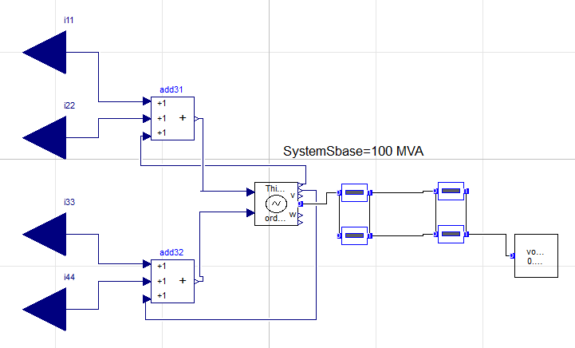
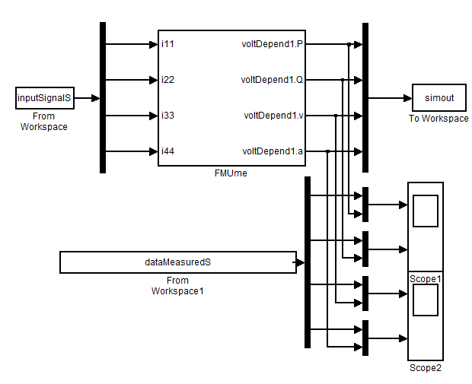
Input data
If the Modelica model contains input ports left unconnected, they will automatically appear as inputs to the FMI block.
In a second example included with the toolbox, a ”From Workspace” is included. It loads a struct with time called InputSignalS, this struct is generated automatically by the GUI based on the data provided by the user.

Slide 16
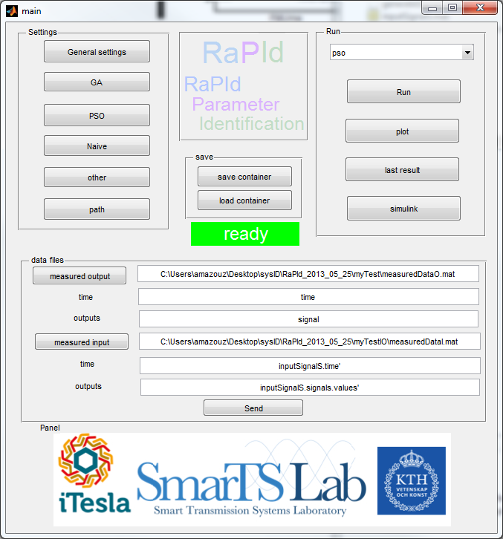
User-provided data
In the GUI, the user points at two files, one containing the measured Output, the second one containing the measured input.
The second one is optional and can be left empty (for output only identification).
Both can also be the same file.
The ’time’ and ’output’ fields correspond to the command that should be typed to obtain the time vector as a row vector and the outputs a matrix whose rows are the different output signals.
In the example on the left, the file measuredDataO.mat contains a row vector called ’time’ and a matrix called ’signal’.

Slide 17
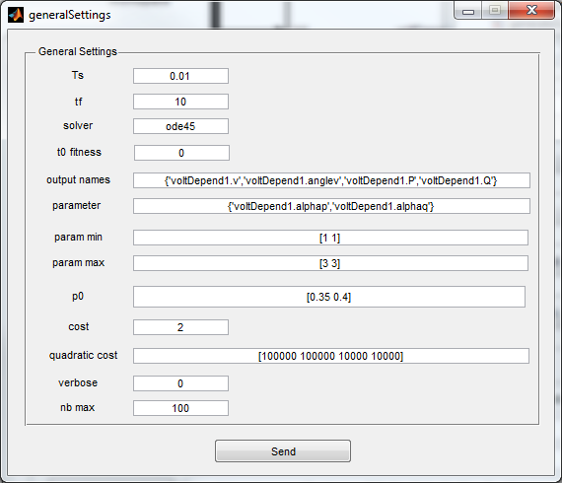
Simulink settings
The sampling time, final time and solver to be used in simulink should not be entered in the configuration parameter of simulink but in the toolbox’s general settings:

Slide 18
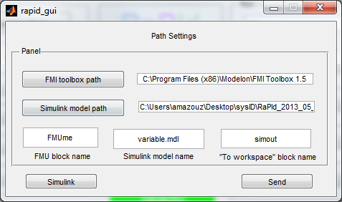
Simulink settings
In the same menu, and in the path settings, some more information about the simulink model must be set.
Paths to the FMI toolbox simulink model
Names of the FMU in the simulink model, name of the simulink file, name of the variable containing the output data after simulation
Complete names of the different outputs and parameters as they appear in the FMU

Slide 19
Configure the methods
Once the simulink model is set up, the different algorithms to be used need to be parametrised
The menus entitled GA, PSO and Naive correspond three methods we implemented with the toolbox
In the menu Other can be found the settings to the matlab methods that can be called in the toolbox
In the main window, a drop-down menu allows selection of the methods:
pso, ga, naive are implemented in the toolbox, the commented source code can be found in \core\functions\algoFunctions
cg, nm, gaExt, fmincon, respectivelly call the matlab functions fminunc, fminsearch, ga, fmincon
psoExt and knitro are based on external toolboxes that need to be installed, see https://code.google.com/p/psomatlab/ and http://www.ziena.com/knitro.htm
Combi uses a combination of two of the methods mentioned here, they are ran one after the other

Slide 20
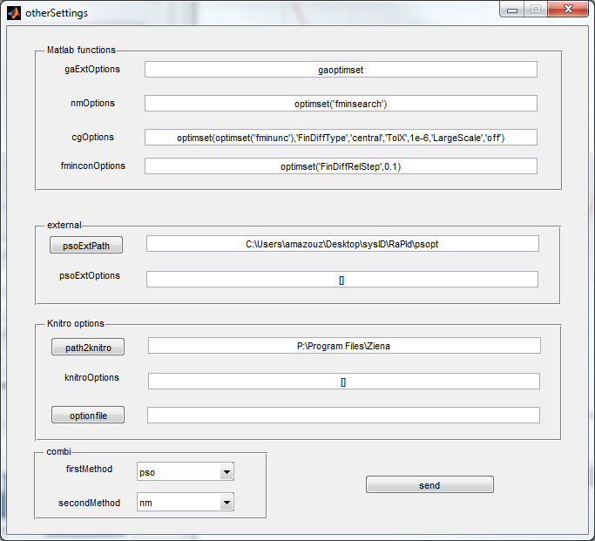
Settings the algo
Pso, ga and naive are set-up directly in the gui.
The external methods (these using matlab or other toolboxes’ functions) are set up through the formulation of an optimset
The comand to get to the so called optimset has to be input in the ”other settings” window.
ga matlab function
fminsearch matlab function
fminunc matlab function
fmincon matlab function
pso function from the toolbox posomatlab
ktrlink function from the toolbox Knitro
Choice of the two methods in the combination

Slide 21

File Structure
Contains the configuration menus, the main and the main window.
RaPId
gui
Functions adapting the calls to the optimisation method to the parameter optimisation of RaPId
algos
Functions used by the algorithm implemented with the toolbox (pso, ga, naive method)
core
functions
algoFunctions
Data files use to transfer data from the gui to rapid. Can be read by the user after computation
Base functions of the toolbox
rapidFunctions

Slide 22
Details of implementation
Called from the gui or the command line, needs to be fed the settings struct and the measured data
Functions from : \core\functions\rapidFunctions
rapid.m
Reads in settings the name of the method to be used, call the appropriate method
Generates iteratively parameter vectors to test taking into account past values of the parameters and corresponding fitness (example of methods: PSO, GA, Gradient) stop after a number of iterations or when a condition on fitness is reached
xxx_algo.m
Provide a vector of parameter, expect the fitness as return value
func.m
Return the fitness
Simulate the simulink model with the vector of parameters fed by the method and return the output of the model
Rapid_simuSystem.m
Evaluate the fitness of the vector of parameters based on the output from the simulation and the output measured
Several criterions can be used
Rapid_objectiveFunction.m

Slide 23
Running the toolbox
The user should go through every single menu and make sure all the fields are correctly filled.
A description of every field can be found in the user manual.
For more information, every script of the toolbox was commented. Reading the code should help understanding the basic usage.

Slide 24
Investigating the code
The user should go through every single menu and make sure all the fields are correctly filled.
A description of every field can be found in the user manual.
For more information, every script of the toolbox was commented. Reading the code should help understanding the basic usage.
The gui only save the data entered in the menus inside a struct called settings and saves it to a file, when the ”run” from the main window is pressed, the settings object is loaded and given to the main toolbox function called ”rapid”.
Everything can be done in command line. The gui code is quite heavy and large, doing things comand line is the right way if the user wants to dig in how things work.
After changing directory to the RaPId directory, to run the gui, execute run_gui.m to run comand line execute run_cmd.m
run_cmd.m can be used with the same philosophy as the gui: let it be like it is, just change the parameters present in the file according to your needs

Slide 25
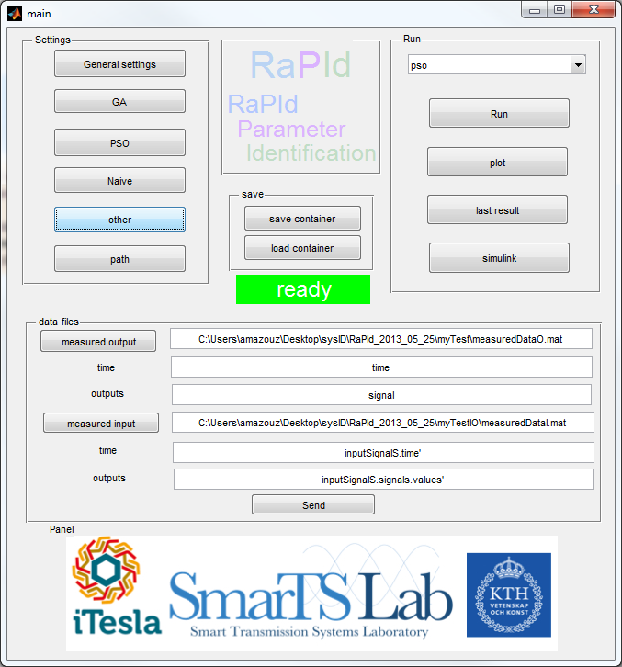
Running the gui
When all menus are filled, press Run. The green ”ready” turns to red. If it goes back to green, the simulation has ended, you can press plot to visualize the simulated and measured outputs.
Press last result to see what were the values found for the parameters.
If a problem occurs, the green space turns to yellow. The message displayed in the console should help finding what went wrong. Most likely a parameter was not entered correctly. Nothing in the toolbox checks that the parameters you entered are valid.
Save container allows you to save all the settings and the last solution (if available) in a file that can be loaded later. When a setting is changed. The last result is erased and the settings struct is modified irreversibly. It’s good to save a container every time a new kind of simulation is performed.

Slide 26
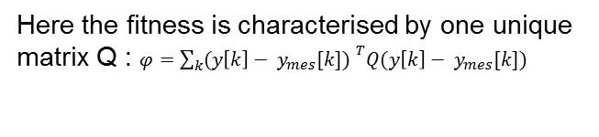
Adding an objective function
In rapid_objectiveFunction, choose a keyword: case 2. Add a case to the switch, in the body of the case, compute the fitness of the vector of parameters based on realRes and simuRes, matrices whose rows are respectivelly the measured output signals and simulated output signals.
realRes is in the toolbox an interpolation of the result of the simulation at the time instants given by the measurement data. This allows you to compare measured and simulated data point to point.
Your method will be used for fitness computation if the approriate keyword is given in settings.cost
You can define as many elements as needed inside settings.objective, in the example here a weight matrix is provided in settings.objective
Here the fitness is characterised by one unique matrix Q : $φ=\sum_{k}{{(y\left[k\right]− y_{mes}[k]) }^{T}Q(y\left[k\right]− y_{mes}[k])}$

Slide 27
Adding an optimization method
Add a case with a new keyword in the function rapid.m Call your method methodName_algo, place it in . It takes the struct settings as argument and return the vector solution, an historic containing the data you wish to have as output (useful for debugging) and the setting struct in which you might have added data. (The methods of the toolbox add to the struct the parameter vector as settings.xsol )
Your method can only call the function func(v)
func takes a vector of parameter and returns the fitness associated to this vector.
This assumes that the good settings.cost and settings.objective were declared to use the objective function you desire to evaluate.
func care of simulating the model, saving its output, interpolating the output data and computing the fitness. All fields of the settings struct must however be filled correctly.

Slide 28
Adding an optimization method
What you need to write:
The function may output any number of parameters, you can store them in other, they will be saved and accessible after computation
If your function is on the main folder of RaPid, nothing needs to be done for the path management
Call to your function

Slide 29
The settings struct
Characterise the simulation, the measured data will also be interpolated to fit this specification
Used to label the plots
Restrict the values allowed to the vector of parameters
Objective function identifier and struct containing it’s parameters
Settings specific to each method
Path and variable names needed to locate the simulink model and the file data.mat used to store and communicate data in between the gui’s components
Determine the method to be used
Initial guess, used for example for NM or CG
Some gui string generated automatically
Data put here automatically after interpolation and filtering

Slide 30
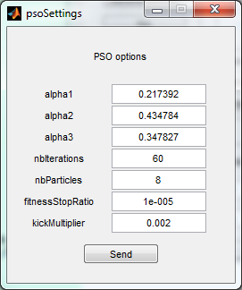
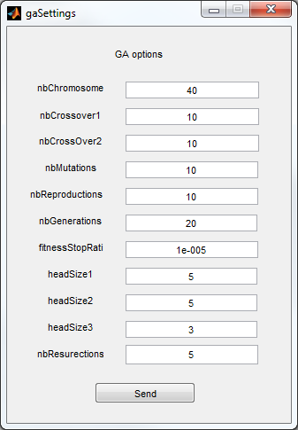
The settings struct
The content of settings is either set manually or through the gui:

Slide 31
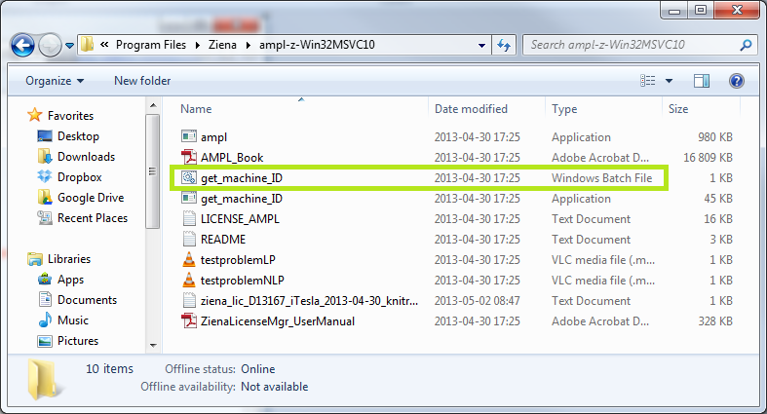
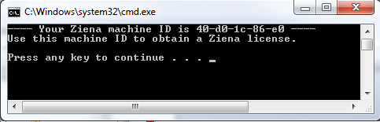
KNITRO: license installation
In the knitro folder (that you either took from the toolbox or downloaded), there is a get_machine_ID batch file. Run it, you get this:
The picture needs to be sent to :
thibaut.brejon@artelys.com

Slide 32
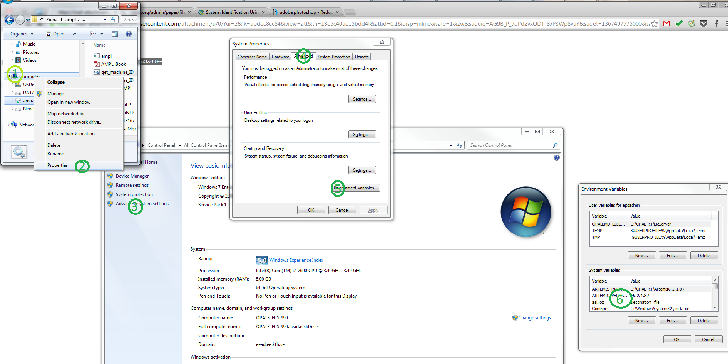
KNITRO
This guy at Artleys will send you a *.txt containing something funky
E.g. : =PbIaetle19HUlZwSGZkSczyHMNRRBj-MF2yzQHVriPpnuSsGJ+=
We need to change two environment variables
rightClickOnComputer>Properties>AdvancedSystemSettings>loginAsAdministrator>Advanced>EnvironmentVariables>SystemVariables

Slide 33
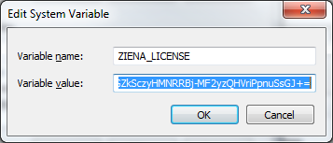
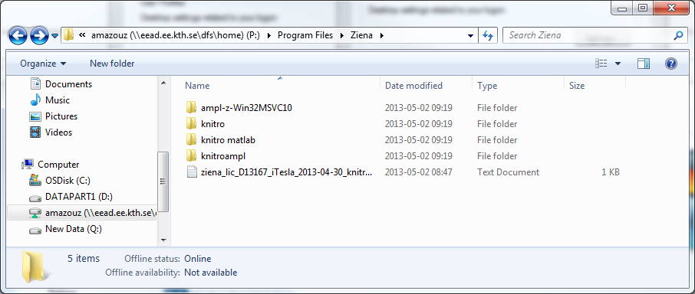
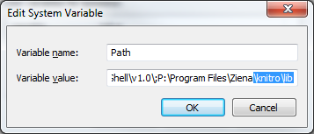
KNITRO
Add the content of the file you received as ZIENA_LICENSE
Add the path to the folder \knitro\lib to the Path variable
”knitro” is the one of the 4 folders you should have downloaded and unpacked somewhere
In my case: P:\Program Files\Ziena
This is the license file they sent
Notice the semicolon
Don’t erase the line, just add to it

Slide 34
KNITRO
Add the content of the file you received as ZIENA_LICENSE
Add the path to the folder \knitro\lib to the Path variable
”knitro” is the one of the 4 folders you should have downloaded and unpacked somewhere
In my case: P:\Program Files\Ziena
This is the license file they sent
Notice the semicolon
Don’t erase the line, just add to it

Slide 35
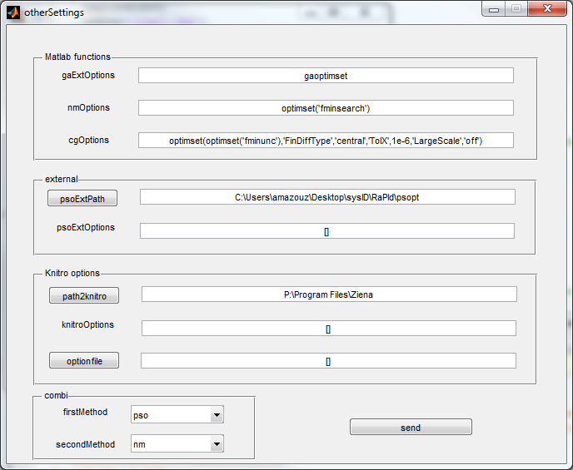
KNITRO
The toolbox asks for a path2knitro in ”other”
You should select the folder ”knitro” that you downloaded
You can give something of the kind optimset(’parameter’,’value’)
Name of a file, that you add yourself to the path or, better, put in the Knitro folder, the kind of file is given in the documentation of KNITRO

Slide 36
Some words on the GUI
A file named data.mat is used to communicate data to the different elements of the gui and finally to the toolbox
data.mat contains :
The struct settings
sol , the output of the toolbox at the last use
Inside the GUI: a gui element (a window) is
Characterised by fields with an initial value and,
Read the file – fill in window: Automatically initialised in the function windowName_OpeningFcn
This function reads the settings struct stored in core\data.mat and copy the values of parameters inside the window’s fields
Read the window – fill in the file: Updated and closed in the call back of a push button (send or next) pushbuttoni_Callback
This does the opposite of an OpeningFcn, it reads the content of the window, save it in the settings struct and saves the struct in core\data.mat

Slide 37
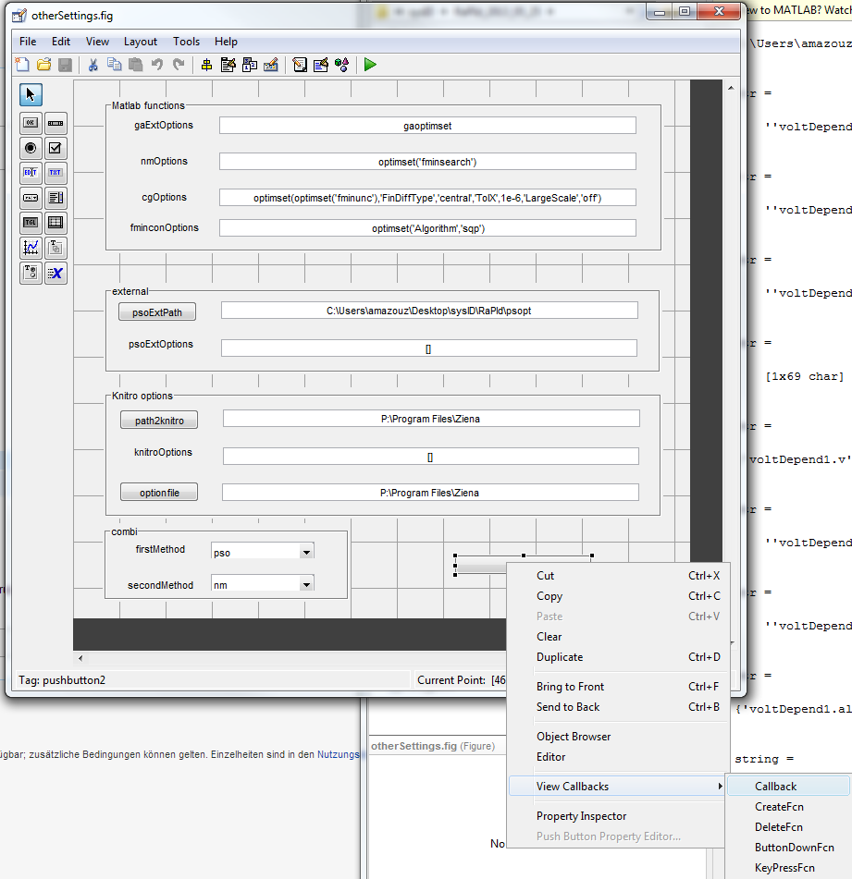
GUI
To summarize, the GUI code operates following the scheme:
At initialisation, the data.mat file is loaded, the settings struct is read and the different fields of the windows are filled with the corresponding values in the struct
Upon press event on the send button, all the fields of the GUI are read and the settings struct is updated with the new values
If you want to study what is done in a particular window, open the fig related to this window inside GUIDE (graphical GUI editor) right click on the element you would like to control and click on the callback, this will open the part of the script launched upon interraction with the investigated element (for a button, when the user presses the button…)

Slide 38
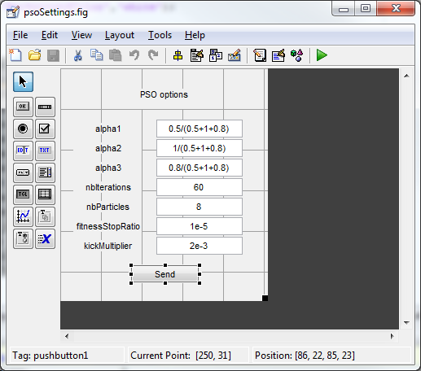
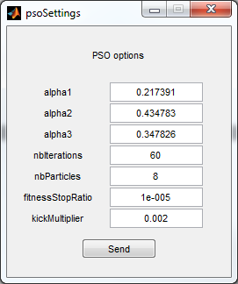
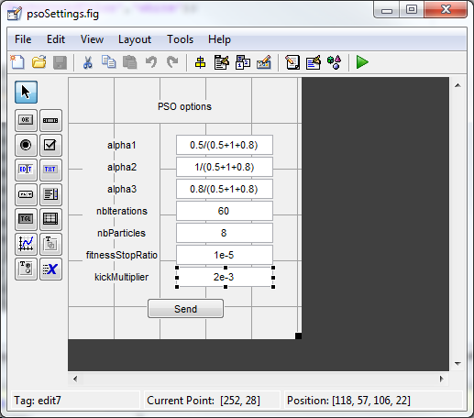
Some words on the GUI
Example:
One of the option windows
Clicking on an element will show you its name
In the GUIDE
Graphical editor

Slide 39
Some words on the GUI
Initialisation:
Each of the text fields is given the value of the corresponding parameter in the settings struct

Slide 40
Some words on the GUI
Update:
This function is called when the button is clicked
The values from the GUI are copied in the settings struct
The data file is loaded
The new data is appended to the loaded struct
The data is saved at the same emplacement

Slide 41
Bug list
If you give to the GUI bad names for the parameters to fetch in the simulink diagram, FMItoolbox will make simulink shut down without notice
Some jpeg files are included in the main window, warnings are displayed in console…
The fmi toolbox sometimes requires the FMU block to be re-initialised. If that’s the case the model won’t simulate even out of the toolbox. When this happens, we usually need to restart matlab.
In the simulink model, if a variable step method is used, set manually a value to simulation>configuration parameters>solve> Max Step Size, otherwise matlab complains a lot in the console

Slide 42
Extra Info for developers and advanced users
Advanced

Slide 43
Adding new functionalities
If a new functionality comes with settings to be parametrised or has to be launched by the user (to display the value of a parameter for example), a new window has to be written.
The files main.fig and main.m have to be edited to call this new window
If any data needs to be stored, be sure to do it in the struct settings in core\data.mat
Here every window looks into the settings struct to set it’s initial values, if you load a different object data.mat, the setting windows will be updated automatically and the next time you run the optimisation the parameters of the new file are used and not some defaults
If you delete or empty data.mat, the interface will be filled with default values, be sure to go through every menus and set good parameters everywhere

Slide 44
Getting Technical
If you want to get technical. Use the /core/ files. Show the scripts:
<open the script run_cmd.m>
in run_cmd, all parameters are declared and given a value. They are all stored in a struct called settings. This struct is provided to the main function of the toolbox rapid.
<open the script core\functions\rapid.m>
this script contains a switch which choses a xxx_algo.m script to run according to the value of settings.methodName

Slide 45
Getting Technical
<open fmincon_algo.m>
in the xxx_algo.m script, we adapt the call to the algorithm function to the toolbox's use. To do that we use the function func.m which yields the fitness of the parameter vector given in input, This is the function of several variables to be minimised in R
<open func.m>
this function calls two of the rapid functions
<show rapid_simuSystem.m>
Sets the values of the parameters that are currently tested by the algorithm, inside the fmu and simulates the system, it takes as an output the result of the simulation

Slide 46
Getting Technical
<show rapid_objectiveFunction>
this result is used for the computation of the objective function.
Before the computation, the simulated output data is interpolated at the time instant of the measured output data using rapid_interpolate.m and then the fitness is computed according to the method chosen through the switch.
Then you show the diagram in the slides to see were is the reccursion.
The files contain quite a bit of comments. Somebody who has a some experience programming should spend a bit of time thinking about it looking at the files.

Slide 47
Options for Generating FMUs
Advanced

Slide 48
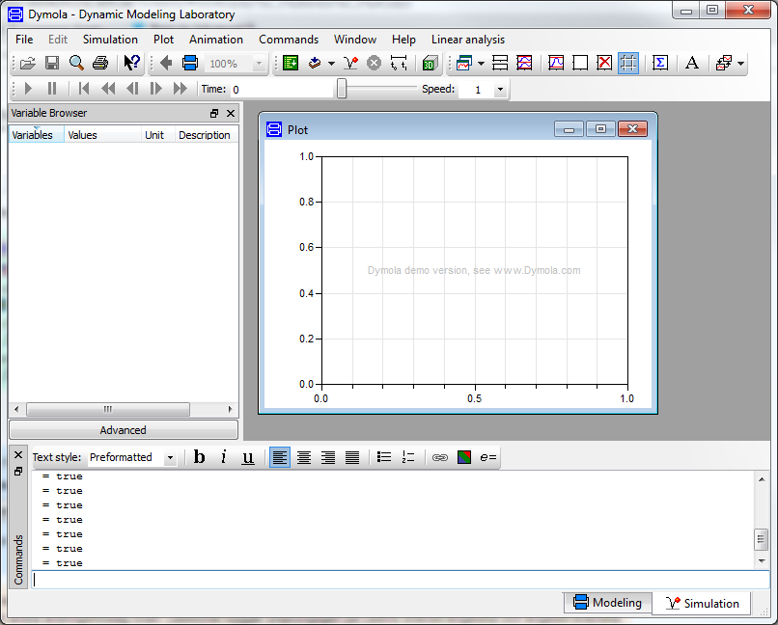
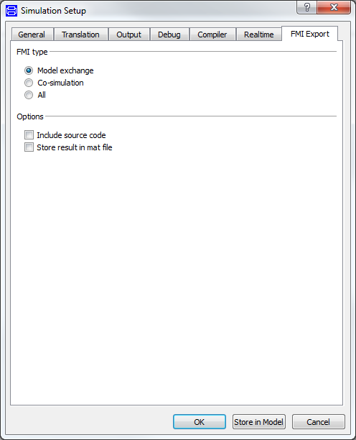
Generate the *fmu from Dymola

Slide 49
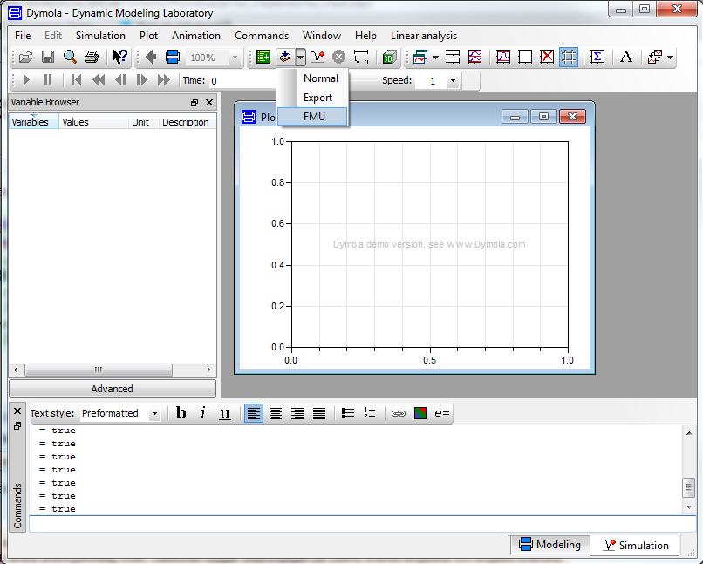
Generate the *fmu from Dymola

Slide 50
Optional – Advanced Generate the FMU from JModelica.org
JModelica.org is an extensible Modelica-based OSS platform, providing facilities for simulation and analysis of Modelica models.
However, it has the following disadvantages for novice users:
It does not provide a user interface
It requires some expertise working with Python scripting
It requires a correct set up of JModelica
It does not support the complete Modelica standard definition ( e.g. reinit commnad used by the DFIG WT is not support -> no FMU can be generated)
We illustrate one example here, carried out with JModelica.org-1.8.1

Slide 51

Optional – Advanced Generate the FMU from JModelica.org
Setting up an environment to compile FMUs with JModelica
Download JModelicaorg-1.8.1: http://www.jmodelica.org/downloads/JModelica.org-1.8.1.exe
Download Python(x,y) – an environment for numerical computations using Python
https://code.google.com/p/pythonxy/
Python will include Spyder, a development environment for the Python language
Open the file C:\JModelica.org-1.8.1\Python.bat with Notepad++ or similar. Make sure you have the following statements:

Slide 52

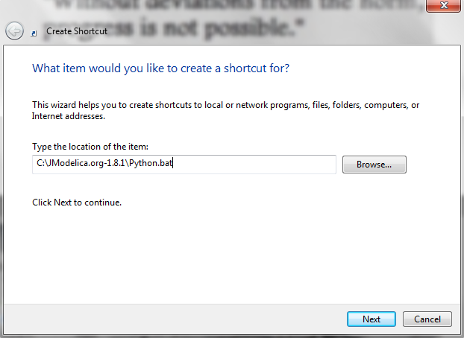
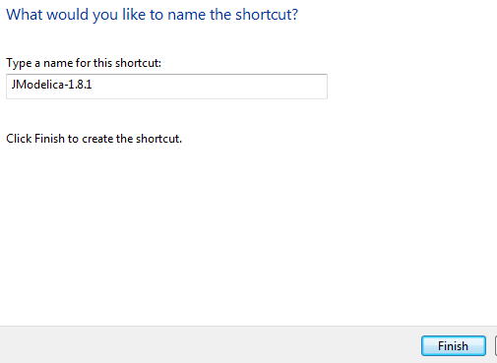
Optional – Advanced Generate the FMU from JModelica.org
Shortcut and automatic loading of JModelica
Create a shortcut icon in your desktop, and point it to the “C:\JModelica.org-1.8.1\Python.bat” file.
Give a name to the shortcut and click on “Finish”
You should get a shortcut to launch Spyder with the Jmodelica libraries loaded and enabled

Slide 53
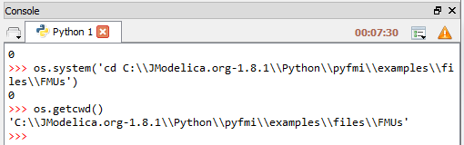
Optional – Advanced Generate the FMU from JModelica.org
Compile FMUs from JModelica
Go to the directory where you have put the Modelica model you whish to compile through the command prompt in Spyder, and check that you are there
The following syntax can now be used to compile your FMU, we use it in the next example:
# Import the compiler function
from pymodelica import compile_fmu
# Specify Modelica model and model file (.mo or .mop)
model_name = 'myPackage.myModel'
mo_file = 'myModelFile.mo'
# Compile the model and save the return argument, which is the file name of the FMU
fmu_file = compile_fmu(model_name, mo_file)

Slide 54
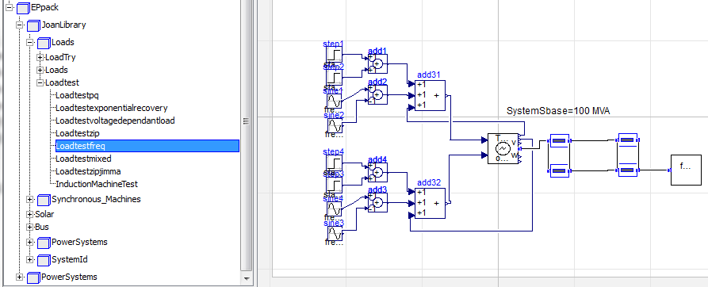
Optional – Advanced Generate the FMU from JModelica.org
Compile FMUs from Jmodelica: locating the model name and the file name.
We will compile a small test system including a third order generator, lines and a frequency dependent load that can be used for load parameter estimation
This model is contained the ‘EPpack.mo’ package, this is the file name.
From the hierarchy illustrated in the figure below, one can obtain the model name: EPpack.JoanLibrary.Loads.Loadtest.Loadtestfreq

Slide 55
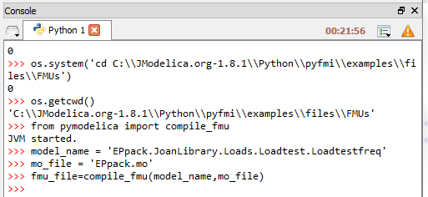
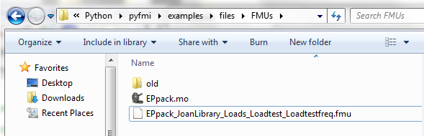
Optional – Advanced Generate the FMU from JModelica.org
Compile FMUs from Jmodelica: Example, part 1 – compiling!
Go to the console of Syper and type the commands as shown in the screenshot
Browse to your FMU folder, you will find the compiled FMU there

