Slide 1


JModelica FMU Compilation A cost free alternative to Dymola without full Modelica Standard Support
Dr.-Ing. Luigi Vanfretti
E-mail: luigiv@kth.se Web: http://www.vanfretti.com
Associate Professor, Docent
Electric Power Systems Dept.
KTH Royal Institute of Technology Stockholm, Sweden
Special Advisor in SPA
R&D Division (FoU) Statnett SF
Oslo Norway
May 2013

Slide 2
Optional – Advanced Generate the FMU from JModelica.org
JModelica.org is an extensible Modelica-based OSS platform, providing facilities for simulation and analysis of Modelica models.
However, it has the following disadvantages for novice users:
It does not provide a user interface
It requires some expertise working with Python scripting
It requires a correct set up of JModelica
It does not support the complete Modelica standard definition ( e.g. reinit commnad used by the DFIG WT is not support -> no FMU can be generated)
We illustrate one example here, carried out with JModelica.org-1.8.1

Slide 3

Optional – Advanced Generate the FMU from JModelica.org
Setting up an environment to compile FMUs with JModelica
Download JModelicaorg-1.8.1: http://www.jmodelica.org/downloads/JModelica.org-1.8.1.exe
Download Python(x,y) – an environment for numerical computations using Python
https://code.google.com/p/pythonxy/
Python will include Spyder, a development environment for the Python language
Open the file C:\JModelica.org-1.8.1\Python.bat with Notepad++ or similar. Make sure you have the following statements:

Slide 4

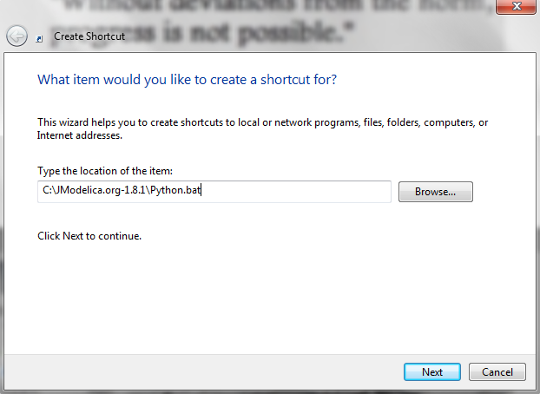
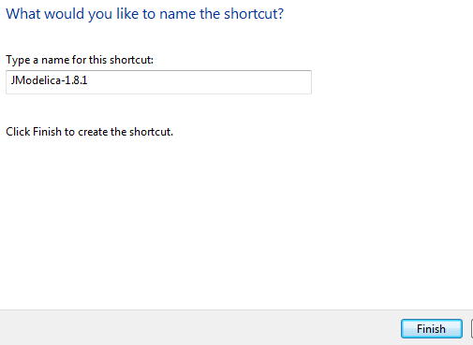
Optional – Advanced Generate the FMU from JModelica.org
Shortcut and automatic loading of JModelica
Create a shortcut icon in your desktop, and point it to the “C:\JModelica.org-1.8.1\Python.bat” file.
Give a name to the shortcut and click on “Finish”
You should get a shortcut to launch Spyder with the Jmodelica libraries loaded and enabled

Slide 5
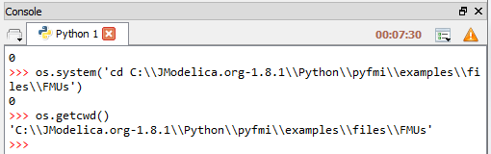
Optional – Advanced Generate the FMU from JModelica.org
Compile FMUs from JModelica
Go to the directory where you have put the Modelica model you whish to compile through the command prompt in Spyder, and check that you are there
The following syntax can now be used to compile your FMU, we use it in the next example:
# Import the compiler function
from pymodelica import compile_fmu
# Specify Modelica model and model file (.mo or .mop)
model_name = 'myPackage.myModel'
mo_file = 'myModelFile.mo'
# Compile the model and save the return argument, which is the file name of the FMU
fmu_file = compile_fmu(model_name, mo_file)

Slide 6
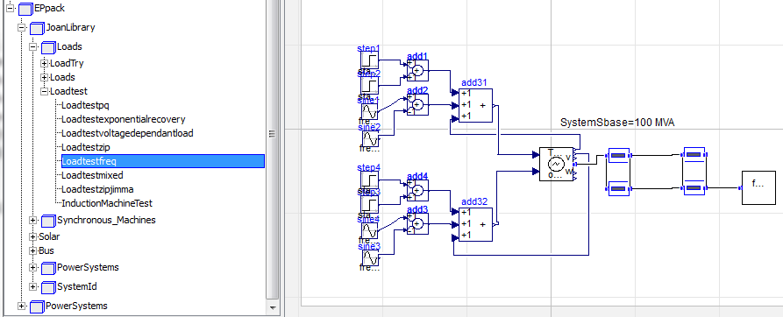
Optional – Advanced Generate the FMU from JModelica.org
Compile FMUs from Jmodelica: locating the model name and the file name.
We will compile a small test system including a third order generator, lines and a frequency dependent load that can be used for load parameter estimation
This model is contained the ‘EPpack.mo’ package, this is the file name.
From the hierarchy illustrated in the figure below, one can obtain the model name: EPpack.JoanLibrary.Loads.Loadtest.Loadtestfreq

Slide 7
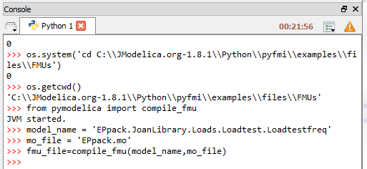
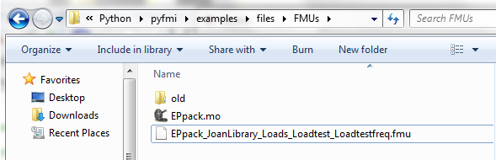
Optional – Advanced Generate the FMU from JModelica.org
Compile FMUs from Jmodelica: Example, part 1 – compiling!
Go to the console of Syper and type the commands as shown in the screenshot
Browse to your FMU folder, you will find the compiled FMU there

Slide 8
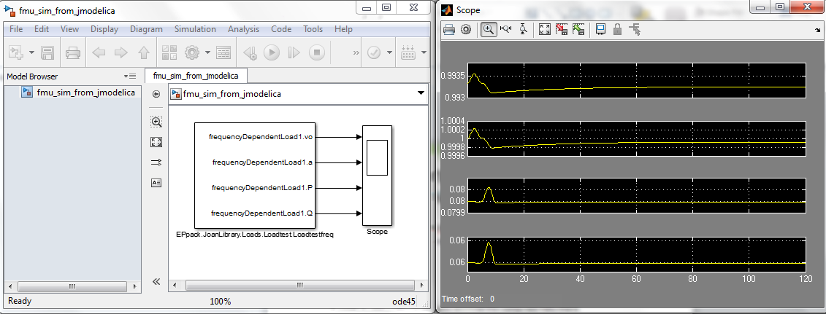
Optional – Advanced Test the FMU with FMI Toolbox 1.5
Create a new Simulink file and load the FMU block for Model Exchange
Load the FMU and select the outputs to display during simulation
Put a scope to display the results
Click on play to see if the FMU is working properly
You might have the situation that the simulation results make no sense. This is not an issue of Matlab/Simulink nor the FMI Toolbox
It is simply due to the fact that JModelica does not support the full definition of the Modelica standard, and thus, its compiler may not be able to give a “correct” FMU (or even it may create an error creating the FMU).

Slide 9
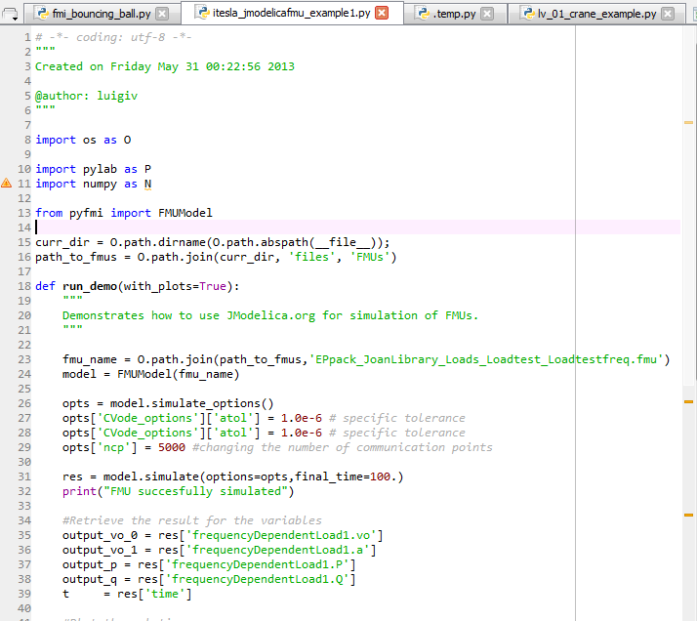
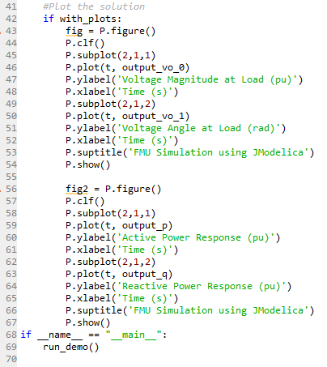
Simulations with JModelica
Here is some Python script to run your FMU:

Slide 10
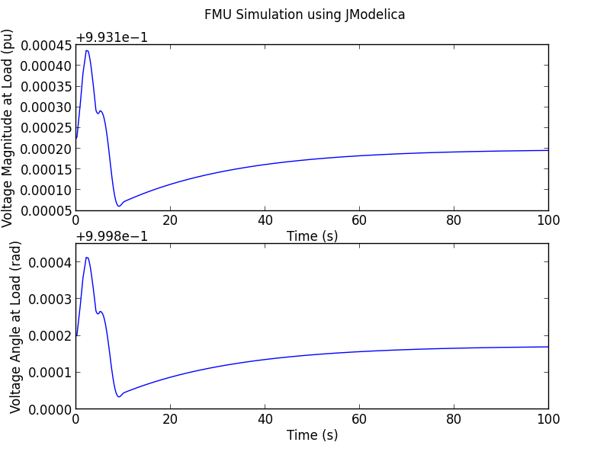
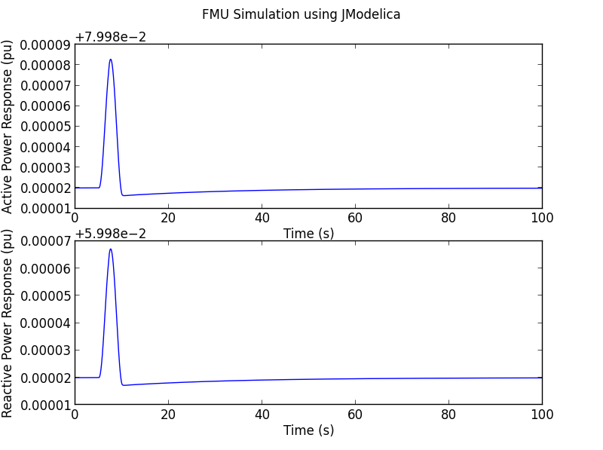
Simulations with JModelica
Here are my results:

