Slide 1
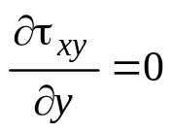
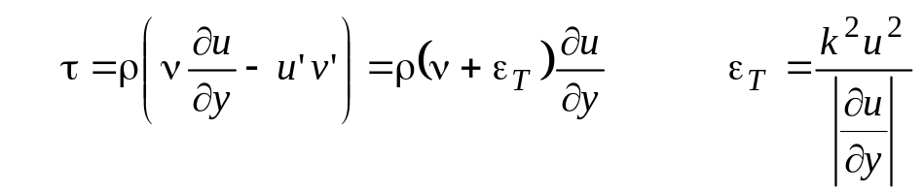
  Homework
( 100 points )
Consider two-dimensional, fully developed, steady incompressible flow (in time-averaged sense)
A Newtonian fluid in a channel of constant height. There is no applied pressure gradient. The upper
surface slides with velocity U, and the lower surface at y=0 is stationary.
Show that the turbulent, time-average continuity and momentum equations,
reduce to
b) If the eddy turbulent kinematic viscosity can be approximated by following algebraic model
where k is a dimensionless constant and y is the distance from the wall,
write the differential governing equation and solve for data given.
What type of equation is obtained ?

Slide 2
  Homework
Given:
Water density 1000 kg/m^3,
viscosity 0.001 Pa-s,
upper plate velocity 10 m/s,
Channel Height, H 1 cm,
empirical constant, k = 0.01,
a) Calculate the shear stress on the wall.
b) Calculate Reynolds No.
c) Plot velocity profile for both turbulent and hypothetical laminar case.
d) Calculate the ratio of shear stress between turbulent and laminar case.

Slide 3
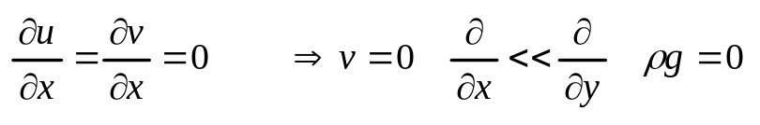
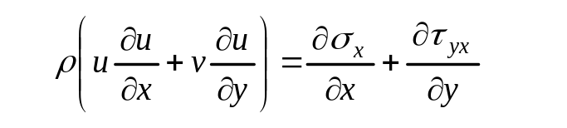
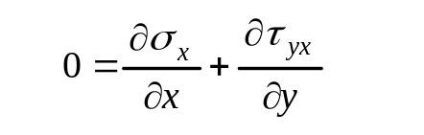
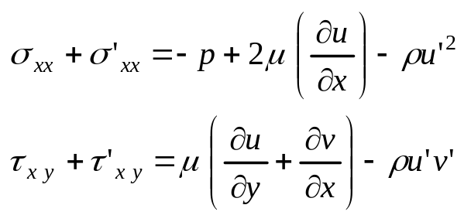
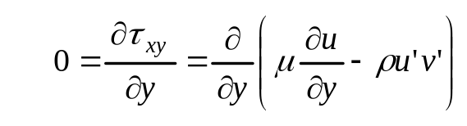
  Approach
Fully developed flow
BL momentum equation
Particularization of
BL momentum Equation
Fully Developed

Slide 4
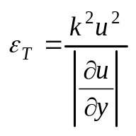
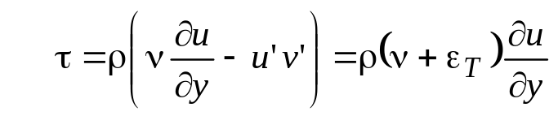
  Approach
Introducing eddy viscosity model
as an algebraic scale model
Given:
Water density 1000 kg/m^3,
viscosity 0.001 Pa-s,
upper plate velocity 10 m/s,
Channel Height, H 1 cm,
empirical constant, k = 0.01,
a) Calculate the shear stress on the wall.
b) Calculate Reynolds No.
c) Plot velocity profile for both turbulent and hypothetical laminar case.
d) Calculate the ratio of shear stress between turbulent and laminar case.
Data

Slide 5
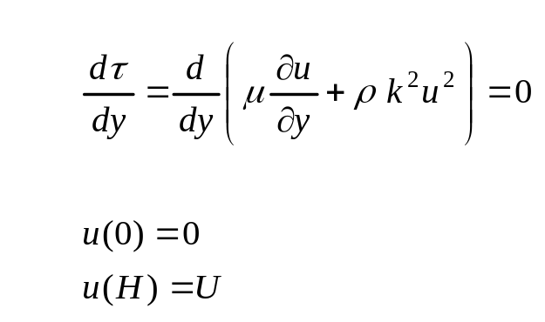


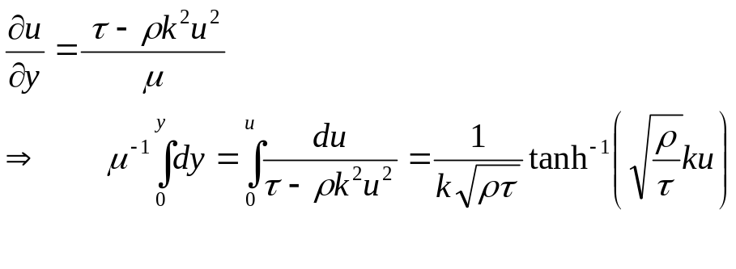
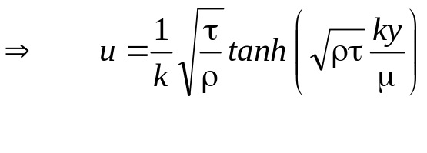
  Approach
Write governing equation and BCs. What type of equation is it ?
Separate
variables
By direct
integration
Ordinary,
2nd order,
homogeneous DE
BCs
Fig. HW1
Solution:

Slide 6
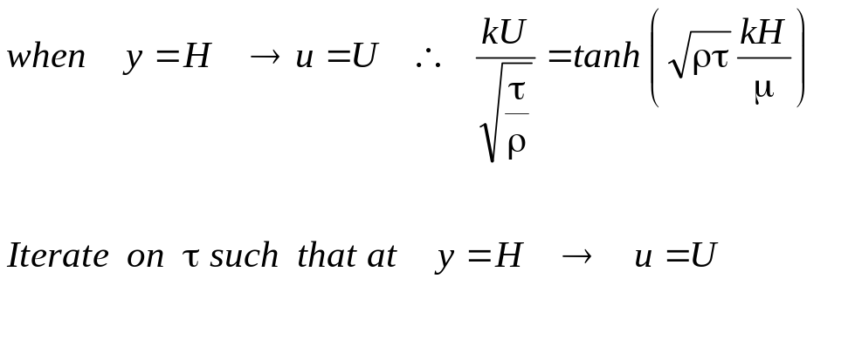
  Approach
Free-stream interface BC needs to be satisfied to yield the turbulent shear stress
a) Calculate the shear stress on the wall.
b) Calculate Reynolds No.
c) Plot velocity profile for both turbulent and hypothetical laminar case.
d) Calculate the ratio of shear stress between turbulent and laminar case.

Slide 7
  Approach
Table 1
a)
rho (kg/m^3) | H(m) | U (m/s) | mu (N-s/m^2) | Tau (N/m^2) Turbulent (iterated) | k (empirical constant)
1000 | 0.01 | 10 | 0.001 | 10 | 0.01
 |  | Re |  | Tau (N/m^2) Laminar Profile
 |  | 100000 |  | 1
sqrt(rho*Tau)*k*H/mu |  | tanh[(sqrt(rho*Tau)*k*H/mu)]
10 |  | 1.00 | <--- @y/H=1
y/H | y | y*=[sqrt(rho*Tau)*k*H/mu]*(y/H) | tanh(y*) | u_turbulent | u_laminar
0.000 | 0.0000 | 0.00 | 0.000 | 0.0000 | 0.000
0.050 | 0.0005 | 0.50 | 0.462 | 4.6212 | 0.050
0.100 | 0.0010 | 1.00 | 0.762 | 7.6159 | 0.100
0.150 | 0.0015 | 1.50 | 0.905 | 9.0515 | 0.150
0.200 | 0.0020 | 2.00 | 0.964 | 9.6403 | 0.200
0.250 | 0.0025 | 2.50 | 0.987 | 9.8661 | 0.250
0.300 | 0.0030 | 3.00 | 0.995 | 9.9505 | 0.300
0.350 | 0.0035 | 3.50 | 0.998 | 9.9818 | 0.350
0.400 | 0.0040 | 4.00 | 0.999 | 9.9933 | 0.400
0.450 | 0.0045 | 4.50 | 1.000 | 9.9975 | 0.450
0.500 | 0.0050 | 5.00 | 1.000 | 9.9991 | 0.500
0.550 | 0.0055 | 5.50 | 1.000 | 9.9997 | 0.550
0.600 | 0.0060 | 6.00 | 1.000 | 9.9999 | 0.600
0.650 | 0.0065 | 6.50 | 1.000 | 10.0000 | 0.650
0.700 | 0.0070 | 7.00 | 1.000 | 10.0000 | 0.700
0.750 | 0.0075 | 7.50 | 1.000 | 10.0000 | 0.750
0.800 | 0.0080 | 8.00 | 1.000 | 10.0000 | 0.800
0.850 | 0.0085 | 8.50 | 1.000 | 10.0000 | 0.850
0.900 | 0.0090 | 9.00 | 1.000 | 10.0000 | 0.900
0.950 | 0.0095 | 9.50 | 1.000 | 10.0000 | 0.950
1.000 | 0.0100 | 10.00 | 1.000 | 10.0000 | 1.000
b)
c)

Slide 8
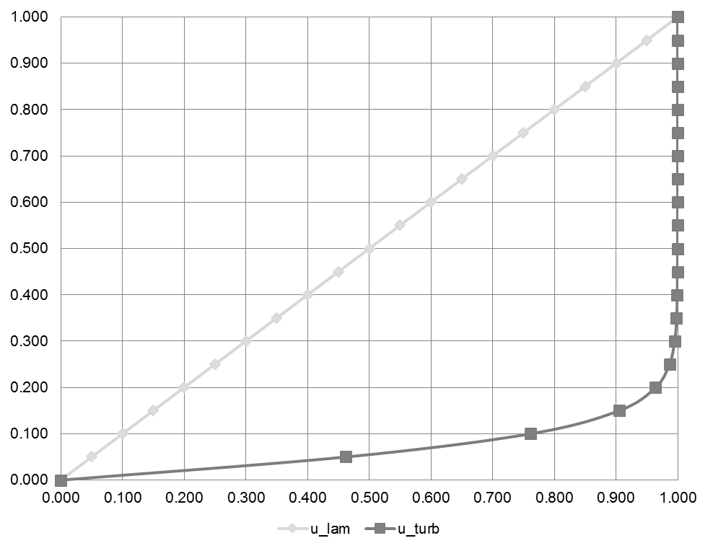


  Approach
c)
Linear ~ Laminar
Non-linear ~ Turbulent
Fig. HW2
d)
At the wall, the turbulent shear stress = 10X laminar shear stress

