Slide 1
Real-time Simulation and CHiL Testing of Power System Stabilizers on Microcontrollers with Modelica and eFMI
Luigi Vanfretti¹ Christoff Bürger² Joseph Pizzimenti¹ Kyle Wilt¹ Hao Chang¹
  ¹ Electrical, Computer and Systems Engineering Dept., Rensselaer Polytechnic Institute, USA
  ² Dassault Systèmes AB, Lund, Sweden
American Modelica & FMI Conference 2026
  Georgia Tech, Atlanta · 12–14 October 2026
Luigi Vanfretti
  Professor, ECSE, Rensselaer Polytechnic Institute
  vanfrl@rpi.edu
  alsetlab.com
  github.com/ALSETLab/efmi-pss-use-case
Notes:
00:00 — 0:20
• Good morning. This talk is about closing the gap between where a damping controller is designed and where it actually runs.
• Joint work with Christoff Bürger at Dassault Systèmes and three students at RPI.

Slide 2
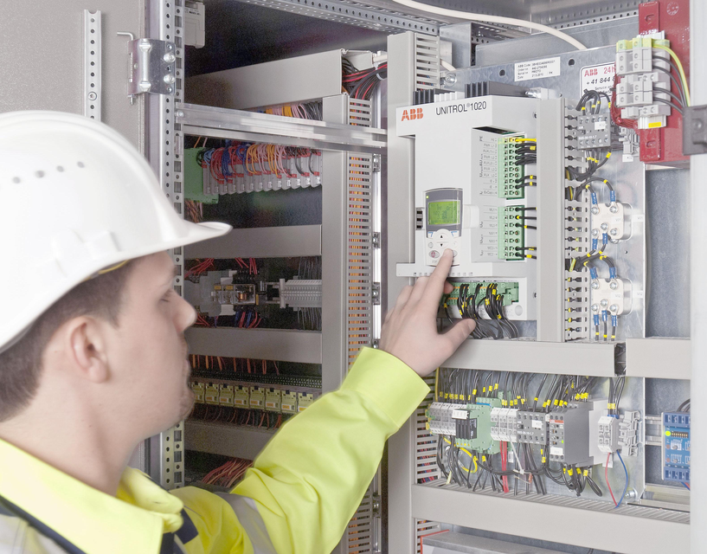
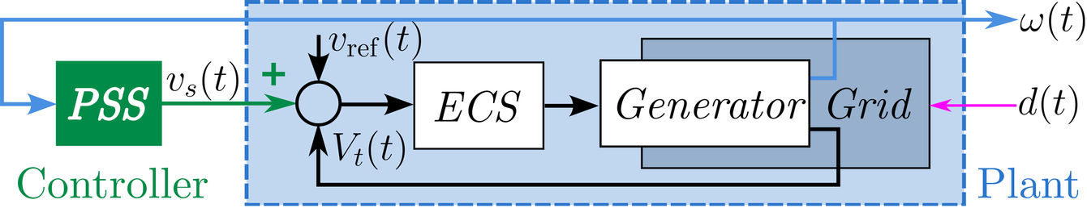
The problem: Why damping control must be redesignable?
Grid incidents keep coming back to damping
  ENTSO-E 2016 and 2017 — inter-area oscillations across the European system.
  Iberian grid, April 2025 — complex 0.63 Hz and 0.2 Hz oscillations. The report blames poor coordination and the absence of detailed models of active damping controls, including existing PSS, for limiting operators' ability to foresee and contain it.
The controller is fixed; the grid is not
  A PSS has a fixed structure — a washout, two lead-lag stages, a gain and a limiter. Only its parameters are designed.
  Those parameters are set once, in offline design studies before commissioning, and rarely revisited.
⇒ Damping controllers must be redesigned and redeployed throughout their operational life.
ABB Unitrol 1020 Excitation Control System (ECS)
PSS included as part of the ECS firmware.
Vocabulary for the rest of the talk
  controller — the PSS alone
  generator unit — the generator and its excitation control system (ECS), with or without a PSS
  plant — the generator, the ECS and the rest of the grid, w/o the PSS
  d(t) — grid disturbances: faults, line trips
Generator with a PSS ahead of the ECS, interconnected with a grid
Notes:
00:20 — 1:05
• The PSS sits ahead of the excitation control system and feeds generator speed back to add damping. Bottom left is the arrangement; the box on the right is where it actually lives — inside the exciter's firmware, a vendor product.
• Europe 2016 and 2017: inter-area oscillations. Iberia 2025: 0.63 and 0.2 Hz. The incident report is explicit that the *absence of detailed models of active damping controls* limited what operators could foresee.
• The structure of a PSS is fixed; its parameters are not — and they are set once, at commissioning.

Slide 3
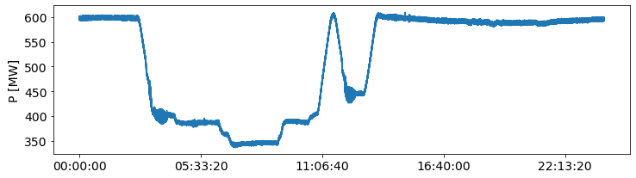
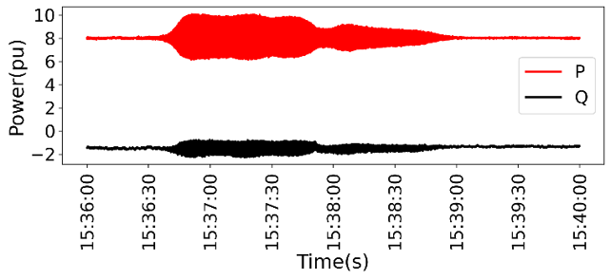
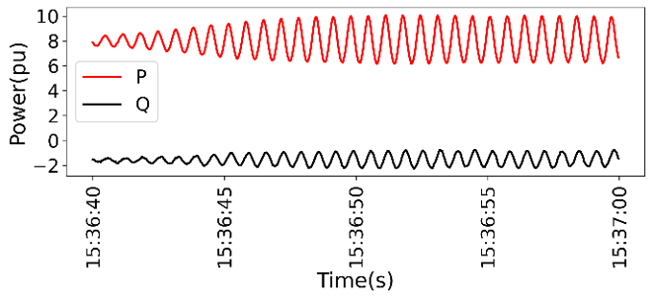
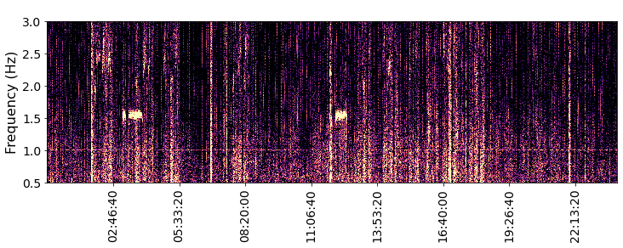
The Evidence: Local oscillations — Need for new PSS and Re-design
Change of operating conditions
~1.58 Hz oscillation
PMU measurements of P and Q from the plant:
entire test window
Zoom — the limit cycle in both P and Q
Control design tested at several power points;
the mode is excited at low power dispatch
  A change of voltage set-point moved the excitation system and AVR dynamics into the leading power-factor region.
  Visible in both P and Q — P participates through the P–V coupling of the synchronous machine.
  A limit cycle, not a divergence — the over-excitation limiter bounds it; the ≈1.58 Hz mode is excited only in the low-P conditions where the design fails.
The PSS was not tuned for light load in the leading-p.f. region.
New controller functions will require to update the parameters with changes in operating conditions.
C. Mishra, L. Vanfretti, M. Baldwin, J. Delaree Jr. and K. D. Jones, “Analysis of Generator Forced Oscillations During MOD 25 Testing Exploiting Wavelets,” HICSS-57, 2024, doi:10.24251/HICSS.2024.364.
Notes:
01:05 — 1:50
• This is our own measurement, from a Dominion plant during MOD-25 testing.
• A change of voltage set-point pushed the excitation system into leading power factor.
• P and Q both oscillate — P participates through the P–V coupling of the synchronous machine.
• It does not grow without bound: the over-excitation limiter turns it into a limit cycle.
• The plant model was correct. The PSS was simply not tuned for light load in the leading-p.f. region. That is the whole argument for this talk.

Slide 4
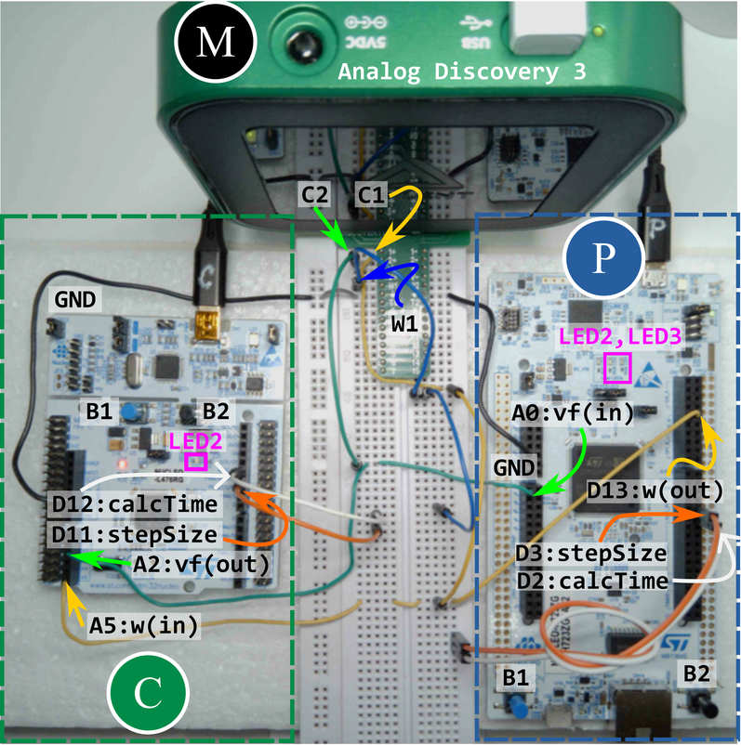
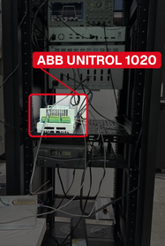
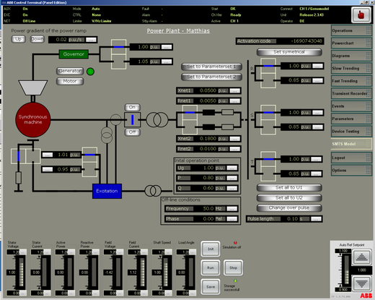
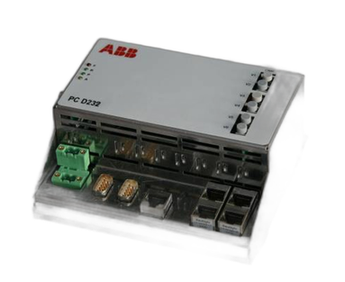
The gap: from control design to CHiL testing
What it takes today
  Offline tools cannot cross over — power system models are monolithic off-line simulators, PSS®E and PSCAD®, models are not usable for real-time simulation.
  Manual re-implementation breaks traceability — the deployed code stops matching the physics model.
  Control code is hardware-bespoke — PSS implementations are written against embedded hardware specific platforms.
  Real-time simulation platforms are expensive:
    Require real-time capable plant models, costly to develop.
    General Purpose: dSPACE®, Typhoon HIL®, OPAL-RT®: typically, ≫ $50,000, plus license stack, requiring to re-built plant model.
    Vendor Specific Platform: single purpose RTS (plant cannot be modified), ABB SMTS-RT 6000, limited to specific vendor controllers.
What we do instead
  One acausal Modelica model is the single source of truth — for both controller and plant
  eFMI generates the code — GALEC, then production C that is MISRA C:2023 and SEI CERT C compliant.
  Validated at every level — MiL → SiL → CHiL.
  Deployed on < $50 STM32 boards — controller and real-time plant
Two NUCLEO boards replace the real-time platform:
(left, C) one runs the controller, (right, P) one runs the plant
(top, M) oscilloscope and signal generator for data acquisition and signal injection
Own bench: ABB UNITROL 1020 interfaced with Typhoon HIL®
ABB’s Synchronous Machine Transient Simulator
SMTS-RT 6000
One source of truth with Modelica · traceability by design with eFMI · ≫ $50,000 platform → < $50 microcontroller
Notes:
01:50 — 2:35
• Say what the photo is: our own bench, and the boxed unit is a commercial excitation controller with its PSS.
• Today, getting a redesigned PSS onto hardware means re-implementing it by hand in somebody else's tool, against somebody else's fixed block structure.
• And to test it you need a real-time plant model, which is where the $50,000 goes.
• Our claim: one physics model, generated all the way down, on $50 of hardware.

Slide 5
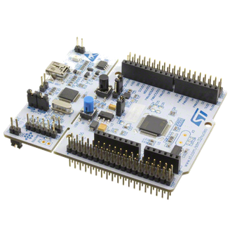




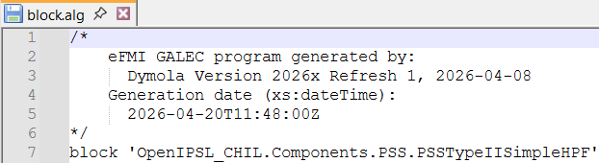
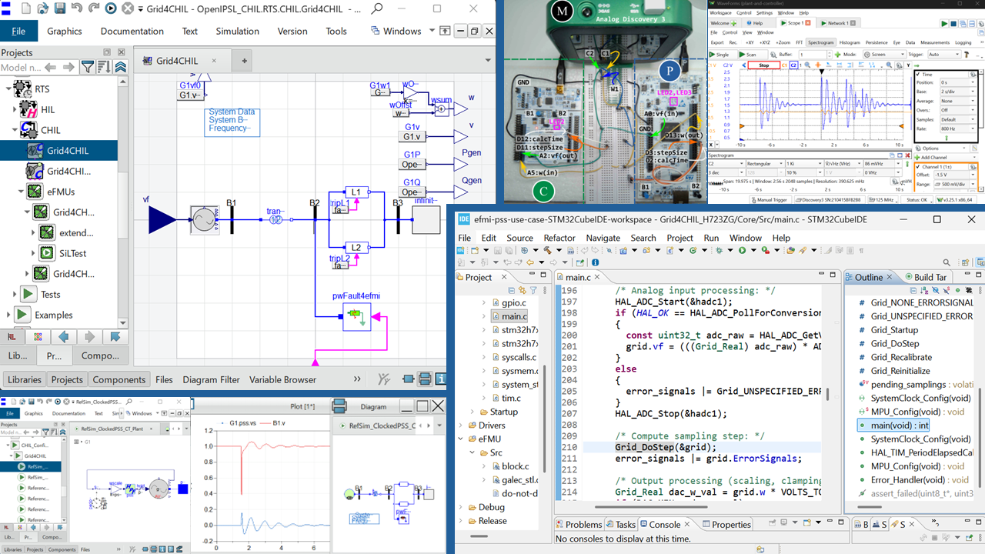
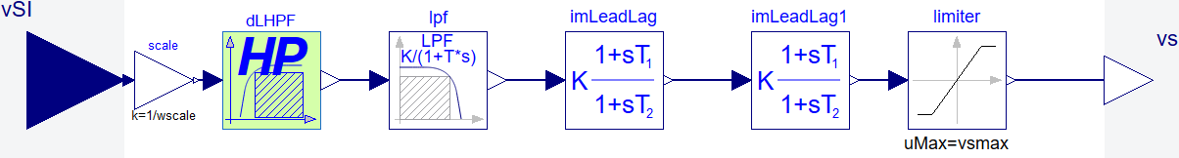
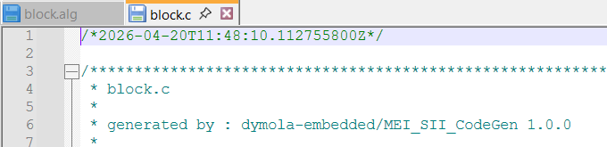
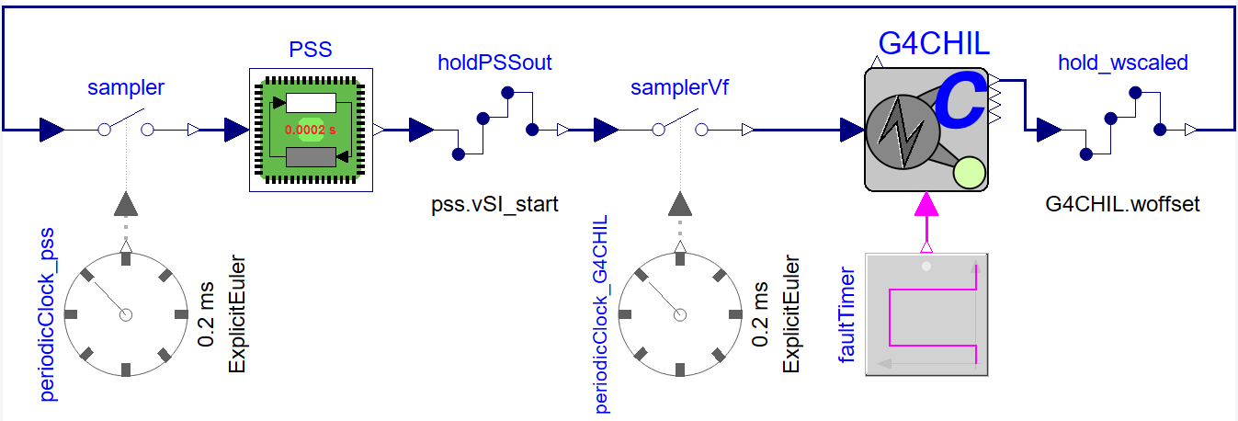
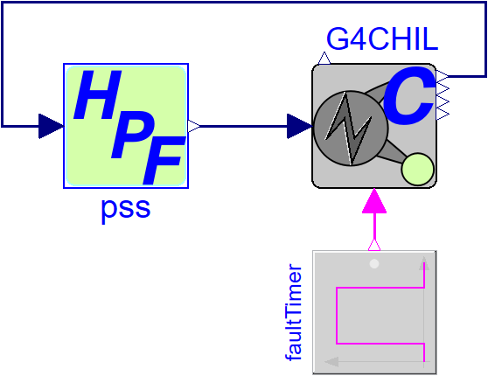
Our approach: one source of truth, generated down
Modelica® model
acausal physics · controller + plant
eFMI® eFMU
GALEC → production C
MISRA C:2023 · SEI CERT C
STM32 microcontrollers
NUCLEO-L476RG + H723ZG
0.2 ms · 5 kHz
MiL
model-in-the-loop
SiL
software-in-the-loop
CHiL
controller-hardware-in-the-loop
  Physics-based Modelica is the single source of truth — controller and plant.
  eFMI generates production-ready, safety-critical C from that same model.
  Validate at every abstraction level — MiL → SiL → CHiL.
Notes:
02:35 — 3:20
• Read the chain left to right: physics model, eFMU, microcontroller.
• The important word is *generated*. Nothing in the chain is re-typed.
• The second row is the validation ladder; each rung is checked before the next.
• Note that the plant goes on a microcontroller too — that is the unusual part.

Slide 6

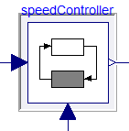

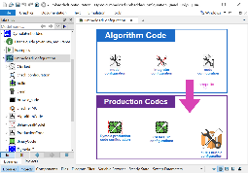



eFMI® in one slide
Algorithm Code(GALEC)
  GALEC — guarded algorithmic language for embedded control
  Standardized block interface and life-cycle
  High abstraction level (multi-dimensional arithmetic, rich set of built-in functions, e.g. interpolation 1-2-3D, solve linear equations, etc.)
  Guaranteed termination and maximum memory consumption, safe indexing
  Strict error handling (within normal control-flow, no exceptions)
  Self contained – no foreign function interface
  Requires solver to be inline-integrated
eFMU Manifest
model
Behavioral
Model*
Algorithm
Code
Dymola
Production
Code*
✔
✔
✖
Binary
Code*
Production Code – Dymola’s Features
  C17, generated from GALEC
  Compliant with MISRA C:2023, SEI CERT C
  32- and 64-Bit floating-point precision
  No use of external libraries, only C Standard Library (mainly math.h)
Dymola
  An eFMU is an open workspace container, not a sealed artefact — it stays in development alongside the model.
  GALEC is the pivot — simulation tools target it; embedded code generators consume it, and benefit from its guarantees.
Every container links back to the same standardised block interface!
Traceability is structural, not documentary!
More details: https://www.efmi-standard.org/
Behavioral Model
  Manifest file with test scenarios, units, tolerances
  Variable or equidistant time grids
  Reference trajectories in CSV (described in manifest)
Notes:
03:20 — 4:05
• eFMI is a Modelica Association standard for stepwise, model-transformation-based development of control functions for safety-critical real-time targets.
• Four container types, one eFMU. GALEC is the pivot: computationally safe, self-contained, no foreign function interface.
• The point for this audience: every container links back to one standardised block interface. That is what makes traceability structural rather than documentary.
Guaranteed algorithmic real time execution
Error handling: can’t ignore errors, you must signal them or do something (error handling) → as part of normal control-flow

Slide 7
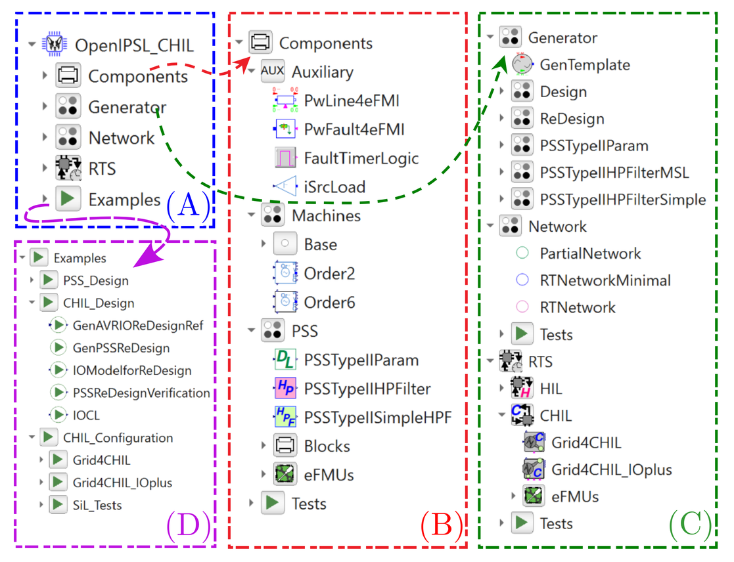
OpenIPSL_CHIL: OpenIPSL for embedded real-time
OpenIPSL 3.1.0 — the starting point
  Open-source Modelica library for phasor-domain transient (RMS) power system simulation.
  Transmission, distribution with unbalanced three-phase, and mixed EMT / TS modelling.
OpenIPSL_CHIL — what this paper adds
  Extensions of OpenIPSL for embedded real-time applications.
  (B) Components — PSS variants, specialised blocks, and the OpenIPSL machine, line and fault models that needed modification for eFMU export.
  (C)Generator / Network — generator-unit and grid variants per design stage: continuous, redesign, embedded.
  (C) RTS — plant models for HiL and CHiL targets, with their eFMU configurations.
  (D) Examples — whole-system closed-loop MiL and SiL experiments.
Every sub-package ships its eFMU generation configuration (when appropriate) and unit tests.
OpenIPSL_CHIL library overview
Notes:
04:05 — 4:50
• OpenIPSL 3.1.0 is our open-source phasor-domain power system library.
• OpenIPSL_CHIL is new with this paper: the extensions needed to take those models into the embedded domain.
• Every sub-package ships its own eFMU generation configuration and unit tests, so the whole thing is reproducible from the repository.

Slide 8
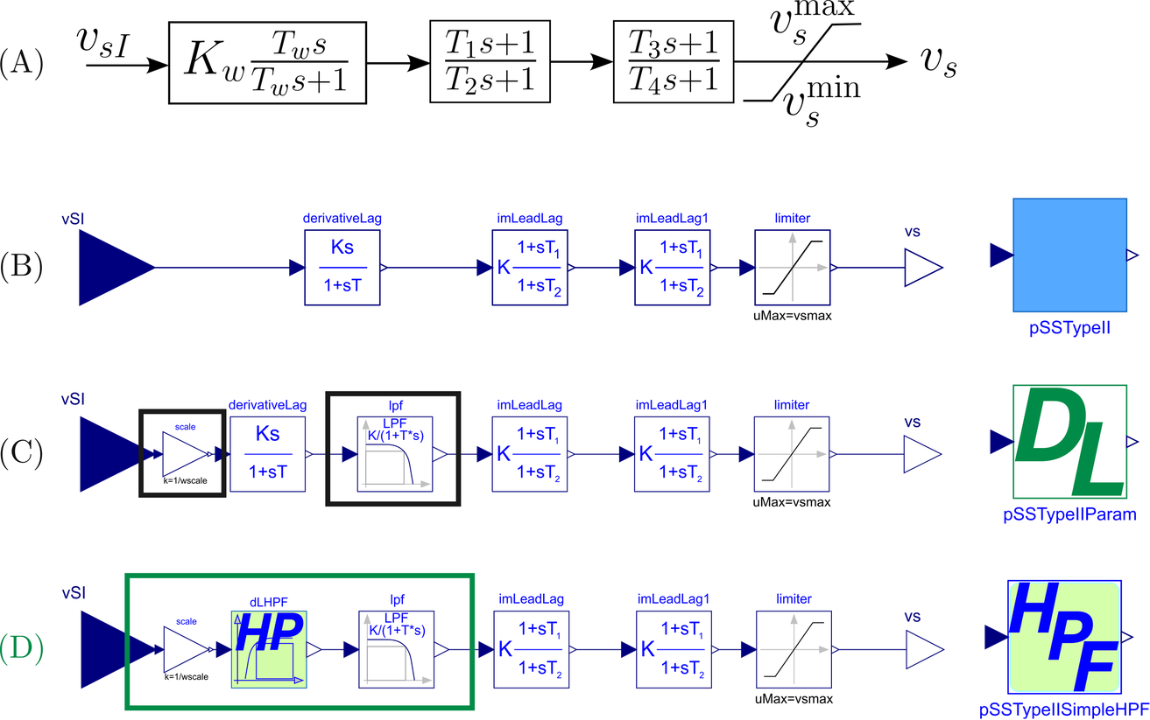
Re-factoring the controller for eFMI Export: need → µ-controller
From textbook block to deployable model
  (A) is the textbook PSAT Type II, equivalently PSS®E STAB1
  (B) PSAT Type II / PSS®E STAB1: gain, washout, two lead-lag stages, limiter. Implemented in OpenIPSL as PSSTypeII.
  (C) Input-dependent initialization:
    vSI_start as a tunable parameter;
    Scaling: ×10 input scaling to use the DAC range;
    LPF: a 5 Hz low-pass against analog noise.
  (D) washout → HighPassSimple — implements a first-order Butterworth high-pass to replace the “washout” (derivativeLag) block
    one state, one differential equation,
    one algebraic output, same
    Benefits:
      same parametrisation,
      no differentiation!
⇒ Every change is at the model-level: MiL test can show the effects of every change.
⇒ The generated code is never edited.
block HighPassSimple
parameter Real K = Kw*Tw;
parameter Real T = Tw;
equation
der(x) = (u - x)/T;
y = K/T*(u - x);
end HighPassSimple;
PSS variants: (A) generic block, (B) OpenIPSL, (C) modified for eFMI export,
(D) final variant with the simplified high-pass filter
Notes:
04:50 — 5:35
• Four variants, left to right in the figure.
• (A) is the textbook PSAT Type II, equivalently PSS®E STAB1. (B) is the OpenIPSL implementation.
• (C) adds what the hardware forces on us: input-dependent initialisation, the ×10 scaling to use the DAC range, and a 5 Hz low-pass against analog noise.
• (D) swaps the washout for a plain first-order high-pass. Same frequency response as an ideal derivative, one state, no differentiation.
• Emphasise: all four changes are *model-level*. We never touched generated code.

Slide 9
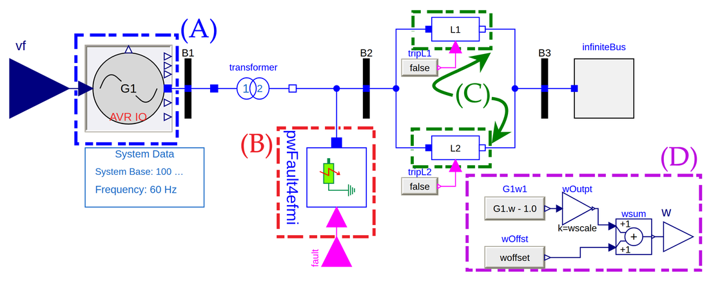
Re-factoring the Plant for eFMI Export: need → RT Simulator
Three changes for GALEC code generation:
  (A) generator unit: atan3 → atan2 in baseMachine
    GALEC has no atan3;
    Mathematically equivalent since the phase angle φ is always 0 in OpenIPSL.
  (B)/(C) fault and line-openings: used to disturb the network and assess the controller’s performance.
  Why this needs modifications?
  No global clock exists in CHiL, and fault to be triggered by user
  Solution: implicit time-based switching → explicit Boolean inputs
  (D) signal conditioning:
    STM32 boards equipped with 12-Bit, 0–3.3 V DAC
    We need to:
    remove the 1.0 pu offset,
    scale by wscale = 10,
    re-offset to 1.0.
    Speed deviations rarely exceed the third decimal — unscaled,
    →the signal would sit on the quantization floor.
The plant model: generator with ECS interconnected with a power grid — *.RTS.CHIL.Grid4CHIL
Signal conditioning (D) — making the deviation visible to a 12-Bit DAC
G1.w
1.0 pu nominal
− 1.0
offset removal
× 10
wscale
+ 1.0
DAC centring
Notes:
05:35 — 6:20
• The plant is the generator with its excitation control system plus the rest of the grid — everything except the PSS.
• Three changes were needed for GALEC. atan3 does not exist in GALEC; since the phase angle is always zero in OpenIPSL, atan2 is mathematically identical.
• The time-based fault and line switches had to go: there is no global clock in CHiL, and we want the fault triggered by a button.
• The signal conditioning is the part people underestimate: without it the speed deviation sits on the quantisation floor.

Slide 10
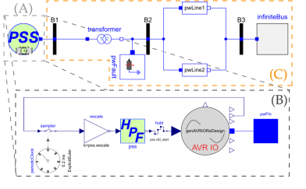
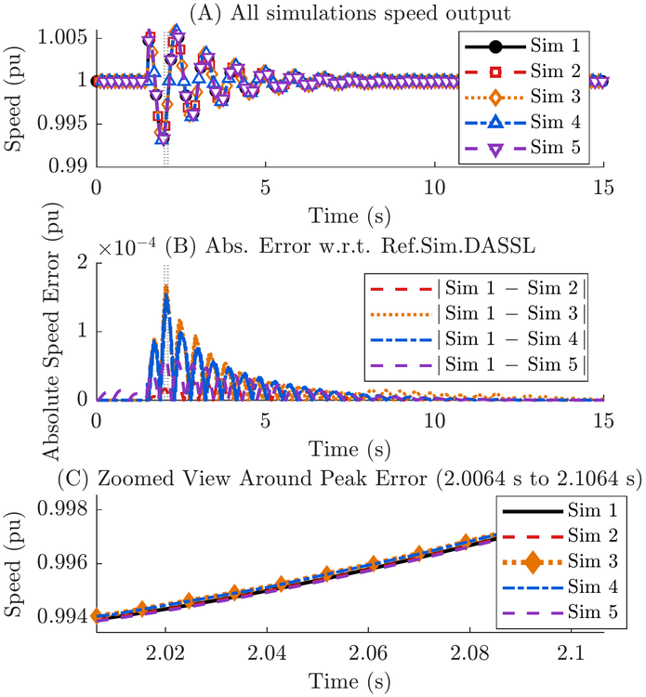
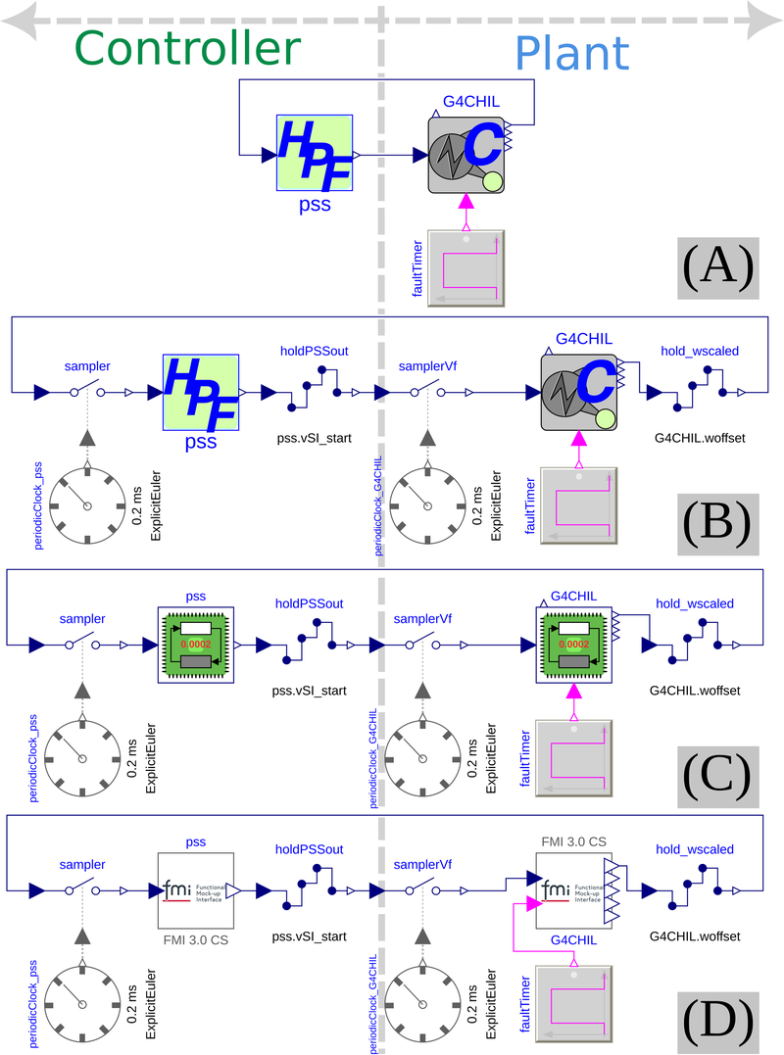
MiL: five variants, one answer – understanding re-factoring impact
Models:
Reference (Ref.) Model: represents the deployment of the digital control in a “real-world” power plant
CHiL-Models: representation of the experimental controller-hardware-in-the-loop setup we will build with HW → continuous and clocked representation (both controller and plant)
Five cases, same experiment
Sim 1: Ref. with DASSL, Interval = 0.0002
Sim 2: Ref. with Exp. Euler, 0.2 ms fixed step
Sim 3: CHiL (A) with DASSL, Interval = 0.0002
Sim 4: CHiL (A) with Exp. Euler, 0.2 ms fixed step
Sim 5: CHiL (B) clocked representation, with DASSL, Interval = 0.0002
Explicit-Euler baseline penalty alone: max 3.02 × 10⁻⁵ pu, RMS 9.23 × 10⁻⁶ pu (in other words: noise is >>)
Reference Model (Sim1)
(A) Generator in power grid
(B) Inside the generator unit, showing the PSS
(C) Reminder of the grid
CHiL Models used for
Simulations 2-5
(A) Continuous time representation
(B) Clocked Representation
MiL simulations: all cases vs the DASSL reference
  Visually indistinguishable (RHS Fig) — the five cases overlay in panel (A); the errors are in (B) and (C).
  Peaks in recovery, not in the fault — the worst error occurs near t ≈ 2.06 s, during post-fault recovery, which confirms the numerical stability of the eFMI-targeted variants.
  RMS an order of magnitude below the maxima — these are brief numerical transients, not a systematic bias.
1.69 × 10⁻⁴ pu
worst-case deviation, all variants
8 × 10⁻⁴ pu
12-Bit DAC quantisation floor
4.7 ×
margin — the refactoring is invisible to the hardware
Notes:
06:20 — 7:05
• Five simulation cases, from the textbook reference model through to the clocked CHiL representation.
• Panel (A): the traces are visually indistinguishable. Panel (B) and (C): the errors.
• The number that matters is on the bottom. The worst deviation introduced by every refactoring we did for eFMI is well under the hardware's own quantisation step.
• So the structural changes cost nothing the hardware can see.

Slide 11
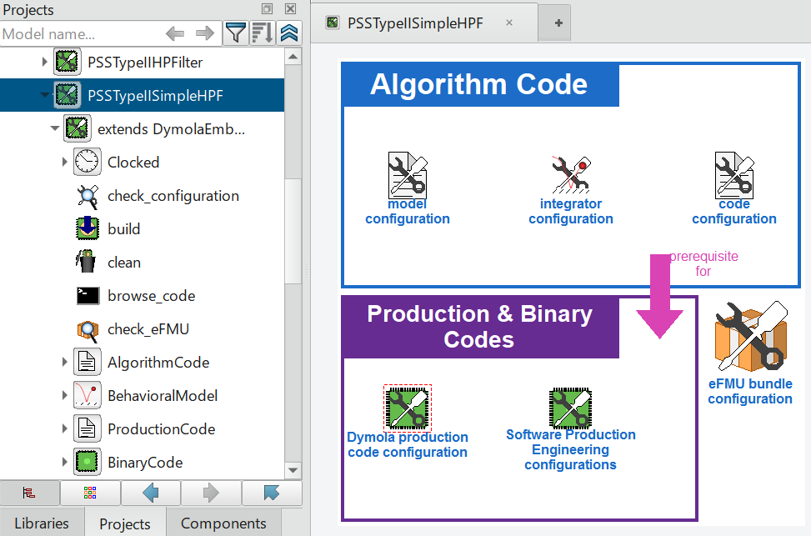
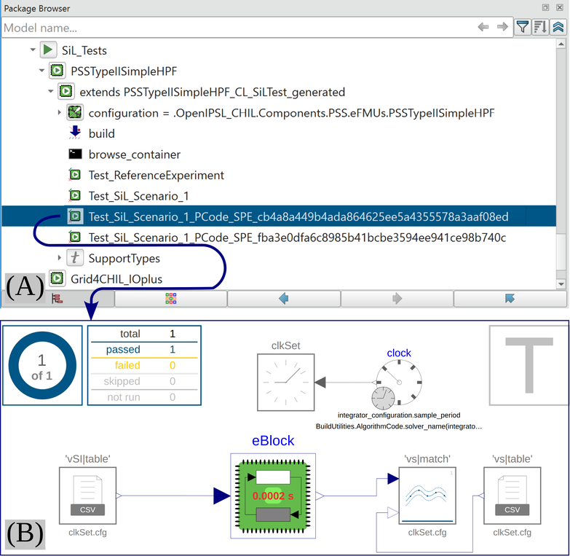
eFMU generation and SiL testing using Dymola
Configuration is just a Modelica package
  DymolaEmbedded.EmbeddedConfiguration:
    Model Configuration: define the model subject to eFMU export
    Integrator Configuration: define fixed sampling period (mandatory), and optional solver method for inline integration.
    Available solvers: Explicit Euler (mature), implicit Euler and Ronsenbrock (under dev).
    Code Configuration: optional options to obfuscate GALEC code, keep multi-dimensional entries intact, etc.
    Software Production Engineering Configurations: define the
    floating-point precision (fpp), target architectures.
  Fully scriptable automation fuctions in *.mos: build(), check_codes(), build_tests().
SiL Experiment Packages
  Derived from the MiL experiments.
  No new test authoring — reference trajectories come from the existing MiL experiment; tolerances are the only user input
  Deviations:
    Controller ≈3.65 × 10⁻⁴ (32-Bit fpp) / ≈1.39 × 10⁻¹⁶ (64-Bit fpp)
    Plant ≈1.61 × 10⁻⁴ (32-Bit fpp) / ≈1.78 × 10⁻¹⁴ (64-Bit fpp)
32-Bit fpp goes on the hardware: the NUCLEO-L476RG (controller) accelerates only 32-Bit fpp, and 64-Bit fpp plant code left too little real-time headroom.
DymolaEmbedded.
EmbeddedConfiguration — eFMU configuration for the PSS controller
SiL experiment package derived from the MiL experiment, & test model for the 32-Bit production code
Notes:
07:05 — 7:50
• eFMU export is configured as an ordinary Modelica package extending DymolaEmbedded.EmbeddedConfiguration — so it is scriptable in .mos files like anything else.
• The part I want to stress: SiL tests are *derived* from the MiL experiments. build_tests() takes an existing experiment, records the reference trajectories, and generates the test package. The only extra input is the tolerance.
• 32-Bit is what goes on the hardware: the L476RG only accelerates single precision.

Slide 12
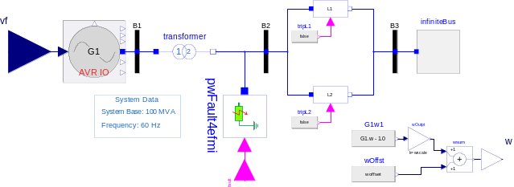
eFMI generated code and exchange with FMI: 175× smaller FMUs
31 kB
controller, eFMU source code FMU
5.41 MB
controller, ordinary source code FMU
38 kB
plant, eFMU source code FMU
5.49 MB
plant, ordinary source code FMU
Compiled binaries, the same story
eFMU-backed FMU: 176 kB controller, 220 kB plant
Ordinary Dymola binary FMU: 2.84 MB and 2.93 MB
Why it matters
It is what lets the code fit a microcontroller!
No dependency beyond math.h — portable by construction
≈175× smaller than the same model exported as an ordinary source-code FMU!
  eFMU exported as source code FMU, the same artefact imports into dSPACE ConfigurationDesk®, TwinCAT® or Silver®, which compile and deploy it themselves — so eFMI reaches the established real-time platforms.
  Exports also as a Simulink® C Function block or an Arduino® sketch, with the production code used as is.
Notes:
[OMISSION CANDIDATE — drop if time is short]
07:50 — 8:20
• A quick aside on size, because it is what makes the code fit at all.
• The eFMU production code exported as a source FMU is 31 kB. The same model exported as an ordinary Dymola source FMU is 5.41 MB.
• And no library dependency beyond math.h — which is why the same artefact drops straight into dSPACE ConfigurationDesk, TwinCAT or Silver.

Slide 13
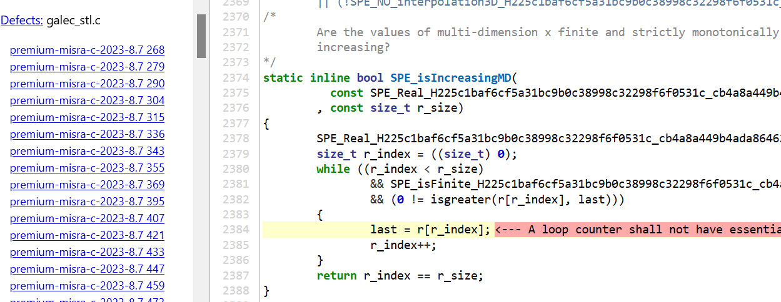
Production code quality: MISRA C:2023 and SEI CERT C
The analysis is deliberately as strict as it goes
  Cppcheck Premium 26.3.0 — exhaustive check level, style and information analyses, inconclusive reports included, MISRA C:2023 and SEI CERT C enabled
  clang-tidy (Clang Tools 19.1.5) — all checks except four, each excluded for a stated reason: short physics variable names, magic numbers in equations, loop unrolling left to the compiler, and struct alignment left to the compiler
204 reports, none of them a defect
  The only reports clang-tidy raises are 64-Bit literals narrowed into 32-Bit variables — intended, but Dymola omits the F suffix that would make it explicit — and false-positive uninitialized locals
One genuine-looking MISRA violation: “A loop counter shall not have essentially floating type”, false-positive, Cppcheck bug — fixed upstream in 26.6.0 based on our report
159 × MISRA 8.7
  Advisory: external linkage in one translation unit
  All are GALEC built-ins, intended as a shared library
  Can be ignored.
23 × SEI CERT DCL06-C
  Use symbolic constants for literals
  Stem from magic numbers in physics equations
  Can be ignored too.
3 × SEI CERT INT30-C
  Unsigned wrap
  Impossible: index - 1 ≥ 0
  GALEC indexes from 1
  False positives.
Excerpt of the Cppcheck Premium report for the 32-Bit floating-point precision production code generated for the PSS
Notes:
[OMISSION CANDIDATE — drop if time is short]
08:20 — 9:05
• This is the slide that separates eFMI from ordinary code generation.
• Cppcheck Premium at exhaustive level, with MISRA C:2023 and SEI CERT C enabled, plus clang-tidy with everything on bar four justified exclusions.
• 204 reports sounds alarming. Go through the categories: 159 are an advisory rule about external linkage, and our built-ins are deliberately a shared library. 23 are magic numbers in physics equations. 3 are provably impossible.
• The one genuine-looking report turned out to be a Cppcheck bug, which they fixed in 26.6.0 on our finding.

Slide 14
STM32 integration and the CHiL bench
Controller
NUCLEO-L476RG
80 MHz Arm Cortex-M4
Hardware FPU, 32-Bit FPP
Plant
NUCLEO-H723ZG
550 MHz Arm Cortex-M7
For the matrix algebra
freq = (550/2 MHz) / ((ARR+1)(PSC+1))
= (275 MHz) / ((199+1)(274+1)) = 5 kHz
The board timer must match the eFMU sampling period exactly
  Production Code containers are symbolically linked into the STM32CubeIDE projects:
    re-export from Dymola, just refresh and rebuild
    No manual re-import → makes the prototyping loop fast.
  Integration is confined to main.c:
    include the block header, call Startup() and DoStep() on the timer tick, and
    handle ADC/DAC scaling and clamping around it.
  Interactive testing: —
    onboard buttons inject the plant fault and engage or disengage the PSS;
    LEDs signal overruns and eFMU error signals.
CHiL test bench: (C) controller, (P) plant, (M) Analog Discovery 3
  Total hardware cost: < $90.00*
    NUCLEO-L476RG - $21.30 at DigiKey
    NUCLEO-H723ZG - $40.81 at DigiKey
    Break boards + patch cables: ~$11.00-$25.00
    * Excl the Analog Discovery 3 ~$379.00
Notes:
09:05 — 9:50
• Two boards: the controller on an 80 MHz Cortex-M4, the plant on a 550 MHz Cortex-M7 because of the linear algebra.
• The integration trick worth stealing: the Production Code containers are symbolically linked into the CubeIDE projects. Re-export from Dymola, refresh the project, done. No manual re-import in the loop.
• The timer has to match the eFMU sampling period exactly — that equation is the whole of it.
• Buttons inject the fault and toggle the PSS, so the demo is interactive.

Slide 15
STM32 System Integration Code
All details in the paper!

Slide 16
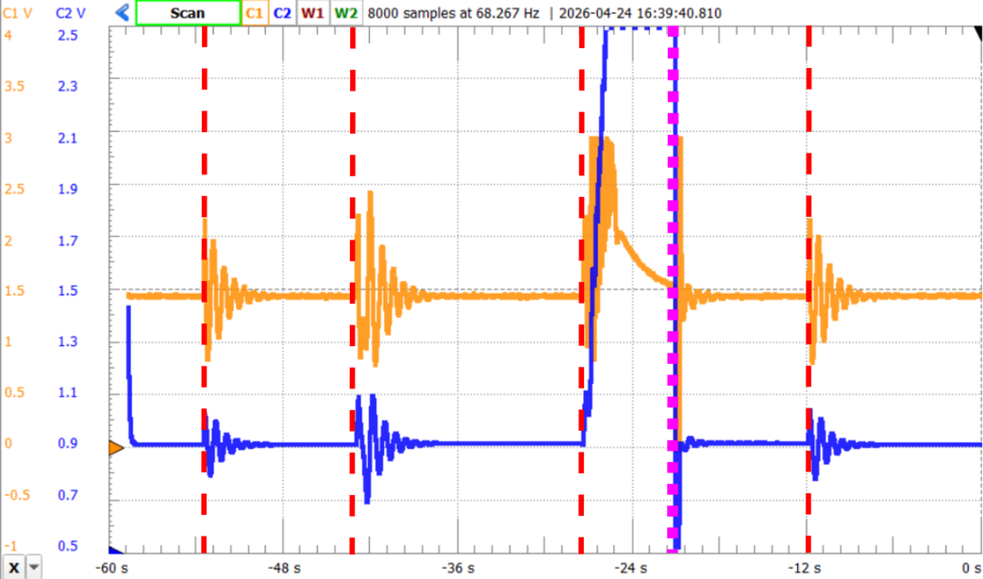
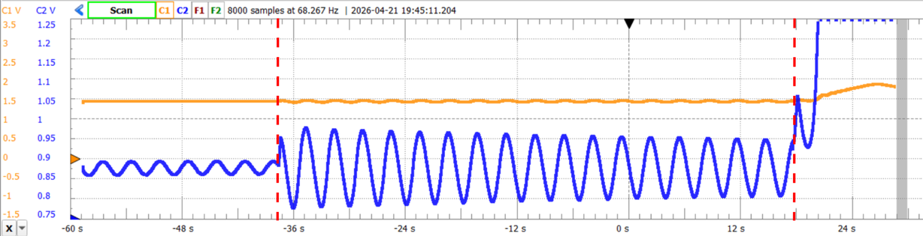
CHiL results: the controller does its job
  Legend:
    Blue: scaled speed from NUCLEO-H723ZG, output of plant
    Orange: PSS output voltage (pu) from NUCLEO-L476RG, input to plant
    Red: fault applied via push-button B1 on NUCLEO-H723ZG
    Magenta: reset applied on both boards via push-button B2.
PSS engaged — damped within seconds.
PSS disengaged — sustained oscillations, then instability.
  Engaged:
    The controller voltage provides immediate active damping
    Generator speed damps to steady state within seconds.
  The limit is real:
    Faults were held long enough for the speed to run away,
    The controller has a finite window of operating speeds it can stabilise
  Disengaged:
    The plant behaves as an undamped pendulum;
    A later fault excites it further and it becomes unstable.
±0.2 pu
recovers, PSS engaged
±0.1 pu
unstable, PSS off
Notes:
09:50 — 10:35
• Left: PSS disengaged. The plant is an undamped pendulum; a second fault drives it unstable.
• Right: PSS engaged. The controller voltage in orange, the speed in blue. Damped to steady state within seconds.
• The number: with the PSS it recovers from a ±0.2 pu speed deviation. Without, ±0.1 pu is enough to lose it. We deliberately held the fault button down long enough to find the limit.

Slide 17
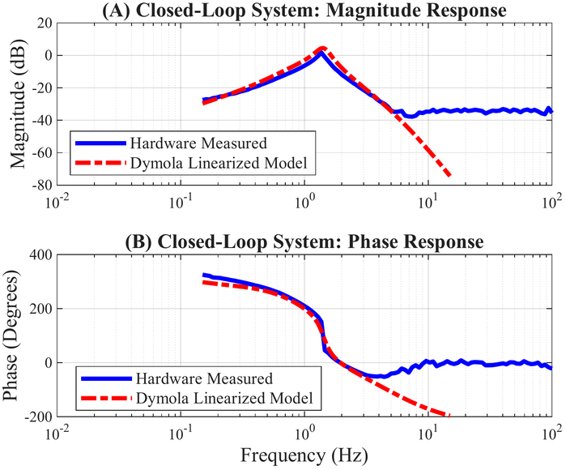
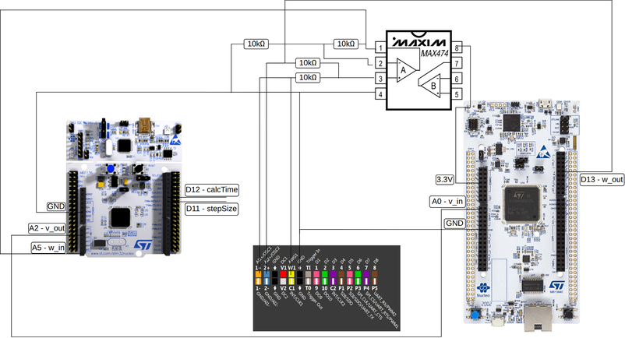
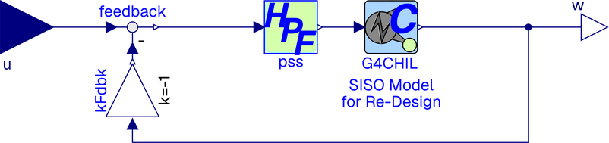
Closed-loop frequency response: model against hardware
Dymola closed-loop model with input and output interfaces
Closed-loop wiring for network analysis with the Analog Discovery 3
Closed-loop response: hardware (blue) vs Dymola linearisation (red)
  Logarithmic sweep 0.15–100 Hz at 50 mV — amplitude chosen so the plant Excitation Control System (AVR limiters) are never reached.
  A summing amplifier was needed:
    the STM32 ADC cannot process negative voltages,
    A MAX474 biases the ±50 mV stimulus onto the plant's flat 1.0 V DC speed output, giving 0.95–1.05 V into the controller.
The eFMU reproduces the offline model in closed loop; the flattening near 5 Hz is the instrument noise floor and the onboard converters, not the model.
Notes:
[OMISSION CANDIDATE — drop if time is short]
10:35 — 11:20
• We also wanted the closed-loop frequency response of the two-board system, not just the time domain.
• The STM32 ADC cannot take negative voltages, so a MAX474 summing amplifier biases a ±50 mV sweep onto the plant's 1.0 V DC speed output — 0.95 to 1.05 V into the ADC.
• The match is good through the resonance. The flattening above about 5 Hz is the Analog Discovery's noise floor and the onboard converters, not the model.

Slide 18
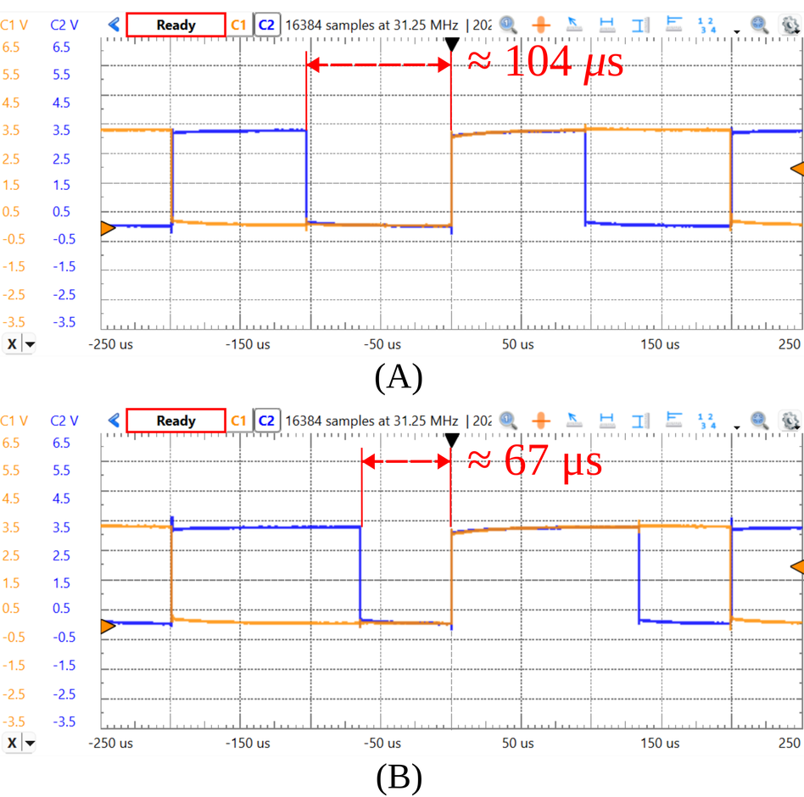
Real-time headroom: no overruns, with margin
  Headroom is measured, not estimated —
    a GPIO pin is driven high at the start of a sampling and low at the end;
    a second pin toggles on every timer tick, giving the oscilloscope a reference grid.
  Why the fault case is the real test —
    plant's GALEC code is dominated by solveLinearEquations(A, b);
    without a fault, A and b are sparse → generated solver skips the zeros.
For the plant, the debug build overruns:
  → This is why it is important to have the ability to do SiL testing
  What about the PSS controller headroom?
    Release build: 92.17 % headroom (15.67 µs)
    Same for steady state or fault tests
52 %
plant headroom
steady state
(96 µs)
33.5 %
plant headroom
sustained fault (133 µs)
What that buys for the PSS ?
Controller Debug build also deployable: 82.8 % headroom
Room for richer stabilizers, and for -O0 where -O3 is not allowed
What does not fit on the plant board (NUCLEO-H723ZG)?
Plant, Debug build: 239 µs — 19.5 % overrun
Plant, 64-Bit FPP Release: 180 µs — only 9 % headroom
Computation time (blue) vs sampling timer (orange) of the NUCLEO-H723ZG, Runs the plant model
Notes:
11:20 — 12:05
• A GPIO pin goes high when a sampling starts and low when it finishes; a second pin toggles on every timer tick. The oscilloscope then measures the true computation time against the sampling period.
• Plant, release build: 96 µs in steady state, 133 µs under sustained fault. The difference is sparsity — without a fault, A and b in solveLinearEquations are sparse and the solver skips the zeros.
• That is why the fault case is the real test, even though the plant is beyond recovery there.
• The debug build overruns by 19.5 %. That is the argument for SiL: debug functional problems offline, not on the target.
What is -O0 (No optimizations), -O3 (Applies all optimization)

Slide 19

Conclusions — and the repository is open-source
What we showed
  A complete MBSE chain from acausal Modelica physics to MISRA-compliant embedded C, traceability preserved by design thanks to eFMI std.
  Validation at every level — once SiL passes, hardware integration is mostly memory fit and timing.
  eFMI is viable for the plant too, not only the controller — this surprised us.
  We planned to use a real-time simulator for the plant but tried eFMI out of need,
  as the RTS vendor has poor FMU support (only works with models exported from a specific tool).
  ≫ $50,000 platform → < $100 microcontrollers, with free tooling apart from Dymola.
What comes next
  More PSS models and board templates; online recalibration for adaptive tuning; eFMU integration on dSPACE, Typhoon HIL and OPAL-RT.
github.com/ALSETLab/efmi-pss-use-case · 3-Clause BSD
Models and tests
  models/ — OpenIPSL_CHIL:
  PSS variants,
  real-time-suited plant models,
  eFMU configurations,
  unit tests
  etc
Firmware
  firmware/ — STM32CubeIDE projects for controller and plant, with the production code symbolically linked
Evidence
  measurements/, postprocessing/, logs/check-code/ — raw CHiL captures, the scripts that reproduce every figure, and the full clang-tidy and Cppcheck reports
Scan for models, firmware,
measurements and analysis scripts
Notes:
12:05 — 12:50
• A complete MBSE chain from acausal physics to MISRA-compliant embedded C, with traceability preserved by construction.
• The surprise: eFMI works for hard real-time *plant* simulation, not just controllers. We only tried it out of curiosity, expecting to buy a dSPACE box for the plant.
• Everything is open: models, eFMUs, CubeIDE projects, raw measurements, analysis logs.
• Please take it and build on it — that is why it is there.

Slide 20
Thank you — Questions?
Luigi Vanfretti · Professor, ECSE · Rensselaer Polytechnic Institute
  vanfrl@rpi.edu
  github.com/ALSETLab/efmi-pss-use-case
Notes:
12:50 — end
• Leave this up through Q&A: the QR is the repository.
• Back-up slides follow if a question needs one.

Slide 21
Back-up slides
Everything in the paper that did not fit the main deck
Notes:
Not shown unless a question calls for one.

Slide 22
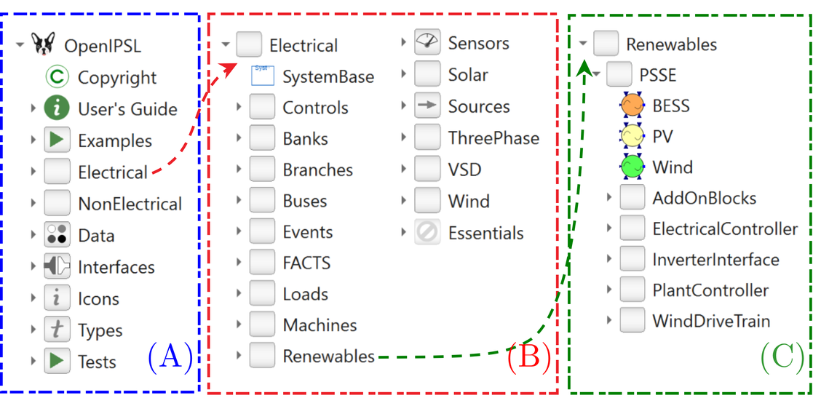
B1 · OpenIPSL 3.1.0 library overview
  *.Electrical — machines, loads, lines, transformers, regulators and control devices; renewables with PV, wind and storage.
  *.NonElectrical — blocks, functions and MSL extensions that keep results consistent with PSS®E.
  *.Interfaces — the PwPin physical phasor connector and the Generator partial model every generation unit derives from.
  Phasor-domain transient (RMS) simulation; unbalanced three-phase without co-simulation; mixed EMT and TS modelling.
OpenIPSL 3.1.0 library overview

Slide 23
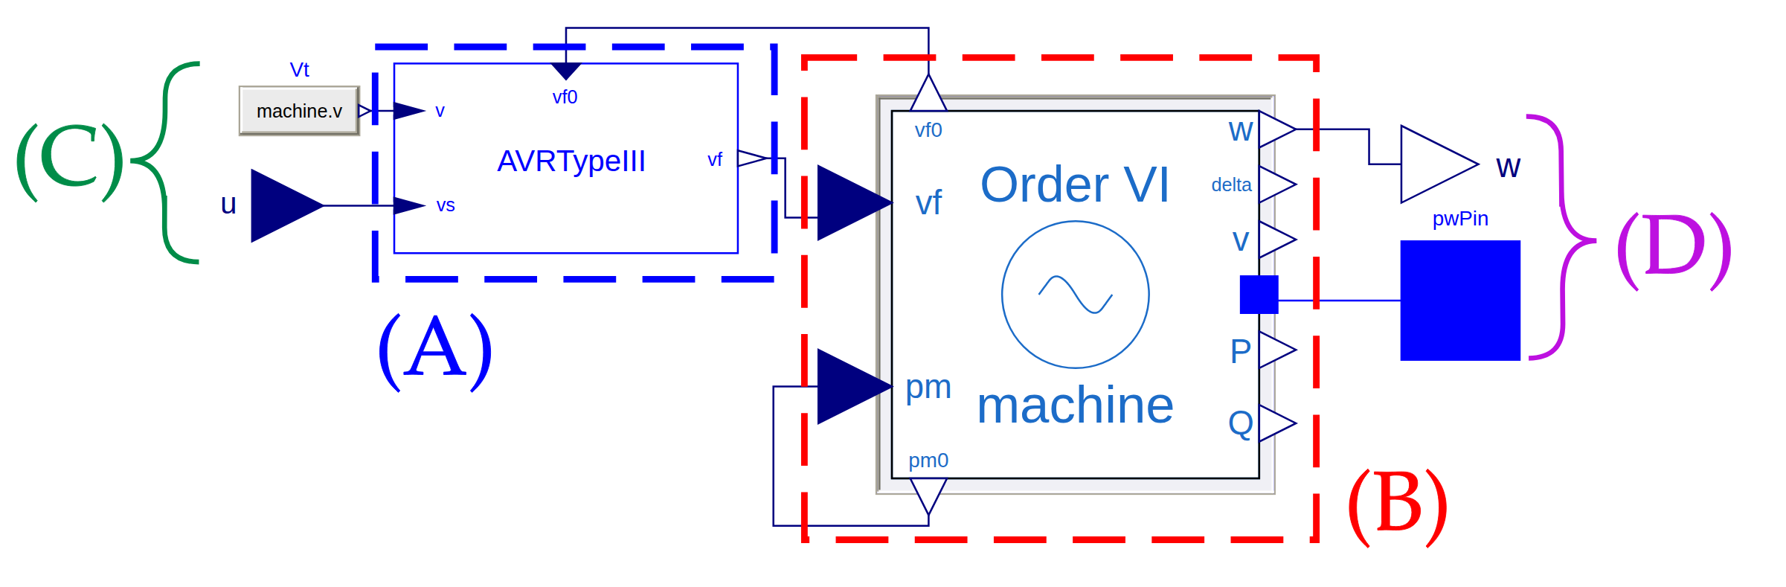
B2 · The generator unit: generator with ECS
*.Generator.ReDesign.GenAVRIOReDesign — the generator unit model
  (A) the ECS — AVR Type III from PSAT as implemented in OpenIPSL; no modification was needed.
  (B) the synchronous machine — “Order VI” from PSAT, in OpenIPSL.Electrical.Machines.PSAT.BaseClasses.baseMachine; the base class needed the atan2 change of back-up B7.
  (C)/(D) interfaces — u is the ECS input, v the terminal-voltage feedback, w the speed output ω(t), and pwPin the OpenIPSL physical connector.

Slide 24
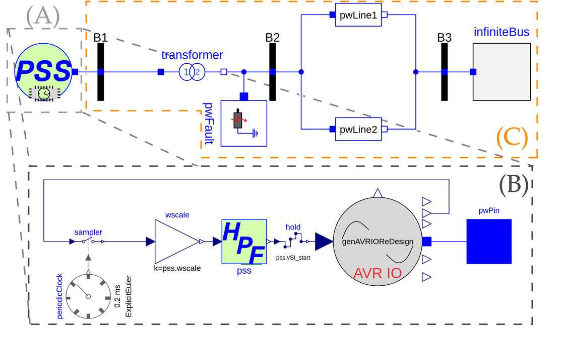
B3 · Reference simulation model for MiL
  (A) and (C) are the power system model; (A) is expanded in (B).
  (B) carries the PSS variant of Figure 4 (D) in a clocked partition: a periodicClock at 0.2 ms with an explicit Euler solver, a sampler on the speed input and a hold on the output.
  The wscale gain is applied before the sampler because the signal comes straight from the generator unit, not from the pre-conditioned plant output.
  Everything else is unmodified OpenIPSL in continuous time — this model represents deployment in a real plant, not the CHiL bench.
Reference simulation model: (A) power system, (B) generator unit with clocked PSS, (C) interface

Slide 25
B4 · CHiL setup model variants
  (A) continuous time — the PSS output drives G4CHIL, whose output drives the PSS. A faultTimer models the push-button fault over t = [1.5, 1.55] s.
  (B) clocked — controller and plant each in their own clocked partition with sampler, hold and a 0.2 ms periodic clock.
  (C) with eFMUs — the Modelica models replaced by the generated eFMUs.
  (D) with source-code FMUs — built from the generated eFMI production code; this is the SiL configuration.
Breadboard capacitance and patch-cable delay are irrelevant at this scale and are not modelled.
Simulation models of the CHiL setup, (A)–(D)

Slide 26
B5 · MiL error statistics, all five cases
Case max |e| (pu) RMS e (pu) t_max (s)
-----------------------------------------------------------------
2 Ref.Sim.ExpEuler 3.0160e-05 9.2302e-06 3.2156
3 Ref.Setup 1.6949e-04 3.0662e-05 2.0564
4 Ref.Setup.ExpEuler 1.5353e-04 2.7456e-05 2.0564
5 Ref.Setup.Clocked 6.1989e-05 1.6466e-05 2.0310
Reading the table
Case 2 isolates the fixed-step explicit Euler penalty
Cases 3–4 add the structural refactoring for eFMI
Case 5 is the clocked CHiL representation
All tolerances 1e-4
Generator speed error relative to Ref.Sim.DASSL
  Peaks occur in post-fault recovery near t ≈ 2.05 s, not during the fault interval — the eFMI-targeted variants are numerically stable through the disturbance.
  RMS an order of magnitude below the maxima — brief numerical transients, not a persistent bias.
The largest deviation, 1.6949e-04 pu, is below the ≈ 8e-04 pu quantisation floor of the target's 12-Bit DAC — the hardware cannot resolve the difference.

Slide 27
B6 · HighPassSimple — the replacement washout
Why replace the washout at all
  A washout filter approximates an ideal derivative — historically an RC op-amp circuit, with Tw the RC time constant, attenuating the low frequencies of normal grid operation.
  OpenIPSL implements it as derivativeLag, which differentiates and so amplifies numerical noise.
  A first-order Butterworth high-pass gives the same response with one state, one differential equation and one algebraic output — and keeps the original parametrisation, K = Kw·Tw and T = Tw.
Simpler, no differentiation, and a smaller GALEC solution.
block HighPassSimple
...
parameter Real K = Kw*Tw "Gain K = Kw*Tw";
parameter Real T = Tw "Time constant T = Tw";
...
initial equation
der(x) = 0;
equation
der(x) = (u - x)/T;
y = K/T*(u - x);
end HighPassSimple;
Listing 1 — used in the PSS variant of Figure 4 (D)

Slide 28
B7 · baseMachine — atan3 → atan2
Why the change was needed
  GALEC provides atan2 as a built-in function, but not atan3.
  OpenIPSL computes the initial rotor angle with CM.arg, an alias of Modelica.ComplexMath.arg, which passes the real and imaginary parts to Modelica.Math.atan3 together with a parameterised phase angle φ.
  φ is always 0 in OpenIPSL, and atan3(c.im, c.re, 0) == atan2(c.im, c.re) — so the replacement is mathematically equivalent, not an approximation.
// Original OpenIPSL baseMachine:
parameter Types.Angle delta0 = CM.arg(
Vt0 + ((ra + CM.j*xq0) * Z_MBtoSB*I0))
"Init. val. rotor angle";
// Modified OpenIPSL_CHIL baseMachine:
parameter Complex auxCMval =
Vt0 + ((ra + CM.j*xq0) * Z_MBtoSB*I0)
"Auxiliary variable to calc. delta0";
parameter OpenIPSL.Types.Angle delta0 = atan2(
auxCMval.im, auxCMval.re)
"Init. val. of mach. rotor angle";
Listing 2 — baseMachine modification for eFMU GALEC code generation

Slide 29

B8 · DymolaEmbedded eFMU configuration
  eFMU bundle — output directory; defaults to the full package name.
  Model — the model subject to export (mandatory).
  Integrator — fixed sampling period (mandatory) and inline-integration method; explicit Euler is the only mature solver today.
  Code — GALEC obfuscation, parameter constant-folding, and whether multi-dimensional entities are kept intact.
  Software Production Engineering — float precisions (32- and 64-Bit by default) and the instruction-set architectures for which static libraries are built for SiL.
Our setting: explicit Euler at 0.2 ms, obfuscation off, for both controller and plant.
eFMU configuration for the PSS controller

Slide 30
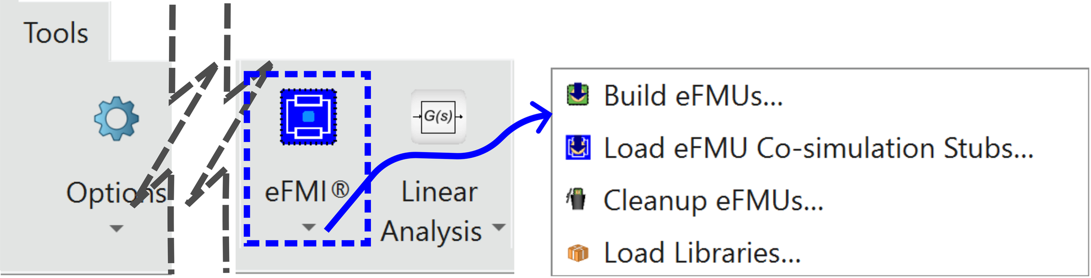
B9 · The eFMI button in Dymola’s Tools ribbon
The eFMI entry in Dymola’s Tools ribbon
  Builds every eFMU of a whole package hierarchy, or loads the SiL stubs of eFMUs that already exist.
  Everything it does is also scriptable — eFMU configurations are ordinary Modelica packages, so their options and generative functions can be driven from *.mos scripts for variant and batch processing.

Slide 31
B10 · Production code export: FMI, Simulink, Arduino
FMI® 3.0 source-code FMU
  with fixedInternalStepSize
  only addition is a lean fmi3Functions.h implementation plus sanity checks
  imports into dSPACE ConfigurationDesk®, TwinCAT®, Silver®
Simulink®
  a MATLAB® script instantiates a C Function block on the production code
  GALEC block interface typed with native ERT types — no conversions, no copying
  ERT code generators skip generation for the block
Arduino®
  production code exported as a sketch
  generated *.ino with initialisation and main loop
  commented hooks for inputs, outputs and parameters
For every export path the production code is used as is — no additional library dependency beyond common C Standard Library routines, mostly math.h.
  Export means taking the C of a Production Code container, adding only the wrapper and metadata the target ecosystem requires, and letting that ecosystem's toolchain compile and deploy it.

Slide 32
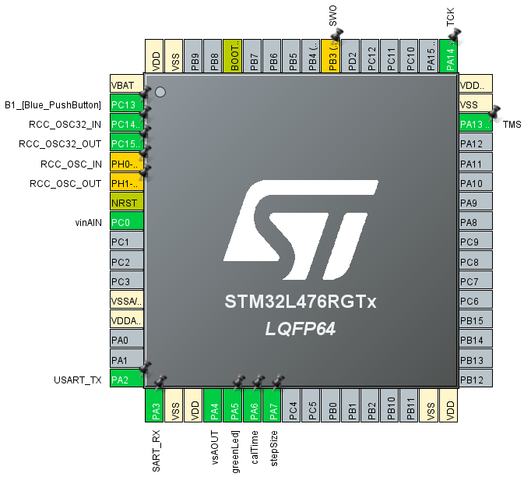
B11 · STM32CubeMX pin configuration (NUCLEO-L476RG)
  Analog and digital I/O are mapped to prevent peripheral collisions and minimise latency inside the 0.2 ms loop.
  Digital outputs for profiling — one pin toggles on every timer tick (stepSize), another goes high for the duration of each sampling (calcTime), which is how the computation times of back-up B-17 were measured.
  LEDs signal real-time violations and eFMU production-code error signals.
  On the plant board the PSS voltage input is PA3 (ADC1 channel 15) and the speed output PA5 (DAC1).
  The variable-load prototype maps its extra input to PC0 so it routes to an independent ADC2, avoiding scan mode and DMA.
Pin configuration for the controller board

Slide 33
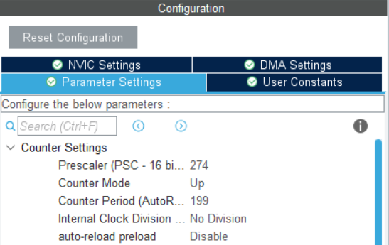
B12 · STM32CubeMX timer configuration (NUCLEO-H723ZG)
The timer must match the eFMU sampling period exactly
  frequency = APB clock / ((ARR+1)(PSC+1))
  For the plant board: 550 MHz system clock, APB pre-divider 2, ARR 199, PSC 274 ⇒ 275 MHz / (200 × 275) = 5 kHz. TIM2 is used.
  For the controller board: TIM1, with different APB, ARR and PSC values, because the L476RG runs at 80 MHz rather than 550 MHz.
Code generation settings
  Peripheral initialisation as one .c/.h pair per peripheral, to keep main.c clean.
  All custom code strictly inside /* USER CODE BEGIN */ … /* USER CODE END */ — otherwise regeneration overwrites the integration.
Timer configuration for the plant board

Slide 34
B13 · The control loop in main.c
Three parts, and why
  The interrupt only registers a request — HAL_TIM_PeriodElapsedCallback increments pending_samplings (saturating, not overflowing). Doing the sampling inside the interrupt would silently block the next tick on an overrun.
  The loop is greedy — while (true) with busy waiting rather than sleeping, which is typical for hard real-time code.
  Errors are latched to an LED — eFMU error signals, ADC timeouts, and overruns when the counter exceeds 1; held for 30 s so a transient cannot be missed.
The sampling logic itself is entirely inside DoStep(); everything around it is I/O provisioning, scaling and clamping.
if (0 < pending_samplings)
{
error_signals = PSS_NONE_ERRORSIGNAL;
/* profiling pin high */
HAL_GPIO_WritePin(calTime_GPIO_Port,
calTime_Pin, SET);
/* ADC -> input, volts */
HAL_ADC_Start(&hadc1);
... pss.vSI = adc_raw * ADC_TO_VOLTS;
PSS_DoStep(&pss); /* <- eFMU */
error_signals |= pss.ErrorSignals;
target_pu = use_pss ? pss.vs : CONSTANT_PU;
/* scale, clamp, DAC out */
HAL_DAC_SetValue(&hdac1, ...);
/* profiling pin low */
--pending_samplings;
}
Abridged from Listing 6 — the full source is in the repository

Slide 35
B14 · Compiler and linker settings
Common to Debug and Release
  Toolchain — GNU Tools for STM32 14.3.rel1.
  Runtime — reduced C runtime (--specs=nano.specs) and hardware floating-point ABI (-mfloat-abi=hard): FPv4-SP-D16 on the controller, FPv5-D16 on the plant.
  Assembler — -nostdinc, so no third-party macros can leak in.
  Compiler — ISO C18 (-std=c18), everything warned (-Wall -Wextra -pedantic -Wconversion and more).
  Linker — -nodefaultlibs and --specs=nosys.specs, to prove the production code is self-contained.
Where the two builds differ
  Debug — -g3, -DDEBUG, -O0; stack-usage and cyclomatic-complexity analysis enabled.
  Release — no debug info, -O3.
What the settings proved
  The eFMU production code is warning-free under that warning set, apart from the 32-Bit narrowing conversions already explained — while the STM32 driver and standard-library code produces many warnings.
  It links without default libraries — confirming no dependency beyond basic C Standard Library routines.
All results in the talk are Release builds unless stated otherwise.

Slide 36
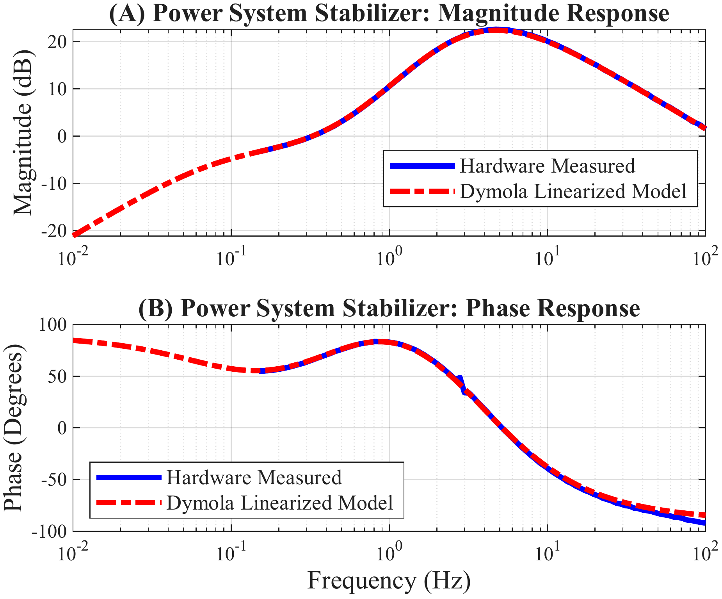
B15 · Open-loop frequency response of the controller
  The controller alone — the NUCLEO-L476RG running the PSS eFMU, measured with the Analog Discovery 3 network analyser, against the Dymola linearisation of the model in Figure 4 (D).
  Excellent agreement across the sweep confirms the controller eFMU runs as designed.
The diagnostic worth remembering
  If the board timer did not exactly match the sampling period set in the eFMU export, the curve would keep its shape and shift horizontally along the frequency axis.
Controller frequency response — blue: hardware, red: Dymola linearised model

Slide 37
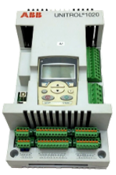
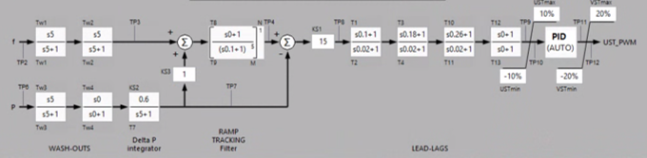
B16 · A commercial excitation controller and its PSS
  The vendor fixes the structure — washouts, a ΔP integrator, a ramp-tracking filter, lead-lag stages and a PID, each with its own test points. The engineer sets parameters, not topology.
  An external PSS input exists on such controllers, which is the port a redesigned stabiliser would ultimately use.
  This is the gap the talk is about — between a physics model in Modelica and a parameter set typed into a device like this, with nothing traceable in between.
The vendor's PSS chain: wash-outs, ΔP integrator, ramp-tracking filter, lead-lags, PID — structure fixed, parameters tunable

Slide 38
B17 · The closed-loop signal injection circuit
Why a circuit was needed at all
  The STM32 ADC is single-supply — it operates on 3.3 V logic levels and cannot physically process negative voltages.
  A standard 0 V-offset AC sweep would clip and distort non-linearly, making the measurement meaningless.
What was built
  A non-inverting summing amplifier around a MAX474 operational amplifier.
  It sums the plant's nominal steady-state speed output, a flat 1.0 V DC, with the ±50 mV, 0 V-offset AC stimulus from the Analog Discovery 3 pin W1.
  The result is a safely biased signal fluctuating between 0.95 V and 1.05 V into the controller's ADC.
  Measurement — the stimulus on channel C1 and the plant's speed output on C2, which captures the true closed-loop transfer function.

Slide 39
B18 · The variable-load plant variant
Prototyped, deployed and tested — left out of the paper for space
  A more advanced plant model supporting variable loads through an additional analog input, changed interactively with a potentiometer.
  The extra input is mapped to PC0 deliberately, because that pin routes to an entirely independent converter, ADC2 — specifically ADC123_INP10.
  Why that matters — distributing the analog inputs across separate dedicated ADCs avoids “scan mode” channel switching and DMA pipelines, which keeps sampling deterministic and low-latency inside the 0.2 ms timer interrupt.
The same workflow, a different model: no change to the toolchain was needed.

Slide 40
B19 · Related work
Prior real-time controller work
  Wide-area controllers on National Instruments hardware; industrial HVDC trials by Red Eléctrica and RTE show that aligning simulation models with hardware behaviour is now paramount.
Industrial platforms
  GE's PhasorController uses deterministic PLC engines for real-time grid control — but relies on manual imperative programming rather than automated synthesis, which severs traceability between the physical model and the implementation.
  Terna proposes online PSS tuning from estimation; our own prior work argues for continuous controller redesign.
Model exchange
  The IEEE/CIGRE DLLs Guideline (ICDMS) distributes vendor algorithms as precompiled DLLs — still black boxes, likely hand-written, not suitable for real-time simulation, so CHiL testing stays limited.
  Modelica and FMI have been used to run OpenIPSL models directly on dSPACE hardware.
eFMI is proven in automotive applications; its use in power system control is first explored in this paper.

Slide 41
B20 · Acknowledgments
  Fabio Ballari and the CATIA® Champions program at Dassault Systèmes®, for complimentary access to the 3DEXPERIENCE® platform and its Systems Software Production Engineer capabilities, which enabled the early development of this work.
  Dr. Christopher R. Laughman, Mitsubishi Electric Research Laboratories, for an unrestricted gift grant to Rensselaer Polytechnic Institute that funded the embedded hardware behind this project.
  Daniel Marjamäki and Magnus Janagård, Cppcheck Solutions AB, for providing a free licence of Cppcheck Premium.

Slide 42
B21 · Tools and versions
Toolchain
  Dymola® 2026x Refresh 1 — modelling, MiL, eFMU generation, SiL. Requires the Dymola Source Code Generation option.
  Cppcheck® Premium 26.3.0 and clang-tidy (Clang Tools 19.1.5) — code quality and MISRA C:2023.
  STM32CubeMX 6.17.0 with STM32CubeH7 1.13.0 (HAL, LL drivers, CMSIS; no middleware used).
  STM32CubeIDE 2.1.0 — compilation and deployment.
  WaveForms 3.25.1 with a Digilent® Analog Discovery 3.
Licensing
  Everything except Dymola and Cppcheck Premium is free.
  Cppcheck has an open-source version that could have been used; its MISRA C:2023 and SEI CERT C coverage is inferior to Premium, which carries TÜV SÜD® certification against EN 50128, EN 50657, EN 50716, IEC 61508 and ISO 26262.
The repository
  github.com/ALSETLab/efmi-pss-use-case
  3-Clause BSD. Models, eFMUs, STM32CubeIDE projects, raw measurements, post-processing scripts, and the full code-analysis logs.

Slide 43


© 2021-2026, Luigi Vanfretti, Christoff Bürger, Modelica Association and contributors.
This work is licensed under a CC BY-SA 4.0 license.
Modelica® is a registered trademark of the Modelica Association.
eFMI® is a registered trademark of the Modelica Association.
FMI® is a registered trademark of the Modelica Association.
Third party marks and brands are the property of their respective holders.

