Slide 1
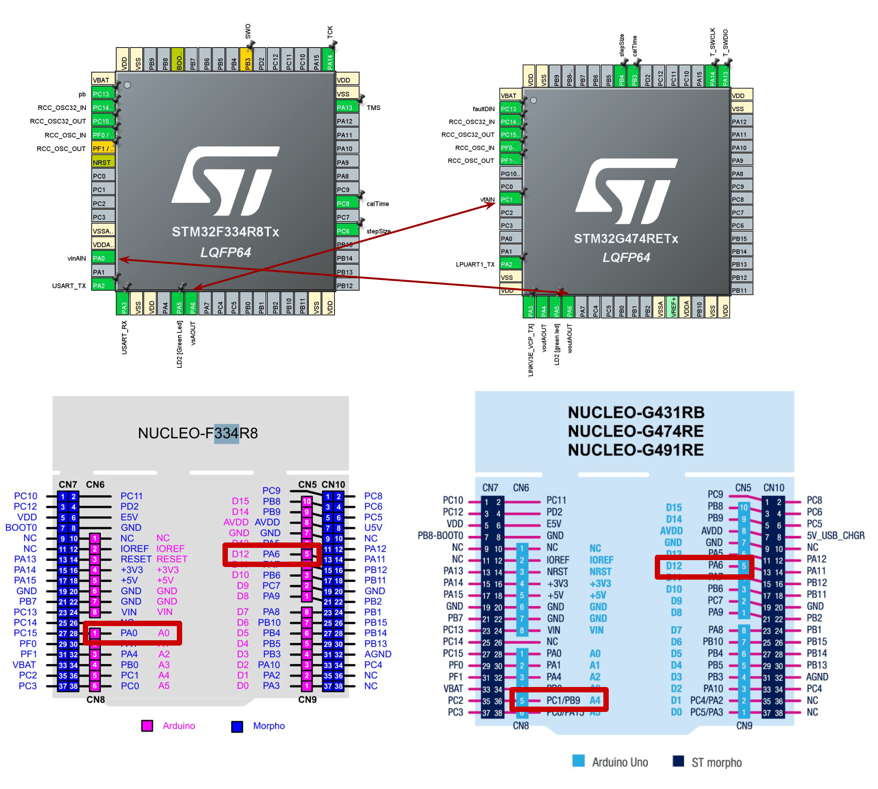
Setup 1
1 input
1 output

Slide 2
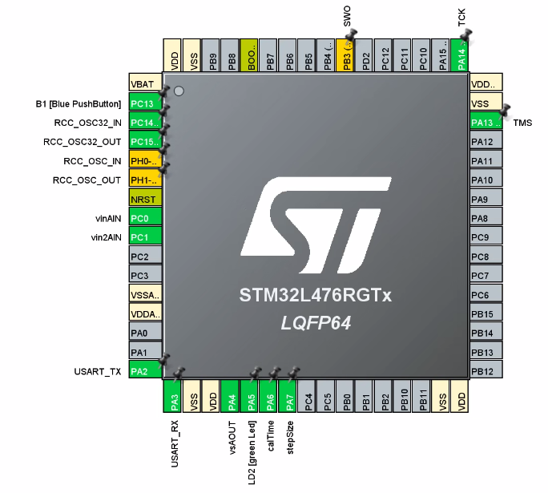
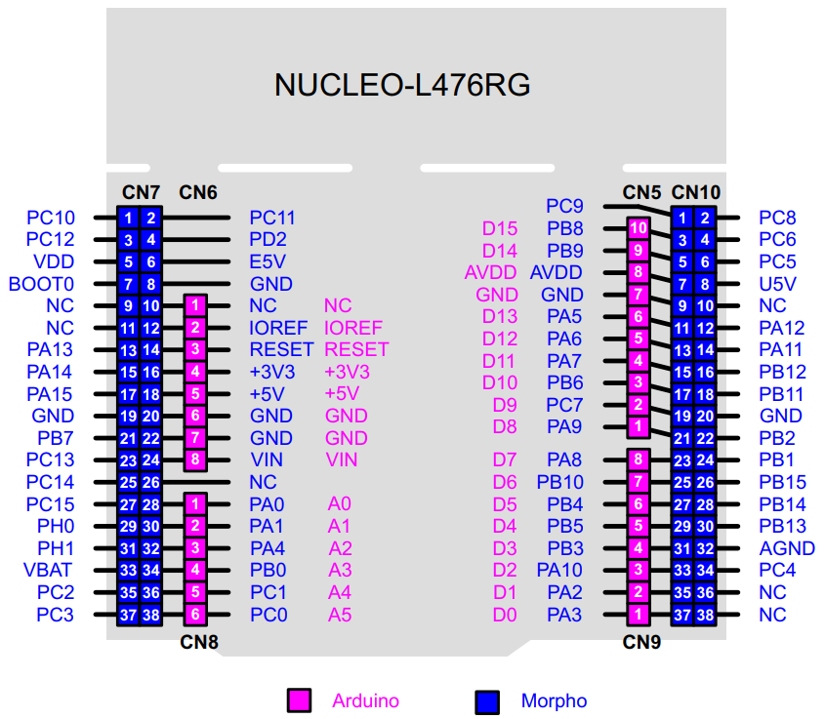
Setup 2
2 inputs
1 output
!Set
To
Zero
vsAOUT
vin2AIN
vinAIN

Slide 3
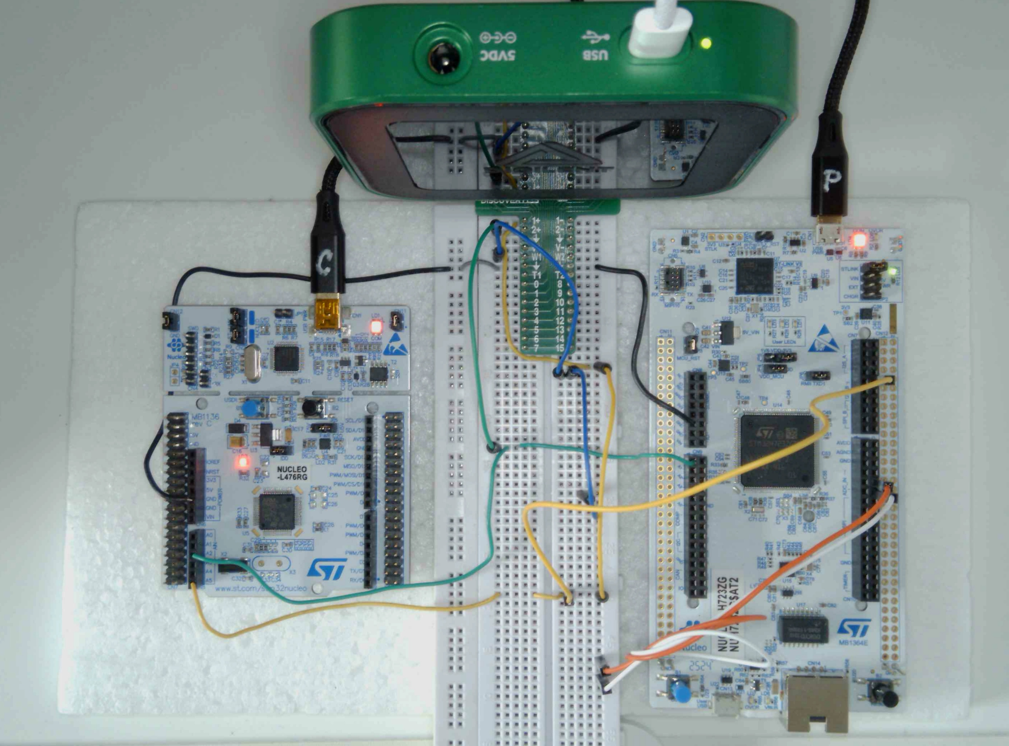
Setup 3
M
Analog Discovery Board 3
C2
C1
P
NUCLEO-L476RG
Nucleo-H723ZG
GND
W1
D13: w (out)
B1
B2
GND
A0: vf (in)
D3: stepSize
A2: vf (out)
D2: calcTime
A5: w (in)
C
B1
B2

