Slide 1
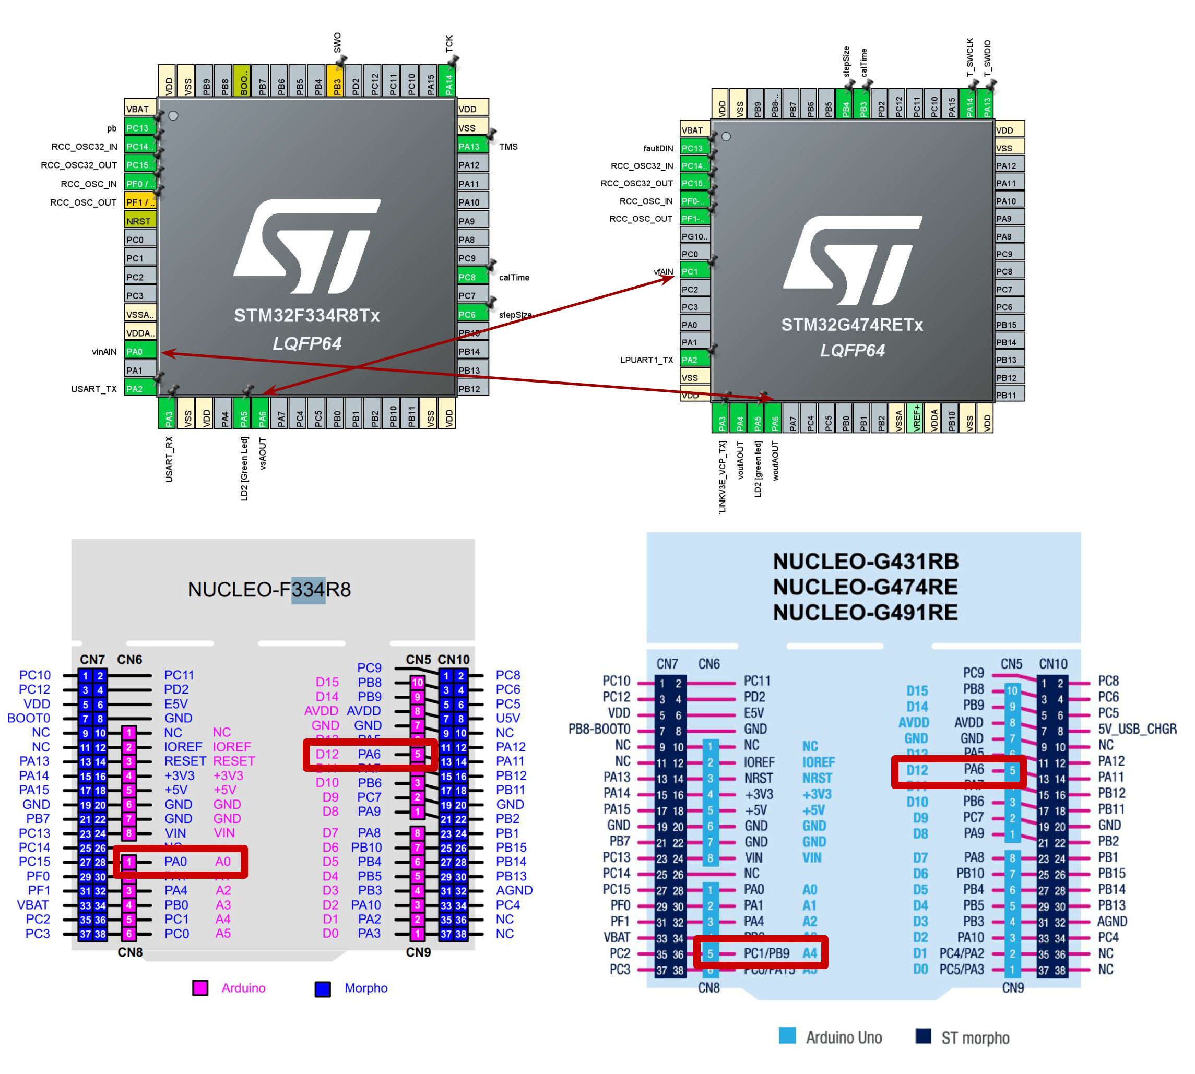
Setup 1
1 input
1 output

Slide 2
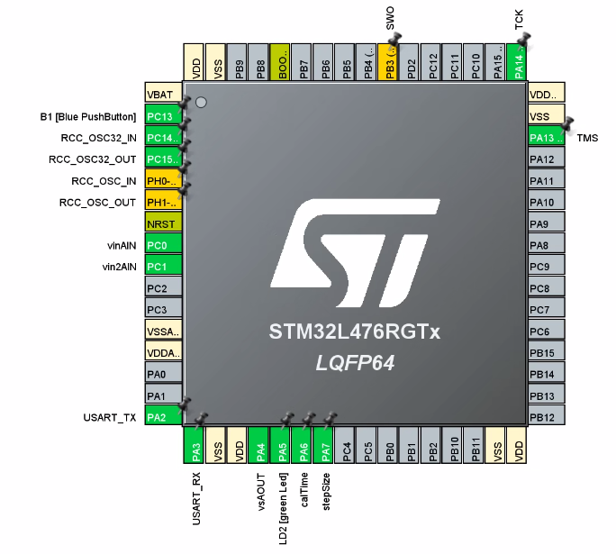
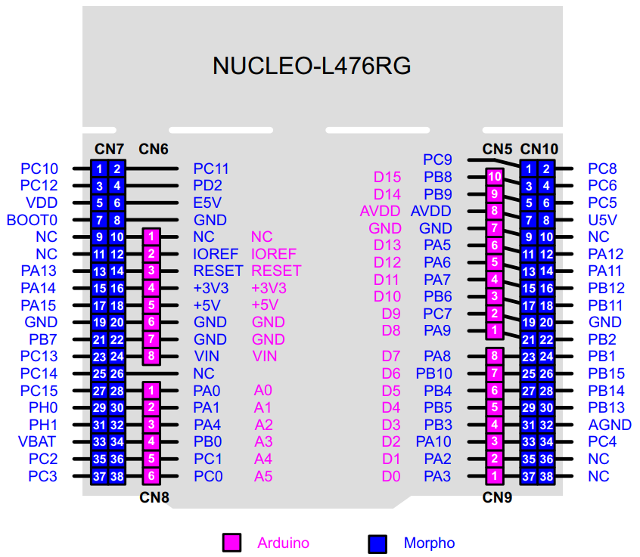
Setup 2
2 inputs
1 output
!Set
To
Zero
vsAOUT
vin2AIN
vinAIN

