Slide 1
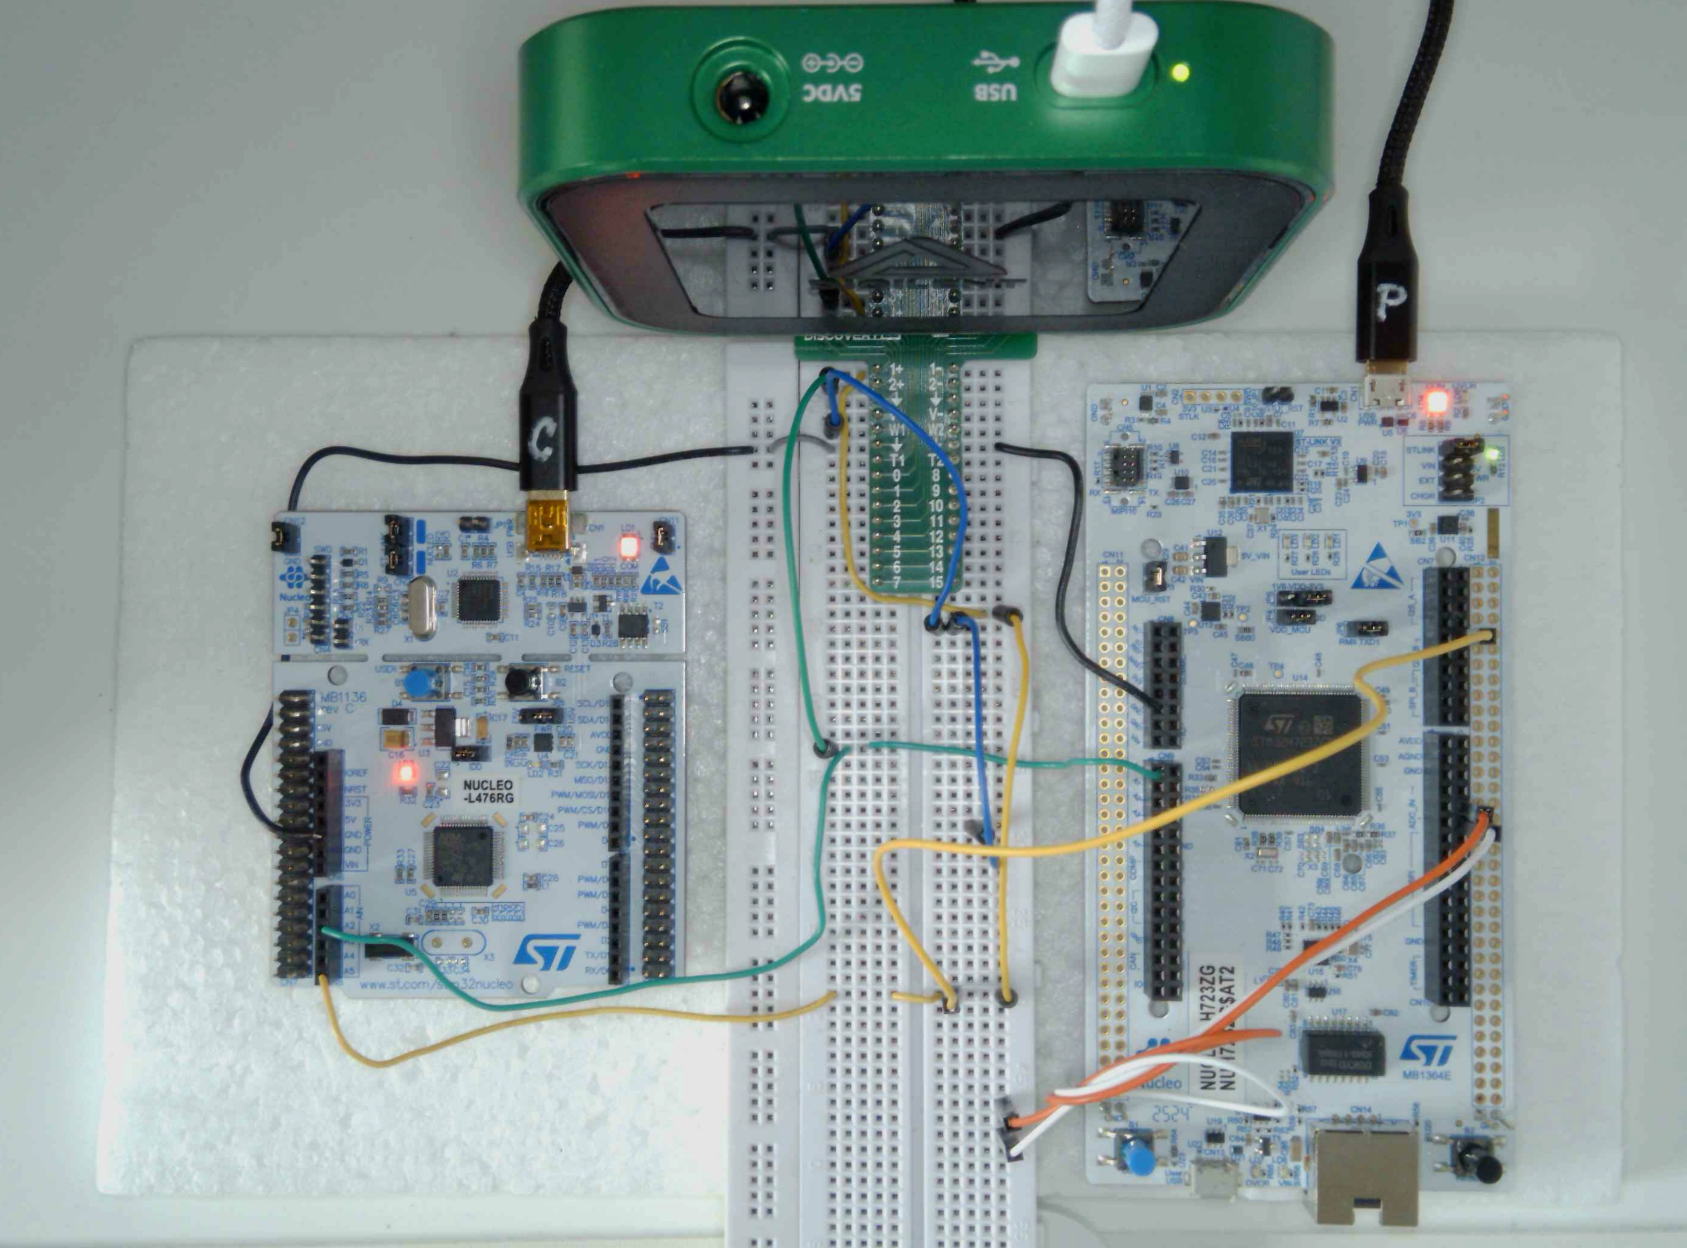
Setup 3
M
Analog Discovery Board 3
C2
C1
P
NUCLEO-L476RG
Nucleo-H723ZG
GND
W1
From Christoph add:
D11 stepSize
D12 calcTime
D13: w (out)
B1
B2
GND
A0: vf (in)
D3: stepSize
A2: vf (out)
D2: calcTime
D11: stepSize
A5: w (in)
C
D12: calcTime
B1
B2

Slide 2
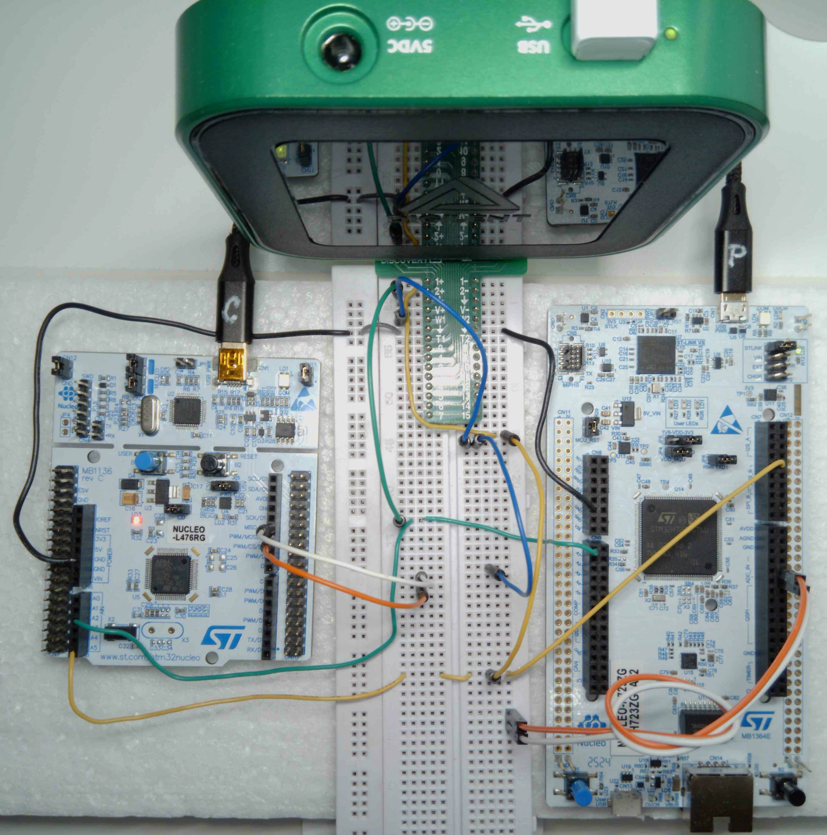
M
Analog Discovery Board 3
C1
C2
P
NUCLEO-L476RG
Nucleo-H723ZG
GND
GND
LD2, LD3
B1
B2
W1
LD2
A0: vf (in)
D12: calcTime
D13: w (out)
A2: vf (out)
D11: stepSize
D3: stepSize
D2: calcTime
A5: w (in)
C
B1
B2

