Slide 1
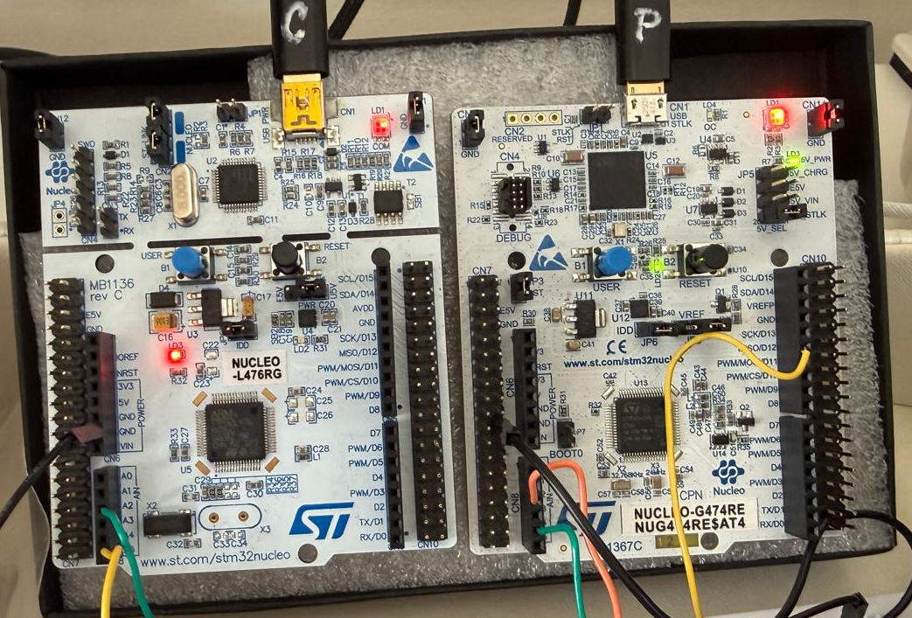
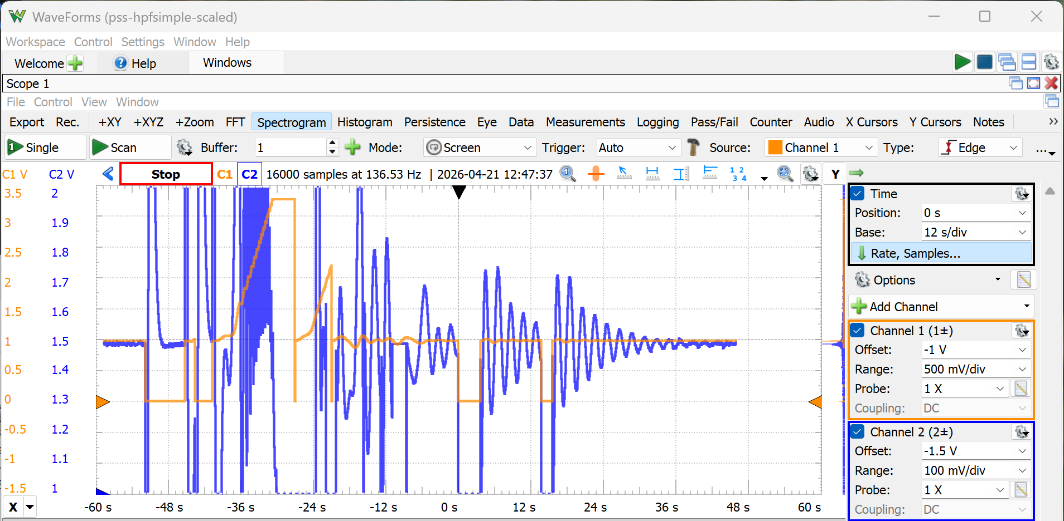
Redeployed G4CHIL
Reset boards and took picture
Redeployed PSS

